Slide 1

LMFF: Efficient and Scalable Layered Materials Force Field on Heterogeneous Many-Core Processors
Ping Gao
Shandong University, China
National Supercomputing Center in Wuxi, China

Slide 2

LMFF: Efficient and Scalable Layered Materials Force Field on Heterogeneous Many-Core Processors
Ping Gao, Xiaohui Duan, Jiaxu Guo, Jin Wang, Zhenya Song,
Lizhen Cui, Xiangxu Meng, Xin Liu, Wusheng Zhang, Ming Ma,
Guohui Li, Dexun Chen, Haohuan Fu, Wei Xue, Weiguo Liu, Guangwen Yang
Shandong University, China
Tsinghua University, China
Jilin University, China
National Supercomputing Center in Wuxi, China
First Institute of Oceanography, Ministry of Natural Resources, China
Dalian Institute of Chemical Physics, Chinese Academy of Sciences, China

Slide 3
Contents
Background
Related Work
Motivation
Optimization Methods
Evaluation
Conclusions and Future Work

Slide 4
Background-MD Simulation
What
Why
Speed of simulation is vital
How
Computational capability of supercomputers
Study properties of materials
Combining algorithms, hardware, and models for innovation
Simulation Requirements：
Longer time scales
Lager atomic systems
A computer simulation method
Develop new materials
Notes:
A computer simulation method for analyzing the physical motion of atoms and molecules
electronic, mechanical and tribological

Slide 5
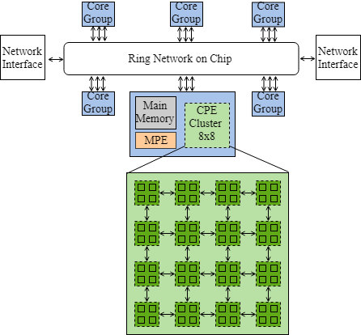
Background-New Sunway
The architecture of Sunway (SW39000) many-core processor:
Inherits and extends the Sunway TaihuLight architecture.
The improvement in hardware parameters:
Processor | Memory | LDM | Cores | Vector
SW26010 | DDR3 8 GB | 64 KB | (1+64)*4 | 256 bit
SW39000 | DDR4 16 GB | 256 KB | (1+64)*6 | 512 bit

Slide 6
Background-Challenges
Challenges:
Consistency
Bandwidth bottleneck
Limited on-chip buffer
The ratio of FLOPS and bandwidth of one CG of an SW processor or one core of a Xeon processor:
Processor | FLOPS (T) | Bandwidth (GB/s) | ratio
Xeon Gold 6148 | 1.5 | 119.21 | 12.88
SW26010 | 0.75 | ~33.6 | 22.5
SW39000 | 2.306 | ~50 | 46

Slide 7


Related Work
Optimized potentials in LAMMPS:
2019 AIREBO on KNL
2016 Tersoff on Xeon Phi
2018 Tersoff on Sunway TaihuLight
AIREBO
Tersoff
ILP
ReaxFF
None!
LJ
2012 ReaxFF on CPU
2014 ReaxFF on GPU
2016 ReaxFF on GPU
2019 ReaxFF on KNL
2020 ReaxFF on Sunway TaihuLight
2015 LJ on GPU of HOOMD-blue
2016 LJ on Sunway TaihuLight
2018 LJ on Sunway TaihuLight

Slide 8
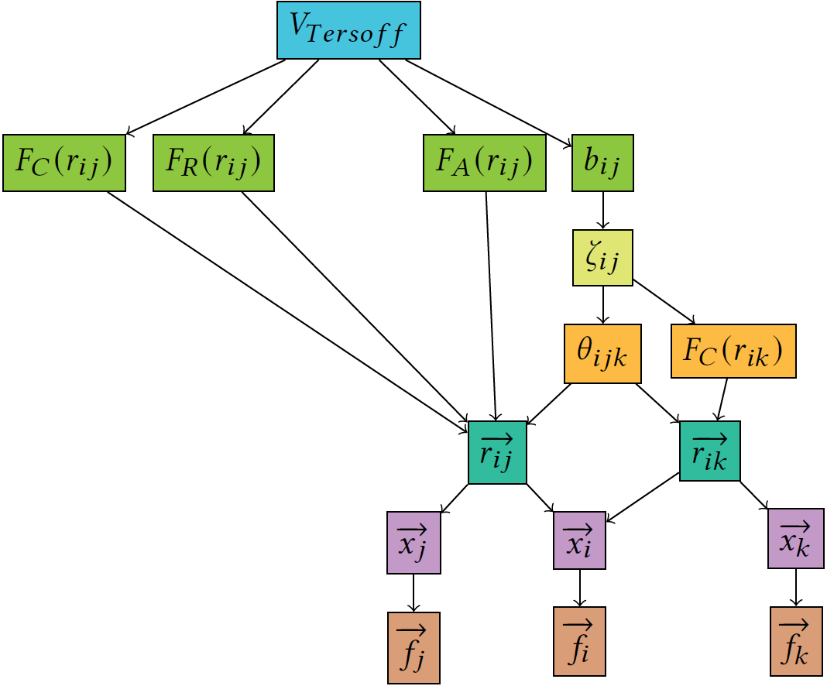
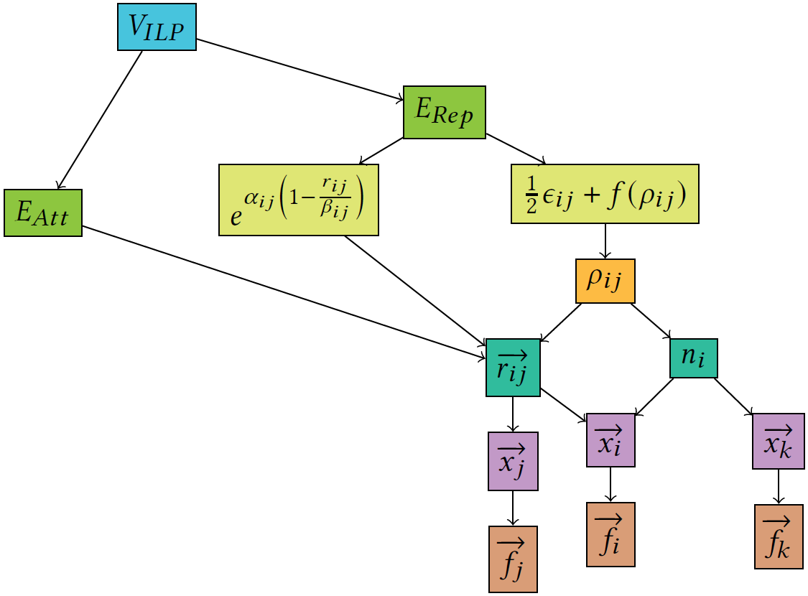
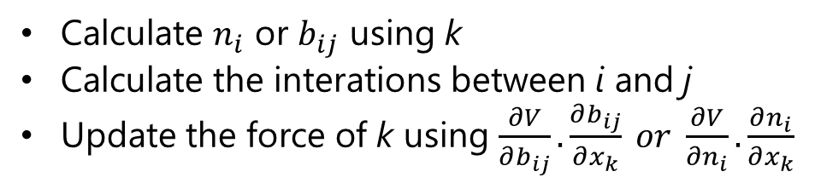
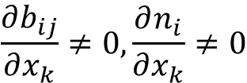

Motivation-Computation Workflow
Known:
$$F_{i}=−∇xiV$$
$$\frac{∂b_{ij}}{∂x_{k}}≠0, \frac{∂n_{i}}{∂x_{k}}≠0$$
Similar Workflow:
Calculate $n_{i}$ or $b_{ij}$ using k
Calculate the interations between i and j
Update the force of k using $\frac{∂V}{∂b_{ij}}.\frac{∂b_{ij}}{∂x_{k}} or \frac{∂V}{∂n_{i}}.\frac{∂n_{i}}{∂x_{k}}$

Slide 9
Motivation-The Origin of LMFF
ILP
Tersoff
LMFF
Inter-layer interaction
Intra-layer interaction
Layered Materials Force Field
ILP and Tersoff have the similar computational workflow
ILP and Tersoff can share short neighbor lists
The short neighbors list of ILP and Tersoff is not updated very frequently

Slide 10
Refactored ILP
The calculation process of ILP:
Construct a short neighbor list
Calculate the normal vector
Calculate the inter-layer attractive force
Calculate the inter-layer repulsive force
Phase 1
Phase 2
Phase 3
Phase 4
The optimizations for ILP:
  On-the-fly calculation of normal vectors
    Eliminates the computational dependence caused by Phases 1 and 2
  Kernel fusion
    Reuse rate of atomic information(Phase 3 and Phase 4)
  Write buffer
    Reduce the number of write operations

Slide 11
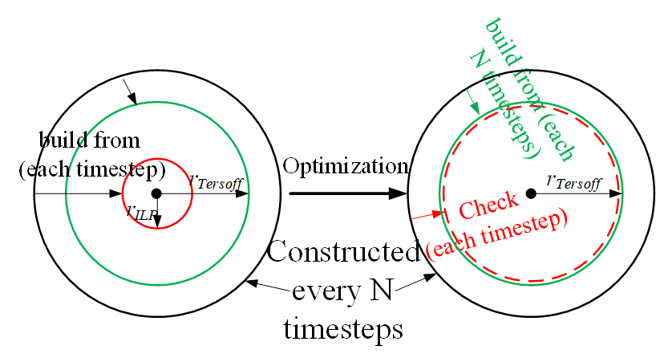
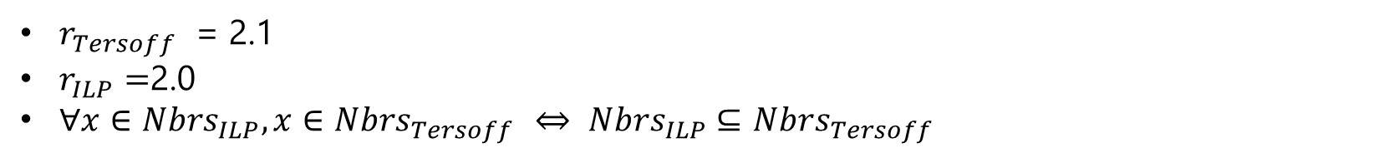
Generic LMFF
The optimized construction for short neighbor lists:
A general short neighbor list based on the cutoff of the Terosff potential
Two optimization Schemes:
Bit-marking method
Delay construction and recalculation check mechanism
$r_{Tersoff}$ = 2.1
$r_{ILP}=$2.0
$∀x∈{Nbrs}_{ILP}, x∈{Nbrs}_{Tersoff }$ $⇔ {Nbrs}_{ILP}⊆$ ${Nbrs}_{Tersoff }$
Notes:
The cutoff radius of Terosff is 2.1

Slide 12
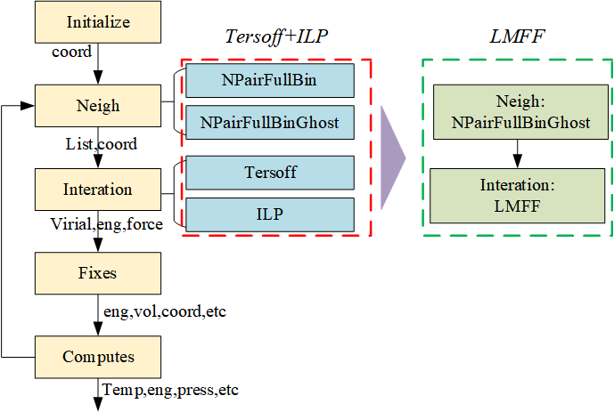
Generic LMFF
Hybrid style Tersoff and ILP potential vs LMFF:
Follow the frame design of LAMMPS
But two modifications:
Building long range neighbor list
Calculating interactions

Slide 13
Optimized SWLMFF
Serial
Parallel
Reduce long cycle instructions
Reduce branch judgment
Reduce discrete memory access
AoS/SoA
Discrete reading: Software cache
Discrete writing: Locked cache

Slide 14
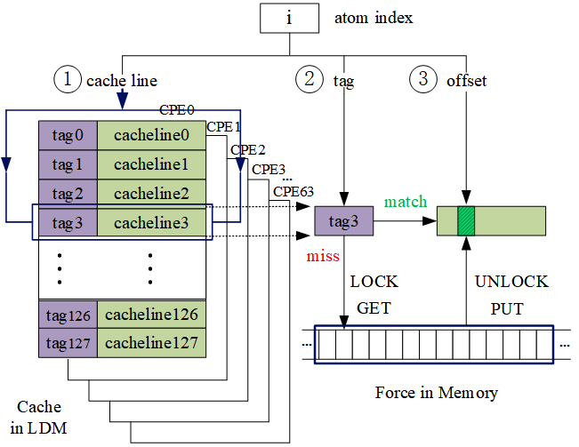
Optimized SWLMFF
Locked Cache method:
Update a line in the cache to lock the corresponding line in the global force array in memory
Miss:
LOCK
PUT via DMA
UNLOCK
GET via DMA
Cached forces + Original forces
Write back all lines
Hit rate: 90%-96%

Slide 15
Other Optimizations
Two commands:
fix/nve
Parallel computing
fix/langevin
Merge two MPI_Allreduce

Slide 16
Discussion of the Portability
Refactored ILP and Generic LMFF
  Platforms: SW processors and X86 architecture
  Problems: such as Memory-bound
Optimized SWLMFF
  Discrete reading
    Software Cache method
    Replace the DMA instructions with the instructions on the corresponding platforms
  Discrete writing
    Locked Cache method
    Replace the FAA instruction with the atomic operation instruction of the corresponding platform. For example, the CAS instruction of GPUs
  Cache efficiency
    The mapping mechanism is designed to reduce cache thrashing

Slide 17
Evaluation-Time Ratio of Hotsopts
Time Ratio of Hotspots on one CG of SW39000 processor:
Evaluations¹ | Tersoff | ILP | LMFF | Comm² | Speedup³
Baseline | 0.63% | 99.28% | - | ~0 | 1
Rft | 10.9% | 87.53% | - | 0.04% | 14.38
LMFF | - | - | 98.33% | 0.05% | 15.4
In Baseline, both Tersoff and ILP potentials are original implementation in LAMMPS.
In Rft, only ILP is refactored, while Tersoff still is the original implementation in LAMMPS. LMFF is the new design based on Tersoff and refactored ILP potentials.
2. which is the communication with neighboring processors in LAMMPS.
3. which is the speedup of the overall performance.

Slide 18
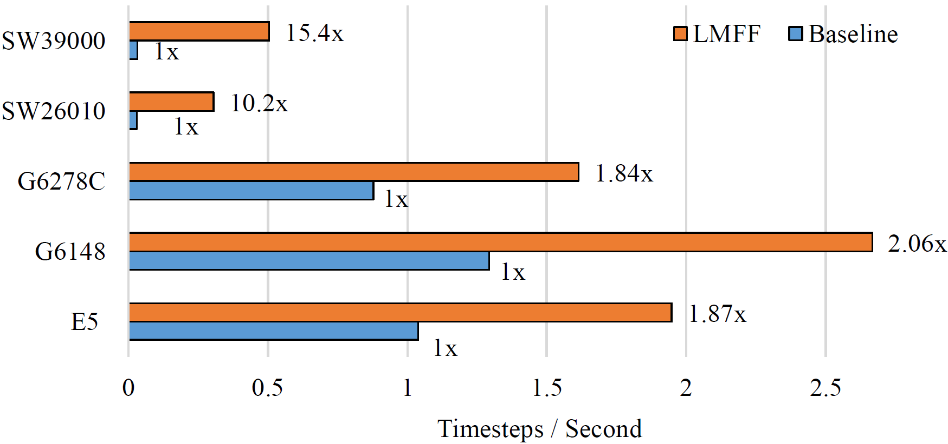
Evaluation-Speedup(One CG or Core)
Baseline is hybrid-style Tersoff and ILP potentials in LAMMPS
The running of Baseline and LMFF on SW processors just are on MPE of one CG, while others use an Intel core.

Slide 19
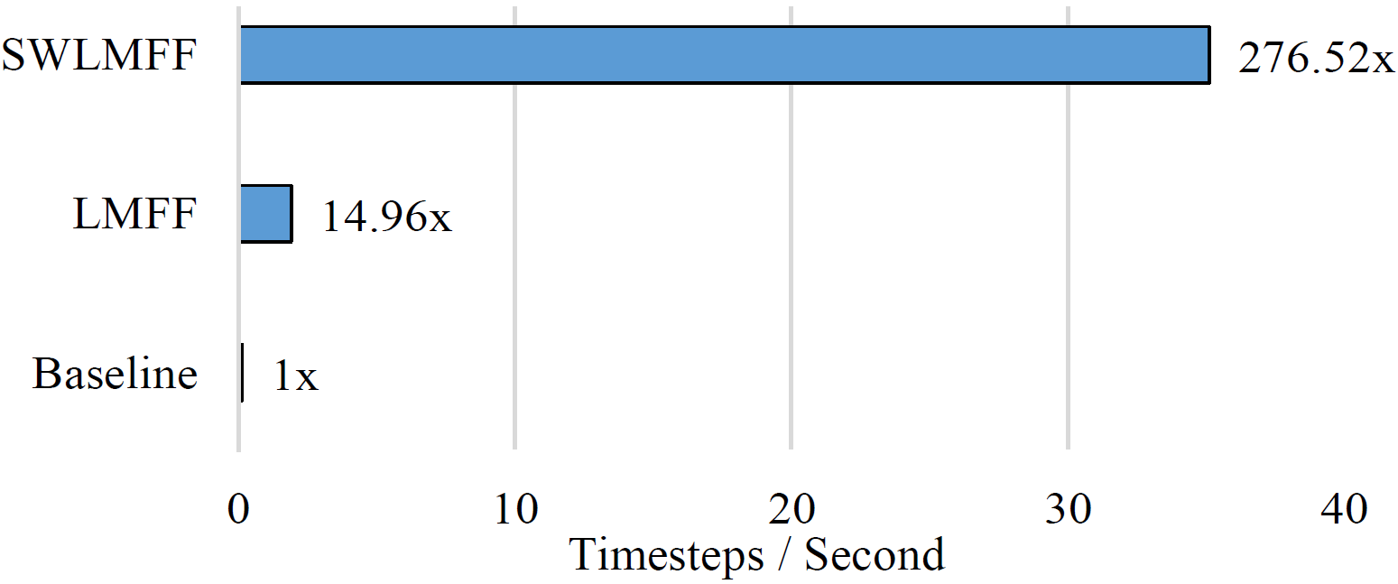
Evaluation-Speedup (One Node)
Our optimized implementation
has achieved a 276 × performance improvement.
Baseline and LMFF just use 6 MPEs of one node, while SWLMFF can run on 6 MPEs and 6 × 64 CPEs.

Slide 20
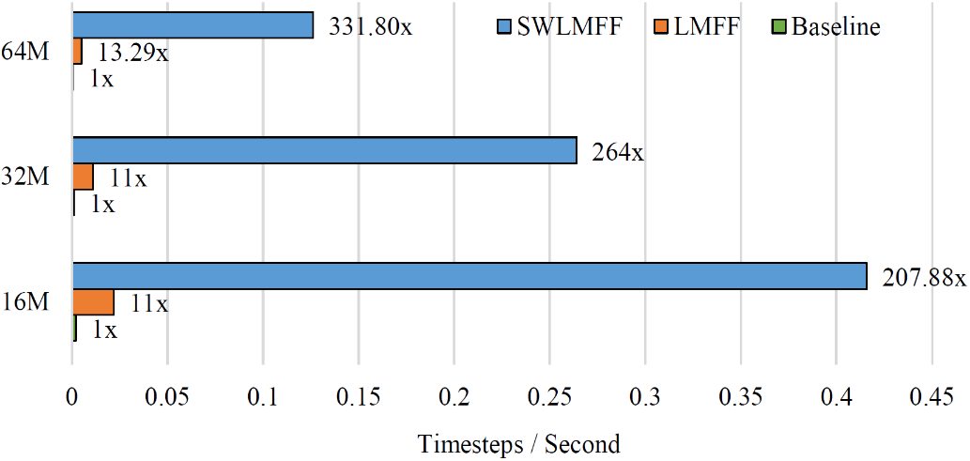
Evaluation-Speedup (One Plugin Board)
Baseline and LMFF just use 8×6 MPEs, while SWLMFF can run on 8×6 MPEs and 8 × 6 × 64 CPEs.
The overall performance is accelerated by 200-330 ×.
66,880,000 atoms (case-6688w)
33,440,000 atoms (case-3344w)
16,720,000 atoms (case-1672w)

Slide 21
Evaluation-Comparison
Evaluation¹ | Potentials | Processors | ORG² | OPT³ | Speedup⁴
[10] | Tersoff | SW26010 | 1957 | 51 | 38.37
SWLMFF | LMFF | SW26010 | 8791 | 73.7 | 119.28
SWLMFF | LMFF | SW39000 | 7874 | 28.5 | 276.52
1. The performance is evaluated with the average time of running one iteration, Walltime / iteration (ms).
2. In [10], “ORG" is the original Tersoff potential in LAMMPS, while “ORG“ is the original Tersoff and ILP potentials in SWLMFF.
3. “OPT" is the best parallel performance without vectorization for [10] and SWLMFF.
4. which is the overall speedup of “OPT" vs “ORG".

Slide 22
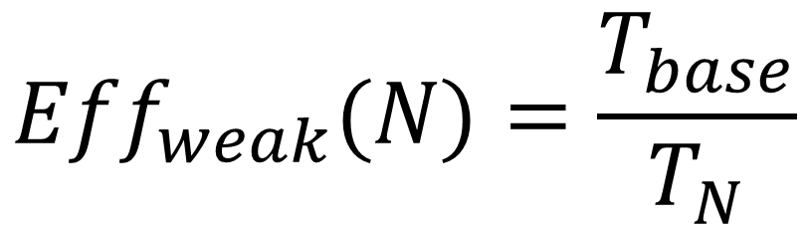
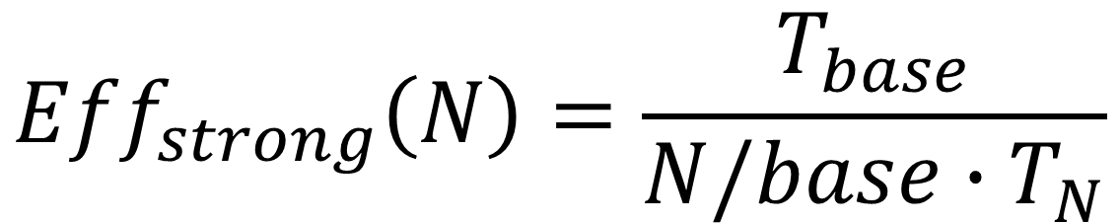
Evaluation-Scalability
$${Eff}_{strong}\left(N\right)=\frac{T_{base}}{N/base∙T_{N}}$$
$${Eff}_{weak}(N)=\frac{T_{base}}{T_{N}}$$
𝑇𝑥 is the execution time of 𝑥 processes, and 𝑏𝑎𝑠𝑒 is the baseline process count.

Slide 23
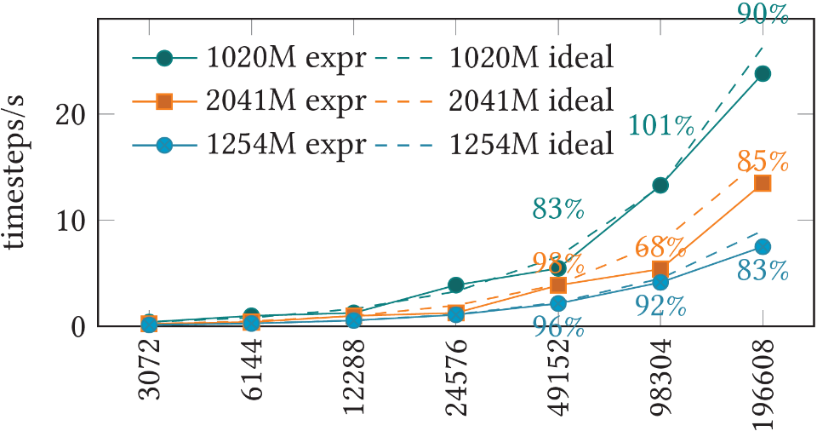
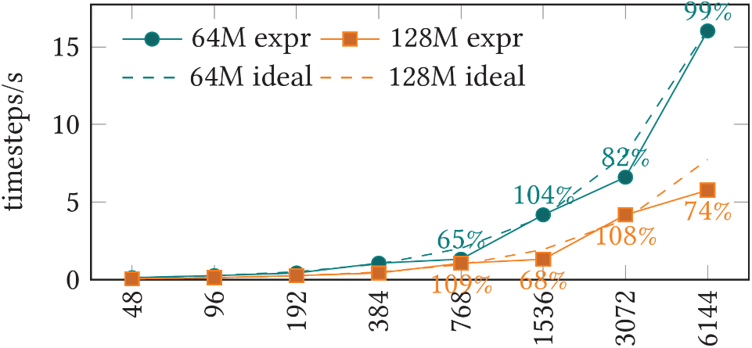
Evaluation-Scalability (Strong Scaling)
from 3,072 to 196,608 processes
with 1,070,080,000 (1020M) atoms,
2,140,160,000 (2041M) atoms,
1,314,914,304 (1254M) atoms
from 48 to 6,144 processes with 66,880,000 (64M) atoms, 133,760,000 (128M) atoms
Abnormal performance data points!

Slide 24
Evaluation-Scalability (Strong Scaling)
Two types of abnormal performance data points:
  sudden drop
  super linear acceleration
Two suspected reasons:
The decomposition of MPI in the three-dimensional space is different due to the different scale of the process
For super linear speedup, the cache hit ratio increases with the number of atoms in one process reduces.

Slide 25
Evaluation-Scalability (Strong Scaling)
MPI process grid for large scaling:
MPI process grid for small scaling:
Process | Grid₁ | Grid₂ | Grid₃
3072 | 384 × 8 × 1 | 256 × 12 × 1 | 3072 × 1 × 1
6144 | 512 × 12 × 1 | 384 × 16 × 1 | 6144 × 1 × 1
12288 | 768 × 16 × 1 | 512 × 24 × 1 | 12288 × 1 × 1
24576 | 1024 × 24 × 1 | 768 × 32 × 1 | 24576 × 1 × 1
49152 | 1536 × 32 × 1 | 1024 × 48 × 1 | 49152 × 1 × 1
98304 | 2048 × 48 × 1 | 1536 × 64 × 1 | 98304 × 1 × 1
196608 | 3072 × 64 × 1 | 2048 × 96 × 1 | 196608 × 1 × 1
Process | Grid₄ | Grid₅
48 | 8 × 6 × 1 | 12 × 4 × 1
96 | 12 × 8 × 1 | 16 × 6 × 1
192 | 16 × 12 × 1 | 24 × 8 × 1
384 | 24 × 16 × 1 | 32 × 12 × 1
768 | 32 × 24 × 1 | 48 × 16 × 1
1536 | 48 × 32 × 1 | 64 × 24 × 1
3072 | 64 × 48 × 1 | 96 × 32 × 1
6144 | 96 × 64 × 1 | 128 × 48 × 1
The greater the value of 𝐷𝑥/𝐷𝑦, the higher the parallel efficiency.
If the value of 𝐷𝑥 is the same as the number of processes and 𝐷𝑦 = 1 as presented in 𝐺𝑟𝑖𝑑₃, there will be no performance abnormalities because the number of atoms is close to evenly divided into each process.

Slide 26
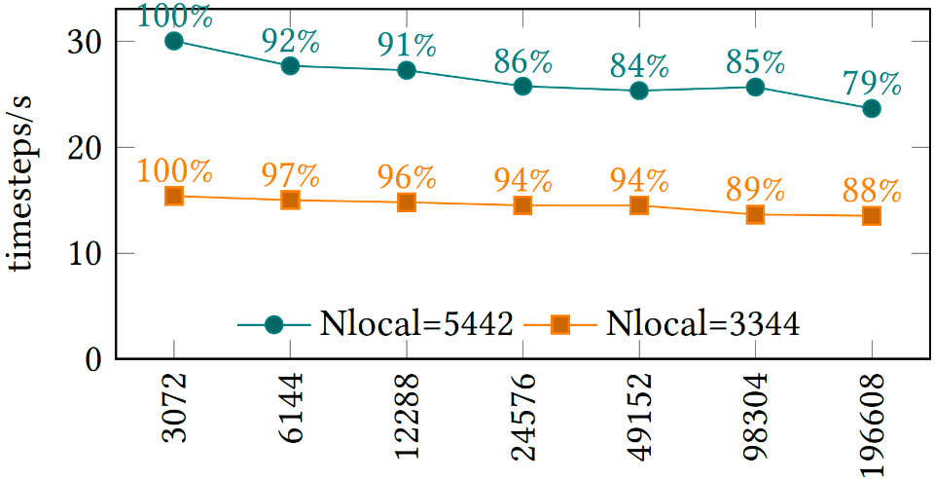
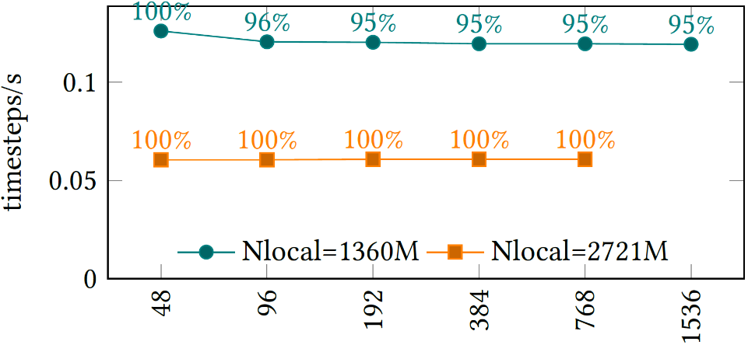
Evaluation-Scalability (Weak Scaling)
The system size is up to one billion atoms with parallel efficiency of 79%.
The system size is Nlocal * processes.
Nlocal = 1360M = 1,393,333 atoms
Nlocal = 2721M = 2,786,667 atoms
When Nlocal=2721M, the parallel efficiency reaches 100%.
Because the number of atoms loaded in one CG reaches the maximum, such a large computational density leads to ideal parallel efficiency.

Slide 27
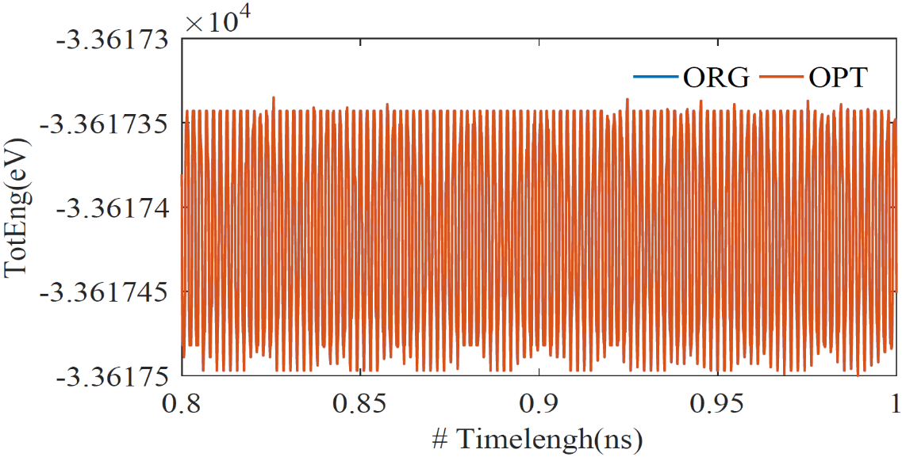
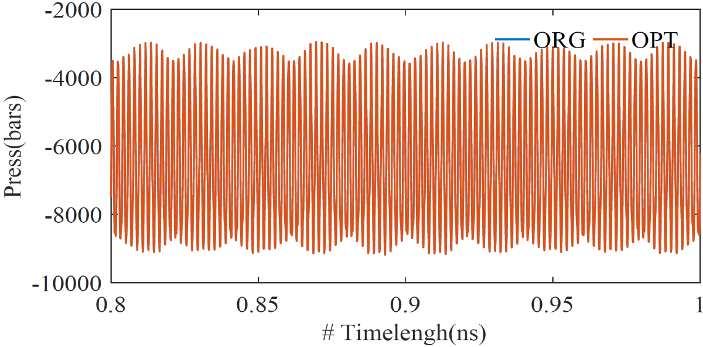
Evaluation-Accuracy
Validation of results for a six-layer graphene system of 5016 atoms with a time length of 1 ns
ORG is the results of Tersoff and ILP potential.
OPT is the results of optimized LMFF potential, SWLMFF

Slide 28
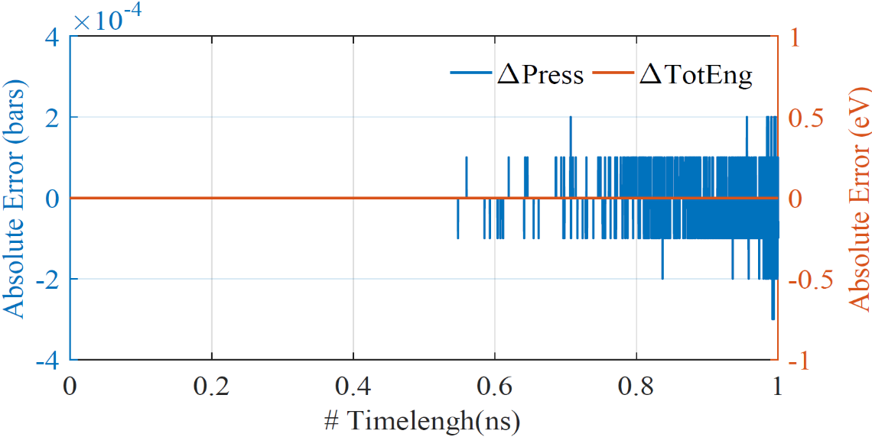
Evaluation-Accuracy
There is no deviation in the energy values of these two versions.
For the pressure, there is a disturbance from a position of about 0.6 ns, and the absolute error range is 10⁻⁴, which is acceptable.
Δ𝑇𝑜𝑡𝐸𝑛𝑔 and Δ𝑃𝑟𝑒𝑠𝑠 are the absolute error for energy and pressure.

Slide 29
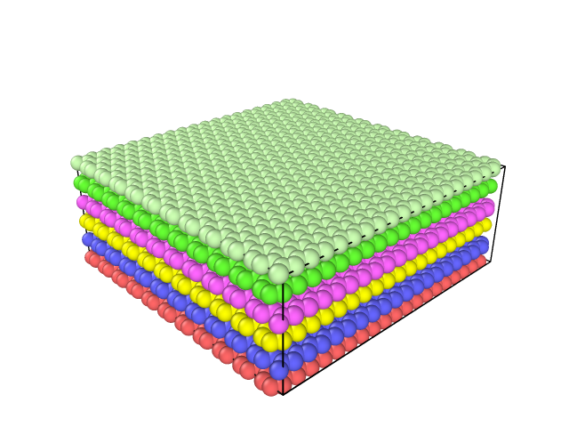
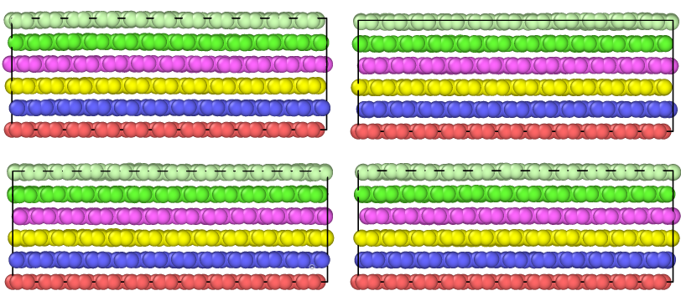
Evaluation-Visualization
It can be seen that some graphene layers did indeed slip.
Size: 5016 atoms
Length: 1 ns
System: a six-layer graphene

Slide 30
Conclusions
Refactored ILP potential
  On-the-fly generation of the short neighbor list and kernel fusion
Generic LMFF
  Bitmarking method
  Delay construction and recalculation check mechanism
  2× on Intel platforms and10-15× on Sunway
Optimized SWLMFF
  On a single node: 270× for a system of 5,016 atoms
  On one plug-in: 200-330× for tens of millions of atomic systems
  Maximum atomic system: ~2³¹ atoms (the limit of gaussian style velocity creation) with weak scaling of 79% when running on 196,608 processes
  Maximum load for one CG: more than 2.7 million with weak scaling of 95% - 100%

Slide 31
Conclusions
Application value
  Nanosecond simulation can be completed in one day
  It is of great significance to the study of layered materials that greatly improves the efficiency of scientific researchers
  It is the first time to optimize and realize the layered material force field on Sunway supercomputer.

Slide 32
Future Work
Extend the functions of LMFF
  Except for Tersoff, REBO can also be used to intra-layer interactions.
  Our optimization is portatble which can be applied to similar potentials, like REBO.
  We will added REBO to the function of intra-layer interactions.
Support for cases with irregular shapes
  Explore solutions to load balancing problems on Sunway.

Slide 33
Thank you for listening!
Email: qdgaoping@gmail.com

