Slide 1


Single-Node Partitioned-Memory for
Huge Graph Analytics:
Cost and Performance Trade-Offs
(Sayan Ghosh, Nathan Tallent, Marco Minutoli, Mahantesh Halappanavar)*, Ramesh Peri⁺, Ananth Kalyanaraman^
*Pacific Northwest National Laboratory
⁺Facebook, Inc (this work was performed when the author was at Intel)
^Washington State University

Slide 2
(Huge) Graph Analytics needs “big memory”
Single-node HPC – 100s cores, 1000s GB (memory + non-volatile persistent memory)
  Optane DCPMM is Intel’s persistent memory offering – byte-addressable block device
  E.g., Intel CXL w 6 memory channels: 3x2x256GB=1.5TB DRAM and 3x2x512GB=3TB PMM
  PMM available on cloud platforms (e.g., MS Azure & Google Cloud)
  PMM+DRAM advantages
  Shared-memory can provide better performance productivity than distributed-memory
  Different modalities: decide which/how algorithms can use PMM/DRAM
  Currently provides better $/GB than DRAM-only (Optane ~ ½ DDR / GB*)
Applications are more complex, irregular applications are everywhere
  Larger byte-per-flop, (irregular) memory access intensive, heuristics-driven, etc.
  Graph and combinatorial algorithms for analytics is a rapidly emerging area of data science
  Massive data sets emerging – billions of vertices (entities), trillions of edges (relationships)
*https: //blocksandfiles.com/2019/09/29/optane-pricing-micron-dram-headache/

Slide 3
Our work
Graph Analytics apps
Community detection
Influence maximization
Different working set, partitioning, access patterns, synchronize
Memory Modes
DRAM-only
DRAM caches Optane
Direct, via virtual mem.
Direct, via file system
Evaluation
Scaling trends
Processor cache, DRAM-PMM locality
Per socket & hotspot
Price/Performance
Key observations:
  About 12% improvement in scalability for Direct vs when DRAM caches Optane for huge graphs
  Optane memory modes can match DRAM-only!
  Processor-cache latency can cause major performance degradation (non-temporal hints ~25%↑)
  $/performance estimates 4-10x for shared-memory graph analytics over distributed-memory
Our work
Large Shared Memory
6 TB Optane, 768 GB DRAM
4 sockets, 6 channel/socket
96 CPU, 192 h/w threads
Allocation Strategies
No change
Naïve
Optimized
Huge Graphs
Working set: 2.3 TB
Graph v. Path space

Slide 4
Discussion
Optane memory configurations and notations
Graph applications – Clustering or Community Detection and Influence Maximization
Experiments – microbenchmarks, applications and analysis

Slide 5
Discussion
Optane memory configurations and notations
Graph applications – Clustering or Community Detection and Influence Maximization
Experiments – microbenchmarks, applications and analysis

Slide 6
Overview of Intel Optane DCPMM configurations
DRAM is a cache to PMM
Data brought from PMM to DRAM in 4K blocks
DRAM cache hit is ~10ns, miss is ~100ns
No code update required
Manage allocations separately
Classic: Mount PMM and access via filesystem
Direct: PMM as a special NUMA node
Direct allows spreading over NUMA nodes
% of PMM in Memory & AppDirect
DRAM is a cache to PMM (1DRAM:4PMM?)
PMM capacity is lost
Memory traffic may increase [deprecated]

Slide 7
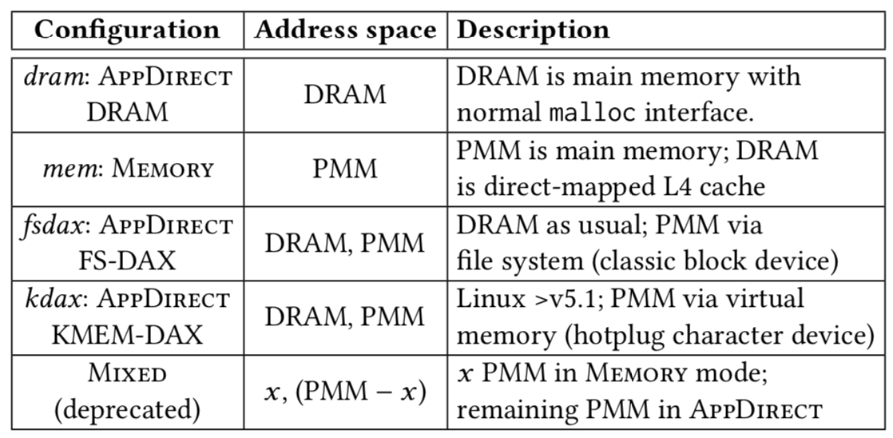
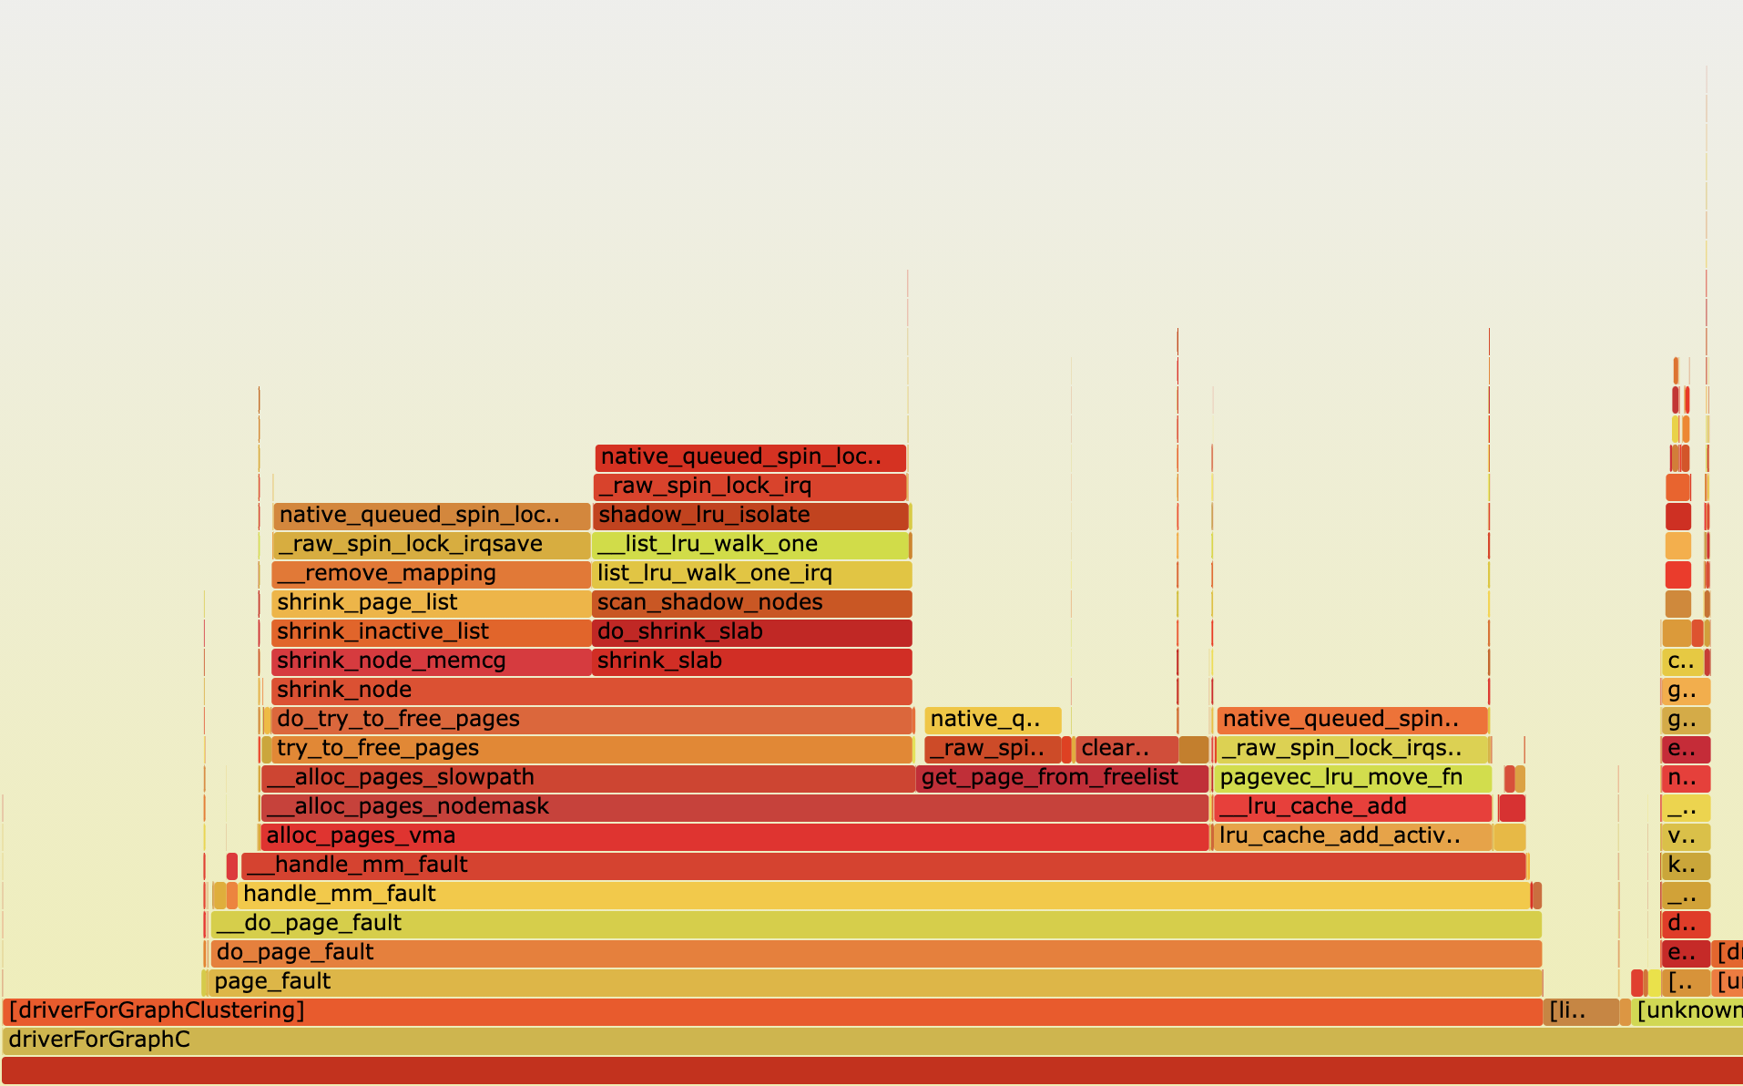
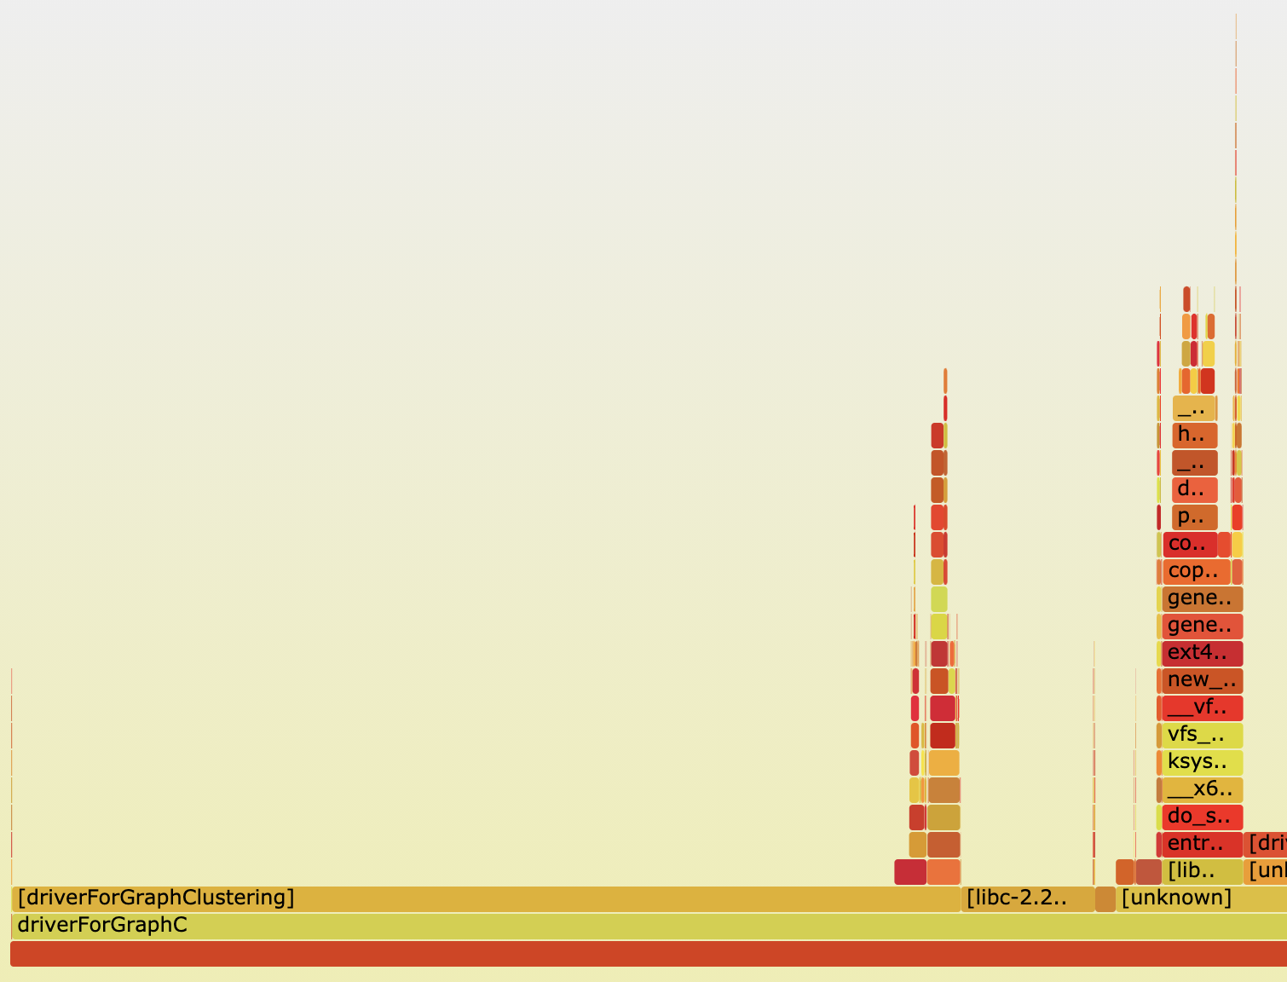
Optane direct access (DAX) provisioning and notations
Past: Access PMM as block device thru filesystem, incurs page cache buffering overhead
Now: Special PMM driver supporting direct-access (DAX) filesystem or device
  FS-DAX – Access PMM through user space filesystem mountpoints
    Restricted to PMM DIMMs mapped to a single socket
    Spanning a single filesystem across multiple sockets is complicated, requires striping, RAID-0
  KMEM-DAX – Access PMM through direct load/store (requires Linux kernel >v5.1)
    No mountpoints, device allocations spread across PMM DIMMs on multiple sockets
    Different allocation policies (we use memkind) govern how data is allocated across NUMA nodes
    For graphs exceeding DRAM size, allocation strategies matter (page allocations, buddy allocator issues)
Page faults
NUMA-aware graph
loading
resolves page fault overhead
Notations

Slide 8
Discussion
Optane memory configurations and notations
Graph applications – Clustering or Community Detection and Influence Maximization
Experiments – microbenchmarks, applications and analysis

Slide 9
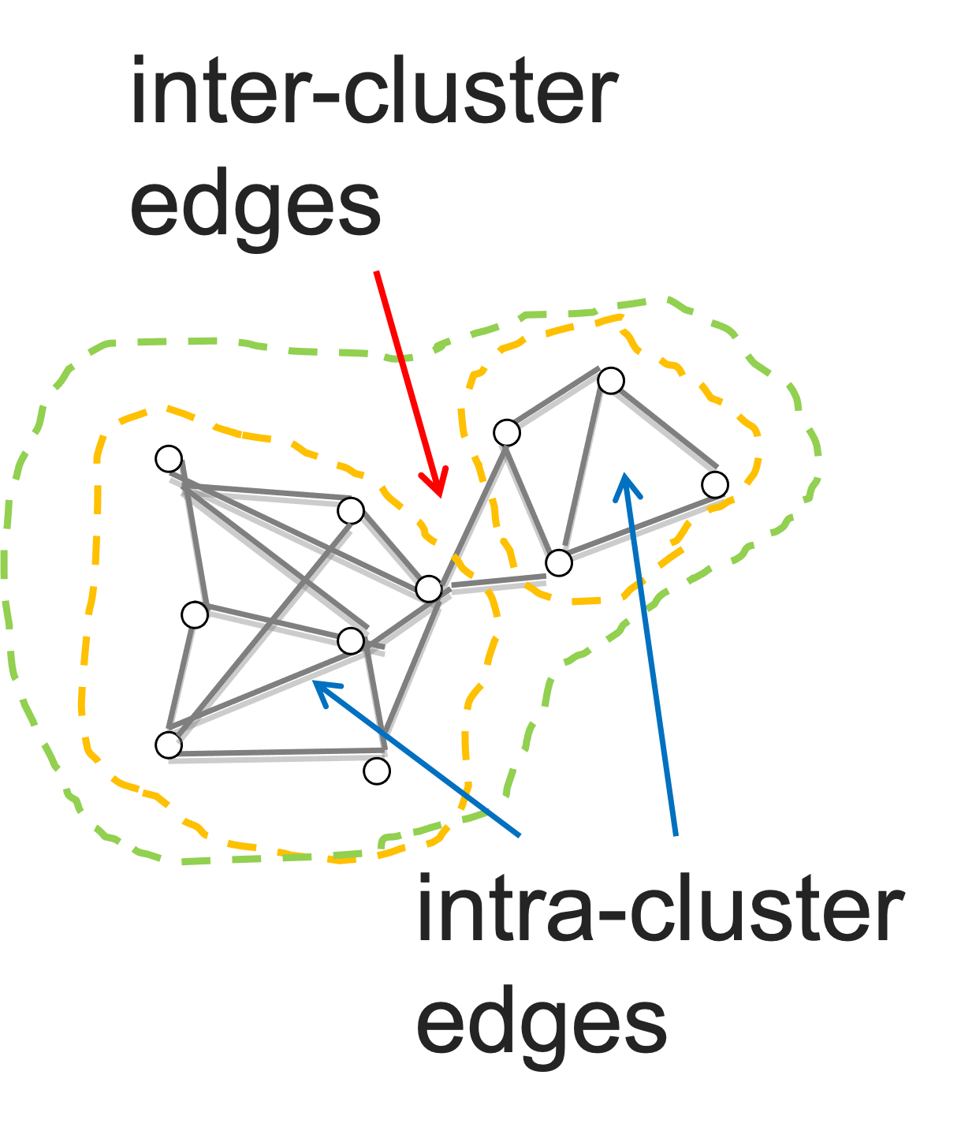


Graph applications – clustering and influence maximization
Graph Clustering or Community Detection (Grappolo)^{[1]}
  Greedy iterative method that partitions a graph into communities or clusters
    Working set: Input graph, set of vertices and associated edges (up to 2.3TB)
    Partitioning strategy: Concurrent graph loading from NUMA nodes, good locality
    Access pattern: Neighborhood search (regular) and determine target community (irregular)
    Synchronization: Tasks require global knowledge, all-to-all pattern
  Graph Influence Maximization (Ripples)^{[2]}
  Independent Monte Carlo simulations on a graph using stochastic diffusion method
    Working set: MC-based reconstruction (via BFS) of all paths backwards from a seed set (RRR* sets)
    Partitioning strategy: Probabilistic BFS leads to arbitrary RRR sets
    Access pattern: Unpredictable (local/remote) accesses to RRR sets with poor NUMA locality
    Synchronization: Tasks are relatively asynchronous, exploits accelerators and distributed-memory
  [1] Lu, Hao, Mahantesh Halappanavar, and Ananth Kalyanaraman. "Parallel heuristics for scalable community detection.
  " Parallel Computing 47 (2015): 19-37.
  [2] Minutoli, Marco, et al. "Fast and scalable implementations of influence maximization algorithms." 2019 IEEE International Conference on Cluster Computing (CLUSTER). IEEE, 2019.
*Random Reverse Reachable
Notes:
Emphasize the high-level contrasts w.r.t. working set composition, partitioning strategy, access patterns, and synchronization

Slide 10
Discussion
Optane memory configurations and notations
Graph applications – Clustering or Community Detection and Influence Maximization
Experiments – microbenchmarks, applications and analysis

Slide 11
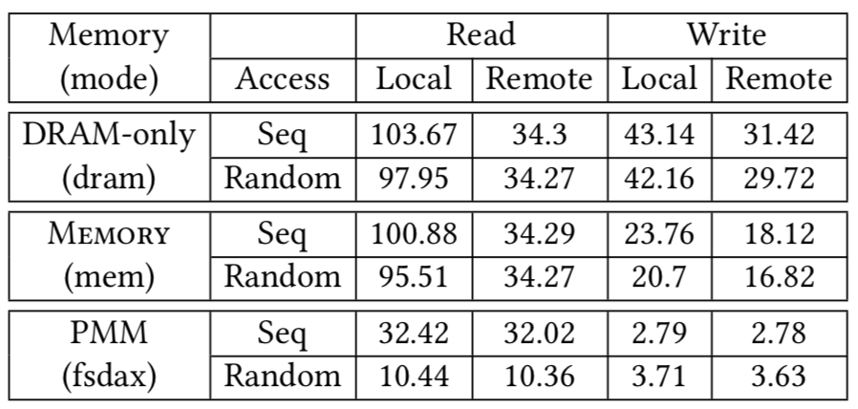
Platform and benchmarks
4x 24-core (192 threads) Intel Xeon Platinum 8260 (Cascade Lake pre-rel.) CPU at 2.3GHz
  32 KB L1, 1 MB L2 cache/core, 33 MB shared L3 cache
  6x memory channels/socket, 768GB DDR4 DRAM and 1.5TB Optane DCPMM/socket (6TB total)
  3x ~60GB/s UPI (Ultra Path Interconnect) links to connect to other sockets
Sequential/Random-access b/w using MLC v3.7
STREAM benchmark b/w
DRAM/Memory 3x better than FS-DAX
10% slower b/w for random accesses
Remote sequential and random-access b/w are similar
DRAM/Memory: remote reads are 1/3 b/w of local
DRAM only 18% better than Memory
Direct modes 40x worse compared to DRAM/Memory
KMEM-DAX up to 4.5x better than FS-DAX
In apps, KMEM-DAX shows better performance

Slide 12
Overall performance trends
Default
Community detection
goal↓
Non-temporal
hints
Grappolo/Ripples
Optane configurations
Variants
Versions: {g|r}{dram, mem, kdax}{2, 3}
Memory vs AppDirect (+12%)
L3 cache invalidations can change!
Fix with non-temporal hints (+25%)
AppDirect/Memory can equal DRAM...
Default
AppDirect can beat Memory...
Different
RRR sorts
Influence maximization
goal↓
...even with irregular access patterns, if most accesses are NUMA-local and Optane accesses are frequently reads
Sorting strategies
rkdax: target buf on PMM, tmp on DRAM
rkdax2: in-place sort on PMM
rkdax3: target/tmp on DRAM, copy to PMM (-2x)
Notes:
AppDirect/Memory can equal DRAM
gkdax for friendster and moliere2016
gmem2 for moliere2016
rmem for slash, talk, topcats at 192 threads
rkdax{2|3} for slash, twitter, and talk (≤64 threads)
AppDirect can beat Memory:
gkdax > gmem always (except clueweb12 at 64 threads)
gkdax2 > gmem2 for uk2014
rkdax{2|3} > rmem for slash, twitter, and talk (≤64 threads)

Slide 13
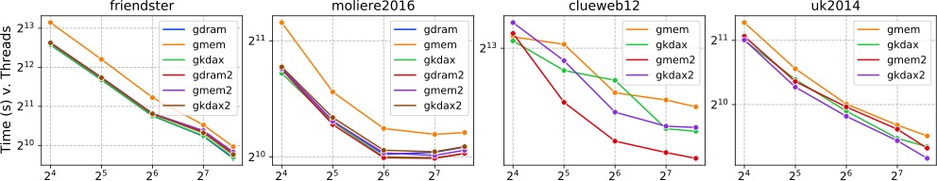
Community Detection (Grappolo) performance and metrics
goal↓
Working set size
48.5G
128G
2.16T
2.3T
Non-temporal hints improves memory mode
Cache stalls can exceed Memory stalls
Load balance depends on graph structure, can affect remote loads
Memory and DRAM-only are similar
AppDirect 12% better than Memory
cmty: C++ map search
Average work time
Waiting for mem/cache
Coherence activity
Loads DRAM/PMM - local (L), remote (R)
clueWeb’s σ(vertex-degree) is 9x of uk2014
LPMM negligible for 2 medium graphs
Contrasting processor-cache effects between original and optimized variants
*Profiling results collected using Intel Vtune v19
gmem2 25% better than gmem

Slide 14
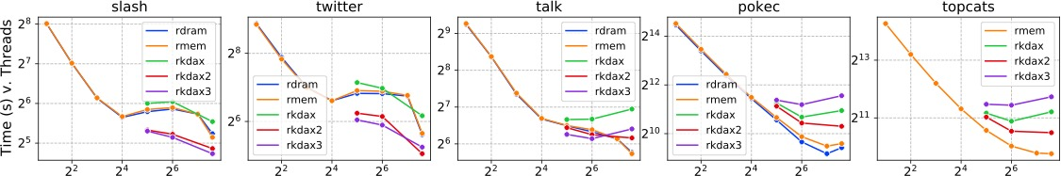
Influence Maximization (Ripples) performance and metrics
goal↓
17.5G
21.6G
41G
590G
785G
Larger input, RRR access b/w limited
DRAM-only & Memory are close!
AppDirect leads to more stalls
better ←AppDirect variants scaling → worse
More random remote accesses as RRR grows
rrr: random BFS & sort
Average work time
Waiting for mem/cache
Coherence activity
Loads DRAM/PMM - local (L), remote (R)
Memory & DRAM have similar random-read b/w
Better performance with Memory than AppDirect

Slide 15
Distributed-memory comparison with best Optane versions
Best dist. perf
Best Optane perf (on 192 threads)
goal↓
NERSC Cori
17.5G
590G
48.5G
Using medium-sized graphs for Grappolo/miniVite
21.6G
785G
128G
41G
Grappolo/miniVite distributes the graph, whereas Ripples replicates the graph
For Grappolo/miniVite, total working set size expands (“ghost” vertices), whereas for Ripples it remains constant (per PE)
Influence maximization
Community detection
OLCF Summit
For Grappolo/miniVite, distributed graph structure, irregular accesses and synchronization impacts scalability
Ripples is relatively asynchronous, exhibits better scalability
Distributed-memory perf better…
Notes:
Both codes are MPI-based.
Replication in Ripples means per node memory can determine how many ppn
No problem for miniVite, as it distributes a graph

Slide 16
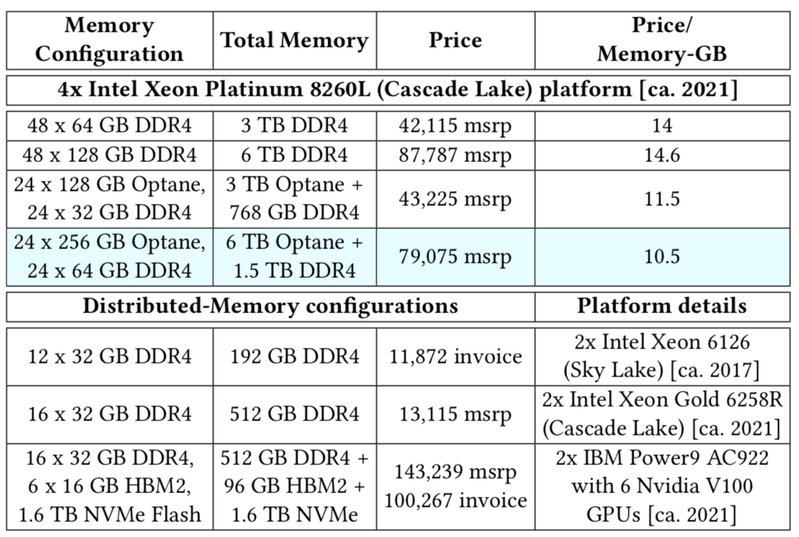
Price($)/Performance(secs.) between Optane vs. Distributed-memory
$-price estimates from system vendors
Best dist. $/perf
Best Optane $/perf
OLCF Summit
goal↓
Optane
Optane
Optane
Influence maximization
NERSC Cori
Community detection
Ours
Cori
Optane
Optane
Optane
Summit
Best Optane $/performance compared to distributed-memory variants of Grappolo (miniVite) and Ripples
Distributed-memory $-price estimates excludes networking/I/O resources
Optane provide >25% memory at 20–30% reduced costs …
Optane $/perf better vs. Distributed-memory…
Notes:
Despite of the bias in estimating distributed-memory platforms, Optane provides very similar or better $-perf in all cases.
Optane-based systems provide 25% more memory for 20–30% cost reduction

Slide 17
Conclusions and future work
Evaluated suitability of huge-graph (TB-size) analytics on a single-node system with Optane
  Used single and partitioned-address spaces: Memory and AppDirect Optane modes
  Benchmarks cannot replace application-based evaluations (essentially different outcomes)
  AppDirect showed 12% improvement relative to Memory
  Memory and DRAM-only performances complementary
  Single node Optane vs. 8 nodes on distributed-memory platforms depicts promising results
Two contrasting graph applications – community detection and influence maximization
  Grappolo: better locality, interesting cache behavior (non-temporal hints → 25% improvement)
  Ripples: poor locality, surprisingly similar Memory and DRAM-only performances
  AppDirect performance depends on the volume of NUMA-local PMM reads
Compelling price/perf trade-offs for graph analytics on Optane systems
  4-10x better than distributed-memory (NERSC Cori and OLCF Summit)
Notes:
Different access patterns, locality and parallelism – applications.

Slide 18
Thank you
Graph Analytics apps
Community detection
Influence maximization
Different working set, partitioning, access patterns, synchronize
Memory Modes
DRAM-only
DRAM caches Optane
Direct, via virtual mem.
Direct, via file system
Evaluation
Scaling trends
Processor cache, DRAM-PMM locality
Per socket & hotspot
Price/Performance
Our work
Large Shared Memory
6 TB Optane, 768 GB DRAM
4 sockets, 6 channel/socket
96 CPU, 192 h/w threads
Allocation Strategies
No change
Naïve
Optimized
Huge Graphs
Working set: 2.3 TB
Graph v. Path space
https://github.com/Exa-Graph/grappolo [Grappolo]
https://github.com/Exa-Graph/miniVite [miniVite]
https://github.com/pnnl/ripples [Ripples]

