Slide 1



MAPA: Multi-Accelerator Pattern Allocation Policy for Multi-Tenant GPU Servers
Kiran Ranganath* Joshua D. Suetterlein Joseph B. Manzano
Shuaiwen Leon Song Daniel Wong

Slide 2
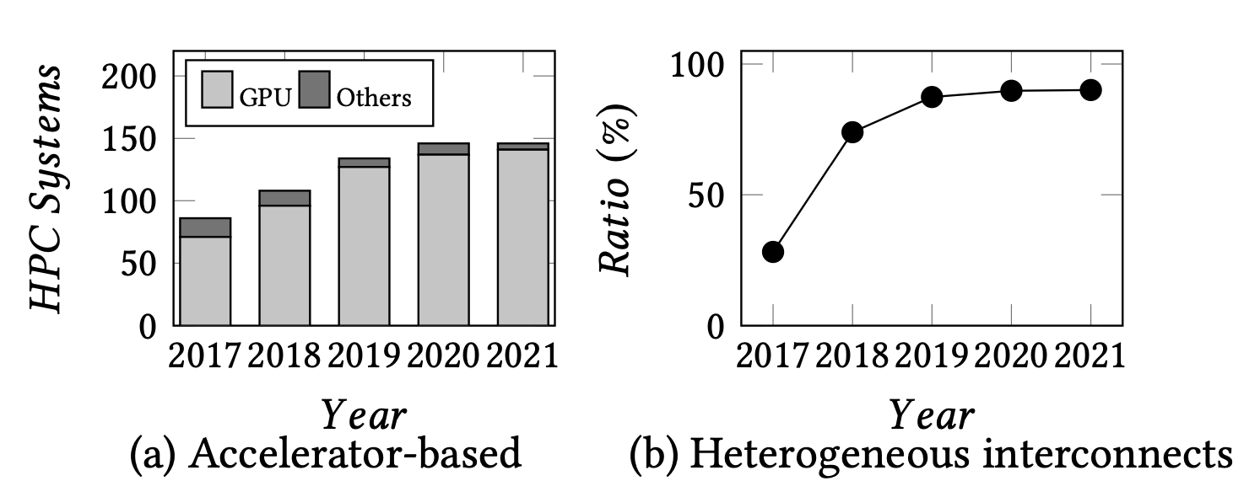




Multi-GPU systems are increasingly common
Increased adoption of Accelerators in Top 500 Supercomputers
  GPUs
Scientific and ML applications

Slide 3
Interconnects are becoming heterogeneous
AMD Infinity fabric
Nvidia Nvlink/NVSwitch
Compute Express Link
And more!

Slide 4
Adopting multiple interconnects
Accelerator-based Supercomputers equipped with more than one type of interconnect technology.
Nearly 90%

Slide 5

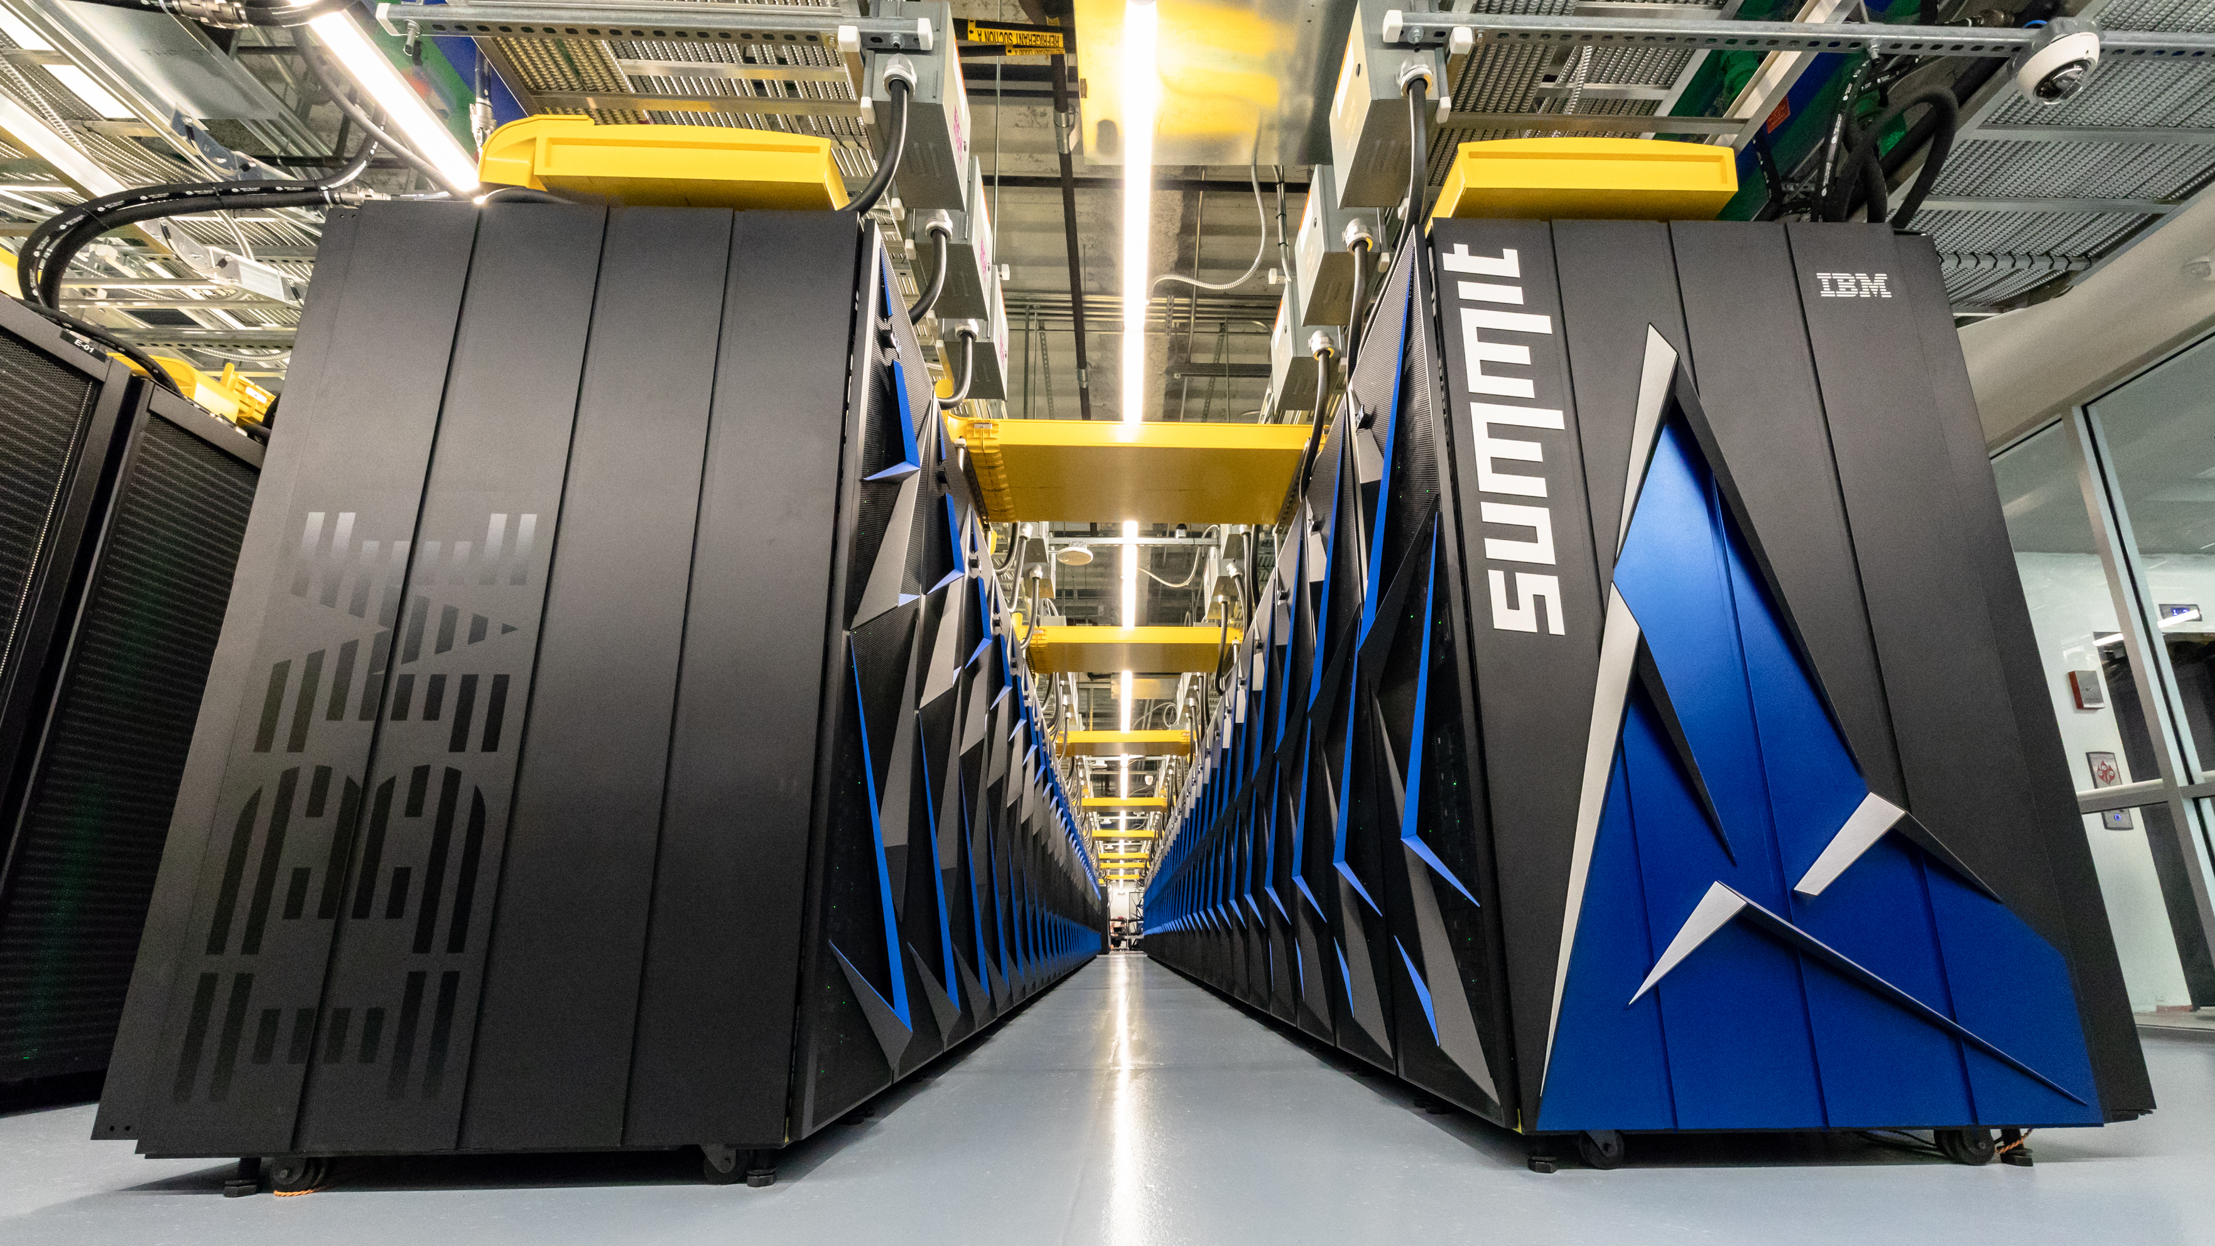



Accelerator topology is diverse
Nvidia DGX-1 V100
Azure NDv2
AWS P3
Facebook Big-basin
Summit

Slide 6
Variety of communication links
Variety of topologies

Slide 7
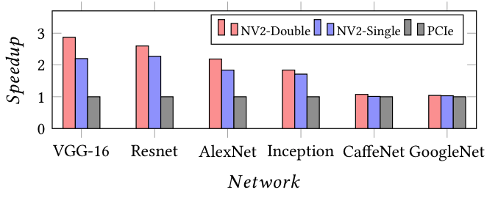
Impact of communication links on Caffe ML training
(1,4)
(5,6)
(3,8)
25 GBps
50 GBps
12 GBps
Can lead to more than 65% slowdown.

Slide 8
Existing allocators can cause fragmentation
Assignment based on lowest available GPU ID. Eg. Nvidia Docker
 |  |  |  |  |  | 2 | 3
NVLink
QPI
PCIe
Job Queue
GPU 1
GPU 2
GPU 6
GPU 5
CPU 1
CPU 2
GPU 4
GPU 3
GPU 7
GPU 8
DGX-1 V100
Notes:
Exisiting allocators can allocate using lowest available GPU ID.

Slide 9

Existing allocators can cause fragmentation
Assignment based on lowest available GPU ID. Eg. Nvidia Docker
 |  |  |  |  |  |  | 2
NVLink
QPI
PCIe
Job Queue
GPU 1
GPU 2
GPU 6
GPU 5
CPU 1
CPU 2
GPU 4
GPU 3
GPU 7
GPU 8
DGX-1 V100
Notes:
Exisiting allocators can allocate using lowest available GPU ID.

Slide 10
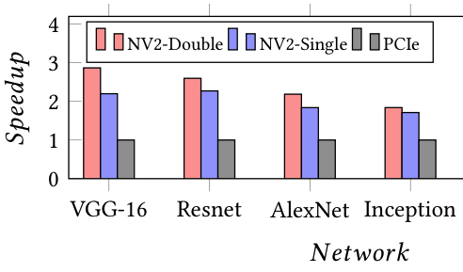

Existing allocators can cause fragmentation
Assignment based on lowest available GPU ID. Eg. Nvidia Docker
NVLink
QPI
PCIe
Job Queue
GPU 1
GPU 2
GPU 6
GPU 5
BW_{allocated} = 12 GBps
CPU 1
CPU 2
GPU 4
GPU 3
GPU 7
GPU 8
DGX-1 V100
Notes:
Exisiting allocators can allocate using lowest available GPU ID.

Slide 11

Existing allocators can cause fragmentation
Assignment based on lowest available GPU ID. Eg. Nvidia Docker
NVLink
QPI
PCIe
Job Queue
GPU 1
GPU 2
GPU 6
GPU 5
BW_{allocated} = 12 GBps
CPU 1
CPU 2
GPU 4
GPU 3
GPU 7
GPU 8
DGX-1 V100
BW_{ideal} = 50 GBps
Notes:
Exisiting allocators can allocate using lowest available GPU ID.

Slide 12
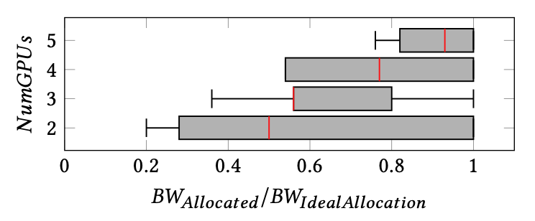
How often is the resource fragmentation?
Experiment
  100 randomly generated Jobs
  Each job utilizing different no. of GPUs with different execution times
  Record BW_{Allocated} in each job
  Calculate BW_{Allocated} / BW_{Ideal}

Slide 13
How to reduce fragmentation?

Slide 14
MAPA: Multi-Accelerator Pattern Allocation
A framework to obtain nearly ideal allocations by using Graph-aware matching techniques.
User provided
App graphs
Allocation Policy
Possible Matches
How to score patterns?
Apps
Graph Pattern Matching
(Peregrine¹)
Pattern Scoring
2
1
2
2
6
1
2
6
4
3
4
3
7
8
3
7
8
3
HW graph
1
1
2
Server
2
6
5
Allocation
4
3
7
8
Update
3
1
2
3
^{[1]}Kasra Jamshidi, Rakesh Mahadasa, and Keval Vora. 2020. Peregrine: A Pattern- Aware Graph Mining System. In Proceedings of the Fifteenth European Con- ference on Computer Systems (Heraklion, Greece) (EuroSys ’20).

Slide 15
Aggregated bandwidth
Total available bandwidth in a matching pattern.
NVLink
QPI
PCIe
Aggregated BW
GPU 2
GPU 6
GPU 5
GPU 1
GPU 2
GPU 1
25
Matching
pattern
App Graph
100 GBps
Isomorphic
50
CPU 1
CPU 2
25
GPU 4
GPU 3
GPU 8
GPU 4
GPU 7
Notes:
Title How do I score?
Instead of

Slide 16
Effective Bandwidth
Peak practically achievable bandwidth for any given allocation
Calculated by running NCCL All-Reduce microbenchmarks
NVLink
QPI
PCIe
Effective BW
GPU 2
GPU 6
GPU 5
GPU 1
GPU 2
GPU 1
App Graph
Matching
pattern
Isomorphic
CPU 1
CPU 2
GPU 4
GPU 3
GPU 8
GPU 4
GPU 7

Slide 17
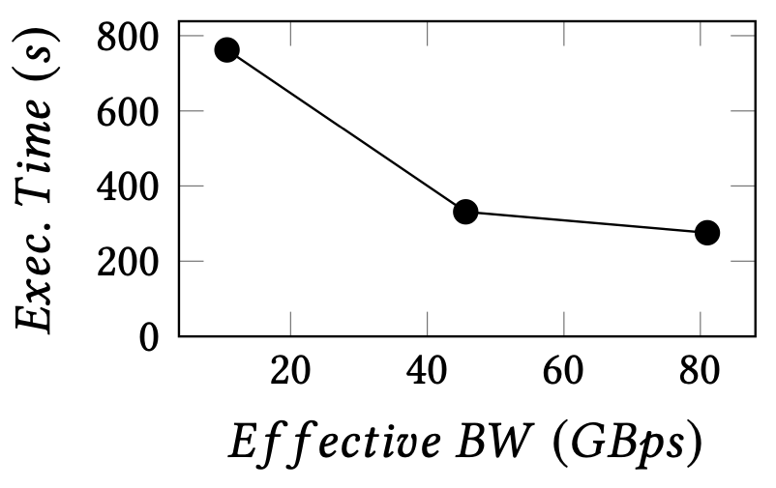
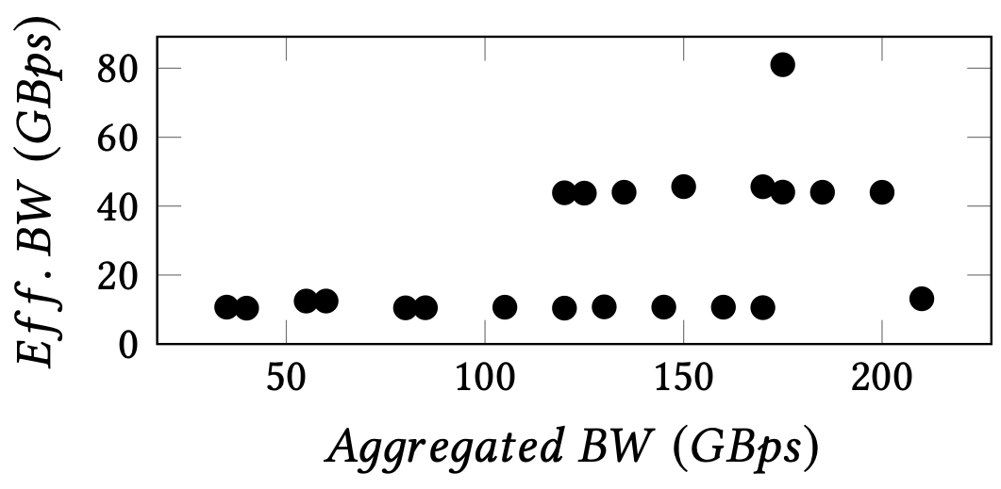
Correlate Effective Bandwidth
Scoring all possible (2,3,4,5)-GPU allocations using Microbenchmarks.
VGG Training
Effective Bandwidth is a better metric.

Slide 18
Benchmarking allocations at runtime is not scalable.

Slide 19
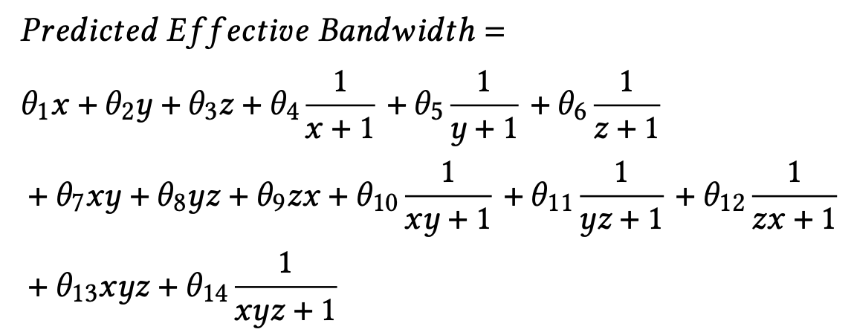
Modeling Effective Bandwidth
Non-linear regression to predict effective bandwidth
  Number of Double NVLinks (𝑥), Single NVLinks (𝑦), and PCIe links (𝑧)
  31 samples of possible 2, 3, 4, 5 GPU combinations
Notes:
Relative Error, 0.0709
Root Mean Square Error (RMSE) 1.5153
Mean Absolute Error (MAE) 7.0539

Slide 20
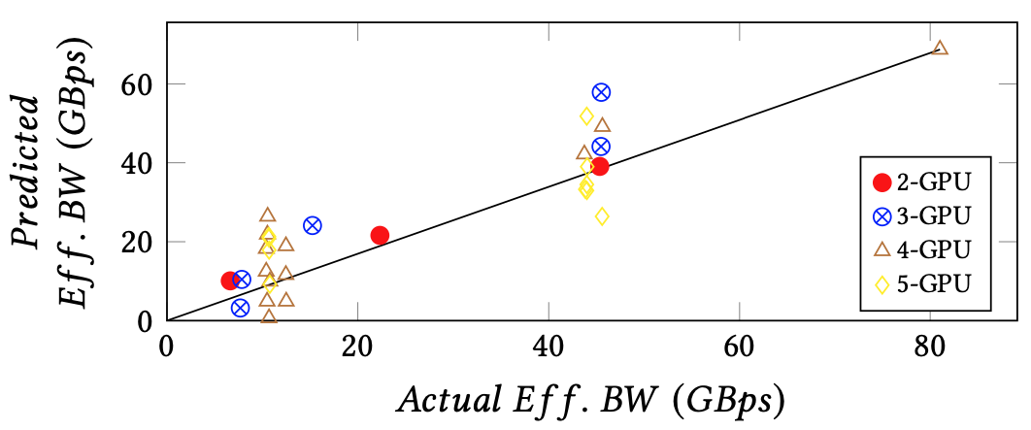
Modeling Effective Bandwidth
Non-linear regression to predict effective bandwidth
Predicted Effective BW correlates well with Actual Effective BW
RMSE = 1.5153
Notes:
Relative Error, 0.0709
Root Mean Square Error (RMSE) 1.5153
Mean Absolute Error (MAE) 7.0539

Slide 21
Do we need a metric other than Effective bandwidth?

Slide 22
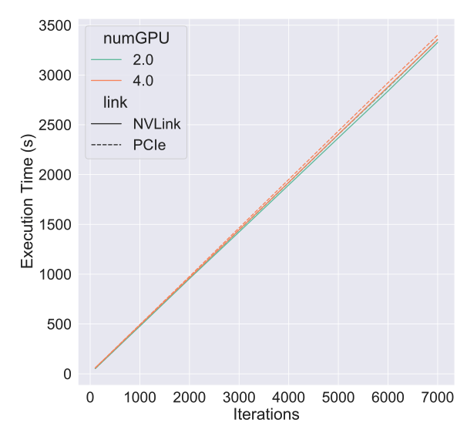
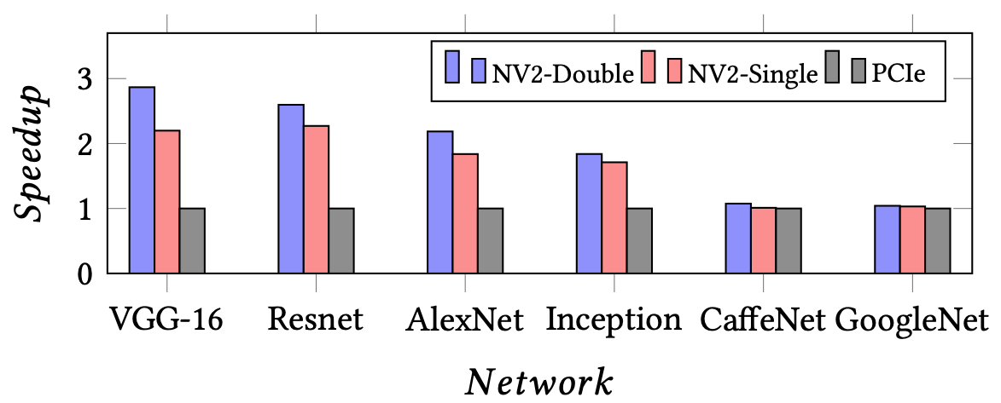
Revisiting ML training speedup
Not all applications benefit from Effective Bandwidth.
BW Insensitive
Google Net

Slide 23
How do we allocate for Bandwidth insensitive workloads?

Slide 24
Preserved Bandwidth
Preserved bandwidth is total available bandwidths with the allocation
Goal: Retain high-bandwidth links for future use
NVLink
QPI
PCIe
Preserved BW
GPU 2
GPU 6
GPU 5
GPU 1
GPU 2
GPU 1
Matching
pattern
CPU 1
CPU 2
GPU 4
GPU 3
GPU 8
GPU 4
GPU 7

Slide 25
Allocation Policy using Effective and Preserved Bandwidths

Slide 26
A better Allocation policy
Goal: Intelligent allocations based that suits well for the application.
BW Sensitive
BW Insensitive
Predicted Effective Bandwidth
Preserved Bandwidth

Slide 27
Preserve Allocation policy
BW
Sensitive?
Yes
No
App graph
HW graph
Find Allocation with highest
Effective _{BW}
Graph Pattern Matching
Find Allocation with highest
Preserved _{BW}
Allocation
Allocation

Slide 28
Experimental Setup
DGX-1 : 8 V-100 GPUs
300 randomly generated jobs requiring
1-5 GPUs
Policies
  Baseline
  Topo-aware²
  Highest Aggregated Bandwidth (Greedy)
  Preserve allocation policy
^{[2]} Marcelo Amaral, Jordà Polo, David Carrera, Seetharami Seelam, and Malgorzata Steinder. 2017. Topology-aware gpu scheduling for learning workloads in cloud environments. In Proceedings of the International Conference for High Performance Computing, Networking, Storage and Analysis.

Slide 29
Multi-GPU optimized workloads
Neural networks (Caffe)
  VGG-16, Resnet-50, AlexNet, Inception-v3, CaffeNet, GoogleNet
Non-neural networks
  Parallel simulated annealing algorithm for global optimization (Cusimann)^{[1]}
  Gaussian Mixture Model (GMM) ^{[1]}
  Jacobi solver^{[2]}
^{[1]} AngLi,ShuaiwenLeonSong,JieyangChen,XuLiu,NathanTallent,andKevin Barker. 2018. Tartan: Evaluating Modern GPU Interconnect via a Multi-GPU Benchmark Suite. In 2018 IEEE International Symposium on Workload Characteri- zation(IISWC).
^{[2]} GTC 2019. Multi-GPU Programming Models. https://developer.download. nvidia.com/video/gputechconf/gtc/2019/presentation/s9139- multi- gpu- programming- models.pdf

Slide 30
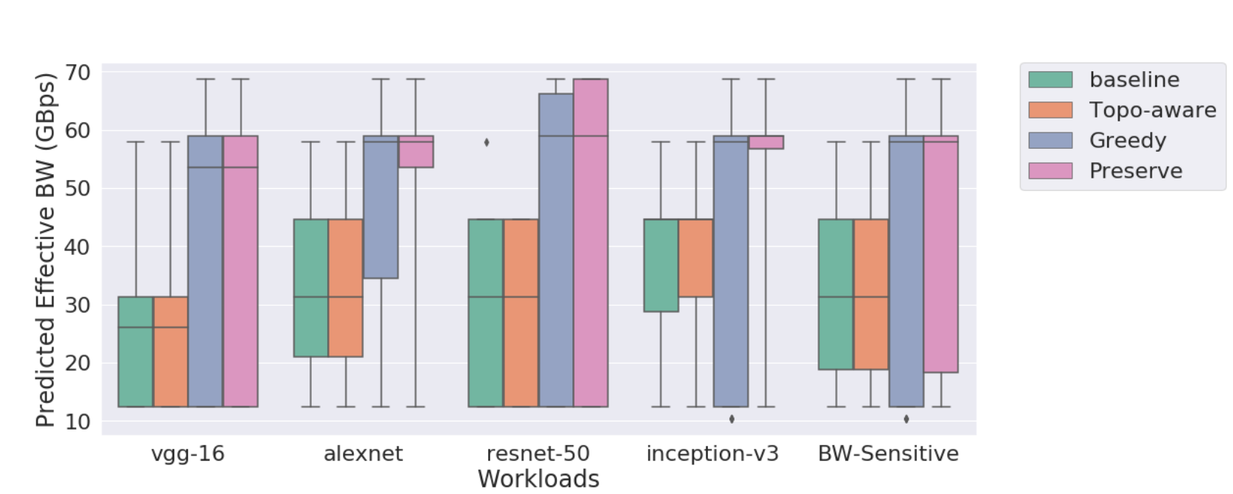
50% of jobs with MAPA have better bandwidth allocation than all jobs in Baseline/Topo-aware
Higher the better→
Notes:
Cusimann - annealing algorithm for global optimization
Gaussian Mixture Model (GMM)
Jacobi solver
BW Sensitive is a different

Slide 31
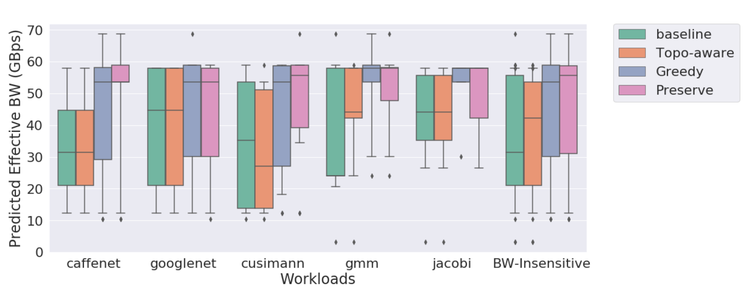
Preserve policy does not starve insensitive workloads
Higher the better→
Notes:
Cusimann – CUDA simulated annealing algorithm for global optimization
Gaussian Mixture Model (GMM)
Jacobi solver
We did not worsen the bandwidth for insensitive
BW Sensitive is a different

Slide 32
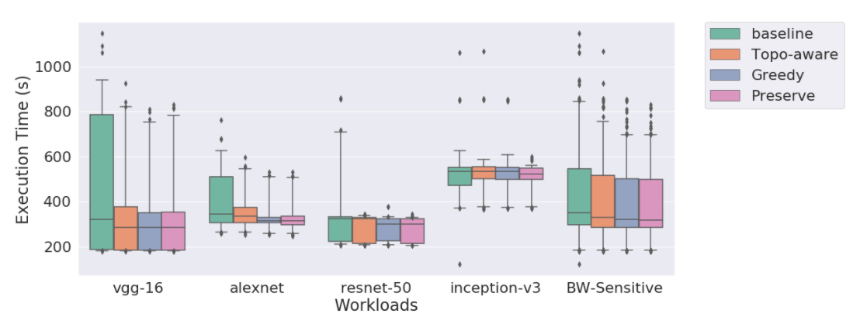
Reduced execution time with better allocations
Lower the better←

Slide 33
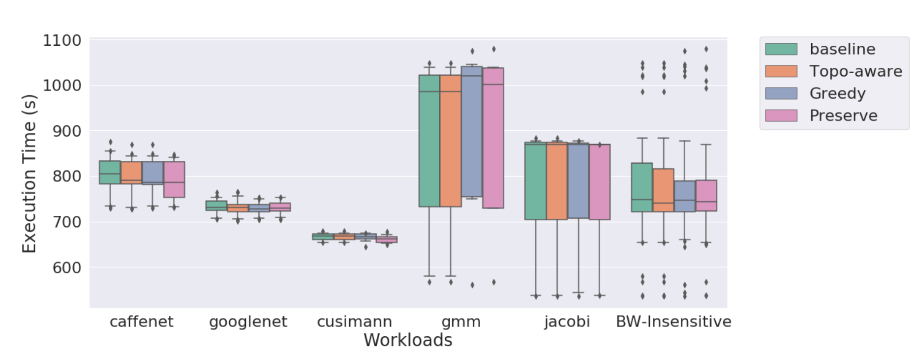
No performance degradation among
BW-insensitive workloads

Slide 34
System throughput improvement over baseline
Nearly 12% improvement with Preserve.
Notes:
Axis labels

Slide 35
Exploring future topologies

Slide 36
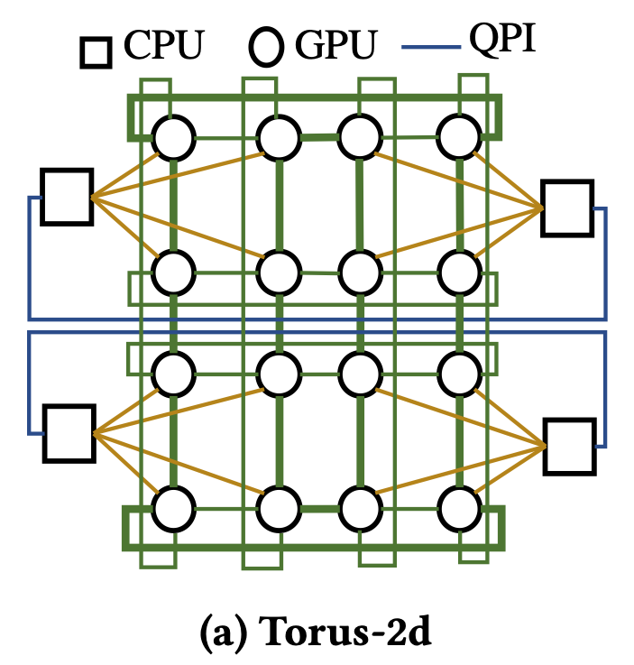
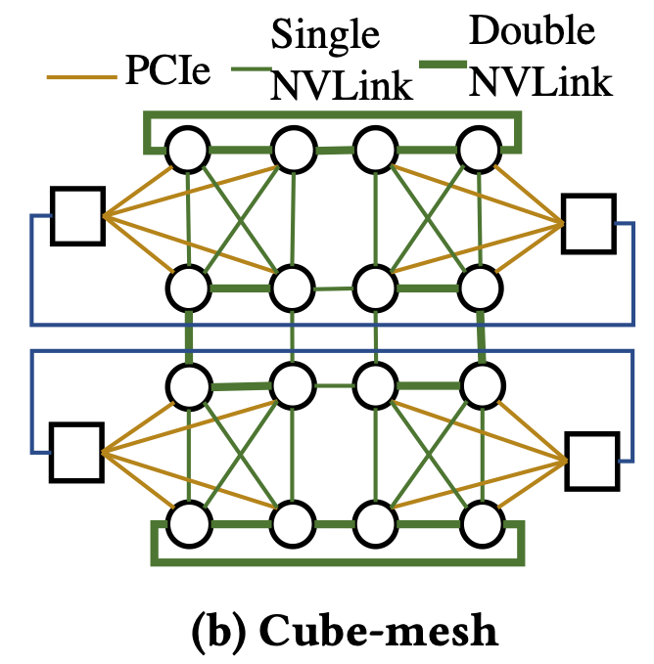
How will MAPA perform on future hardware topologies?
Simulate 16-GPU hardware topologies
Regular
Irregular

Slide 37
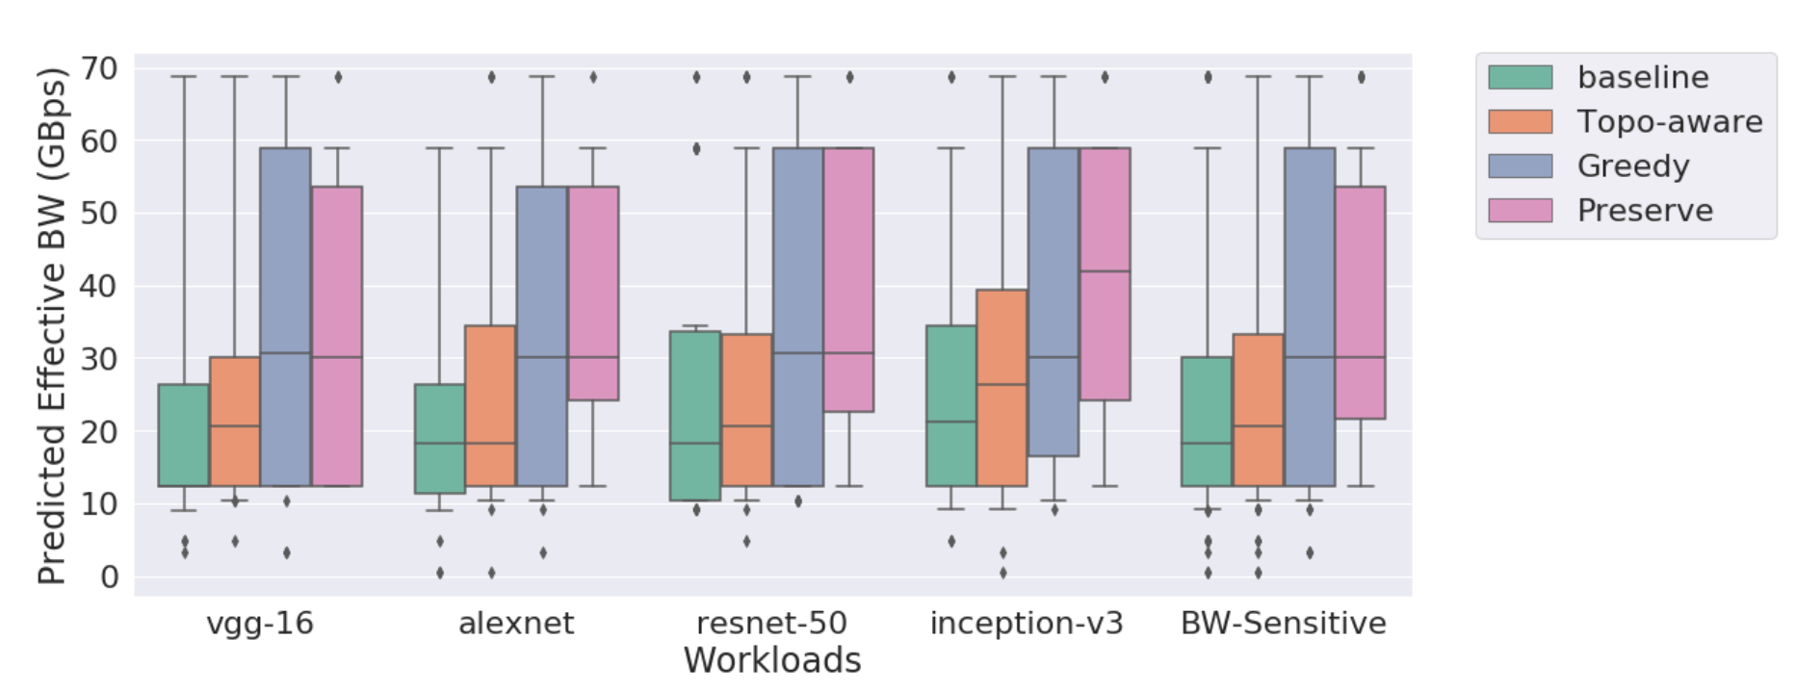
Improved Effective bandwidth in 16-GPU Torus-2d
Greedy performed better for 75% due to less irregularity in hardware topology

Slide 38
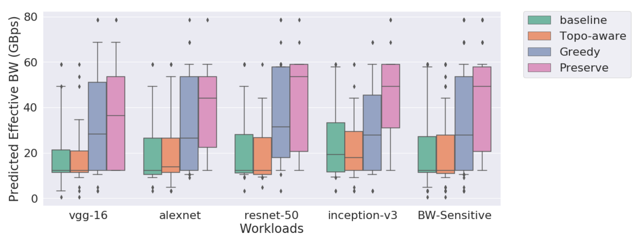
Improved Effective BW in 16-GPU Cube-mesh
Preserve performed better for 25%, 50%, and 75% due to more irregularity in hardware topology

Slide 39
Conclusion
Communication Links and topologies in multi-accelerator systems
  Increasingly becoming heterogeneous and complex
  Presents challenges in allocations (fragmentation)
Multi-Accelerator Pattern Allocation (MAPA) System
  Graph Pattern Matching approach
  Preserve allocation policy
    Pattern scoring metrics – Effective and Preserved Bandwidth
  12% system throughput improvement over baseline
  35% improved worst-case execution time over baseline
https://github.com/socal-ucr/mapa

Slide 40


Thank you!
Q & A

Slide 41
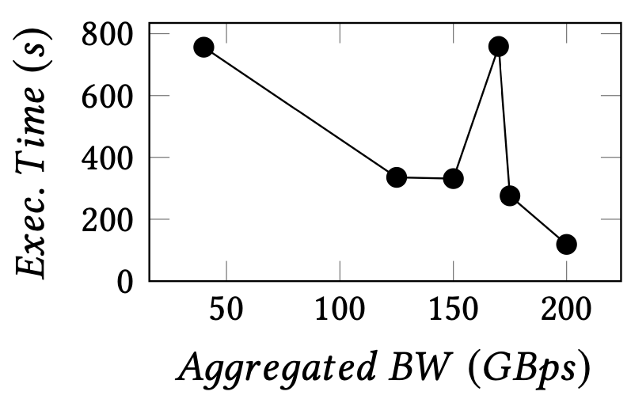
Better Agg_{BW} may not improve performance
Why?
VGG Training

Slide 42
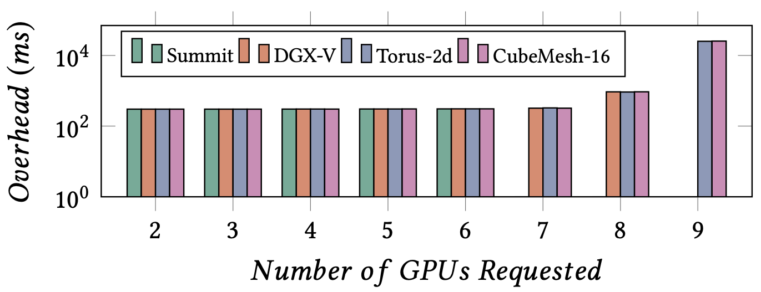
Overhead of pattern lookup
Overhead is in the order of hundreds of milliseconds
We observe moderate overheads when
  Application graphs have 9 or more edges and,
  Hardware graphs have 120+ edges
The statistics are upper-bound
Future optimization: Parallel scoring

Slide 43
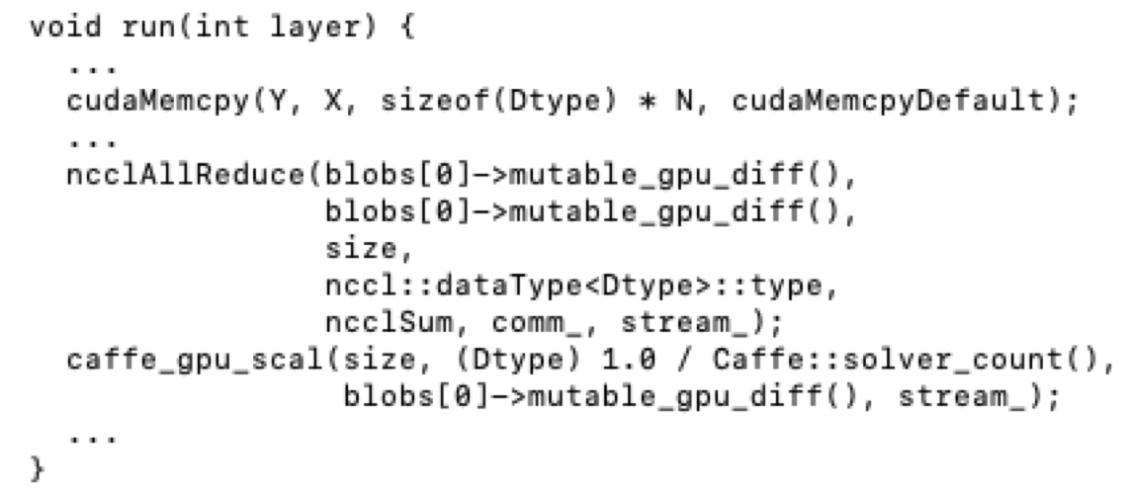
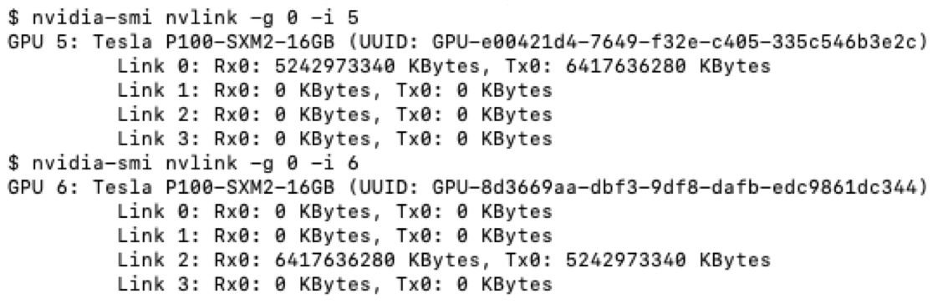
Extracting Application topologies
Source Code Analysis
  Identifying CUDA and NCCL APIs
Runtime Analysis
  Number of Nvlink packets

Slide 44
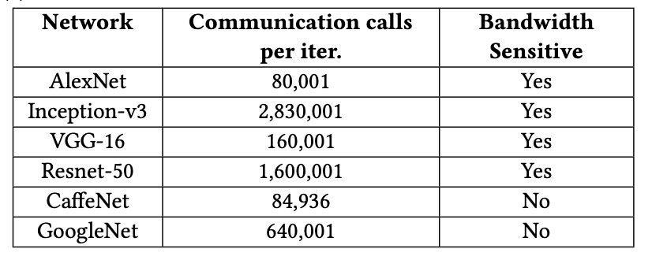
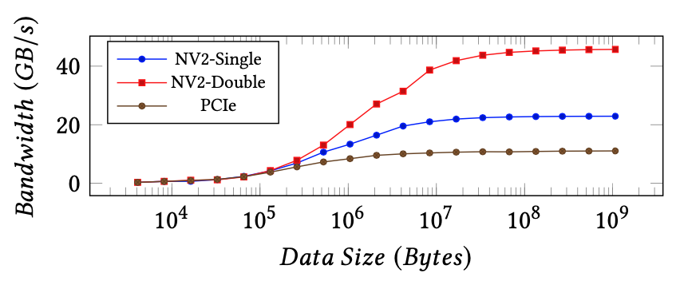
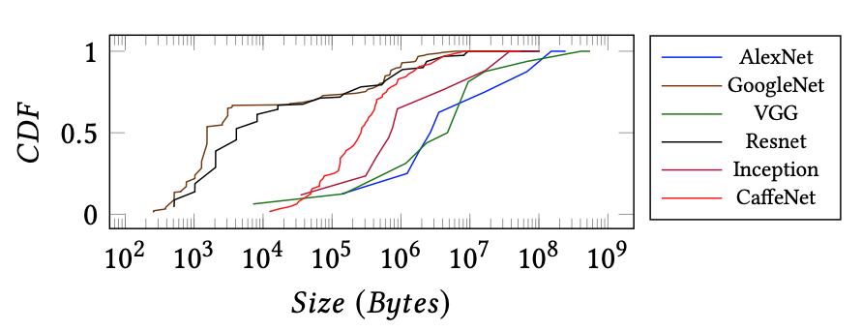
Determine BW sensitivity
More calls should have >10⁵ bytes
Enough number of calls to amortize

Slide 45
Greedy Allocation policy
App graph
HW graph
Graph Pattern Matching
Find Alloc with highest
Aggregated _{BW}
Allocation

Slide 46
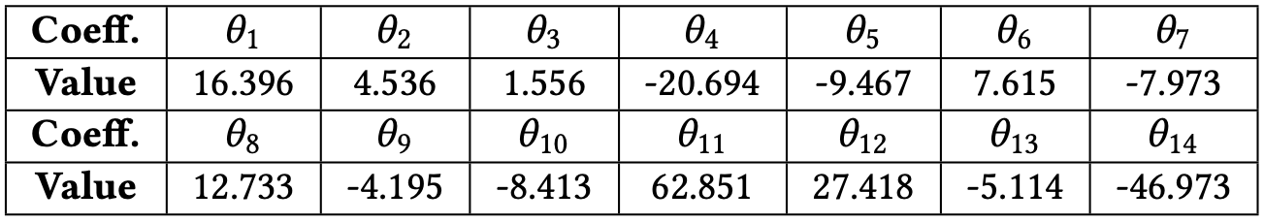
Predicted Effective Bandwidth
Running microbenchmarks not scalable
Non-linear regression to model effective bandwidth
  31 samples of possible 2, 3, 4, 5 GPU combinations
Linear
Inverse linear
Pairwise
Inerse pairwise
Calculated Weights
triplet
Inverse
triplet

Slide 47
Simulate future topologies and policies
Job File
ID, NumGPUs, Topology, BW Sensitive
1, 3, Ring, True
2, 4, Tree, False
….
Hardware graph
Hardware Topologies
  More accelerators
Application Topologies
  Different communication patterns
Allocation Policies
  Pattern scoring
MAPA Simulation framework
Log File
ID, Allocation, Topology, Effective BW (GBps)
1, (1,2,3), Ring, 45
2, (5,6,7,8), Ring, 48
….

Slide 48

Simulation Framework
Hardware graph
Job File
ID, NumGPUs, Topology, BW Sensitive
1, 3, Ring, True
2, 4, Ring, True
3, 5, Tree, False
4, 4, AllToAll, True
….
A mechanism to explore novel
  Hardware Topologies
    Cost-effective
    Point-to-point
  Application Topologies
  Allocation Policies
1
2
6
5
4
3
7
8
Update
(Allocate/
Deallocate)
Retrieve
Available
HW graph
Job Queue
Dispatcher
 |  |  |  | 6 | 5 | 4 | 3
App Graph
MAPA
Job Finished
Job
Start
Simulation Execution Engine
Job Finished
1 | 2 | 6 | 5
4 | 3 | 7 | 8
Allocation
Job ID: 1
Job ID: 1
Job ID: 2
Job ID: 2
Allocate
Deallocate
Job ID: None
Job ID: 1
Job ID: 2
Job ID: 2
Log File
ID, Allocation, Topology, Effective BW (GBps)
1, (1,2,3), Ring, 45
2, (5,6,7,8), Ring, 48
….

Slide 49
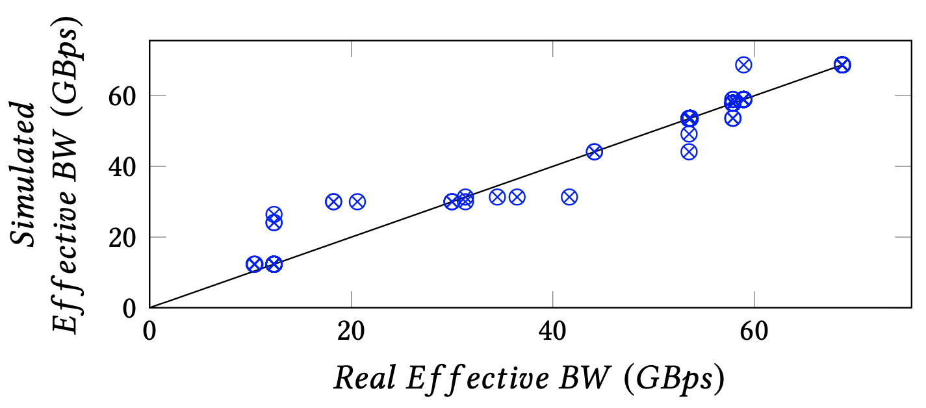
Evaluating MAPA Simulation framework
Effective_{BW} obtained during real and simulations correlate

