Slide 1


G-SEPM: Building an Accurate and Efficient Soft Error Prediction Model for GPGPUs
Hengshan Yue†, Xiaohui Wei†, Guangli Li*, Jianpeng Zhao†, Nan Jiang† and Jingweijia Tan†
† College of Computer Science and Technology, Jilin University
* SKL Computer Architecture, ICT, CAS

Slide 2
Outline
Background & Motivation
Fault Site Error Characterization
G-SEPM Framework
Evaluation
Use Case & Discussion
Conclusion & Future Work

Slide 3
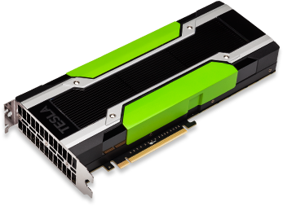


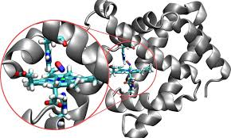

GPGPU
GPUs = Graphics Processing Units
High computational throughput
Popular in general-purpose computing
  i.e., GPGPUs
Financial application
Machine Learning
Simulation
Autonomous vehicles

Slide 4

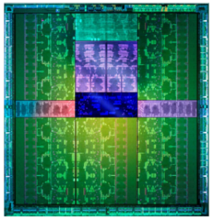




Reliability Challenges in GPUs
GPUs are originally designed for graphic applications
  Error detection and fault tolerance are ignored
General-purpose HPC programs require strict execution correctness
Reliability is a growing challenge in GPU architecture design

Slide 5

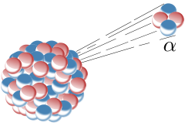
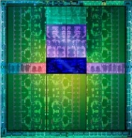
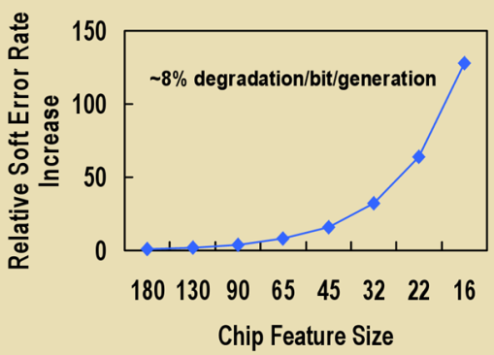
Soft errors in GPGPUs
Caused by high energy neutrons or α-particle strikes
  Flip the device state (0→1 or 1→0)
Lead to data corruption
  Circuits are not damaged
α-particle
neutron
GPUs are highly vulnerable to soft errors attacks
  E.g.,8 soft errors in a 72-hour run of GPU programs [Maruyama, IPDPS’10]
S. Borkar, Designing reliable systems from unreliable components: the challenges of transistor variability and degradation, IEEE Computer Society, 2005

Slide 6
Fault Injection
Fault Injection (FI) is the common practice to understand the resilience of programs toward soft errors.
  Randomly injecting errors to a subset of the program's fault sites
  E.g., SASSIFI, G-SEAP, GPU-Qin…
Limitations of Current FI Frameworks
Consuming tremendous resources- and time-overhead
Unable to find all the error-critical fault sites of programs

Slide 7
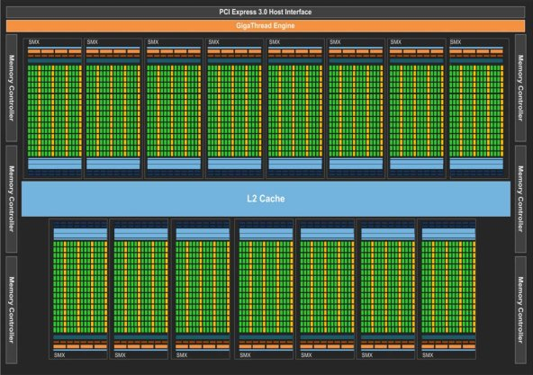
Contributions
G-SEPM: building a GPGPU-based Soft Error Prediction Model to estimate the resilience characteristic of individual fault sites.
CORE IDEA :
identifying GPGPU-specific features relevant to fault site error resilience
leveraging heuristic features to drive the ML model for error estimation
Achieving an average accuracy of 93.92%
Covering 95.99% of critical fault sites
Obtaining a speedup of 6557𝑋 over baseline FI

Slide 8
Background: GPGPU Architecture
warp
SM: Streaming Multiprocessor SP: Streaming Processor

Slide 9
Background: Fault Model
Error manifestation model:
Critical fault site
The symptom of the corrupted program reveals the resilience (or vulnerability) profile of the corresponding fault site.

Slide 10
Outline
Background & Motivation
Fault Site Error Characterization (Determining an Effective Set
of Resilience-relevant Features)
G-SEPM Framework
Evaluation
Use Case & Discussion
Conclusion & Future Work

Slide 11
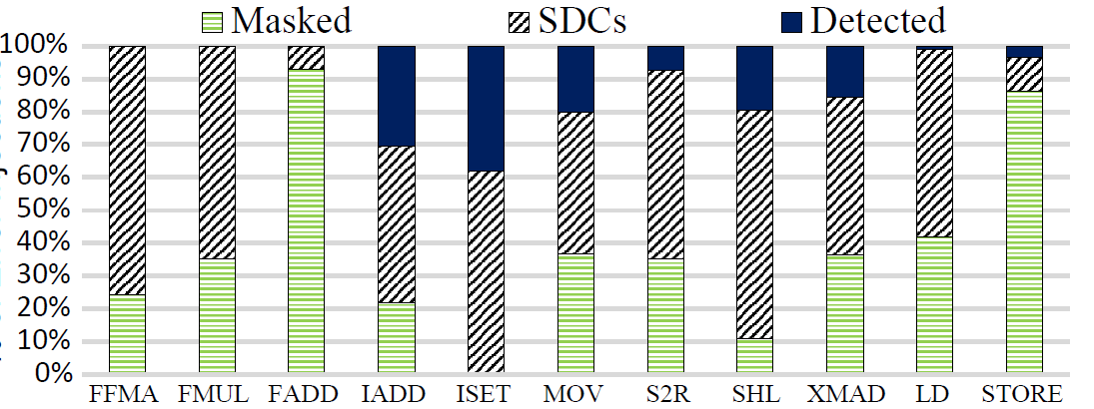
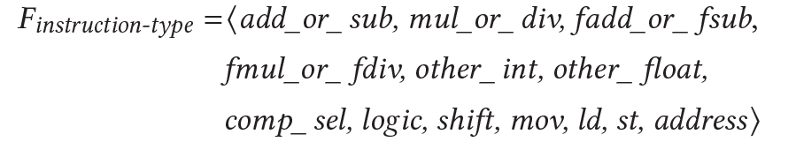
Observation 1: Impact of Instruction-type
Floating-point instructions(e.g., FFMA, FMUL) → SDCs
Integer instructions (e.g., IADD, ISET) → Detected.
Data movement and shift operations are sensitive under soft error attacking.
STORE instructions are resilient to soft errors due to storing “dead-data” in the loop regions.

Slide 12
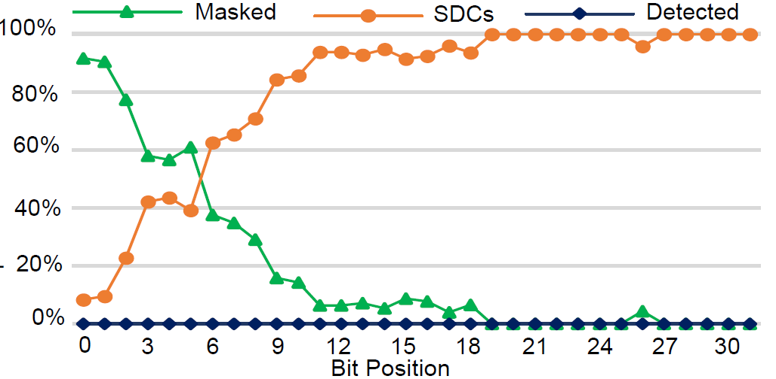
Observation 2: Impact of Bit-position
Higher bit-positions are more critical
The difference between the original data and the corrupted data tends to be larger

Slide 13
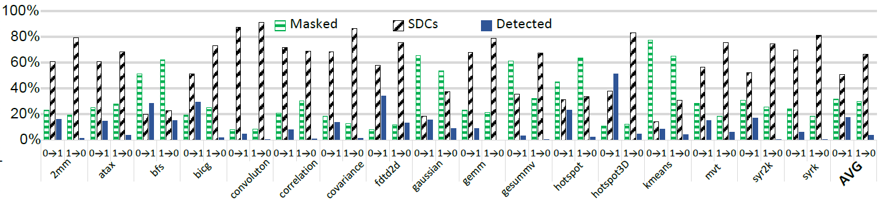
Observation 3: Impact of Bit-flip Direction
Almost all Detected cases are caused by (0→1) flips.
(1→0) has a higher probability of causing SDCs cases than (0→1).

Slide 14
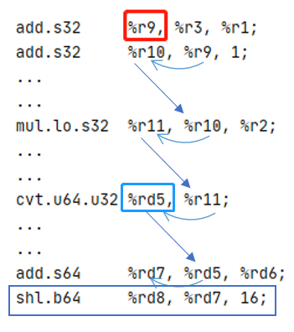
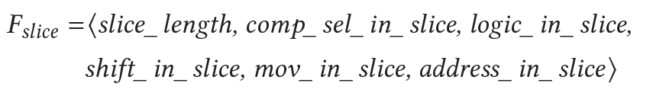


Observation 4: Impact of Error Propagation
Error propagates along the data dependency chain (program slice)
  E.g., corrupted 𝑟₉ will cause program illegal address access by propagation
Shared memory complicates error propagation
  Leading up to ∼60% corruption of memory states
Resilience commonality among parallel threads
  Identical control flow→ similar resilience profile

Slide 15
Putting It All Together
𝑣 =⟨𝐹_{instruction-type,} 𝐹_{bit-position,} 𝐹_{bit-flip-direction,} 𝐹_{slice,} 𝐹_{shared,} 𝐹_{commonality} ⟩
Our goal is to perform fault site error prediction in terms of these features

Slide 16
Outline
Background & Motivation
Fault Site Error Characterization
G-SEPM Framework
Evaluation
Use Case & Discussion
Conclusion & Future Work

Slide 17
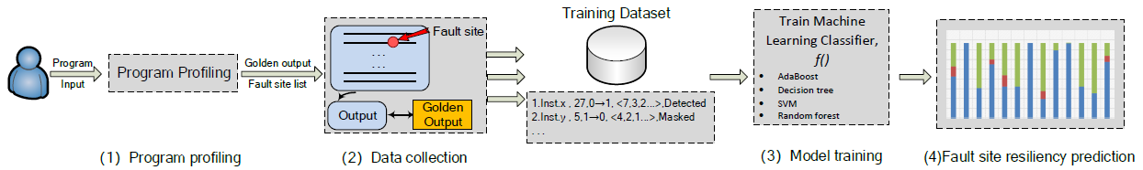
G-SEPM Framework
G-SEPM mainly consists of four steps:
G-SEPM does not need any FI to apply new fault sites once the model is trained.
Program Profiling
Generating the golden output
Identifying all fault sites
Data Collection
𝐹_{instruction-type}
𝐹_{bit-position}
𝐹_{bit-flip-direction}
𝐹_{slice}
𝐹_{shared}
𝐹_{commonality}
Model Training
SVM
AdaBoost
Decision tree
Random Forest
Fault Site Resiliency Prediction
𝑅𝑒𝑐𝑎𝑙𝑙
𝑃𝑟𝑒𝑐𝑖𝑠𝑖𝑜𝑛
𝐹 1 𝑆𝑐𝑜𝑟𝑒

Slide 18
Outline
Background & Motivation
Fault Site Error Characterization
G-SEPM Framework
Evaluation
Use Case & Discussion
Conclusion & Future Work

Slide 19
Research Questions
We evaluate G-SEPM by performing the following research questions:
𝑅𝑄1: What is the accuracy of G-SEPM for individual fault sites error estimation?
𝑅𝑄2: How close is the overall error profile of a program measured by G-SEPM to the ground truth FI ?
𝑅𝑄3: How many critical fault sites can be identified by G-SEPM?

Slide 20
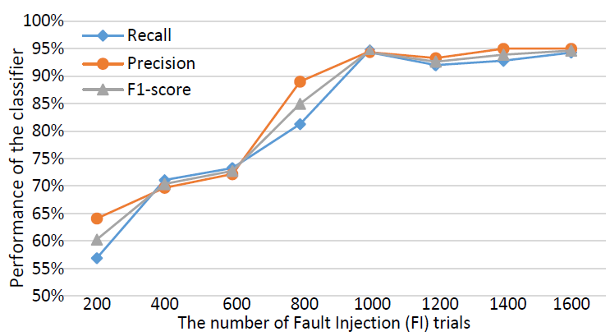
Prediction Accuracy (𝑅𝑄1)
Exploring the minimum number of FI
1000 FI trials are sufficient to train the G-SEPM.

Slide 21
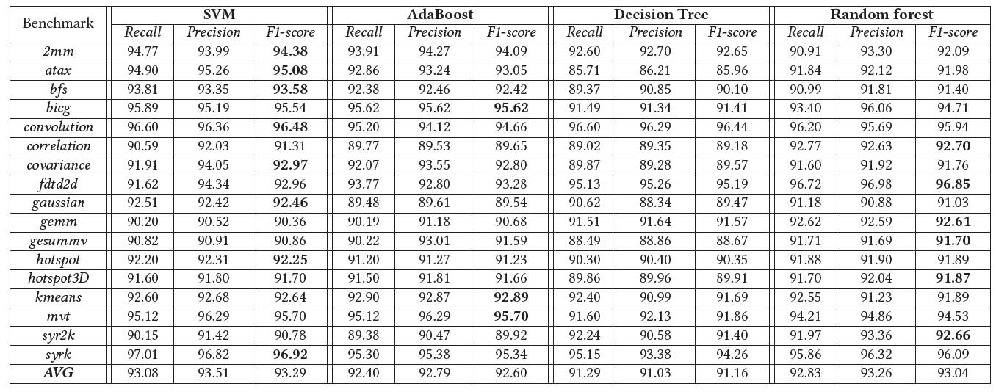
Prediction Accuracy (𝑅𝑄1)
Average accuracy achieves 93.92%
High accuracy on simple/well-known classifiers indicates our identified features are efficient for error characterization.

Slide 22
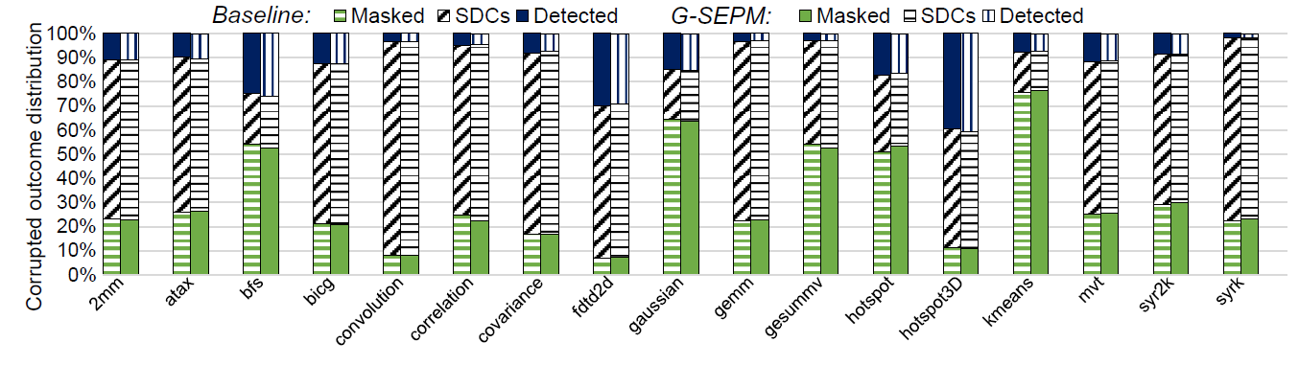
Overall Error Profile Evaluation (𝑅𝑄2)
The difference in terms of the percentage of Masked, SDCs, and Detected comparing with baseline (performed by 60K random FI) are merely 0.80%, 0.79%, and 0.43%, respectively.

Slide 23
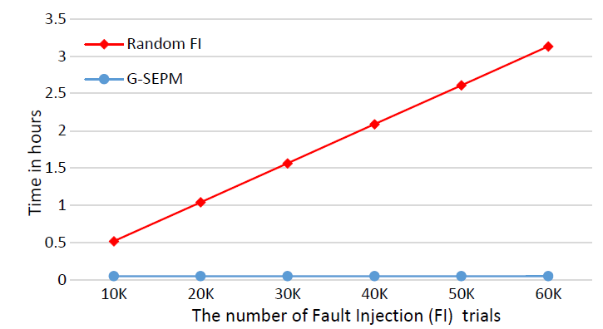
Overall Error Profile Evaluation (𝑅𝑄2)
Overhead Comparison
G-SEPM is 58.49 times faster than baseline 60K-FI (carrying out the data collection and training process online)
Once the model is trained, G-SEPM is ∼ 6557𝑋 faster than FI

Slide 24
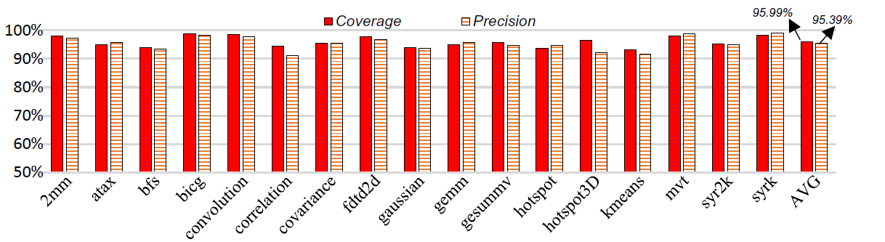
Identifying Critical Fault Sites (𝑅𝑄3)
G-SEPM can cover 95.99% of critical fault sites with 95.39% precision

Slide 25
Outline
Background & Motivation
Fault Site Error Characterization
G-SEPM Framework
Evaluation
Use Case & Discussion
Conclusion & Future Work

Slide 26
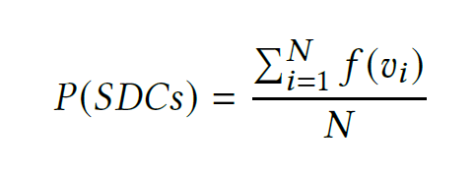
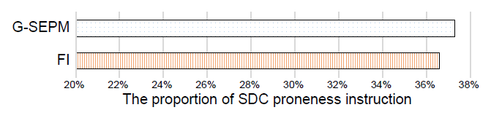
SDC proneness instructions identification
Efficiently estimating the SDC probability of a static instruction:
The difference compared with FI is merely 0.7%

Slide 27
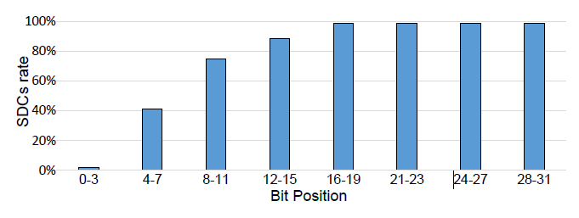
Bit-wise Insights
G-SEPM→ the first individual fault sites (i.e., bit-wise) resilience estimation model
Observation: Lower bit position has lower chances of causing SDC even in the SDC proneness instruction
  Guidance for efficient, reliable execution unit design

Slide 28
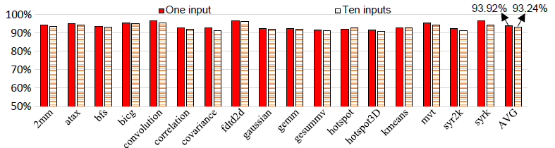
G-SEPM Generalization
Achieving 93.24% accuracy by capturing training samples from 10 different inputs
Exhibiting an average of 85.12% prediction accuracy for unseen applications
  Miss-identification for Masked cases
  Computation pattern/data flow discrepancy among programs
Recommending building application-specific model

Slide 29
Outline
Background & Motivation
Fault Site Error Characterization
G-SEPM Framework
Evaluation
Use Case & Discussion
Conclusion & Future Work

Slide 30
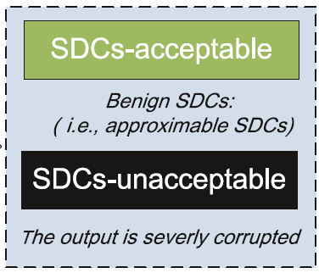
Conclusion & Future Work
Main contribution:
Proposing critical heuristic features for fault site resilience characterization.
Building a framework named G-SEPM that is able to estimate the resilience characteristic of individual fault sites in GPGPU.
Demonstrating how we can leverage G-SEPM to provide insights for efficient protection schemes
Future Work:
Extending G-SEPM for accuracy-aware resilience estimation
2. Designing effective soft error elimination technologies
Some SDC can be used as approximate results

Slide 31
Thanks for your attention!
Hengshan Yue
yuehs18@mails.jlu.edu.cn

