Slide 1

TensorKMC: Kinetic Monte Carlo Simulation of 50 Trillion Atoms Driven by Deep Learning on a New Generation of Sunway Supercomputer
Xin Chen
Institute of Applied Physics and Computational Mathematics
Beijing, China
Notes:
Hello everyone, I am Xin Chen from Institute of Applied physics and computational mathematics. Today it’s my honor to give you the presentation about our paper: TensorKMC, kinetic monte carlo simulation of 50 trillions of atoms driven by deep learning on a new generation of sunway supercomputer.

Slide 2
The presenter: Xin Chen
Ph.D. degree in chemistry from Tsinghua University in 2018
Assistant professor at the Institute of Applied Physics and Computational Mathematics, focusing on materials modeling and equation of state
The leader of TensorKMC (AI-assisted atomic kinetic monte carlo codes) and TensorAlloy (flexible tensor-based codes for modeling interactions of metals and alloy)
Notes:
First, let me introduce myself
I obtained Ph.D. degree in computational chemistry from Tsinghua University in 2018. Then I joined Institute of applied physics and computational mathematics as an assistant professor.
Curently my work focuses on materials modeling and equation of state.
I am the leader developer of two programs: TensorKMC and TensorAlloy.
This presentation I will give a detailed introduction of TensorKMC.

Slide 3
1
Background
2
Related works
3
Key innovations
4
Performances
5
Application
Notes:
The presentation is organized as follows:
First I will introduce the background, the theory and application of Kinetic Monte Carlo
Then I talks about related works.
Next, key innovations and performances will be introduced.
Last is a demo application of our program.

Slide 4
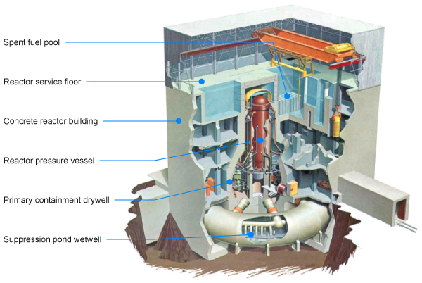
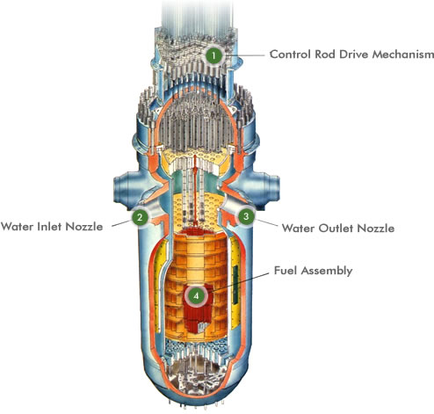
Reactor pressure vessel
Reactor pressure vessel (RPV) plays a critical role in safety of nuclear powerplant
RPV is unsubstitutable
RPV cylinder shell is the life-time limiting component for a nuclear reactor
Notes:
Nuclear energy now provides about 10% of the world's electricity from about 440 power reactors.
Nuclear is the world's second largest source of low-carbon power (29% of the total in 2018).
For a nuclear powerplant, reactor pressure vessel, RPV, is one of the most important component.
It plays a critical role in safety of nuclear powerplant.
However, RPV is unsubstitutable and it operates on harsh conditions. Thus, the RPV cylinder shell material is often the lifetime-limiting component for a nuclear reactor.

Slide 5
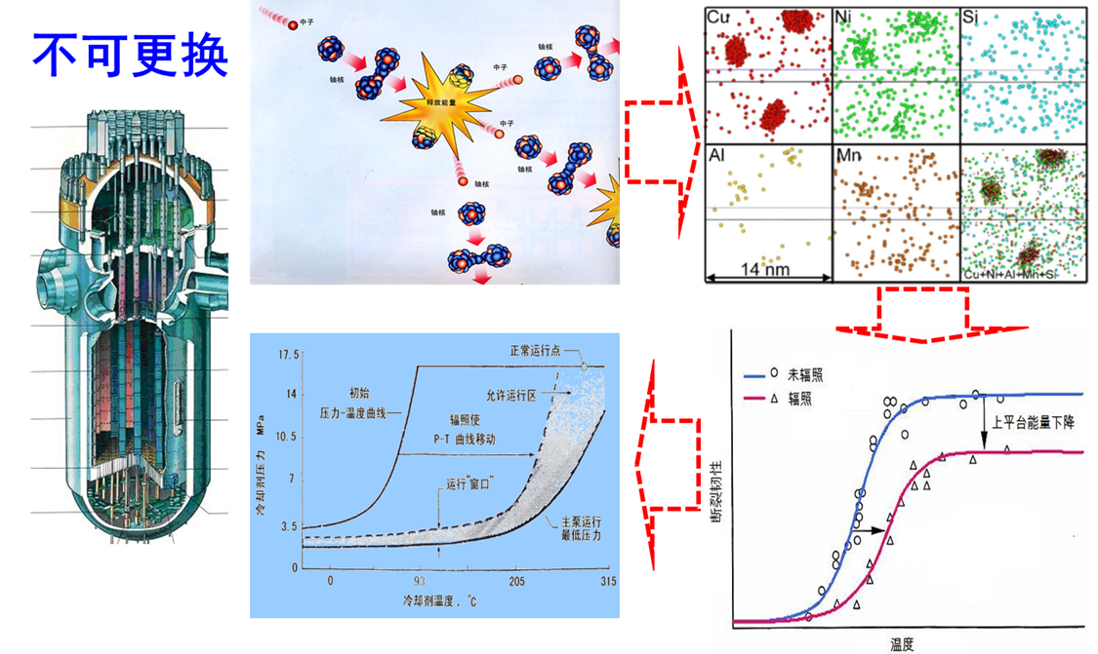
RPV aging
The shell, primarily Fe-based alloy, is constantly bombarded by high-energy particles
Defects accumulated over time, voids, bubbles, dislocation loops or lines, etc, formed
Atoms segregate or aggregate
Radiation hardens materials, but also lowers ductility
  Losing ductility may lead to catastrophic failure without warning
Notes:
Stainless steel is currently the most widely used materials for cylindrical shell of RPVs.
The materials is constantly bombarded by high-energy particles.
The alloy atoms segregate or aggregate.
Defects formed and accumulated. Both the hadrness and brittleness are gradually increasing.
Losing ductility is crucial for RPV because unexpected catastrophic failure may occur.
Thus, understanding the effects radiation on the microstructure in addition to the physical and
mechanical properties will allow scientists to design alloys more resistant to radiation damage.

Slide 6
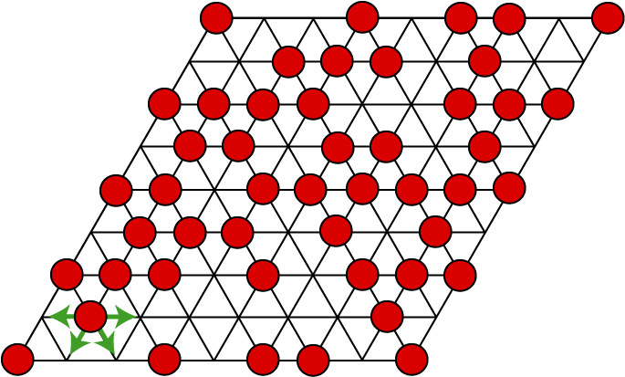
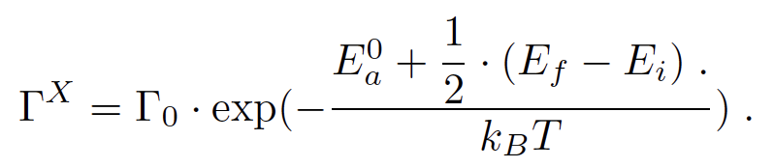
Atomic Kinetic Monte Carlo
Experimentally invetigating radiation-induced aging is difficult
Theoretical study is also a challenge:
  Phenomenons occured atomic level, accurate atomic modeling is required
  Timescale is extremely large, molecular dynamics is not applicable
Atomic kinetic monte carlo (AKMC): a combination of atomic modeling with meso-scale simulation
 | AKMC
Spatial | nm - μm （10⁴ – 10⁷ atoms/proc）
Time | μs, s or longer
Driven by | Energy
Atoms | Always on lattice sites
Notes:
Direct experiment on radiation induced aging is obvously difficult, dangerous and costy.
However, theoretical study and simulation is also a challenge.
Many aging phenomenons closely relate to microstructural changes at atomic level. Accurate modeling approaches at atomic level are required.
But aging is a very slow process. Such changes may occur at the timescale of seconds or even longer. Hence, molecular dynamics is not applicable here.
Currently, atomic kinetic monte carlo, or AKMC, is one of the most promising method for studying mechanisms of various kinetic processes, including irradiation,
defect diffusion, cracking, and solute precipitation, in a wide variety of materials.
AKMC maps hop events to changes in the states lattice sites, provides feasibility for simulating systems of micron size with atomic resolution.

Slide 7
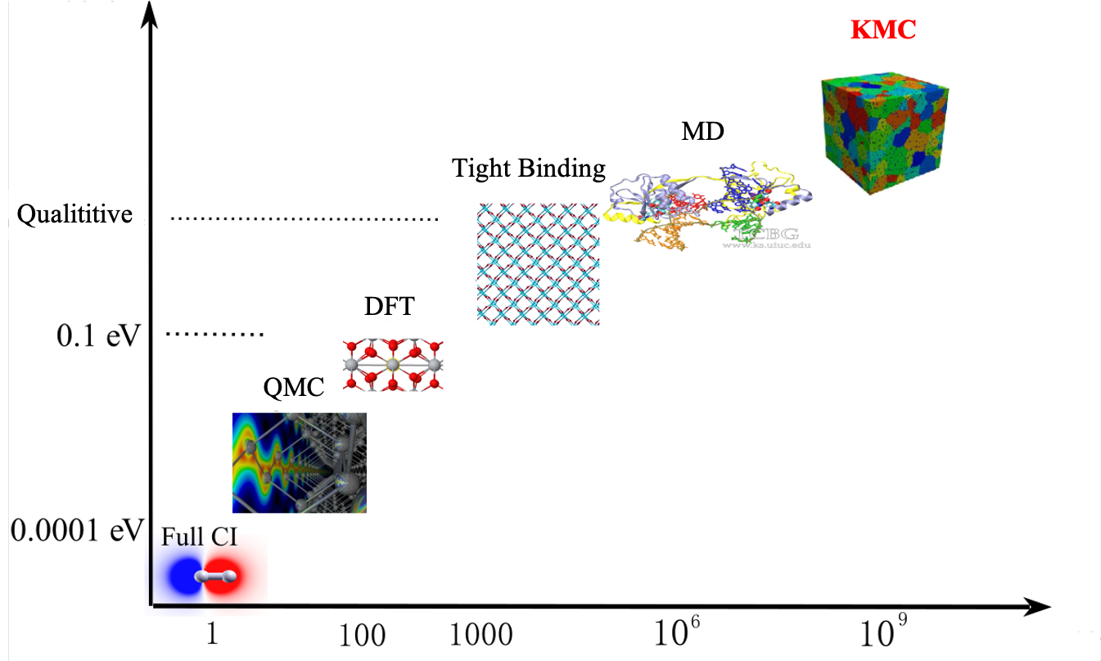
Atomic Kinetic Monte Carlo
Traditionally AKMC is a qualititve simulation method as it often uses simplified interaction models
Massively-paralleled AKMC with highly accurate energetic approach is needed for realistic modeling
?
KMC
Notes:
However, it remains problematic to widely apply the AKMC model to reproduce phenomena at realistic scales because of the complex interaction and kinetics of materials.
Traditionally, AKMC simulation uses simplified interaction models. These models can be established before AKMC simulation. Core models and parameters maybe
tabulated so that the simulation can be extended to experimentally revalent scale, but physical reliability is limited.
For a physically reliable AKMC simulation, interaction and kinetics process should be calculated during simulation with highly accurate theoretical approach .
It also must be applicable to large spatial systems.
Developing such AKMC program is both demanding and challenging.

Slide 8
The new generation of Sunway
Each SW26010pro many-core processor has 6 core groups (CGs)
Each CG has 1 MPE, 8x8 CPEs, 16 GB main memory
Each CPE has 256 kB high-speed manually controllable local device memory (LDM)
Notes:
Modeling materials at realistic spatial and temporal scales obviously requires a lot of computing resources.
Efficiently harnessing power of supercomputer is a fundamental requiste.
Luckily, we got a chance to work on the new generation of Sunway supercomputer.
The new generation of Sunway supercomputer equips with the new SW26010pro many-core processor.
Each processor has 6 core groups and each core group has 1 management processing el;ement, 64 computing processing elements and 16 gigabytes of main memory.
Each CPE has 256 kilobytes high-speed, manually controllable, local device memory.
Similar to the Sunway TaihuLight system, the new Sunway supercomputer adopts a new-generation of domestic high-performance heterogeneous many-core processors
and interconnection network chips in China.

Slide 9
1
Background
2
Related works
3
Key innovations
4
Performances
5
Application
Notes:
Next, I will discuss about related works.

Slide 10
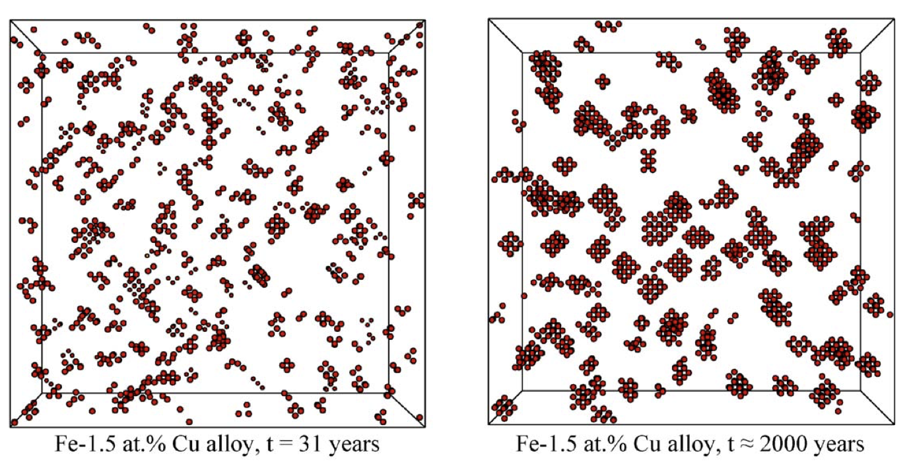
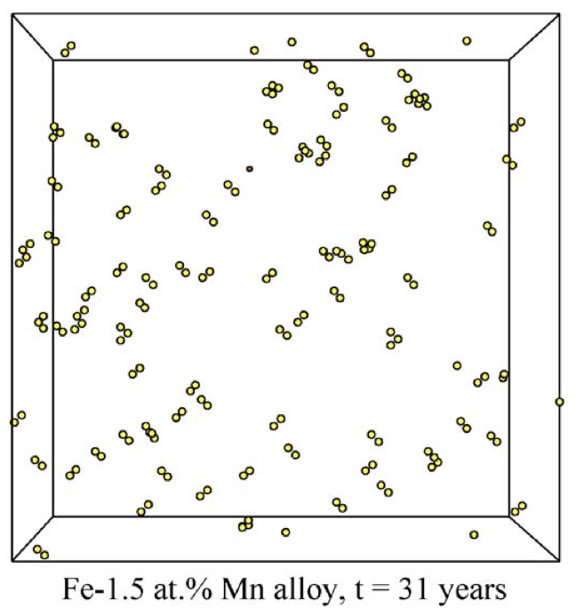
LAKIMOCA
Developed by Électricité de France (EDF), owner of 58 power plants in France
Capable of simulating long-term kinetics and atomic behaviors of dilute metal alloys
Serial, empirical potentials, hundreds of thousands of atoms
Vincent et al., J. Nuc. Mater. 2006, 351, 88-99
Notes:
LAKIMOCA code is a KMC as well as a Metropolis Monte Carlo package developed in standard C by Domain at EDF 1998.
LAKIMOCA has been used to study long-term kinetic behaviors of dilute metal alloys. But this program only has a serial version.
And it only supports modified empirical potentials.

Slide 11
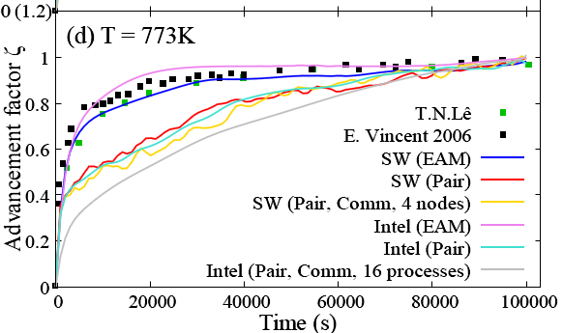
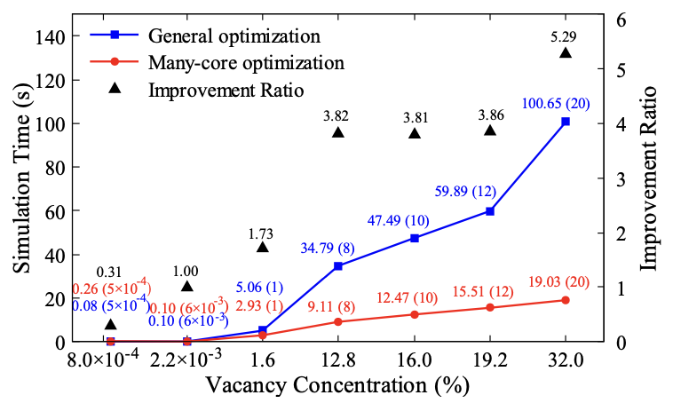
OpenKMC
Developed by Hong-Hui Shang and co-workers in 2019
Can simulate up to hundreds of billions of atoms with empirical potentials
Specially optimized for Sunway TaihuLight
Kun Li and Hong-Hui Shang et al. SC’ 19. doi: 10. 1145/3295500.3356165
Notes:
Hong-Hui Shang and co-workers developed a massively-parallel AKMC program for Sunway Taihulight, named OpenKMC in 2019.
It can simulate up to hundreds of billions of atoms with empirical potentials.

Slide 12
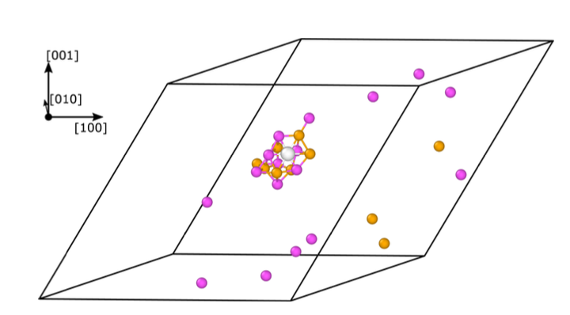
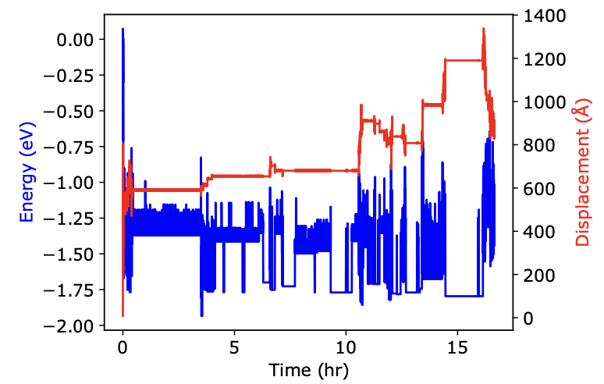
i-PI
i-Pi 2.0 is a universal force engine
Neural network potential based AKMC simulates natural aging behavior of Al-6xxx alloys (~1500 atoms)
Jahn et al. Phys. Rev. M. 2021, 5, 053805
Kapil et al., Comp. Phys. Comm. 2018, 236, 214–223
Notes:
Recently, Jahn published a work about simulating natural aging behaviors of the Aluminum alloy with AKMC based on the i-PI unversal force engine.
They uses an accurate neural network potential. But the AKMC simulation itself is serial.
In a conclusion, massively-parallel AKMC program with accurate interation modeling is still missing.

Slide 13
1
Background
2
Related works
3
Key innovations
4
Performances
5
Application
Notes:
The third part of this presentation is the introduction of TensorKMC and its key innovations.

Slide 14
TensorKMC
TensorKMC is a massively parallel AKMC program integrated with highly accurate neural network potentials
  TensorAlloy: an automatic atomistic neural network program for metals and alloys
    Comput. Phys. Commun, 2020, 107057
    Comput. Phys. Commun, 2021, 108132
  OpenKMC: a KMC Design for Hundred-Billion-Atom Simulation Using Millions of Cores on Sunway TaihuLight
    SC’ 19. doi: 10. 1145/3295500.3356165
Major contributions:
  Triple-encodings and vacancy cache mechanism for largescale AKMC simulation
  Extremely fast NNP implementation algorithms for many-core processor
Notes:
TensorKMC is the first massively-parallel AKMC program.
TensorKMC is the integration of TensorAlloy and OpenKMC.
TensorAlloy is an automatic atomistic neural network program for metals and alloys. OpenKMC, introduced before,
is an AKMC program capable of simulating up to hundreds of billions of atoms.
In this work, we have two parts of major contributions:
The first part is AKMC algorithms, including the triple-encodings approach and the vacancy cache mechanism. These gurantee the ability of largescale simulation.
The second part is the NNP implementation algorithms for many-core processor. This part ensures the practical usability of TensorKMC.

Slide 15
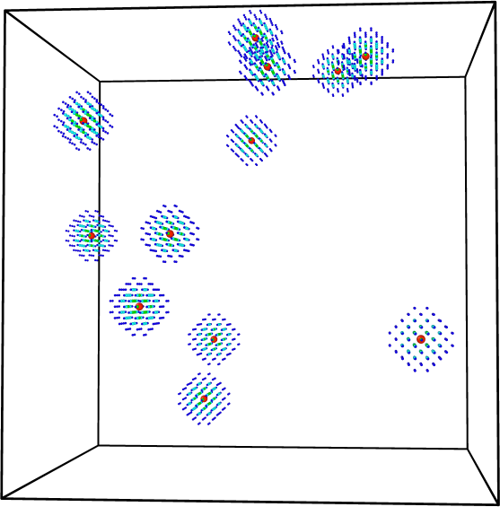
Triple-Encodings
Simulation domain of each process is large
Vacancy concentration is extremely low: 0.0001%-0.01%
Interatomic interaction has limited range, only atoms close to an active vacancy are “important”
Hence, a large simulation domain can be decomposed to discrete vacancy systems
 | AKMC
Spatial | nm - μm （10⁴ – 10⁷ atoms/proc）
Time | μs - s
Driven by | Energy
Atoms | Always on lattice sites
Illustration of domain decomposition
Notes:
The first key innovation is the triple-encodings algorothm.
This algorithm originates from special features of AKMC:
The simulation domain is much larger than MD. For example, OpenKMC can simulate up to 11 millions of atoms per process;
But it;’s the vacancy which plays the crucial role in dynamical evolution by causing random diffusion, even though vacancy concentration is usually low;
A basic kinetic process, a vacancy hop, only involves one vacancy and one of its first nearest neighbors.
The interatomic interaction has limited range.
Therefore, only a small portion of atoms should be invoked for computing the total energy of an AKMC system
Hence, a large simulation domain can be decomposed to discrete vacancy systems, as illustrated by the figure.

Slide 16
Triple-Encodings
How to effectively represent these vacancies and atoms?
Triple-Encodings: tabular arrays describing vacancy systems for BCC/FCC systems
  128 millions of atoms, 0.0008% vacancy concentration → 1024 vacancy systems
  Large randomly accessed array → small continous dense block
Notes:
Then the problem arises: how to effectively represent these vacancies and their nearby atoms?
In this work, we proposed a triple-encodings algorithm. This algorithm is applicable to BCC and FCC systems.
In this presentation we use BCC Iron-Copper system as an example.
Before we talk about the encoding algorithms, we should make clear the concept “vacancy system”.
Here “vacancy” system refers to a vacancy and its nearby atoms. A simulation domain may have several vacancy systems. Vacancy systems may overlap.
“triple encodings” are tabular arrays. There are three types of encodings:
CET, the relative coordinates array;
NET, the neighbor list array
And VET, the vacancy encoding array.
CET are relative coordinates of sites of a vacancy system. One should note that all lattice sites of BCC/FCC systems are geometrically equivalent.
Hence only one CET is required.
CET is a Nall-by-3 matrix. The center of this system,
locating at (0,0,0), is a vacancy. Given a Euclidean cutoff radius rcut, positions of neighbors of the center vacancy can be determined,
and they are colored as green in Figure A. The vacancy may jump to one of its eight nearest neighbors. Neighbors of these first nearest neighbor sites are all affected
by a site jump. These sites together forms the jumping region, colored in light blue in the figure.
The outer deep blue sites are just neighbors of sites in the region. Their energies will not change.
Based on CET, the three-dimensional array NET, describing neighbors indices and distances of each site in the jumping region, can be constructed.
For BCC/FCC systems, CET and NET only depend on lattice constant and cutoff radius, they are shared across all vacancy systems.
The last tabulation is VET, VET encodes real environments of a vacancy system.
The triple-encoding algorithm builds the foundation of TensorKMC. A huge simulation domain can be simplified to several small dense vacancy systems.
Only during the initialization of a VET should we access the large lattice array. Thus, further optimizations, including significant memory reduction and
distributing calculations on CPEs, become possible.

Slide 17
Vacancy cache and memory optimization
Cache mechanism: only properties of atoms of vacancy systems need to be kept
  Vacancy systems can be viewed as “big particles”
  Update properties of a vacancy system only if it is close to a jump
  OpenKMC stores properties of all atoms
Compute the 1D index of a spatial position (i, j, k)
  Applicable to BCC/FCC systems
  OpenKMC uses a 3D array
Overall memory cost reduces by ~66%
Notes:
The second key innovation is vacancy cache mechanism and memory optimization.
Benefit from the domain simplication introduced before, only vacancy systems are cached in TensorKMC.
For each vacancy system, the corresponding VET vector and global IDs of its sites are cached. After a vacancy hop or a sublattice synchronization,
euclidean distances between active site(s) and centers of vacancy systems in the simulation domain are calculated.
Vacancy systems close to the active site(s) will be updated during the next calculation.
On the contrary, OpenKMC had to store all essential atomic properties. This cache mechanism can save significant amount of memory.
Another major memory reduction comes from replacing the three-dimensional spatial mapping array with a direct calculation method.
As a results, overall memory cost of TensorKMC reduces to one third of OpenKMC.

Slide 18
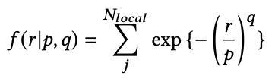

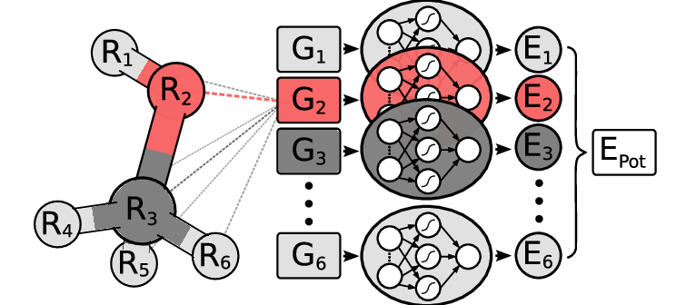
Atomic feature calculation
The general NNP scheme: atomic positions → atomic features → atomic energy
Atomic features are calculated with descriptor functions:
In AKMC, interatomic distances are enumerable
Tabular arrays can be used to compute features
 | AKMC
Spatial | nm - μm （10⁴ – 10⁷ atoms/proc）
Time | μs - s
Driven by | Energy
Atoms | Always on lattice sites
Notes:
The third key innovation is the CPE-based atomic feature calculation algorithm.
Gnerally speaking, to calculate atomic energies with a neural network potential,
atomic positions shall be transformed to translationally, rotationally and permutationally invariant atomic features.
These atomic features are feeded to neural networks as inputs. The outputs are atomic energies.
In NNP-based molecular dynamics simulation, atomic features are calculated by descriptor functions or machine learning models.
However, in AKMC we should note that atoms always locates on lattice sites. Thus, interatomic distances are enumerable.
Naturally we can use tabular arrays for computing features.
This seems a easy task, but for Sunway, we met a challenge.

Slide 19
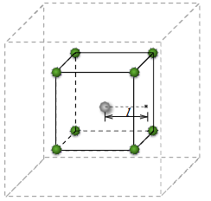
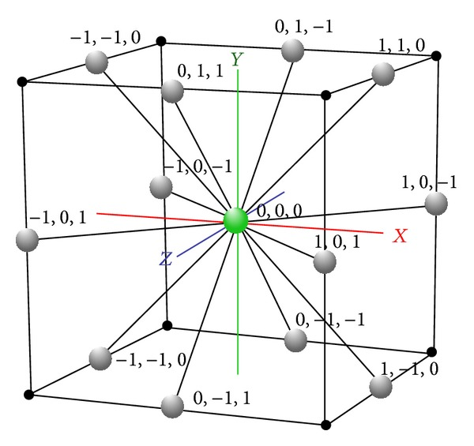
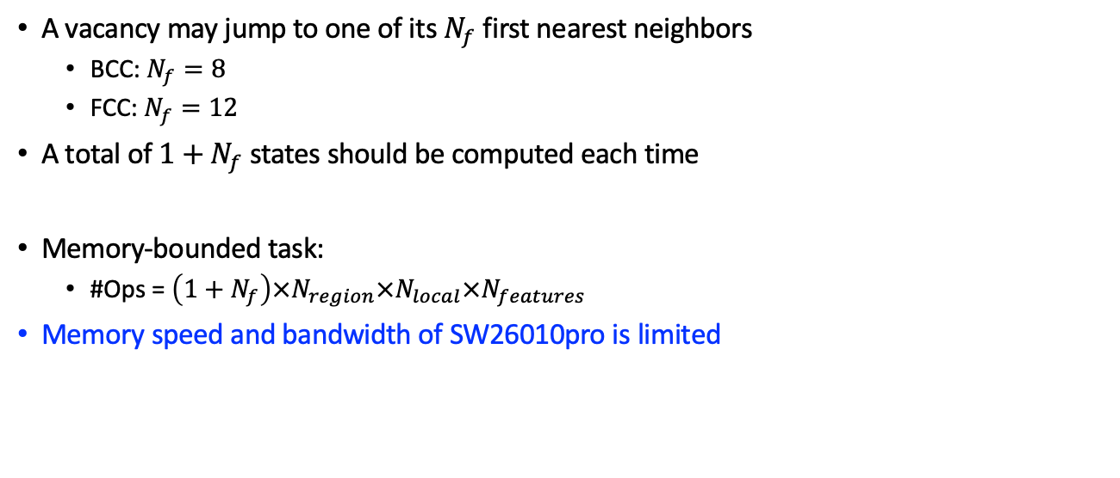
Atomic feature calculation
A vacancy may jump to one of its $N_{f}$ first nearest neighbors
  BCC: $N_{f}=8$
  FCC: $N_{f}=12$
A total of ${1+N}_{f}$ states should be computed each time
Memory-bounded task:
  #Ops = $\left(1+N_{f}\right)×N_{region}×N_{local}×N_{features}$
Memory speed and bandwidth of SW26010pro is limited
BCC
FCC
Notes:
In AKMC, a vacancy may jump to one of its first nearest neighbors. Let’s say Nf.
For BCC Nf equals to eight.
A total of Nf plus one states shall be computed for each vacancy system.
Thus, large numbers of memory operations should be done for computing atomic features.
However, memory speed and bandwidth of the new Sunway is limited. And MPE on the
new Sunway is not that powerfull compared with IBM or Intel CPUs

Slide 20
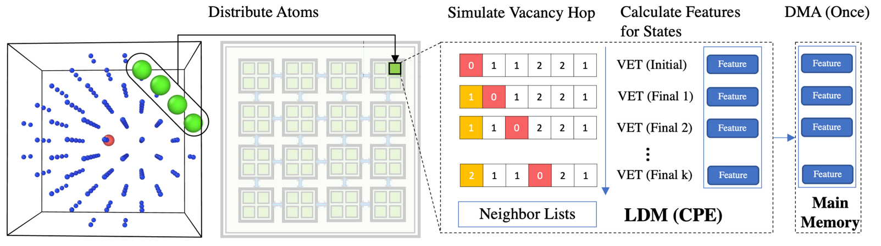
Atomic feature calculation
A parallel CPEs-based feature operator
Vacancy hopping simulation is moved to CPEs
Notes:
To overcome this challenge, we treat CPEs of each core group as normal processors and a micro parallel system is formed.
Atomic features are calculated in parallel on CPEs:.
The 𝑁𝑟𝑒𝑔𝑖𝑜𝑛 sites in a vacancy system are assigned to CPEs circularly. For each CPE, the NET array, a copy of the VET vector, and the precomputed TABLE are stored in LDM.
A total of 1 + 𝑁 𝑓 states will be performed on each CPE. The first loop computes the features for the initial state.
The following 𝑁f loops compute features for 𝑁f possible final states. For each final state 𝑘 , the corresponding vacancy hop is simulated by swapping VET
and re-organizing neighbor lists.
The generated features for 1 + 𝑁𝑓 states are all kept in LDM until all done. These data are then sent back to the main memory with a direct memory access operation.

Slide 21
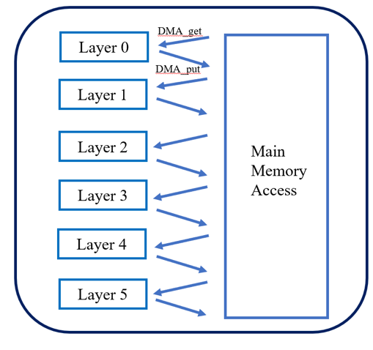
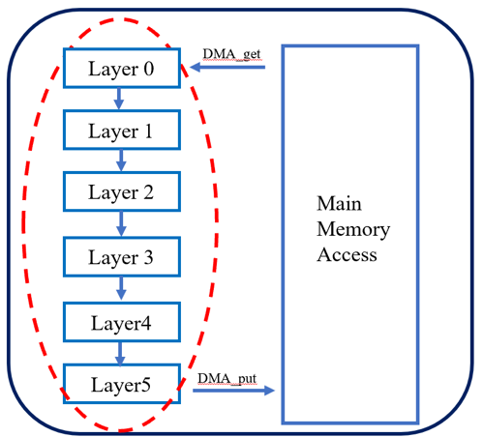
Energy calculation
The energy calculation is achieved by a multi-layer convolutional neural network
  Each batch corresponds to a state
SW officially provides a highly-optimized DNN library (SWDNN)
  Requires massive data exchange between CPEs and the main memory
The big-fusion strategy
  Minimize memory access
  Hide data exchange behind computation
SWDNN
The big-fusion
Notes:
Now we talk about the last key innovation, the energy calculation.
With atomic features as inputs, energies can be calculated with a multi-layer convolutional neural network.
Each batch corresponds to a state.
Sunway officially provides a highly optimized DNN libraray, the implementation is fast, but not fast enough.
Massive data exchange between CPEs and the main memory is required.
If the network has N layers, 2N DMA operations will be performed. The bandwidth significantly limits the overall speed.
To further accelerate the calculation, we proposed a big-fusion strategy.
The ultimate goal is to minimize memory access and hide data exchange behind computation.
In our big-fusion strategy, only two DMA are required, as shown in this figure.

Slide 22
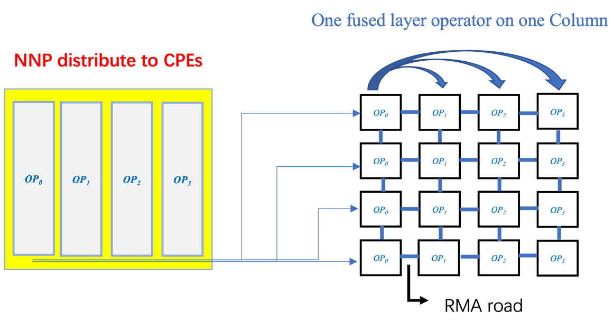
Energy calculation: the big-fusion strategy
CPEs act as “normal” cores
LDM act as distributed storage: NNP parameters are dispatched to CPEs
Parameter sharing across CPEs is achieved by remote scratched memory access (RMA)
Notes:
In the big fusion strategy, CPEs are viewed as normal cores.
The local device memory of CPEs are used as distributed storage. NNP parameters are saved in LDM.
Remote scratched memory access is used for sharing parameters across CPEs.

Slide 23
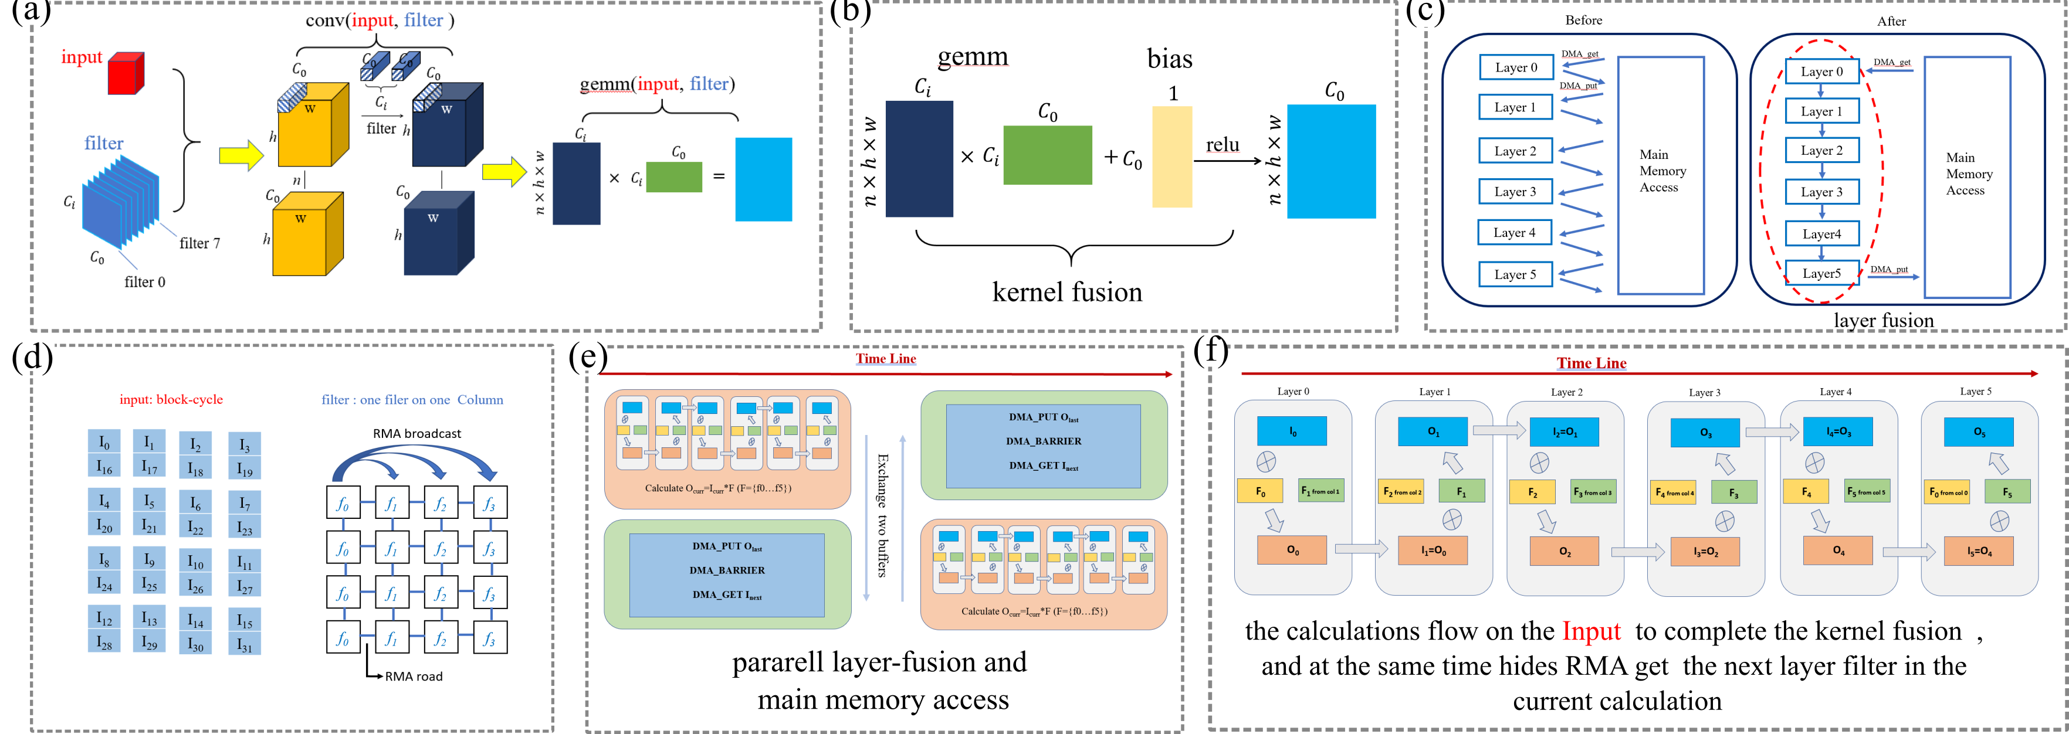
Energy calculation: the big-fusion strategy
Notes:
Inside the calculation of each multi-layer convolutional neural network, a fusion strategy is adopted.
For layer k, the calculation of k and RMA based data fetching of layer k plus one executes simultenously
The cost of data exchange is successfully hided

Slide 24
Energy calculation: the big-fusion strategy
Notes:
The same logic is also applied to the outer loop.
For state k, the calculation of the multi-layer convolutional neural network executes simultenously with DMA operations, including putting k minus one back and fetching k plus one.
the big-fusion operator can reach seventy-six of the single precision peak at most.

Slide 25
1
Background
2
Related works
3
Key innovations
4
Performances
5
Application
Notes:
Next, we will discuss the performances of the innovations.

Slide 26
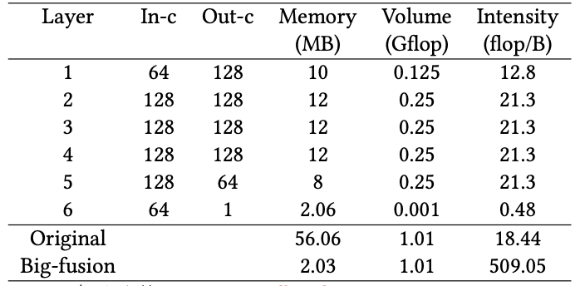
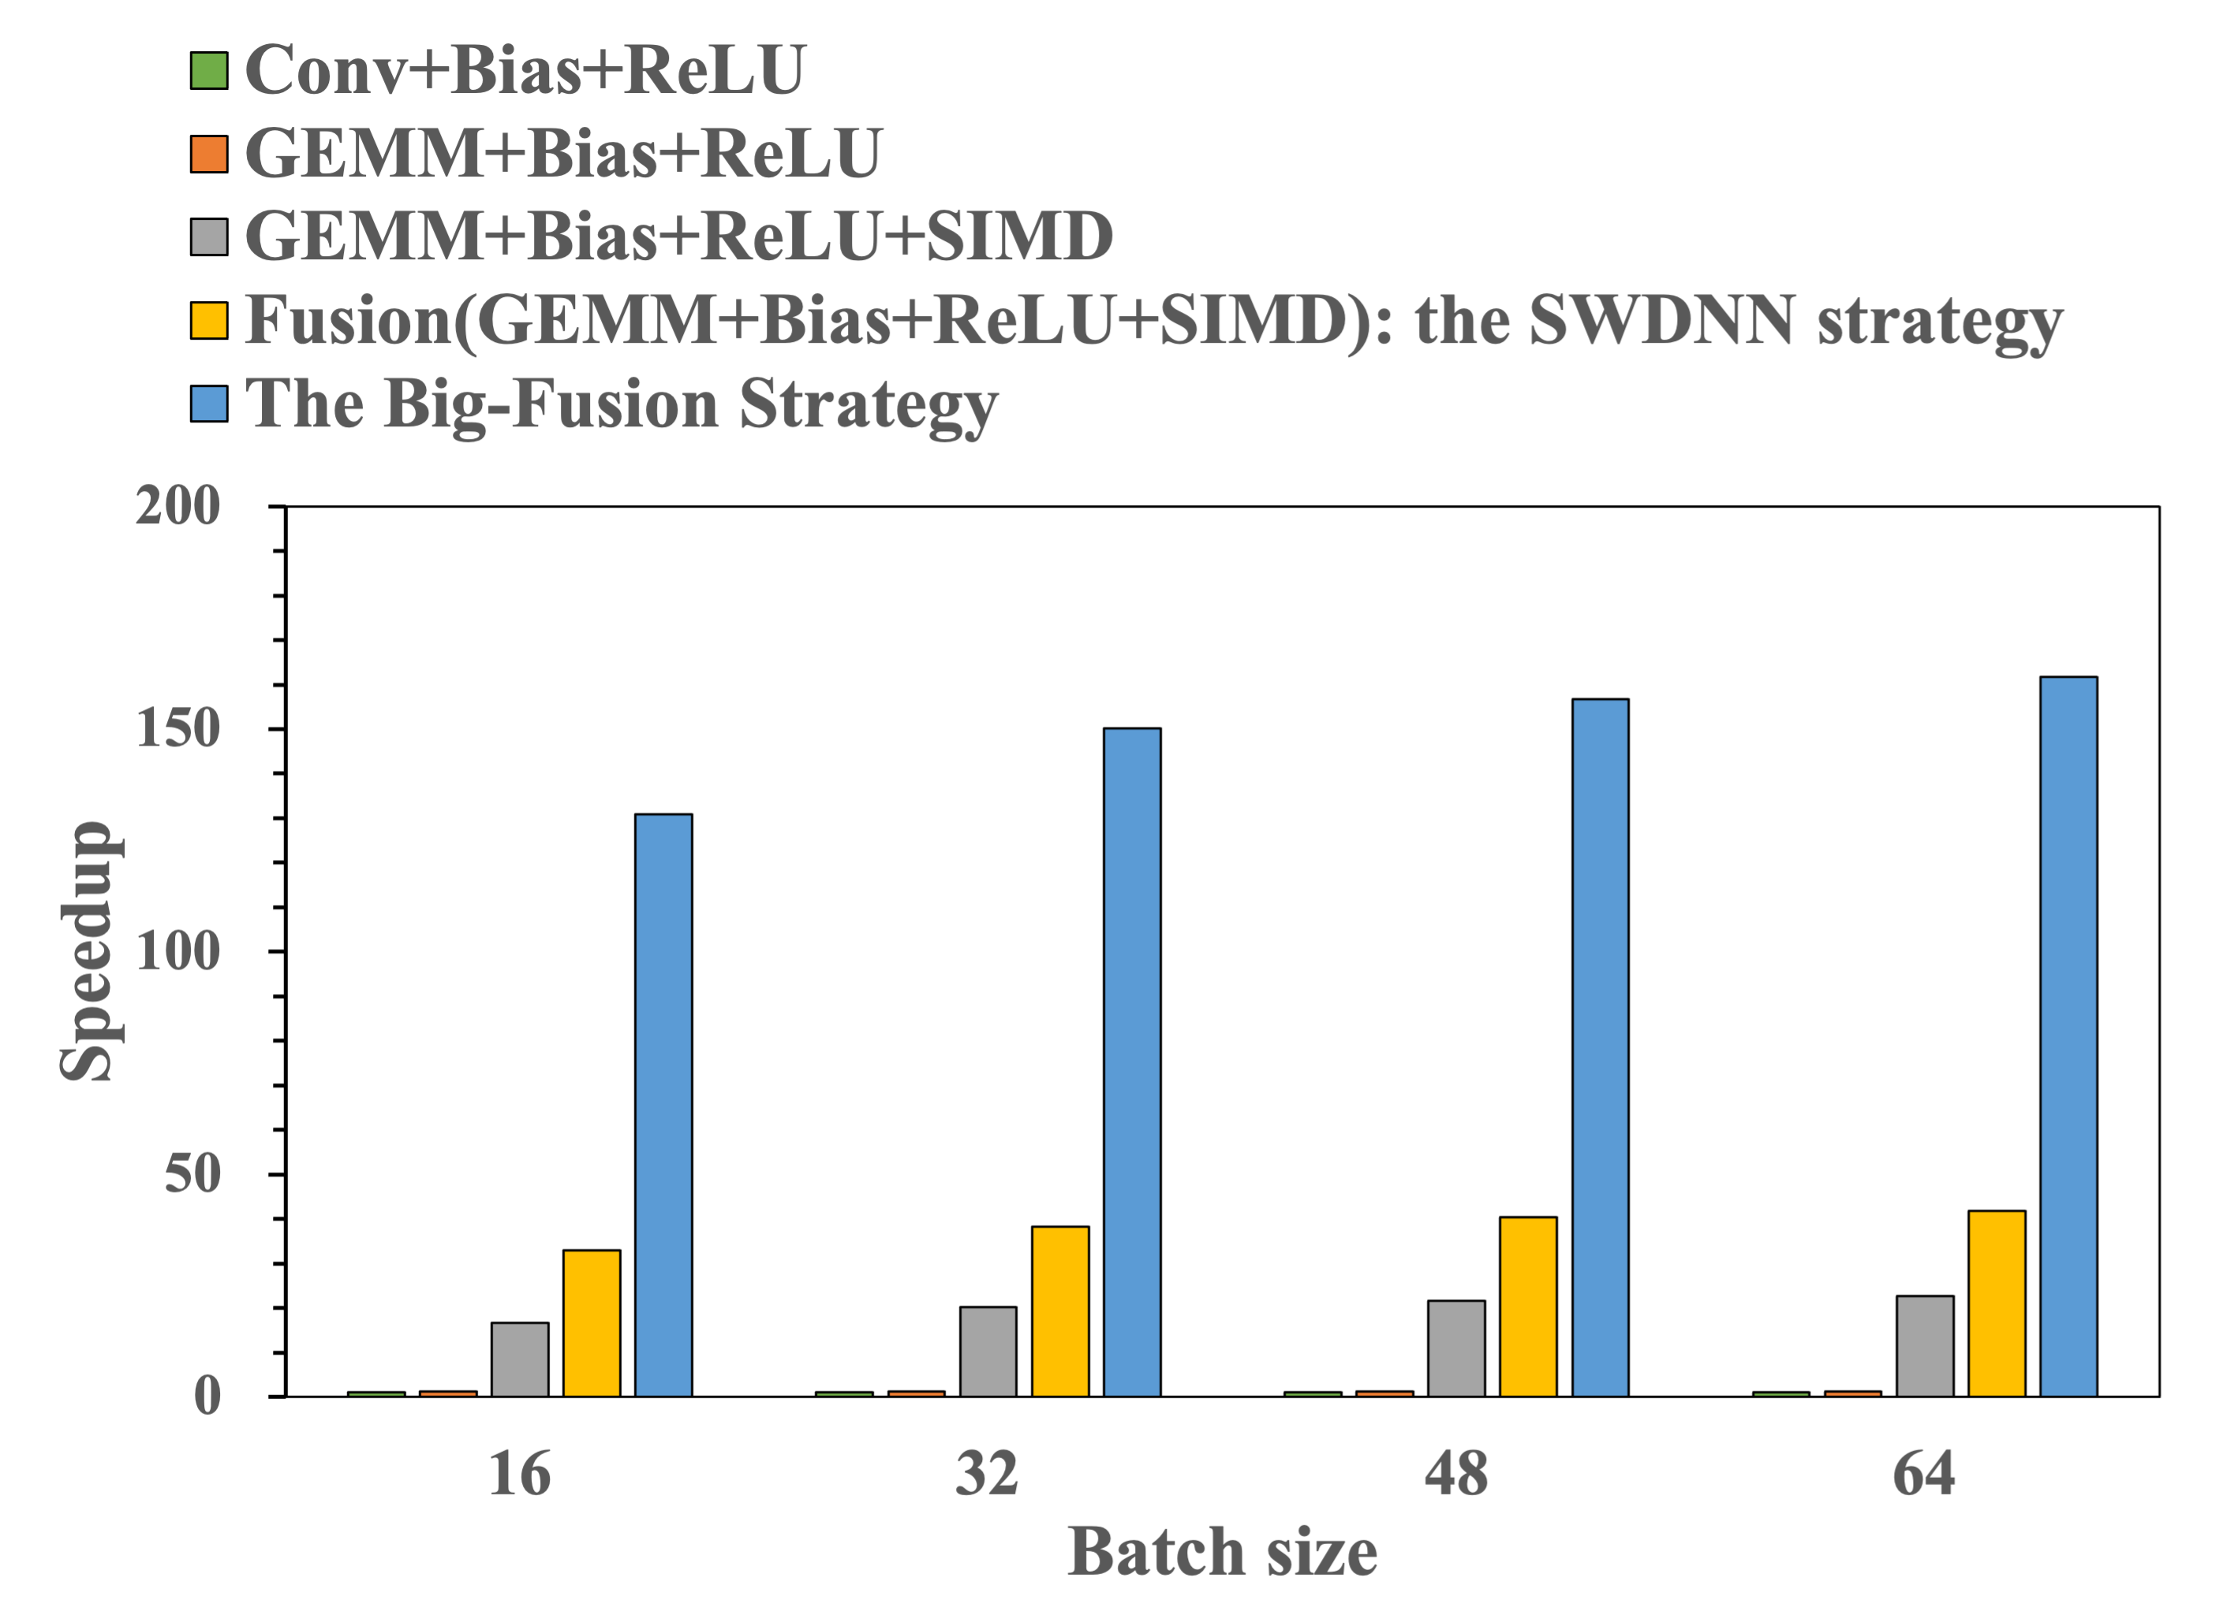
The Roofline analysis
Notes:
First is the roofline analysis.
We use N, H, W of [32, 16, 16] as an example to show this algorithm. The operation-intensity of each layer increases point fourty-eight to twenty one point three, which is far less than the fourty three point sixty three of the machine, and the computing performance is limited by the access bandwidth of the system. Our big-fusion operator reduces the total memory access from 56 megabytes to 2 megabytes, which is equal to the memory size of the last layer.
The arithmetic intensity is increased up to five-hundreds and nine point one F. As a result, energy calculation becomes computation-bounded but not memory-bounded.

Slide 27
The big-fusion performances
Notes:
Then we analyze the performance improvements for different levels of optimization methods.
First, the convolution is converted to matrix multiplication, increasing the performance from 1.0x to 1.23x.
Second, applying SIMD vectorization improves the performance to 16x~22x.
Third, the layer (Conv2D, Bias, ReLU) fusion speedups up around 33x to 41x. This is the performance of SWDNN.
Finally, the big-fusion strategy significantly reduces main memory access and achieved a performance speedup around 131x to 161x compared with the base version, or ~5x faster than SWDNN.

Slide 28
Serial performances
Benchmark settings:
  128 millions of atoms, 1.34% Cu concentration, 0.0008% vacancy concentration, 100 ns simulation time
X86:
  AMD EPYC, libtensorflow_cc, serial atomic feature calculation
SW:
  SW26010pro, libtensorflow_cc + SWDNN, serial atomic feature calculation
SW(opt):
  SW26010pro, customized operators
Notes:
Then we did serial comparisons.
There are three tests:
X86 refers to the test nn a general AMD CPU with libtensorflow and serial atomic feature calculation;
SW refers to the direct ported code with libtensorflow and SWDNN. Atomic features are calculated in serial on MPE.
Swopt refers to the fully optimized code with customized atomic feature and energy operators.

Slide 29
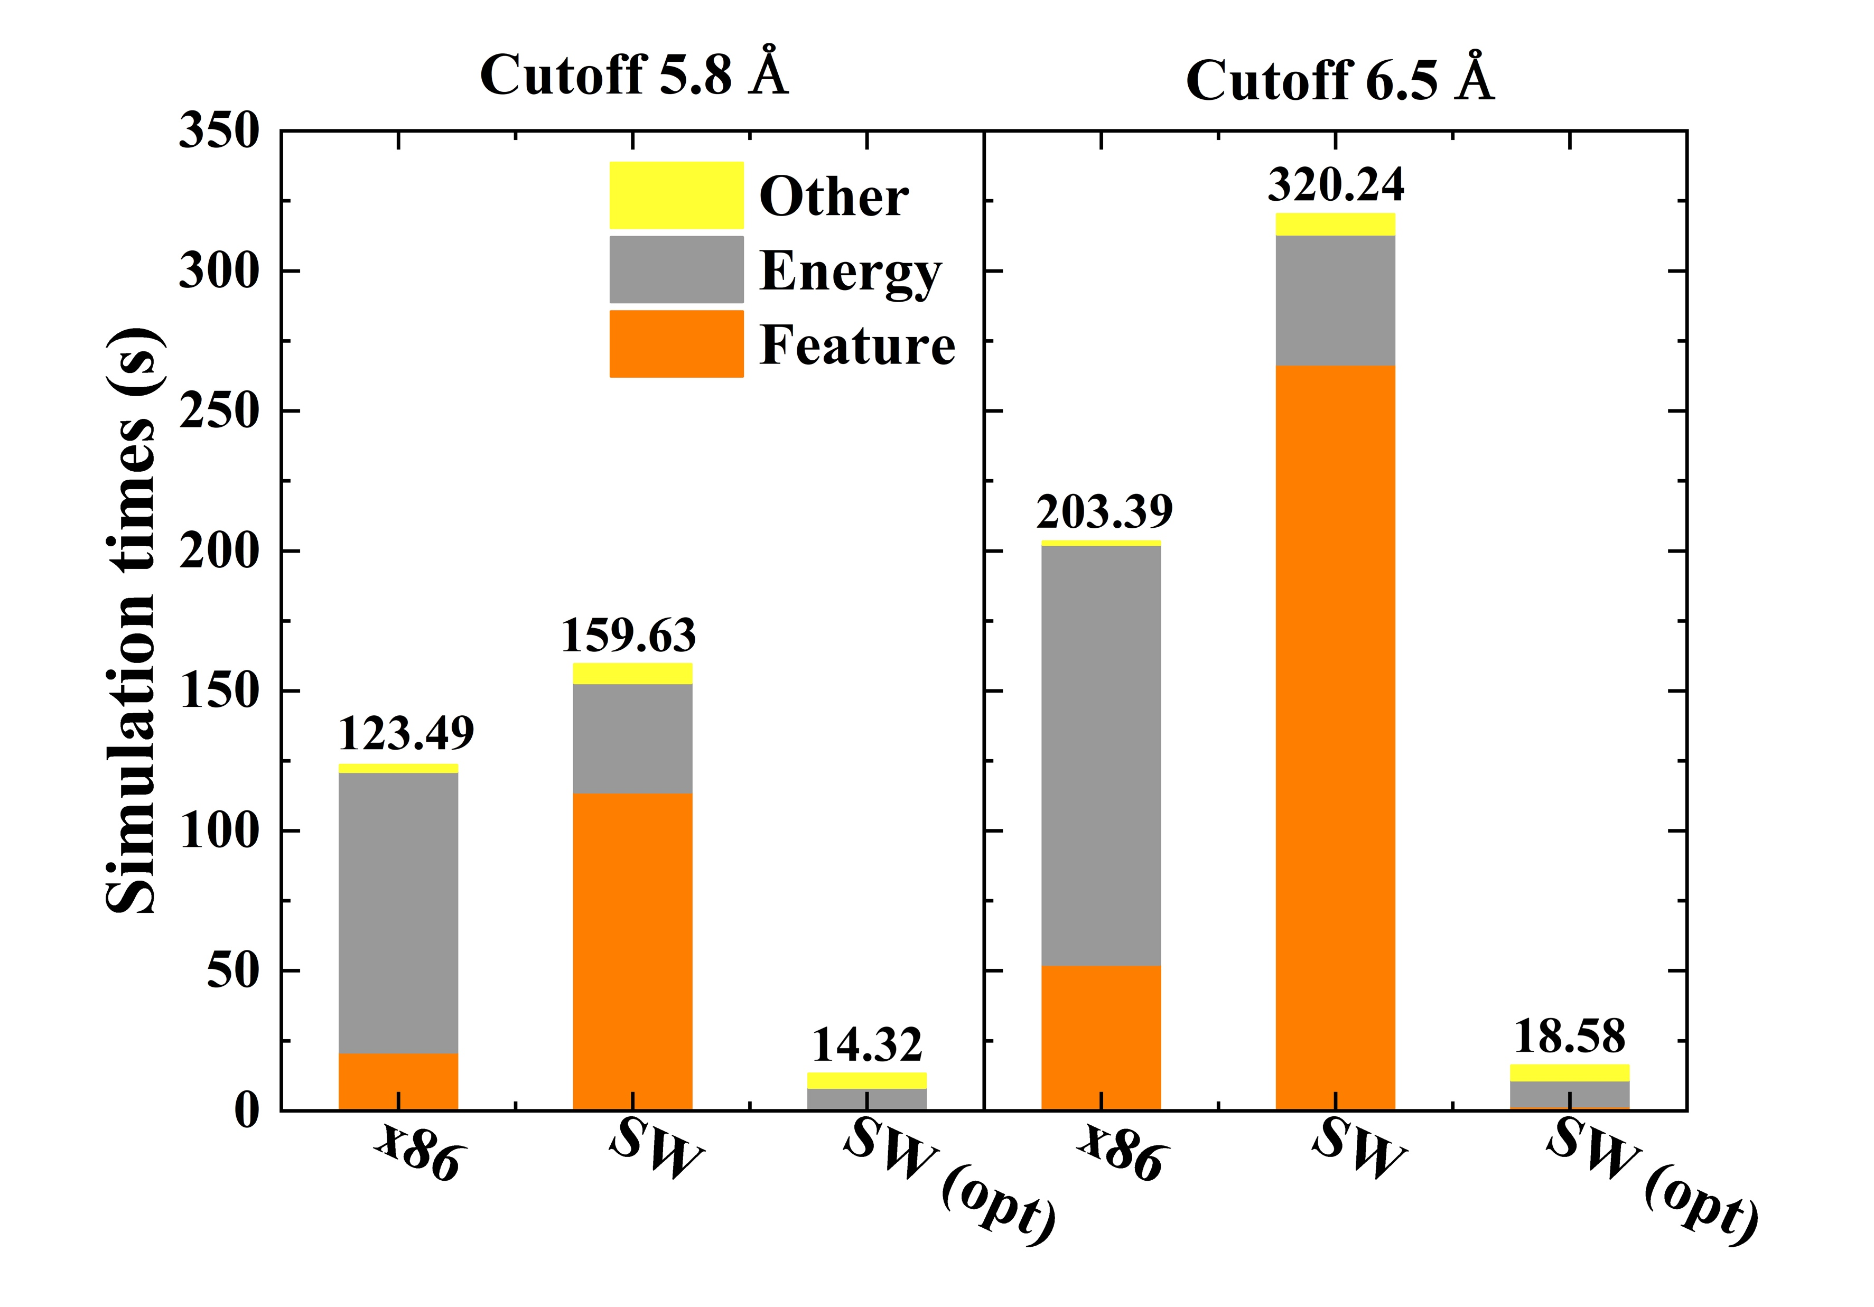
Serial performances
TensorKMC gains significant boost with customized operators
Notes:
Here are the results.
For the feature calculation, Bottle-necked by the main memory speed, the serial version is ~5 times slower on the new Sunway, compared with AMD EPYC. With our innovation, feature calculations can run in parallel on CPEs efficiently. As a result, the optimized version is ~60 times faster than the serial version on the new Sunway, or ~14 times faster than EPYC.
For the energy calculation, CPEs are very powerful vectorized computing units. Energy calculation on new Sunway is ~3 times faster than EPYC, even though there are a lot of main-memory accesses. With our big fusion algorithm, main memory accesses are successfully hidden behind computation. Thus, the time cost of computing energies is amazingly further reduced by almost 80% (or ~15 times faster than EPYC).
For the overall speed, TensorKMC with our fully optimized operators is no doubt the fastest version. It is approximately 11 times faster than the TensorFlow based version on EPYC and 17 times faster than the TensorFlow/SWDNN based version on the new Sunway.

Slide 30
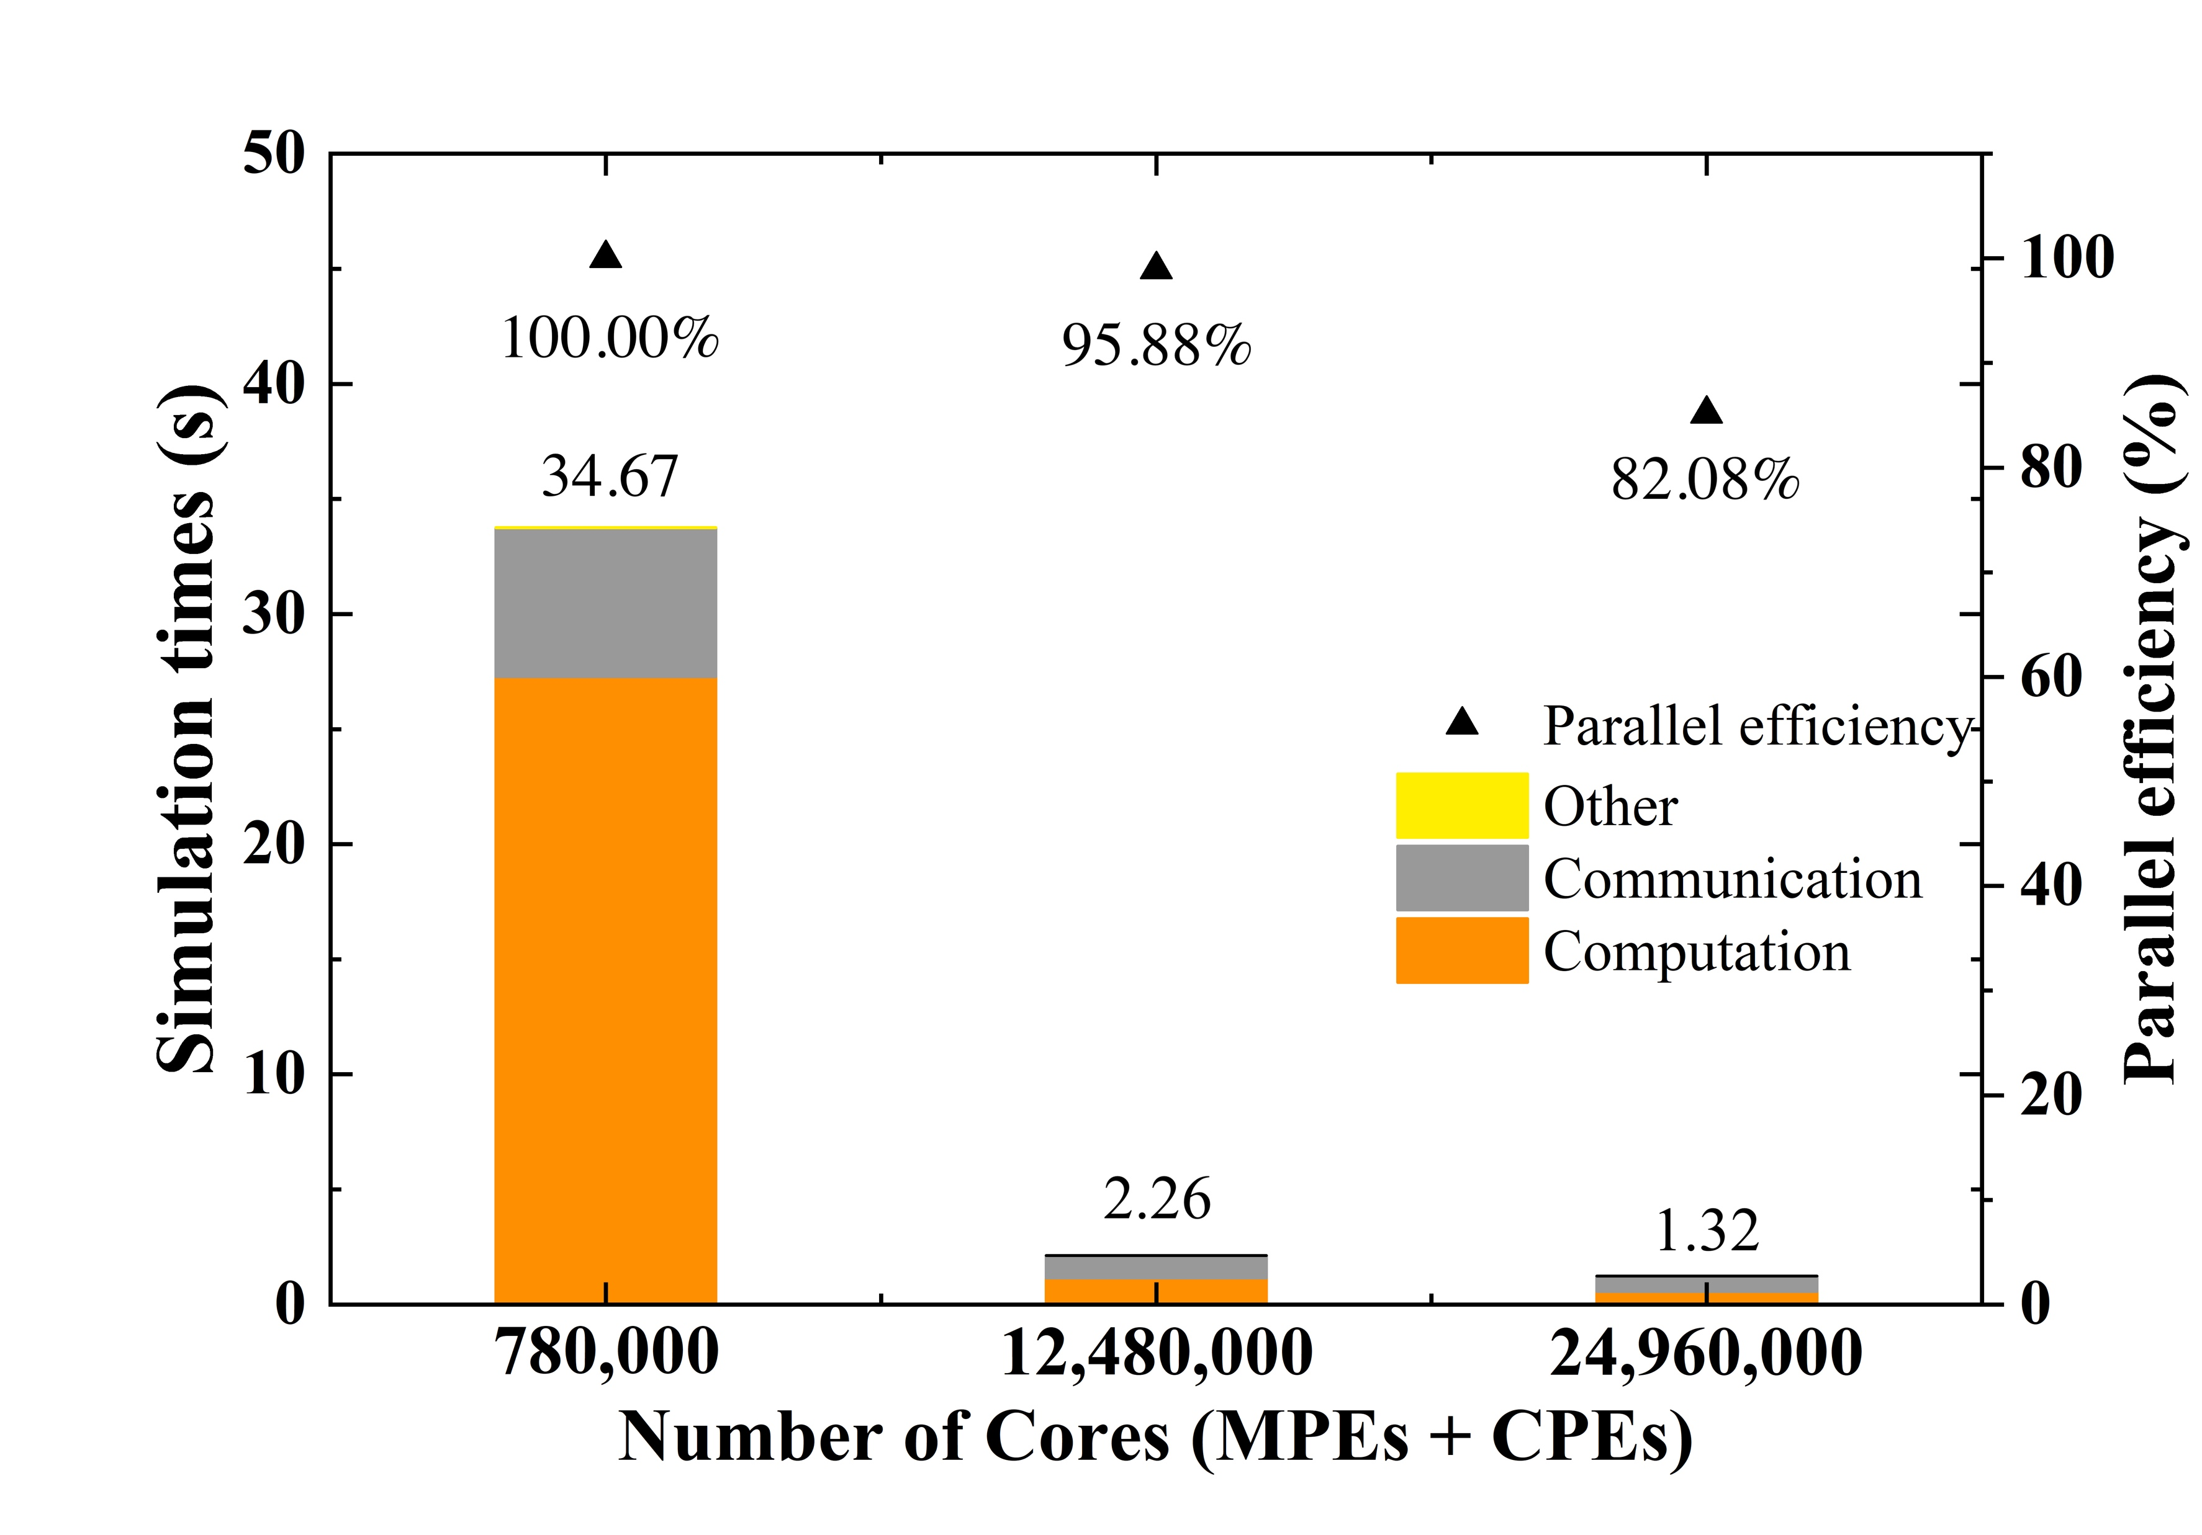
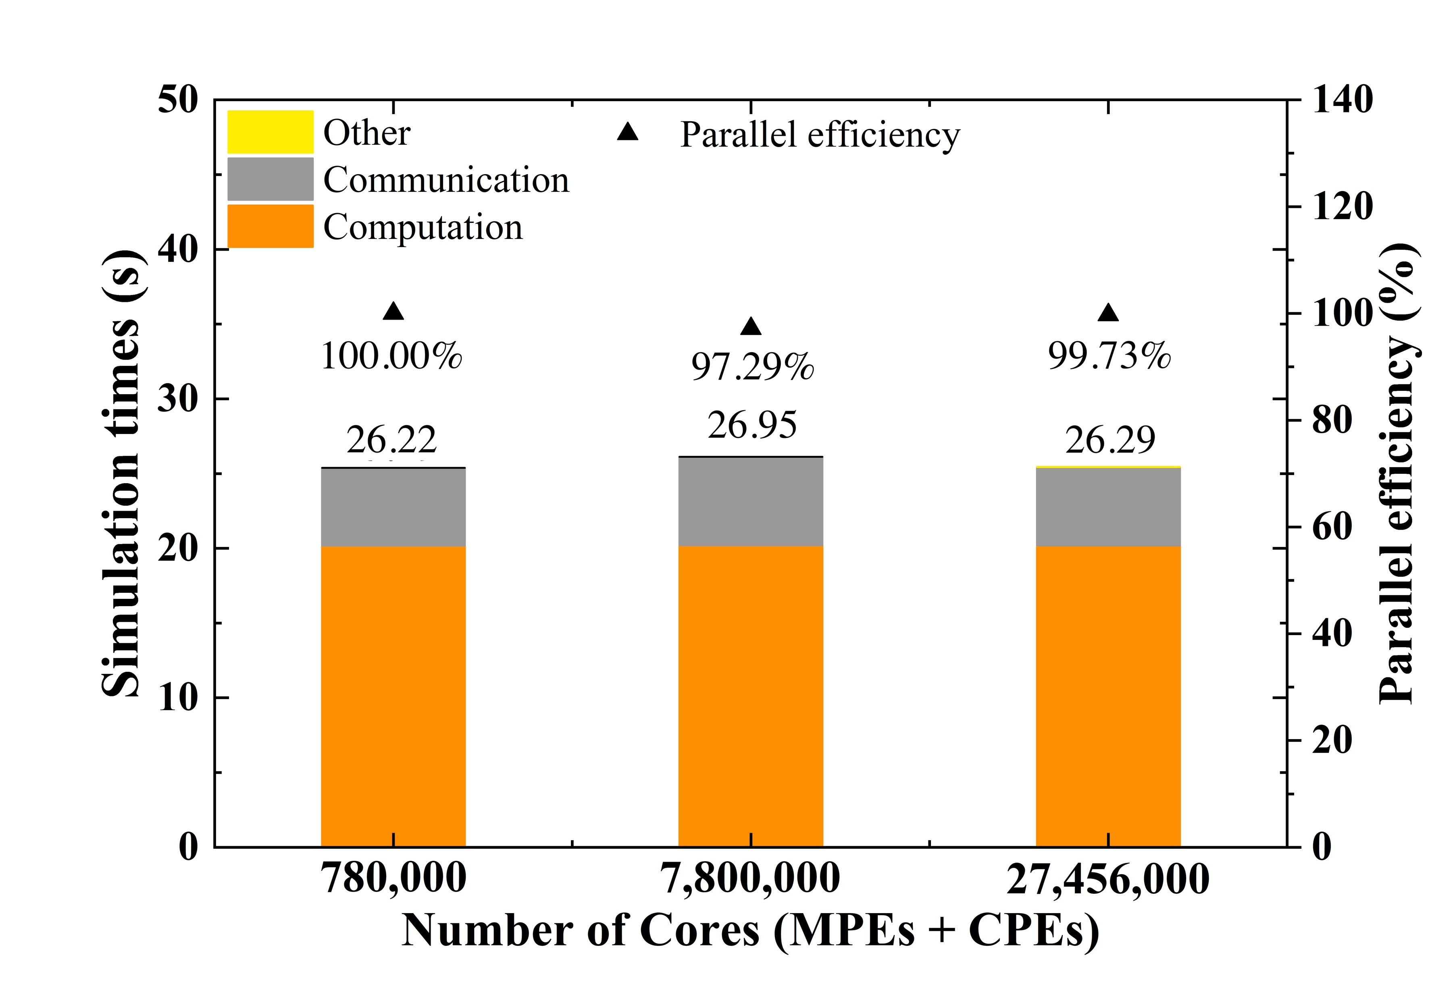
Parallel performances
Strong scaling: 1.92 trillions of atoms
Weak scaling: 128 millions of atoms / CG, maximum 54 trillions of atoms
Synchronization interval: 20 ns
Notes:
Last is the parallel performances.
We did both strong and weak scaling tests. In all scalability tests, we use the tree strategy for propensity update and a very strict synchronization interval even if the vacancy and Cu concentrations are relatively low.
In practical simulations, one can adjust this variable to some larger values to significantly reduce communication between processes.
Both tests achieved extradinary efficiency. Among the testing systems, the largest size is 54 trillion atoms, which is more than two orders of magnitude larger compared with OpenKMC, reaching a true experimentally relevant time-spatial scale.

Slide 31
1
Background
2
Related works
3
Key innovations
4
Performances
5
Application
Notes:
The last part is application.

Slide 32
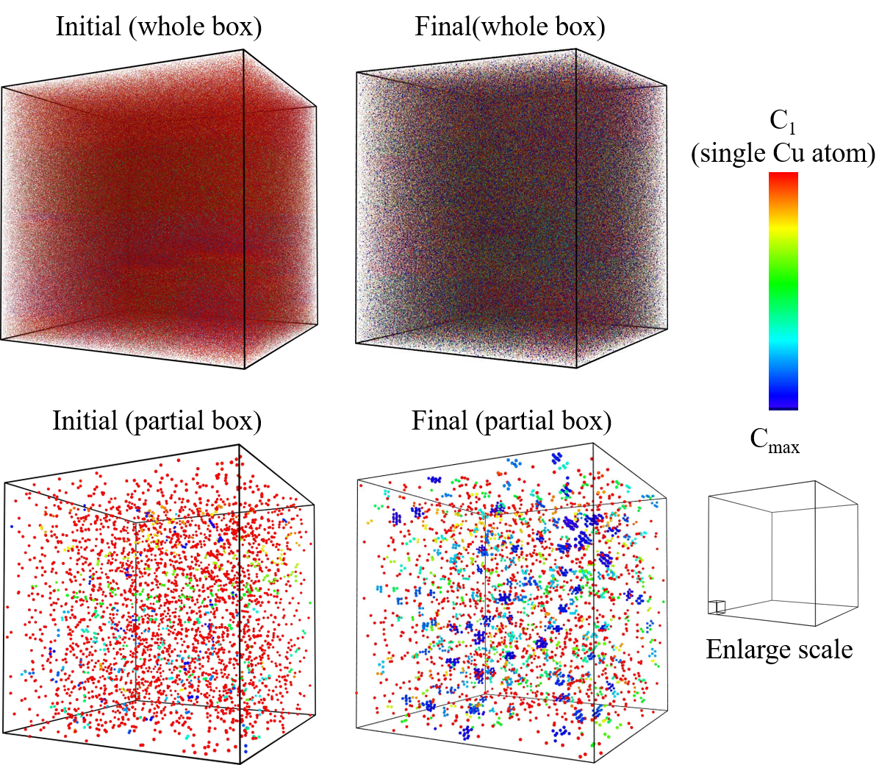
Aging of Fe-Cu alloy
2.5 billions of atoms, 1.34% at. Cu, 0.0008% vacancy
1 second, 573K
After a long-term evolution, considerable Cu cluster precipitations are observed while isolated Cu atoms are significantly reduced
Notes:
The figure showed the Cu precipitation and void formation after one-second evolution in a 2.5 billions atoms of Iron-Copper alloy by TensorKMC simulation. after a long-term evolution, considerable Cu cluster precipitations are observed while isolated Cu atoms are significantly reduced.
Further analysis and scientific insights will be described by another paper.

Slide 33
Conclusion
TensorKMC: deep learning driven massively parallel AKMC code
  A successful integration of TensorAlloy and OpenKMC
  Mesoscaling simulation on exscale machine
The first reported micron-long kinetic simulation of 50 trillion atoms with ab initio accuracy
Notes:
Here is the conclusion.
In this presentation we introduce our TensorKMC code. TensorKMC is a deep learning driven massively parallel AKMC software. It is a successful integration of TensorAlloy and OpenKMC.
the innovations realized in TensorKMC will make it suitable for mesoscale simulation of the atomic system on the future exascale machines.
o the best of our knowledge, this is first reported that the micron-long kinetic simulation of 50 trillion atoms with ab initio accuracy is achieved over twenty million cores, which open new perspectives for predicting
and investigating the microstructure evolution at experimental resolution.
Our algorithms are

Slide 34
Acknowlegements
National Key Research and Devel-opment Program of China under Grant No. 2016YFB0201203
Science Challenge Project under Grant No. TZZT2019, No. TZ2018002
State Key Laboratory of Computer Architecture Foundation under Grant No. CARCH 4205, CARCH 4411
National Natural Science Foundation of China under Grant No. 12004046
Notes:
Thanks all the foundations for supporting this work.

Slide 35
Thanks for your attention

