Slide 1




Efficient Tensor Core-Based GPU Kernels for Structured Sparsity under Reduced Precision
Zhaodong Chen*, Zheng Qu*, Liu Liu, Yufei Ding, and Yuan Xie
SEAL Lab, UCSB
Scalable Energy-efficient Architecture Lab
Notes:
Hi, I’m Zhaodong. It’s my pleasure to introduce our work, Efficient Tensor Core-based GPU kernels for Structured Sparsity under reduced Precision.

Slide 2
Contribution of This Work
Column Vector Sparse Encoding: a structured sparse pattern that offers minimum grain size under given data reuse rate.
Tensor Core-based 1-D Octet Tiling: a warp-level workload partition that feeds tensor cores with data directly loaded from DRAM with lightweight rearrangement.
A pair of SpMM and SDDMM kernel based on 1 & 2 that achieve 0.93~7.19x speedup over existing implementations under float16.
Scalable Energy-efficient Architecture Lab
Notes:
In this paper, we first propose column-vector sparse encoding. It is a structured sparse pattern that offers minimum grain size under given data reuse rate.
So it can potentially better preserve the model accuracy under given speedup.
Then, we propose a warp-level workload partition called tensor core-based 1-D octet tiling. This partition allows us to directly load data from the global memory under optimal pattern, and then feed them into Tensor core with lightweight rearrangement.
With these two techniques, we develop a pair of SpMM and SDDMM kernels. They achieve up to 7.19x speedup over existing implementations under fp16.

Slide 3
Background and Motivation
Notes:
First, I’d like to introduce the background of this paper.

Slide 4




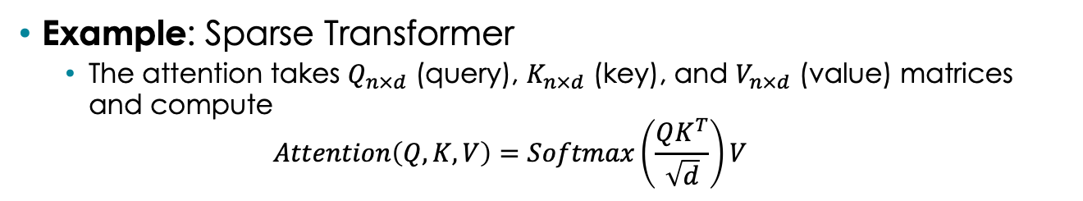



Sparse Matrix Computation in Deep Learning
Example: Sparse Transformer
  The attention takes $Q_{n×d}$ (query), $K_{n×d}$ (key), and $V_{n×d}$ (value) matrices and compute
  $Attention\left(Q, K, V\right)=Softmax\left(\frac{QK^{T}}{\sqrt{d}}\right)V$
SpMM
$$d$$
$$V$$
SDDMM
$$n$$
$$n$$
$$d$$
$$K^{T}$$
$$d$$
$$n$$
$$Q$$
Softmax
$$n$$
Scalable Energy-efficient Architecture Lab
Notes:
Sparse matrix computations are becoming an important component in the Deep Learning software stack.
We take the sparse transformer as an example.
The attention in transformer takes three inputs: query, key, and value.
In the first step, we multiply query and key to obtain the attention score matrix.
This matrix is normalized with the softmax and them multiplied with value to generate the output.
As the attention score has quadratic complexity, previous studies exploit sparsity in it by applying a predefined or learned mask on it.
Then, the first matrix multiplication becomes a sampled dense-dense matrix multiplication operator, or SDDMM
The second matrix multiplication is a sparse matrix-matrix multiplication operator, or SpMM for short.

Slide 5
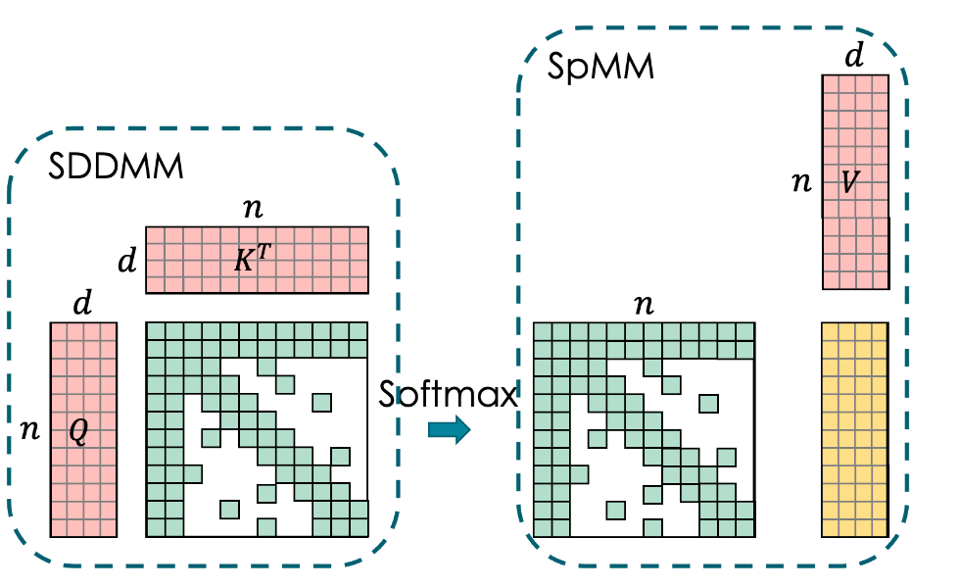
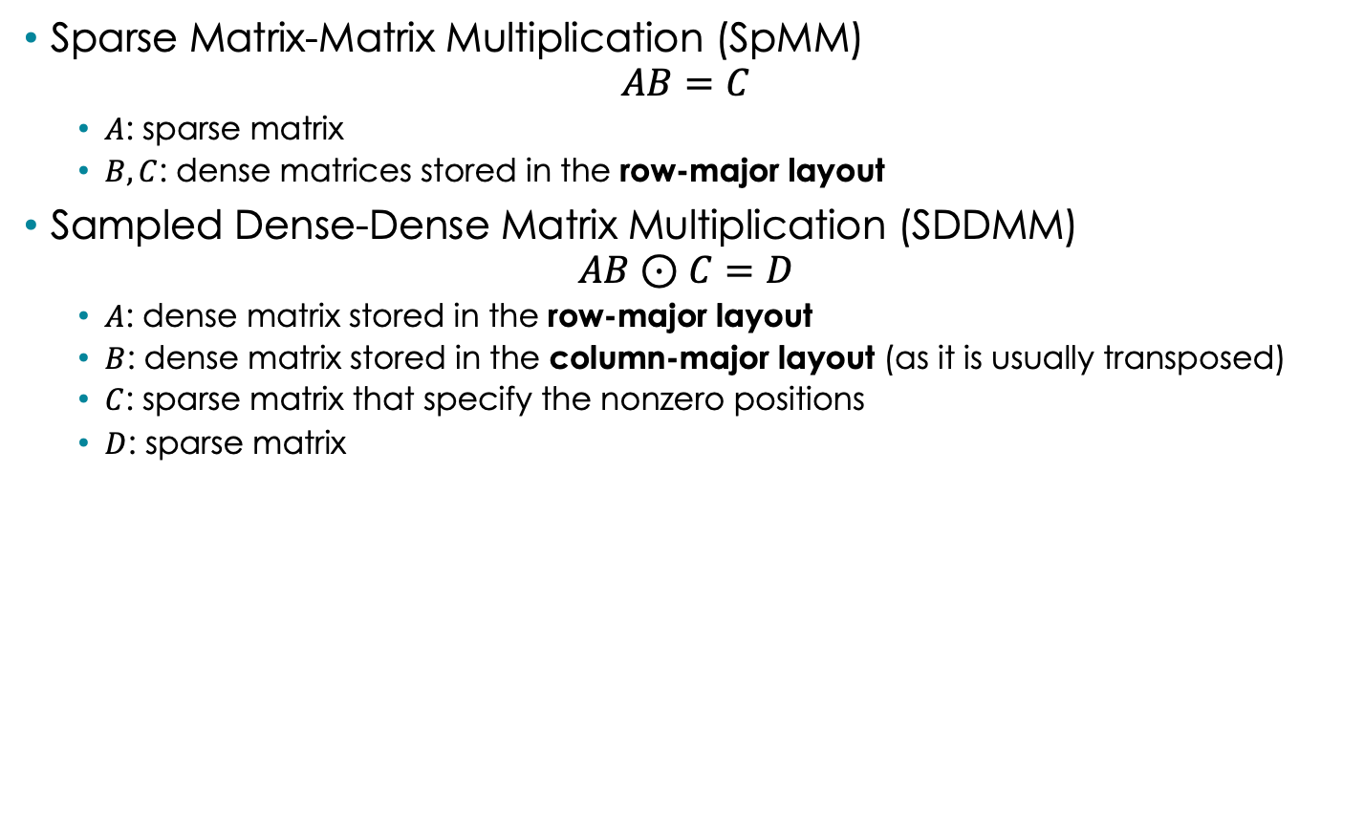
SpMM and SDDMM
Sparse Matrix-Matrix Multiplication (SpMM)
$AB=C$
  $A$: sparse matrix
  $B, C$: dense matrices stored in the row-major layout
Sampled Dense-Dense Matrix Multiplication (SDDMM)
$AB⊙C=D$
  $A$: dense matrix stored in the row-major layout
  $B$: dense matrix stored in the column-major layout (as it is usually transposed)
  $C$: sparse matrix that specify the nonzero positions
  $D$: sparse matrix
Scalable Energy-efficient Architecture Lab
Notes:
These two sparse matrix computation can be formulated as this.
In SpMM, we multiply a sparse matrix A with dense row-major matrix B to produce dense row-major matrix C.
In SDDMM, A is a dense row-major matrix. B is a dense column-major matrix as it is usually transposed. C is a binary mask, and D is a sparse matrix stores the selected nonzeros.

Slide 6
Half Precision in Deep Learning
Previous studies have shown that DNNs under half precision floating-point format can achieve on par accuracy with single precision.
Half precision data are faster to compute (especially with Tensor Core) and have lower memory footprint
sign
exponent
mantissa
e8
m23
FP32
e5
m10
FP16
e8
m7
BF16
Scalable Energy-efficient Architecture Lab
Notes:
On the other hand, previous studies have shown that Neural networks under half prevision achieves accuracy comparable with single precision.
They are not only faster to compute, but also has lower memory footprint.

Slide 7
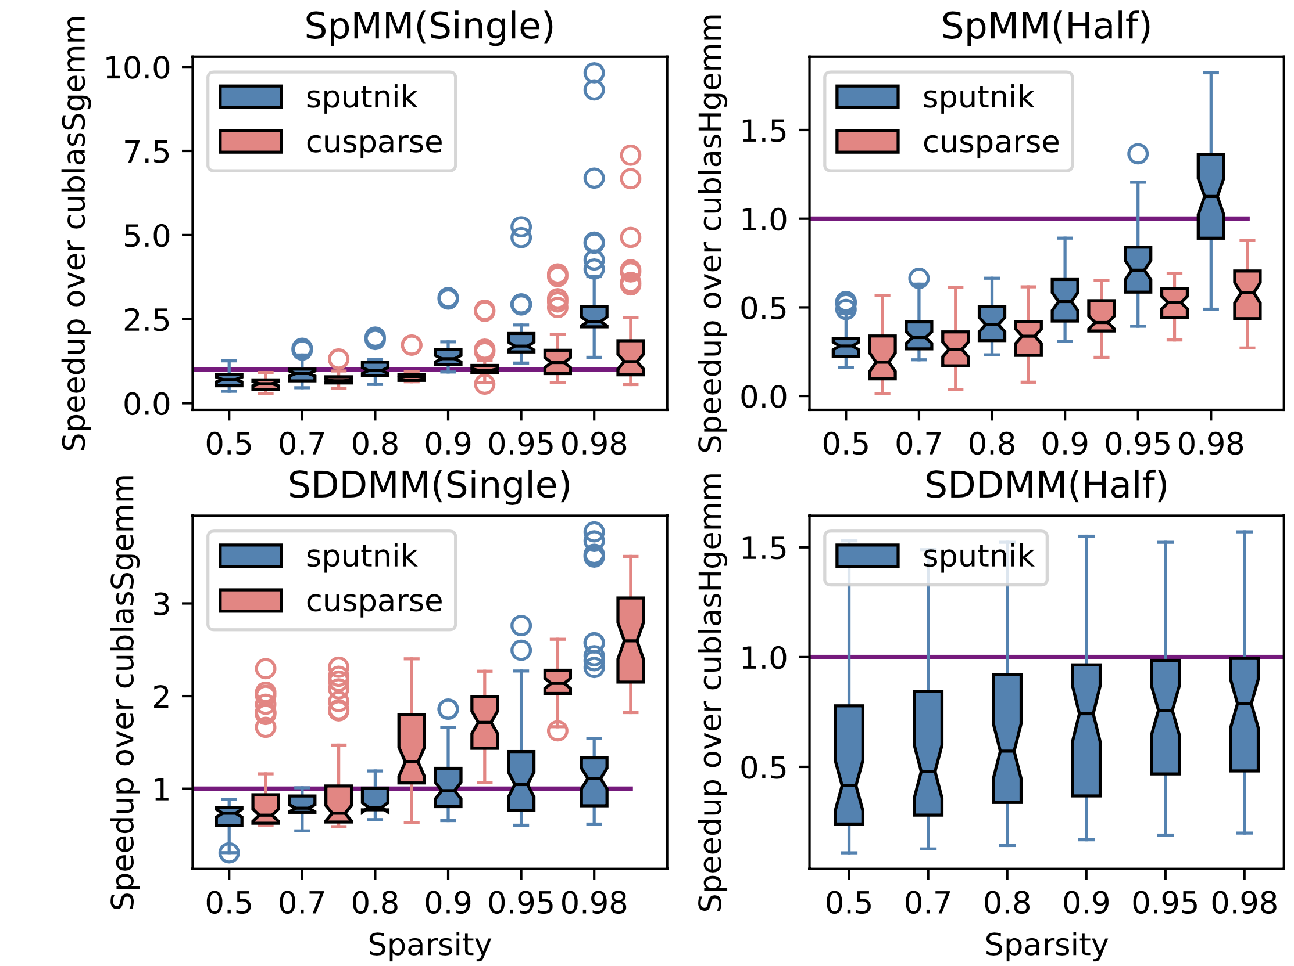
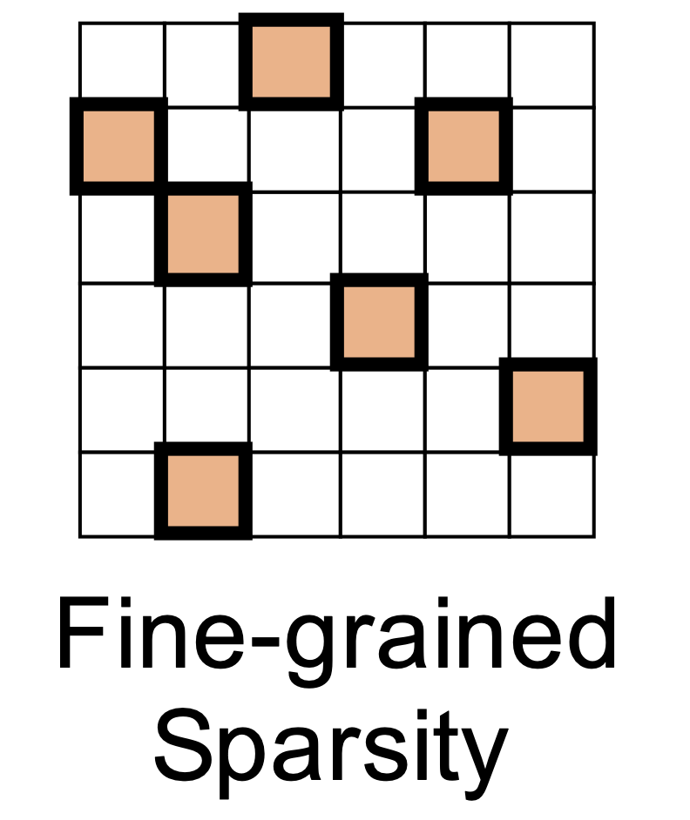
Fine-grained Sparsity + Half Precision
Fine-grained sparsity store sparse matrix under the standard CSR
Unlike FP32, fine-grained SpMM & SDDMM require much higher sparsity to achieve speedup over GeMM under FP16
Sputnik: Gale, Trevor, et al. "Sparse GPU kernels for deep learning." SC20: International Conference for High Performance Computing, Networking, Storage and Analysis. IEEE, 2020.
cuSPARSE: v11.2.2, the SDDMM under fp16 was not supported
Scalable Energy-efficient Architecture Lab
Notes:
A question one would ask is: what will happen if we jointly apply these two techniques?
Let's first takes a look at the fine-grained scenario where the sparse matrix is stored under standard CSR.
We compare the sputnik and cusparse v11.2.2 with the cublas under both single and half precision.
Under single precision like fp 32, both of then achieve good speedup over the dense gemm.
However, the story is quite different under half precision. We need much higher sparsity for real speedup.

Slide 8
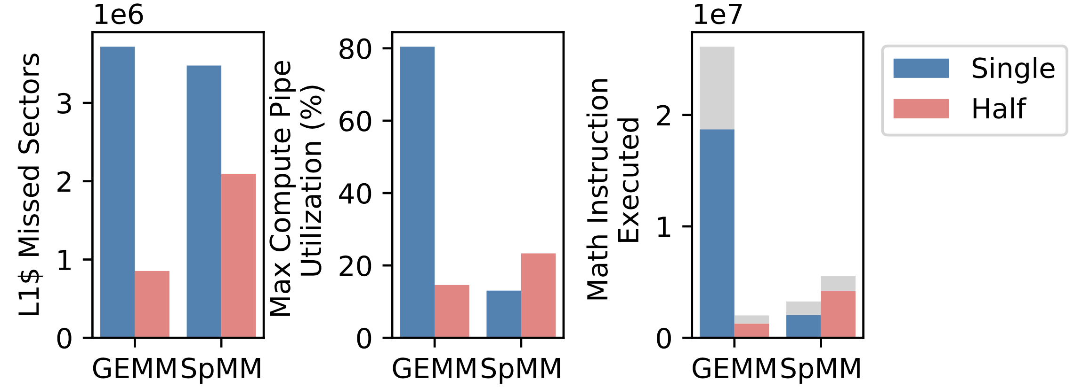
Profiling Results
The fine-grained sparsity is not benefited from the “enlarged” fast memory and Tensor Core units under half precision floating-point
We profile the Sputnik’s SpMM kernel on $A_{2048×1024}×B_{1024×256}$ under 90% sparsity
After switching to half precision:
  GEMM has 77% fewer missed sectors, but SpMM only has 49% fewer missed sectors
  The High Compute Pipeline Utilization & Math Instruction in SGEMM is greatly reduced after switching to half precision
Scalable Energy-efficient Architecture Lab
Notes:
To study the reason behind it, we profile the spmm kernel on a representative workload under 90% sparsity.
After switching to fp16, the dense gemm has 77% fewer traffic between L2 cache and L1 cache. But the SpMM only has 49% fewer traffic. So SpMM actually has more memory access than the dense GeMM unfer fp16.
This is because the data reuse of GEMM is bounded by onchip memory capacity, but the SpMM is bounded by the sparse pattern. After switching to fp16, the onchip fast memory can store more operands, so GEMM has higher data reuse, while SpMM cannot be benefited from it.
Besides, the dense gemm is benefited from the tensor core on volta gpu.
To conclude, the fine-grained sparsity is not benefited from the enlarged fast memory and tensor core units under half precision.

Slide 9
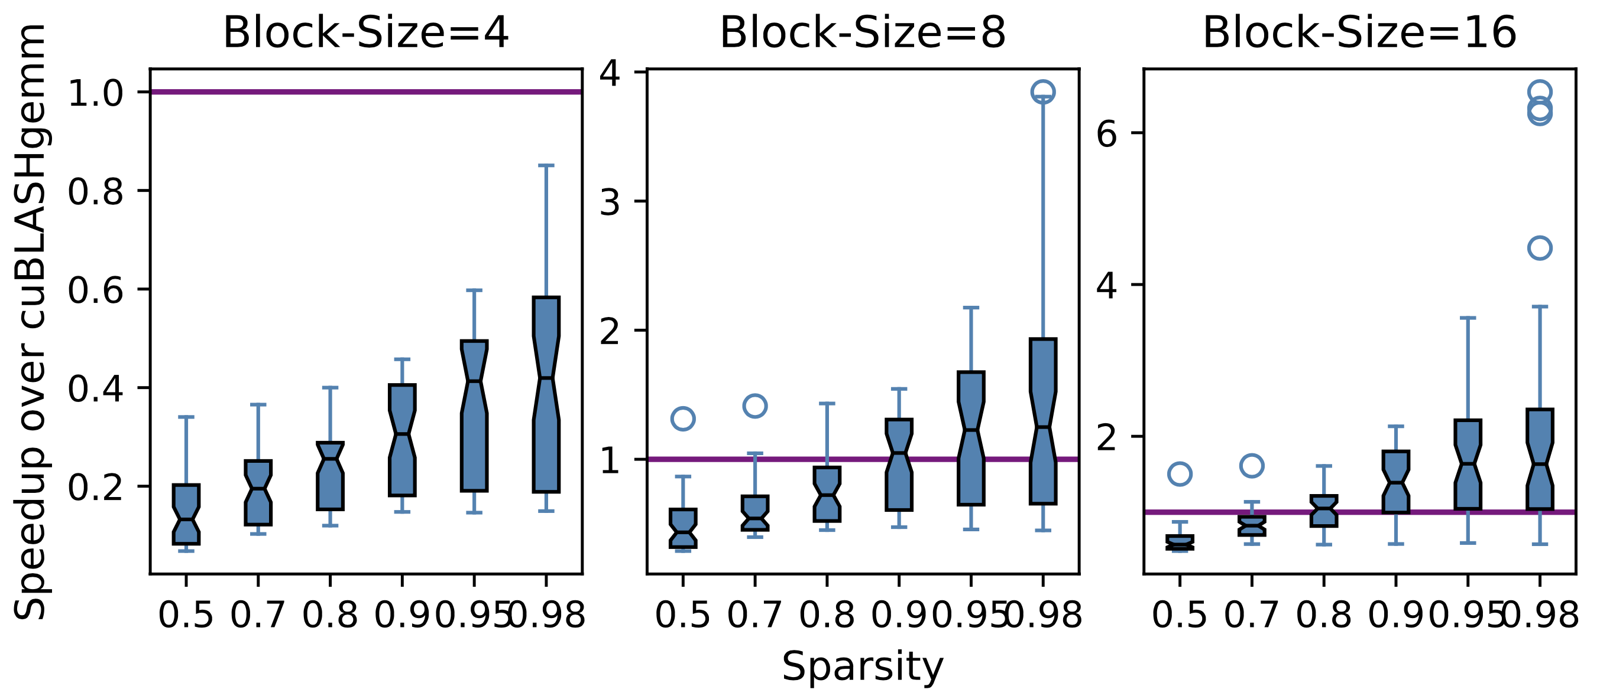
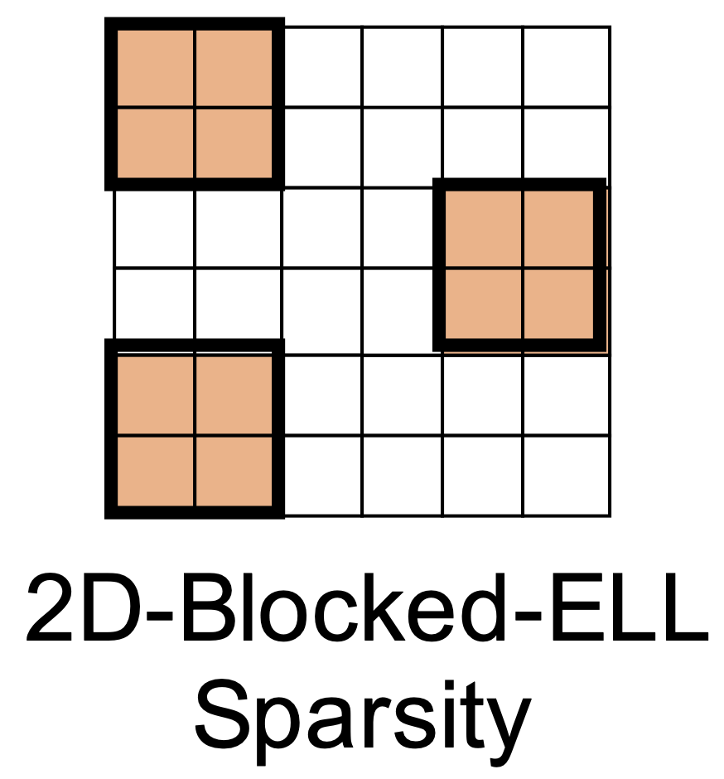
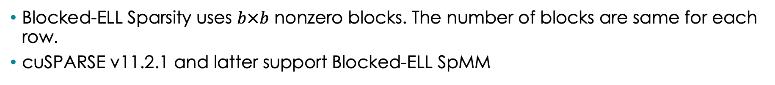
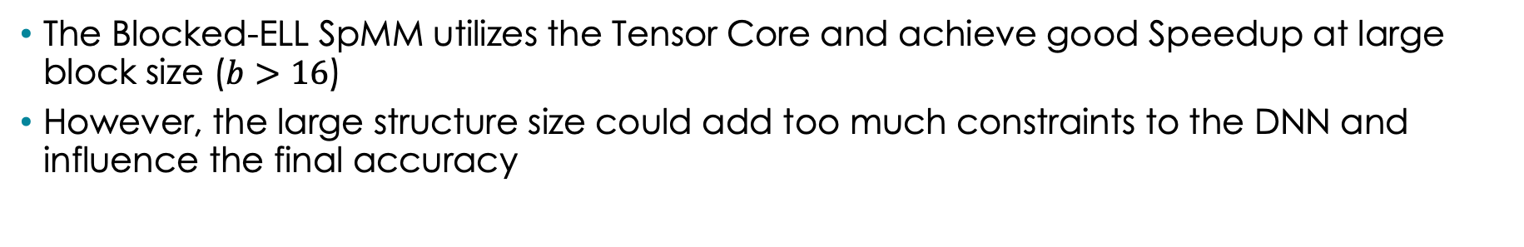
Block Sparsity + Half Precision
Blocked-ELL Sparsity uses $b×b$ nonzero blocks. The number of blocks are same for each row.
cuSPARSE v11.2.1 and latter support Blocked-ELL SpMM
The Blocked-ELL SpMM utilizes the Tensor Core and achieve good Speedup at large block size ($b>16$)
However, the large structure size could add too much constraints to the DNN and influence the final accuracy
Scalable Energy-efficient Architecture Lab
Notes:
Another popular sparse pattern is the block sparsity.
For instance, the blocked-ELL sparsity uses nonzero blocks with size bxb. The number of nonzero blocks are the same in each row. The blocked-ELL based spmm has been introduced to cusparse since v11.2.1
And here is a simple illustration
Although it achieves good speedup over dense gemm under large block size, its performance is quite poor when block size it small. On the other hand, we may need smaller blocks to capture the fine-grained sparsity in deep learning to preserve accuracy.

Slide 10
Profiling Results
We profile Blocked-ELL SpMM in cuSPARSE v11.2.2 on $A_{2048×1024}×B_{1024×256}$ under 90% sparsity and $b=4$
Three guidelines for efficient sparse GPU kernels under small structure size:
Reduce kernel size to fit the I-cache
Reduce the fixed-latency operations, especially the non-FP ones
Remove the shared memory from critical path
Top-3 stall reasons:
  No Instruction: I-cache miss. The kernel has 4,600 lines of SASS code, 5 times larger than the I-cache capacity
  Wait: waiting on a fixed latency execution dependency (e.g., IMAD, IADD3)
  Short Scoreboard: Waiting for shared memory access
Scalable Energy-efficient Architecture Lab
Notes:
To study the reason behind it, we profile the kernel with nsight compute and list the top-3 stall reasons here.
The first reason is no instruction, it contributes 43% of the total warp stalls. we identify that this is caused by the instruction cache capacity miss. Specifically, The kernel contains 4600 lines of SASS codes, it is 5 times larger than the instruction cache capacity.
The second reason is wait, which suggests that the kernel is waiting for a fixed latency execution dependency. We exam the composition of the executed instructions. We find that although the floating point arithmetics are handled to Tensor core, there are still plenty integer arithmetics like IMAD and IADD3 that could be used for index computation or boundary checking.
The third reason is short scoreboard, this usually happens when the warp is waiting for data from the shared memory.
The shared memory has two major uses. First, it stores data frequently used by multiple warps. Second, it coalesce the global memory access.
In SpMM, the data reuse is low and there is limited data sharing between warps. So the only reason to use shared memory is coalesing global memory access.
These profiling results give us three guidelines to design an efficient kernel for structured sparse matrix computation.
First, we need to reduce kernel size to avoid overflowing the instruction cache.
Second, we need to reduce the fix-latency operations, especially those non floating point ones.
Last, if we can coalese the global memory access without shared memory, we can remove it from the critical path to improve the memory access efficiency.

Slide 11
Motivation: Efficient Sparse GPU Kernels for Deep Learning under Half Precision
Sparse Pattern:
  It should provide enough data reuse rate through structured pattern
  The structure size should be small enough to preserve model accuracy
Irregular
?
Regular
Missing Piece
Fine-grained
Sparsity
2D-Blocked-ELL
Sparsity
GPU Kernel Design:
  Reduce kernel size to avoid overflow the I-cache
  Increase the grid size to improve thread-level-parallelism
  Reduce fixed-latency operations
  Remove the shared memory from critical path
  Use 128B coalesced transactions and LDG.128
Execution Efficiency
Compute Efficiency
Memory Efficiency
Scalable Energy-efficient Architecture Lab
Notes:
To conclude, the motivation of our work is summarized as follows.
First, we need a new sparse pattern. On one hand, it should provide enough data reuse rate through structured pattern. On the other hand, the structure size needs to be as small as possible to preserve model accuracy. In another word, it is a missing piece between the fine-grained sparsity and the block sparsity.
Then, we need an efficient GPU kernel design that achieves speedup with this pattern.
Besides the three guidelines we mentioned before, there are two other guidelines.
First, there should be enough thread blocks to ensure good thread level parallelism.
Second, it should have the optimal global memory access pattern. The accesses should 128B coalesced, and 128bit per thread.
In general, the first two guidelines determines whether the kernel can be executed efficiently on GPU. The third guideline indicate the compute efficiency.
The last two guidelines are about the memory access efficiency.

Slide 12
Column-vector Sparse Encoding
Notes:
We address the first motivation with a new sparse pattern: The column-vector sparse encoding.

Slide 13


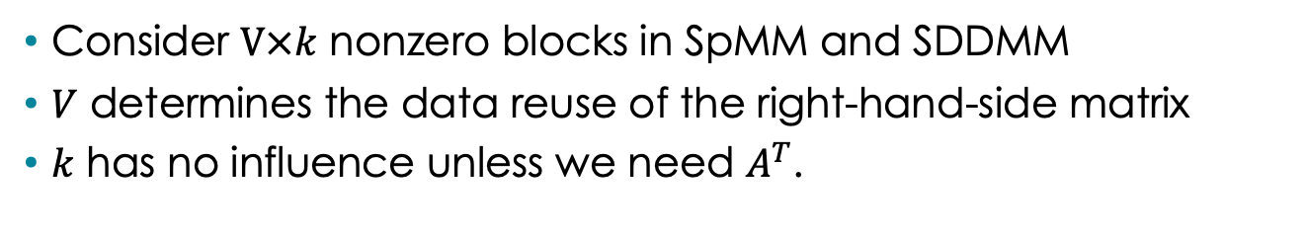

The Minimum Structure under Given Data Reuse
Consider $V×k$ nonzero blocks in SpMM and SDDMM
$V$ determines the data reuse of the right-hand-side matrix
$k$ has no influence unless we need $A^{T}$.
N
N
TileN
The minimum structure is $V×1$: column vectors
(a) SpMM
B
k
(b) SDDMM
B
K
K
Step K
n
$≤$K
K
$≤$N
A
C
A
C
M
Step K
M
Step K
TileN
V
V
m
k
n
Scalable Energy-efficient Architecture Lab
Notes:
Let's consider a generalized block sparse pattern.
Each nonzero block has V rows and k columns. We observe that as long as we don't need its transpose, the number of rows V is the only factor that contributes to the data reuse rate.

Slide 14
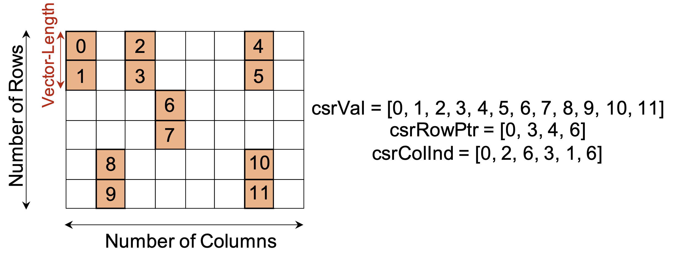
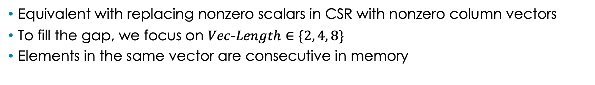
Column-vector Sparse Encoding
Equivalent with replacing nonzero scalars in CSR with nonzero column vectors
To fill the gap, we focus on $Vec$-$Length∈\{2, 4, 8\}$
Elements in the same vector are consecutive in memory
The vectors can be loaded with CUDA vector type
  half2: Vector-Length = 2
  float2: Vector-Length = 4
  float4: Vector-Length = 8
Scalable Energy-efficient Architecture Lab
Notes:
With this observation, we propose the column vector sparse encoding.
It is equivalent with replacing nonzero scalars in the standard CSR with nonzero short column vectors.
As we want to fill the gap between the fine-grained sparsity and block sparsity, in this paper, we focus on vector length 2, 4, and 8.
We store the elements in each vector in consecutive addresses in the memory, so they can be loaded directly with the CUDA vector type.

Slide 15
SpMM Kernel on Column-vector Sparse Encoding
Notes:
Then we introduce our SpMM kernel design on our column-vector sparse encoding.

Slide 16

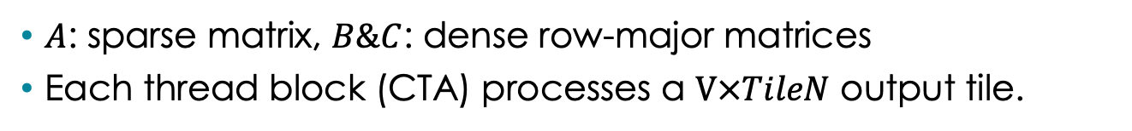
Problem Formation
$A$: sparse matrix, $B\&C$: dense row-major matrices
Each thread block (CTA) processes a $V×TileN$ output tile.
TileN is a multiple 64 to use 128B coalesced transaction
Column-vector SpMM
Thread Block Tile
N
B
TileN
1
TileN %64 =0
K
Step K
$≤$K
A
Step K
C
V
M
Step K
V
1
Scalable Energy-efficient Architecture Lab
Notes:
In the SpMM, we multiply a sparse matrix A under our column vector sparsity with a dense row-major matrix B.
During the execution, each thread block processes a V times TileN output tile.
As matrix B is in row-major, we choose TileN to be a multiple of 64 when possible, so that we can use 128B coalesced memory access.

Slide 17
Challenges: with Floating-Point Units
Each thread processes an independent part:
  Partition the Thread Block Tile along TileN.
TileN should be a multiple of 256
violate Guideline II (small grid size)
A large volume of FMAs generated from the unrolled loop violate Guideline I (I-cache overflow)
Thread Block Tile
Thread Tile
TileN
TileN/CTA size
#pragma unroll
for v in range(V):
#pragma unroll
for n in range(TileN/CTA size):
#pragma unroll
for k in range(StepK):
C[v][n] += A[v][k] * B[k][n]
Step K
Step K
Step K
Step K
V
N
V
Scalable Energy-efficient Architecture Lab
Notes:
We first demonstrate a floating-point unit based implementation inspired by Sputnik.
The thread block tile is partitioned along tileN, so that each thread processes an independent part.
We find that the first issue is small grid size. To enable efficient memory access pattern, we need TileN be a multiple 256. We will show later that with tensor core, minimum TileN can be 64.
The second issue comes from the kernel size. As you can see, each thread has a three-level nested loop to compute its workload.
As the loop iterators are used to index the registers, we need to unroll all the three levels of for loops. This could results in a large amount of FMA instructions that overflow the instruction cache.

Slide 18
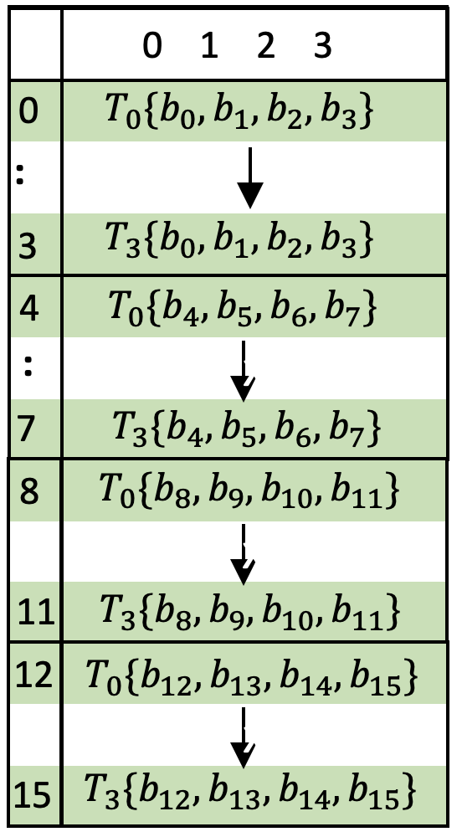
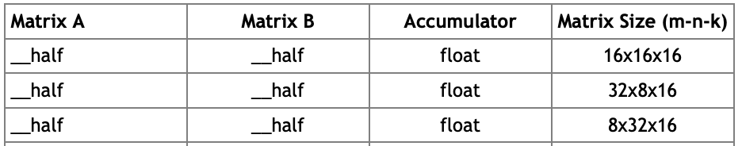


Challenges: with Tensor Core
Each warp processes an independent part:
  Partition the Thread Block Tile along TileN.
The warp tile is computed with wmma.m8n32k16
Only LDG.64 is available
violate Guideline V
(LDG.128 is desired)
Step K is a multiple of 16
Residual Handling Overhead
128B Read
TileN
64
16
32
Step K
When V$≤$4
There are wasted computation
16
Step K
64
16
32
16
V$≤8$
8
Scalable Energy-efficient Architecture Lab
Notes:
On the other hand, we can use the tensor core to process it.
As the tensor core operations are issued by a warp, we partition the thread block tile along Tile N to individual warp.
Similarly, we choose 64 to enable 128B read.
Volta tensor core supports three sizes in CUDA level. As we focus on V = 2, 4, 8, the 8 times 32 times 16 is our best choice to reduce wasted computation.
The first issue with this implementation is Step K should be multiple of 16. As there is no constraint on the number of nonzeros in each row in A, when the remaining elements is less than 16, we need to do a residual handling that causes addition overhead.
The second issue is about memory access. The mapping between operands and registers are shown here. Remember that the right hand size matrix is in row major, so each thread can only issue 64bit continuous access, this is suboptimal and violate guideline V.
Besides, even with m8n32k16, when V is smaller than 8, there are still certain computation wasted.

Slide 19

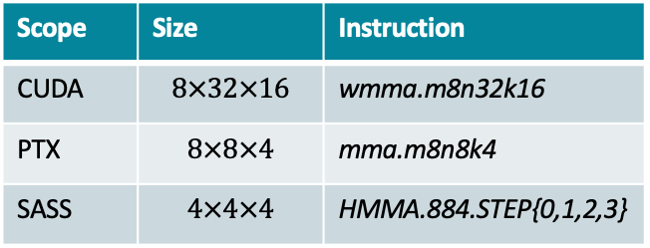
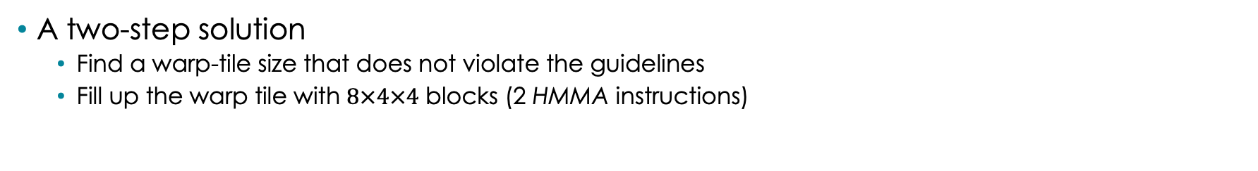
Solution: 1-D Octet Tiling with Tensor Core
The key Strategy is breaking down the workload of a warp to finer granularity
STEP 0
STEP 1
$$×$$
$$×$$
Scope | Size | Instruction
CUDA | $$8×32×16$$ | wmma.m8n32k16
PTX | $$8×8×4$$ | mma.m8n8k4
SASS | $$4×4×4$$ | HMMA.884.STEP{0,1,2,3}
STEP 2
STEP 3
$$×$$
$$×$$
4 Steps in mma.m8n8k4
A two-step solution
  Find a warp-tile size that does not violate the guidelines
  Fill up the warp tile with $8×4×4$ blocks (2 HMMA instructions)
Scalable Energy-efficient Architecture Lab
Notes:
As existing implementations do not work well, we propose a new technique called 1-D Octet tiling with tensor core.
The key strategy is breaking down the wmma to finner grandularity,
This figure shows all the granularity we can reach under different levels of programming language.
The PTX assembly offers 8x8x4 building blocks executed by 8 threads in a warp refered as octet.
The mma.m8n8k4 is further decomposed to four HMMA instructions when compiled to SASS, each HMMA computes a 4x4x4 coutput.
Motivated by this, we propose a two step solution.
First, we figure out a warp-tile size that does not violate our guidelines and possess all the merits we want.
Second, we fill up the warp tile with 8x4x4 blocks. We choose this size because we only need finer granularity at the column vector dimension.

Slide 20
Step 1: Find Warp-Tile Size
Conclusion: the warp tile should be m64n{8,4}k4 for SpMM
k is the smallest multiple of 4 as
The building block is m8n4k4
Smaller k has lower residual handling overhead
TileN
Step K
k=4
Step K
m=64
V
m is the smallest multiple of 64 as
64 FP16 data is perfectly 128 byte
Smaller m enables more warps thus higher TLP
4 or 8
n is 4 or 8 as
The building block is m8n4k4
We put V on n to avoid wasting computation when V=4
Scalable Energy-efficient Architecture Lab
Notes:
Let me show you how to obtain the warp tile size.
We first get a slice of computation from the thread block tile,
We transpose this slice and map the V to n to avoid wasting computations when V=4.
We have k=4 for two reasons. First, the building block is m8n4k4, so k should be a multiple of 4. Then, smaller k can effectively reduce the residual handling overhead.
For m, we pick 64. One one hand, 64 FP16 data is perfectly 128 Byte. So our Guideline V is satisfied. On the other hand, a smaller m enables us to launch more warp, this improves thread level parallelism.

Slide 21
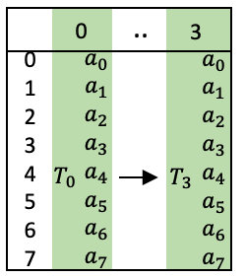
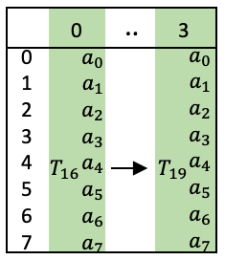
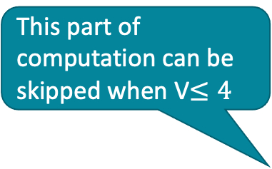
Step 2: Fill up the warp tile with $8×4×4$ blocks
This part of computation can be skipped when V$≤4$
Stored in shared memory for reuse
Consecutive 128-bit data are loaded by a single thread, so LDG.128 is used
8
4
4
0
0
Thread 0~3
Octet 0
0
1
1
Thread 16~19
4
2
2
Thread 4~7
Octet 1
1
3
3
Thread 20~23
64
5
4
4
Thread 8~11
Octet 2
2
5
5
Thread 24~27
6
The m8n4k4 Octet tile
6
6
Thread 12~15
8
Octet 3
3
7
7
Thread 28~31
4
7
Scalable Energy-efficient Architecture Lab
Notes:
The next step is to fill up the warp tile with 8x4x4 blocks.
As you can see, we have 4 octets. Each octet is composed of two thread groups. Each thread group contains 4 consecutive threads.
We fill up the warp tile in this way with several considerations.
First, this register layout enables use to use LDG.128. This is because consecutive 8 FP16 elements are mapped to consecutive registers of the same thread.
The RHS operand is stored in the shared memory as it is reused for many times.
These two small blocks shows the 8x4x4 octet tile.
With this tile, you can see that we can directly skip the useless computations when V=4.

Slide 22
SDDMM Kernel on Column-vector Sparse Encoding
Notes:
Next, I will present how to design an efficient SDDMM kernel for our column-vector sparse encoding.

Slide 23

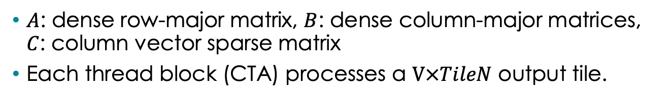
Problem Formation
$A$: dense row-major matrix, $B$: dense column-major matrices, $C$: column vector sparse matrix
Each thread block (CTA) processes a $V×TileN$ output tile.
Column-vector SDDMM
Thread Block Tile
N
B
Step K is a multiple of 64 to enable 128B coalesced reading
TileN
K
Step K
1
Step K
K
$≤$N
A
C
Step K%64 =0
M
Step K
TileN
V
V
V
1
Scalable Energy-efficient Architecture Lab
Notes:
In the SDDMM with column-vector sparsity, the dense row-major matrix A is multiplied with the dense column-major matrix B. The output matrix C is a sparse matrix under our column-vector sparsity.
Similarly, each thread block processes a V times TileN output tile.
To enable 128B coalesced memory access, we pick StepK as a multiple of 64.

Slide 24
Challenge: with Floating-point Units
The workload is partitioned along Step K to enable coalesced memory access
A reduction will be called at last to accumulate the partial sums
#pragma unroll
for v in range(V):
#pragma unroll
for n in range(TileN):
#pragma unroll
for k in range(StepK/CTA size):
C[v][n] += A[v][k] * B[k][n]
TileN
Small Grid Size
Violate Guideline2 (large grid size for higher TLP)
Step K
TileN
Step K/CTA size
A large volume of FMAs generated from the unrolled loop violate Guideline I (I-cache overflow)
Step K
V
V
TileK/CTA size
Each threads hold a copy and the register consumption is high
Low occupancy
Scalable Energy-efficient Architecture Lab
Notes:
Here we present a floating-point unit based implementation inspired by sputnik.
As the memory is continous along Step K, the workload is partitioned along the it, so that the threads can jointly load data from global memory coalescely.
At the end of the kernel, a reduction will be lunched to accumulate all the partial sums.
Similar to SpMM, the Floating-point unit based SDDMM kernel also needs to unroll all the three loops and suffer from instruction cache miss.
Besides, to use optimal memory access pattern, usually we can only map subwarps to this tile. This results in small grid size and violates guideline II.
Another issue is that each thread holds a copy of the partial sum. With TileN = 32 and V = 8, this requires 256 registers to cache the partial sums per thread, this greately reduce the occupancy.

Slide 25
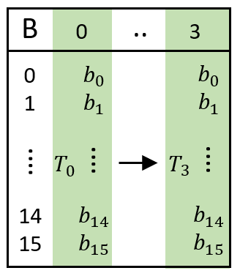

Challenge: with Tensor Core
Only 16B coalescing is available
violate Guideline V (128B is desired)
TileN
128B
Read
TileN
32
Step K
Tile N is a multiple of 32
Residual Handling Overhead
64
32
16
Step K
64
16
V
V
8
16
When V$≤$4
wasted computation
Scalable Energy-efficient Architecture Lab
Notes:
There are also some issues with the naive tensor core base solution.
Here we also pick 64 to enable 128B coalesced memory access. And we can map 8x32x16 blocks to it.
The first issue is with memory access. As you can see, there is only one thread mapped to each column of the right hand size matrix. So the memory access is only 16B while 128B is desired.
Then, similar to SpMM, this implementation requires Tile N to be a multiple of 32, this also introduce residual handling overhead.
Last but not least, then V is smaller than or equal to 4, there are wasted computation.

Slide 26
Step 1: Find Warp-Tile Size
m is the smallest multiple of 8 as
The building block is m8n4k4
Smaller m has lower residual handling overhead
TileN
Step K
m=8
Step K
V
k=64
k is the smallest multiple of 64 as
64 FP16 data is perfectly 128 byte
Smaller k reduces register burden
4 or 8
n is 4 or 8 as
The building block is m8n4k4
We put V on n to avoid wasting computation when V=4
Scalable Energy-efficient Architecture Lab
Notes:
With our two-step solution, we first identify the designed warp-tile size.
We also map V to n to avoid wasting computation when V=4
for m, it should be a multiple of 8 due to the minimum building block size. A smaller m is desired because it can reduce the register consumption and residual handling overhead.
We pick k equals to 64 to enable 128 B memory access with minimum register consumption.

Slide 27

Step 2: Fill up the Warp Tile with $8×4×4$ blocks
This part of computation can be skipped when V$≤4$
8
Consecutive 128-bit data are loaded by a single thread, so LDG.128 is used
0
4
Thread 0~3
Octet 0
0
1
5
Thread 16~19
4
2
6
Thread 4~7
Octet 1
1
3
7
Thread 20~23
64
5
4
0
Thread 8~11
0 1 2 3 4 5 6 7
0 1 2 3 4 5 6 7
Octet 2
2
0
$$T_{0}\{b_{0}, b_{1},b_{2}, b_{3}, b_{4}, b_{5}, b_{6},b_{7}\}$$
0
$$T_{16}\{b_{0}, b_{1},b_{2}, b_{3}, b_{4}, b_{5}, b_{6}, b_{7}\}$$
5
1
Thread 24~27
..
..
6
3
$$T_{3}\{b_{0}, b_{1},b_{2}, b_{3}, b_{4}, b_{5},b_{6}, b_{7}\}$$
3
$$T_{19}\{b_{0}, b_{1},b_{2}, b_{3}, b_{4}, b_{5}, b_{6}, b_{7}\}$$
4
$$T_{16}\{b_{8}, b_{9},b_{10}, b_{11}, b_{12}, b_{13},b_{14}, b_{15}\}$$
4
$$T_{0}\{b_{8}, b_{9},b_{10}, b_{11}, b_{12}, b_{13}, b_{14},b_{15}\}$$
6
2
Thread 12~15
..
$$T_{19}\{b_{8}, b_{9},b_{10}, b_{11}, b_{12}, b_{13}, b_{14}, b_{15}\}$$
..
$$T_{3}\{b_{8}, b_{9},b_{10}, b_{11}, b_{12}, b_{13},b_{14}, b_{15}\}$$
Octet 3
3
7
7
7
3
7
Thread 28~31
64
8
0
1
2
3
4
5
6
7
4
5
6
7
0
1
2
3
The m8n4k4 Octet tile
Scalable Energy-efficient Architecture Lab
Notes:
This 8x8x64 warp tile is filled up in this way.
You can see consecutive 8 operands are mapped to consecutive registers in a thread, so we can use 128bit vector memory load.
Besides, along the reduction axis, there are 8 different threads. So we can use 128 byte transactions to read the source operands.
This small block shows the 8x4x4 building block.
Similarly, it is possible to skip the useless computations when V < 8.

Slide 28
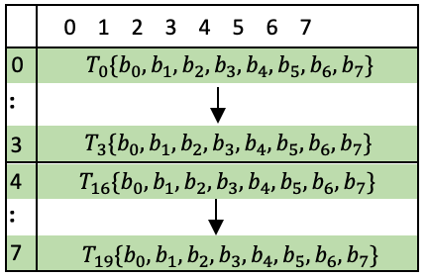
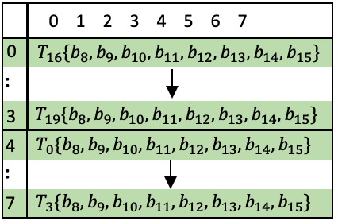
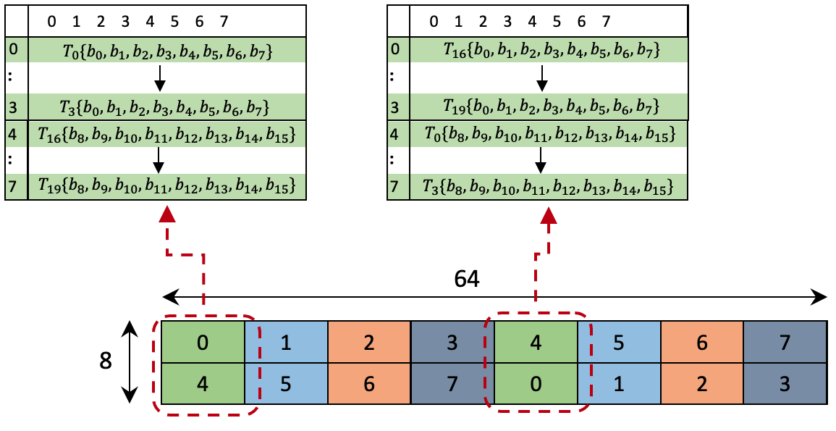
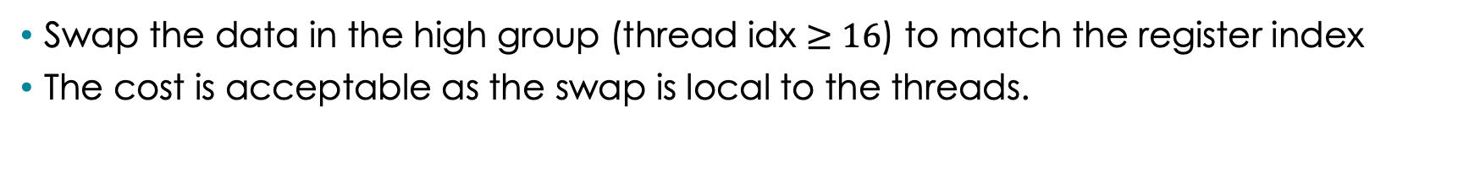
Pre-compute reorganize
Swap the data in the high group (thread idx $≥16$) to match the register index
The cost is acceptable as the swap is local to the threads.
The register index does not match
Scalable Energy-efficient Architecture Lab
Notes:
However, after loading the data to registers, they can not be directly used.
This is because the register index of two thread groups in the same octet doesn't match.
To fix this, we need to manually swap the data in the groups with thread index greater than or equal to 16 to match the register index.
We find that this overhead is acceptable as it is local to the threads.

Slide 29
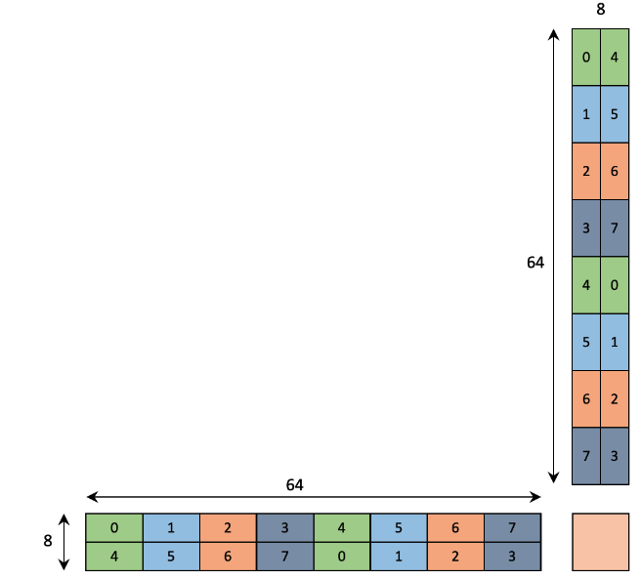
Post-compute reorganize
Software Solutions:
  Store the partial sum from odd & even steps to different registers
    Pros: No overhead during reduction
    Cons: relatively low occupancy due to higher register consumption
  Shuffle the odd steps before accumulation
    Pros: doesn’t affect occupancy
    Cons: overhead from the shuffle
The thread index does not match
0
4
0
0
4
4
4
0
4
4
0
0
Scalable Energy-efficient Architecture Lab
Notes:
The second thing to fix is after the computation.
As you can see, the mapping between output and threads are different in even and odd steps.
On the software side, this can be fixed by storing different mappings in different registers and accumulate them at the end.This introduce no overhead during reduction, but it consumes more registers thus reduces occupancy.
Another solution is shuffle the odd steps before each accumulation. Oppositely, while it does not affect occupancy, there are additional suffle overhead.

Slide 30
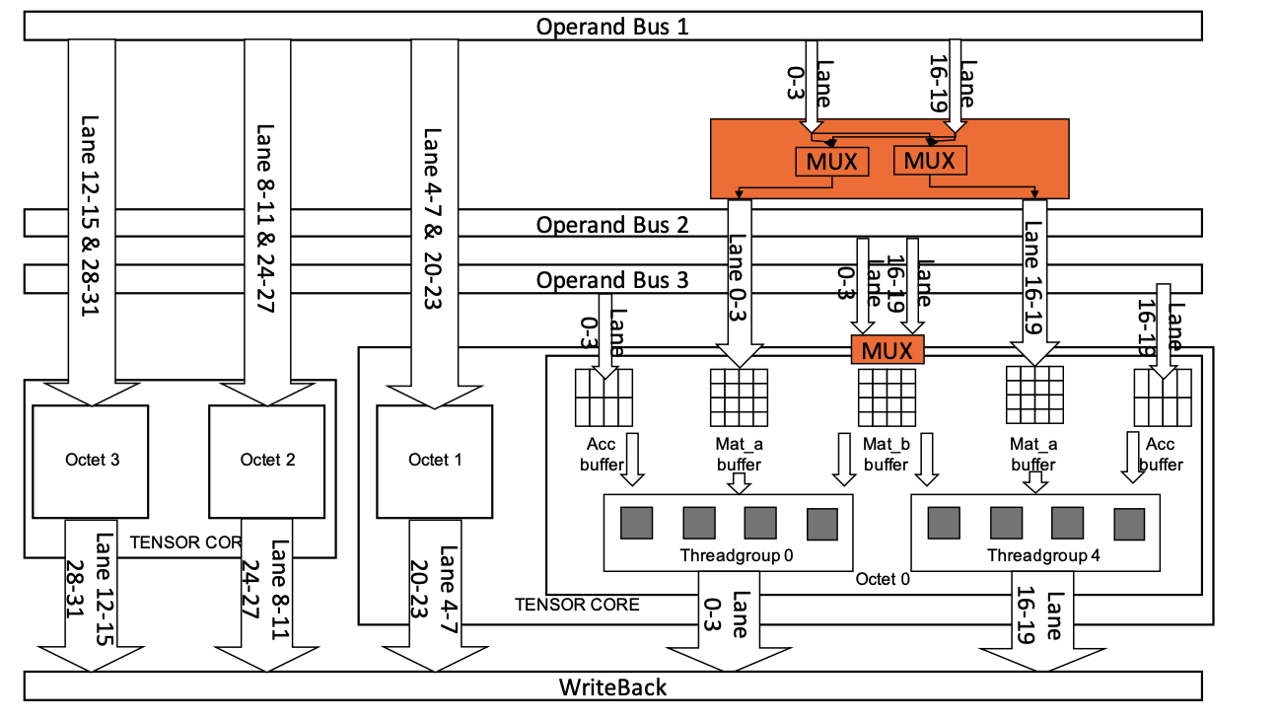
Potential Solution on Hardware Side
  Extend the HMMA with an addition switch Flag:
  HMMA.884.STEP{0,1,2,3}.SWITCH
  The switch flag is XORed with the original control signal of the MUX above Mat_b buffer
  It also controls the two added MUX that switch the source of two Mat_a buffers in an octet
Scalable Energy-efficient Architecture Lab
Notes:
We also propose a potential solution on the hardware side.
We could extend the HMMA instruction with an additional control bit Switch.
When this bit it set, it is xored with the multiplexer for mat-b buffer and also switch the source of two mat_a buffers in an octet through two additional multiplexers.
In this way, we can set the switch bit in the odd steps to avoid the overheads in the software side solutions.

Slide 31
Evaluation
Notes:
At last, we evaluate our implementations and compare it with SOTA kernels.

Slide 32
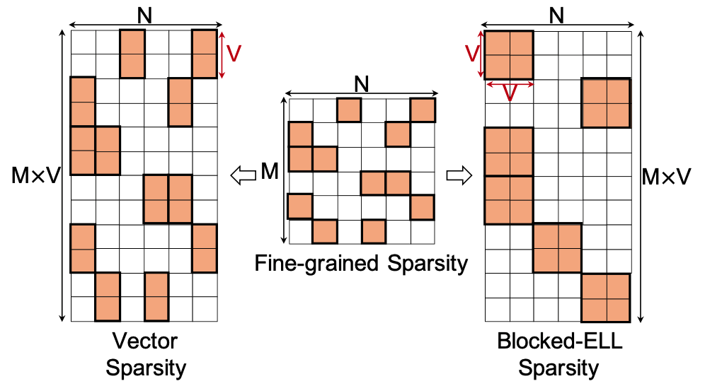
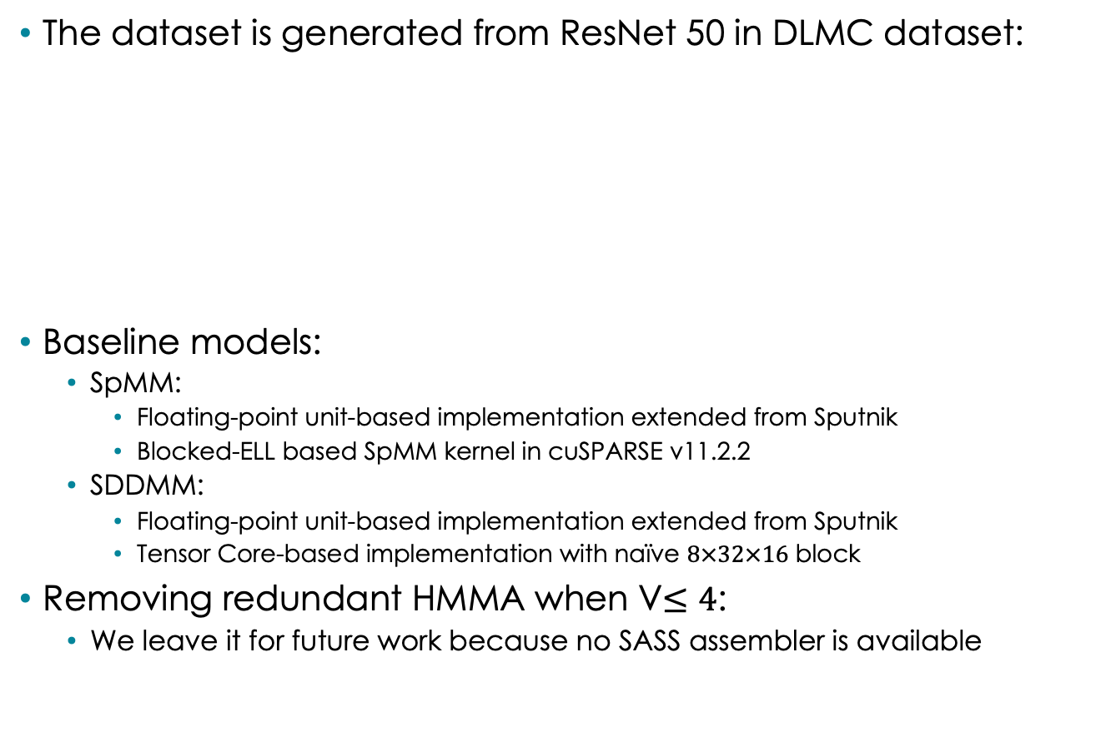
Setup
The dataset is generated from ResNet 50 in DLMC dataset:
Baseline models:
  SpMM:
    Floating-point unit-based implementation extended from Sputnik
    Blocked-ELL based SpMM kernel in cuSPARSE v11.2.2
  SDDMM:
    Floating-point unit-based implementation extended from Sputnik
    Tensor Core-based implementation with naïve $8×32×16$ block
Removing redundant HMMA when V$≤4$:
  We leave it for future work because no SASS assembler is available
Scalable Energy-efficient Architecture Lab
Notes:
We generate the vector column sparse matrices from the fine-grained sparse matrices in DLMC dataset by replacing each scalar with a short vector.
For both SpMM and SDDMM, we choose the extended implementation from Sputnik as the FPU baseline.
We use the Blocked-ELL based SpMM in cuSPARSE v11.2.2 under the same sparsity as the tcu based spmm baseline.
For SDDMM, as the blocked SDDMM is not supported by cuSPARSE at that time, we implemented a version with the naive 8x32x16 wmma blocks.
Although our method expose opportunities to skip redundant computation when V= 4, as there is no SASS assembler available, we leave it for future work.

Slide 33
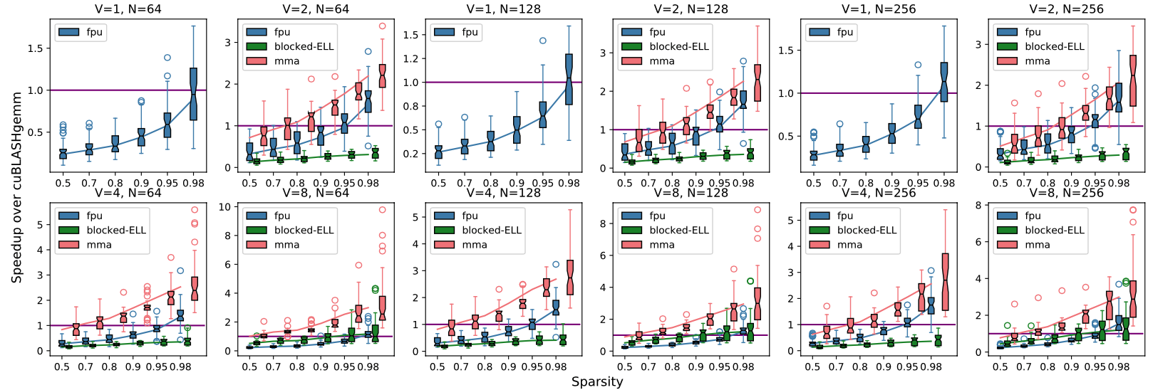
SpMM Speedup
1.34~4.51x and 1.71~7.19x geo mean speedup over FPU & TCU baselines
Scalable Energy-efficient Architecture Lab
Notes:
In SpMM, we achieve 1.34 to 4.51 and 1.71 to 7.19 geometric mean speedup over the FPU & TCU baselines.

Slide 34
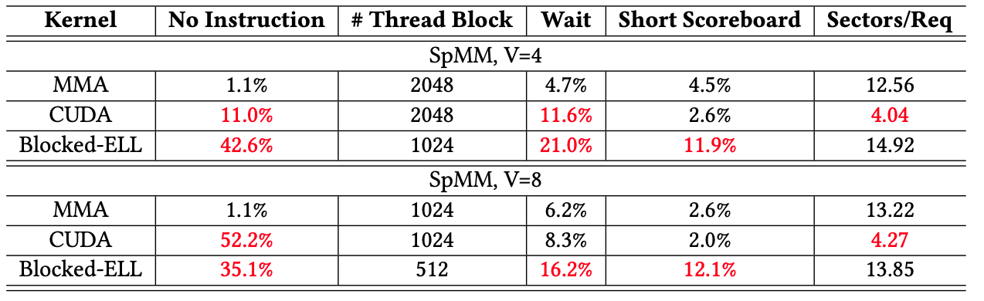
Performance Analysis
We compare the kernels in terms of the five guidelines
  No Instruction: Reduce kernel size to avoid overflow the I-cache
  # Thread Block: Increase the grid size to improve thread-level-parallelism
  Wait: Reduce fixed-latency operations
  Short Scoreboard: Remove the shared memory from critical path
  Sectors/Req: Use 128B coalesced transactions and LDG.128
Scalable Energy-efficient Architecture Lab
Notes:
To justify the speedup. We compare the kernels in terms of our five guidelines.
* We choose the persentage of stall caused by no instruction as an identifier on whether the I-cache is overflowed
* The number of thread block is used to characterize the TLP
* The persentage of stall caused by wait is used to reflect whether the implementation has many fixed latency operations.
* The persentage of short scoreboard stall is used to see whether shared memory becomes a. bottle neck.
* We use Sectors/Req to reflect the efficiency of memory access.
The results are summarized in this figure. We use reg to mark the results that do not meet the guidelines. It is obvious that our mma based implementation is the only one that meets all these guidelines.

Slide 35
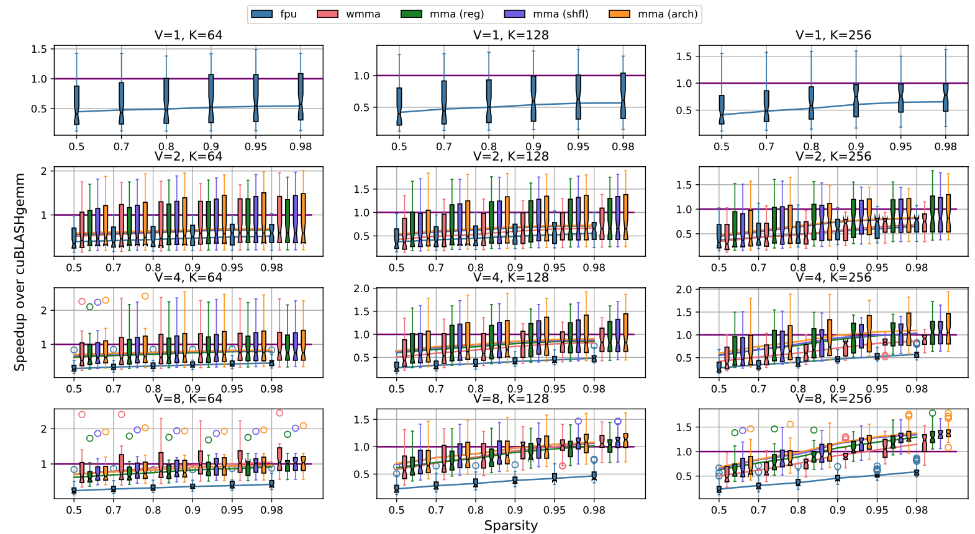
SDDMM Speedup
1.27-3.93x and 0.93~1.44x geo mean speedup over the FPU and TCU baselines
Scalable Energy-efficient Architecture Lab
Notes:
A similar result is observed in SDDMM. We achieve 1.27-3.93 and 0.93-1.44x geometric mean speedup over the two baselines
we observe that the naive wmma achieves better results when K is small. This is because it does not require additional reduction after the accumulation. When K grows longer, our mma based implementation quickely surpass it.
The shuffle based mma usually achieves better speedup than the register based. This suggests occupancy is more important and the shuffle overhead is acceptable. Besides, we emulate the speedup with our hardware level solution with fake code. It is obvious that it achieves better speedup than the two software based solutions.

Slide 36
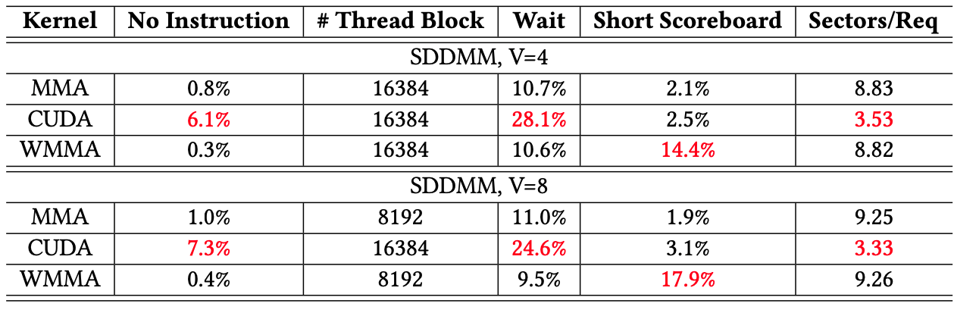
Performance Analysis
We compare the kernels in terms of the five guidelines
  No Instruction: Reduce kernel size to avoid overflow the I-cache
  # Thread Block: Increase the grid size to improve thread-level-parallelism
  Wait: Reduce fix-latency operations
  Short Scoreboard: Remove the shared memory from critical path
  Sectors/Req: Use 128B coalesced transactions and LDG.128
Scalable Energy-efficient Architecture Lab
Notes:
Similarly, our profiling result reveals that our method is the only implementation that meets all the guidelines.

Slide 37
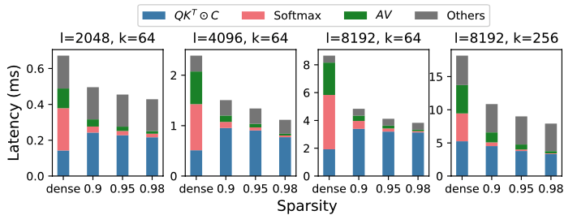
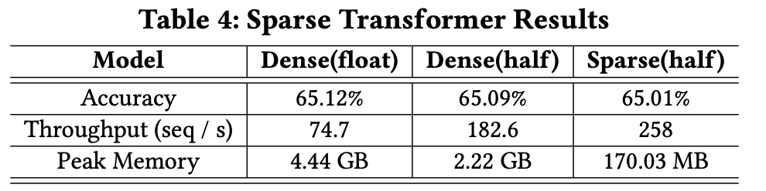
Case Study: Sparse Transformer
A transformer model with fixed sparse attention mask on the byte-level text classification in Long-Range Arena.
  Sequence Length: 4000
  Sparsity pattern: 90% column-vector sparsity with 1x8 nonzero vectors
Scalable Energy-efficient Architecture Lab
Notes:
Last, we demonstrate the performance on sparse transformer.
We use a transformer model with fixed sparse attention mask on the byte-level text classification in Long-Range Arena. The sequence length is 4000, and the sparsity pattern is 90% with 8x1 column vector.
It is obvious that we achieve good speedup and memory footprint reduction over the dense attention with negletable accuracy loss.

Slide 38
Conclusion

Slide 39
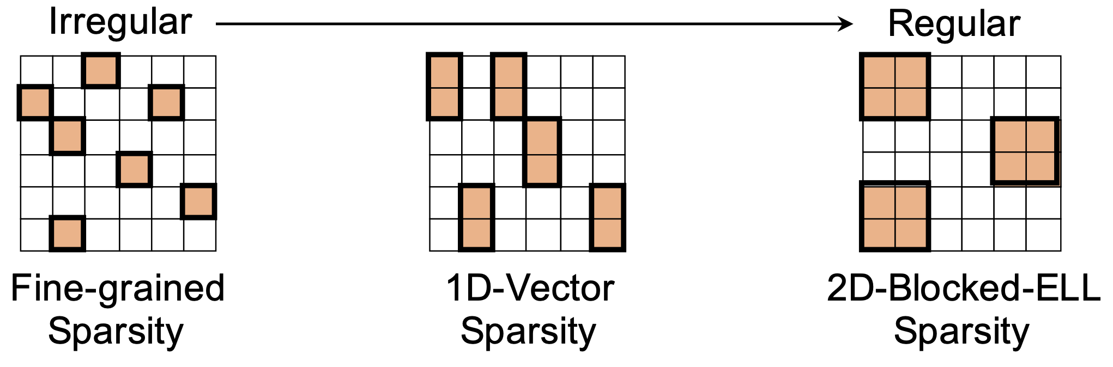
Conclusion
Sparse Pattern:
  It provides enough data reuse rate through structured pattern
  The structure size is small enough to preserve model accuracy
GPU Kernel Design:
  1-D Octet Tiling with Tensor Core
  A pair of SpMM and SDDMM kernels achieve 0.93~7.19x geometric mean speedup over existing implementations under float16
Scalable Energy-efficient Architecture Lab
Notes:
To conclude, in this paper
we first present a new sparse pattern. On one hand, it provides enough data reuse rate through structured pattern. On the other hand, the structure size is as small as possible to preserve model accuracy.
Then, we present an efficient GPU kernel design that achieves speedup with this pattern.
Specifically, we propose the 1-D octet tiling with tensor core that works efficiently under small structure size.
Then, based on this technique, we develop a pair of SpMM and SDDMM kernels that achieve SOTA performance under half precision.
.

Slide 40
Thank You
https://github.com/apuaaChen/vectorSparse
Notes:
That's all my presentation and thank you for your listening.
Our code is publically available on github.

