Slide 1
High-Throughput Virtual Screening of Small Molecule Inhibitors for SARS-CoV-2 Protein Targets with Deep Fusion Models
Garrett A. Stevenson¹, Derek Jones¹, Hyojin Kim¹, W.F. Drew Bennett¹, Brian J. Bennion¹, Monica Borucki¹, Feliza Bourguet¹, Aiden Epstein¹, Magdalena Franco¹, Brooke Harmon², Stewart He¹, Max P. Katz³, Daniel Kirshner¹, Victoria Lao¹, Edmond Y. Lau¹, Jacky Lo¹, Kevin McLoughlin¹, Richard Mosesso², Deepa K. Murugesh¹, Oscar A. Negrete², Edwin A. Saada¹, Brent Segelke¹, Maxwell Stefan², Marisa W. Torres¹, Dina Weilhammer¹, Sergio Wong¹, Yue Yang¹, Adam Zemla¹, Xiaohua Zhang¹, Fangqiang Zhu¹, Felice C. Lightstone¹,
Jonathan E. Allen¹
¹Lawrence Livermore National Laboratory, Livermore CA
²Sandia National Laboratories, Livermore CA
³NVIDIA Corporation, Santa Clara CA
November 18th, 2021

Slide 2
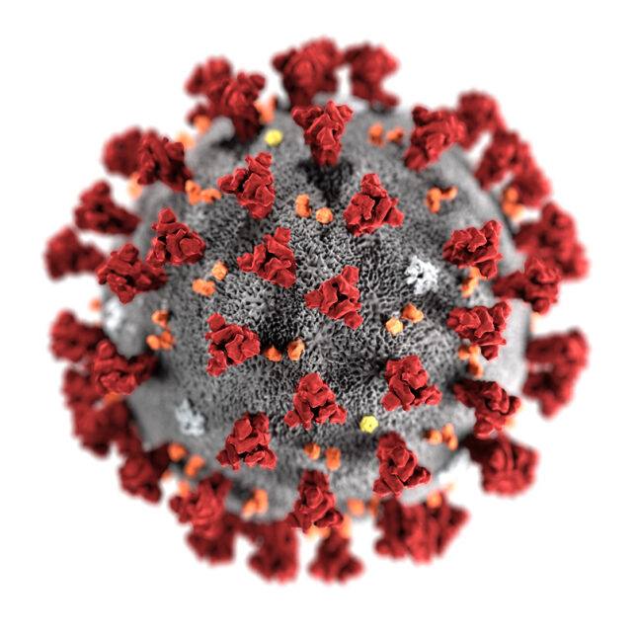
COVID-19 / Deep Fusion Timeline
Pandemic / National Emergency
Covid-19
First Case
(WHO)
FDA approves vaccines
CARES
Act
2 million U.S. Cases
Jan.
2020
Feb.
2020
Mar.
2020
Apr.
2020
May
2020
Jun.
2020
Jul.
2020
Aug.- Dec.
2020
Jan.
2021
Feb.
2021
Mar.2021
Apr.
2021
Original Deep Fusion Paper Drafted
LLN/Sandia Antiviral Work Begins
First large screen with Coherent Fusion
First LLNL/Sandia experimental assays run
LLNL/Sandia iteratively screen and test compounds
SC21 Paper Submitted
Improving Fusion Model
Screening with new Fusion Model
Deep Fusion

Slide 3
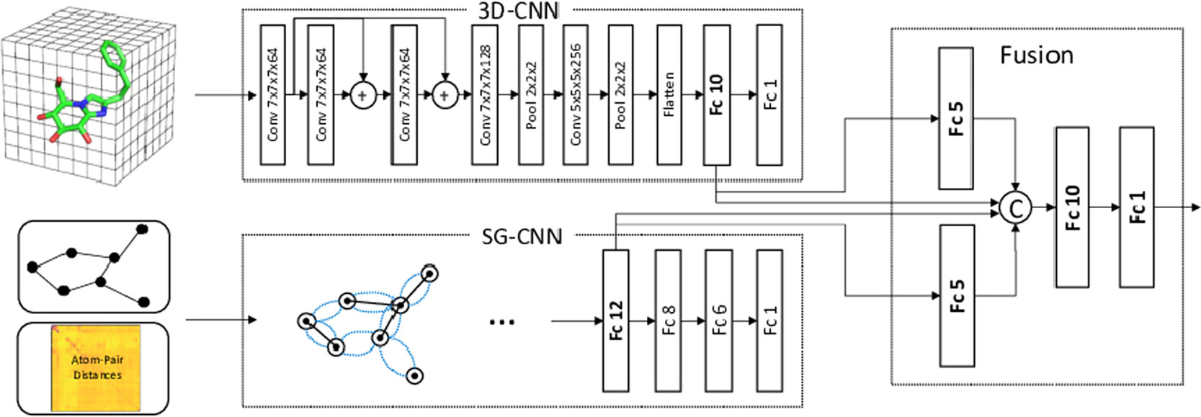
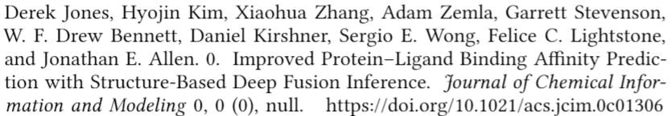
Structure-Based Deep Fusion
Molecular Docking Poses
Binding Affinity Prediction
Structure-Based Deep Fusion combines a Spatial-Graph CNN with a 3D-CNN to improve prediction accuracy.

Slide 4
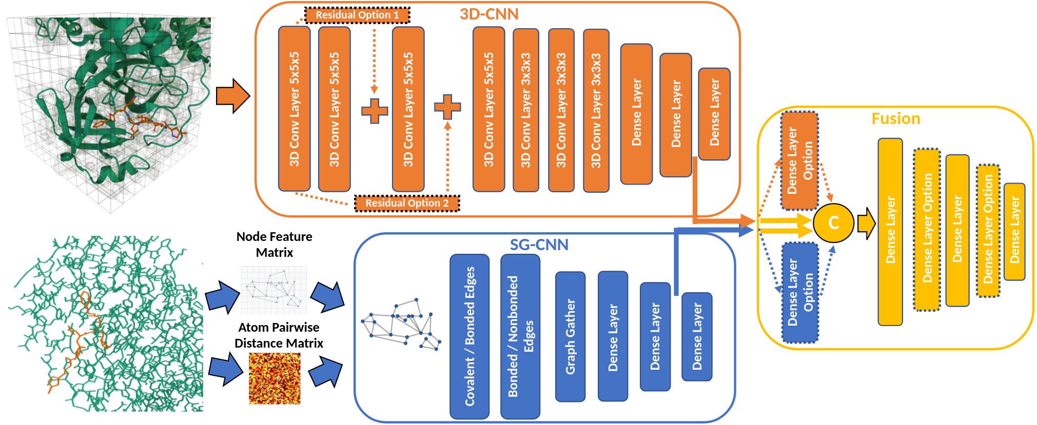
Coherent Fusion Model Architecture
Coherent Fusion backpropagates both heads of the Structure-Based model coherently to emphasize their strengths.

Slide 5
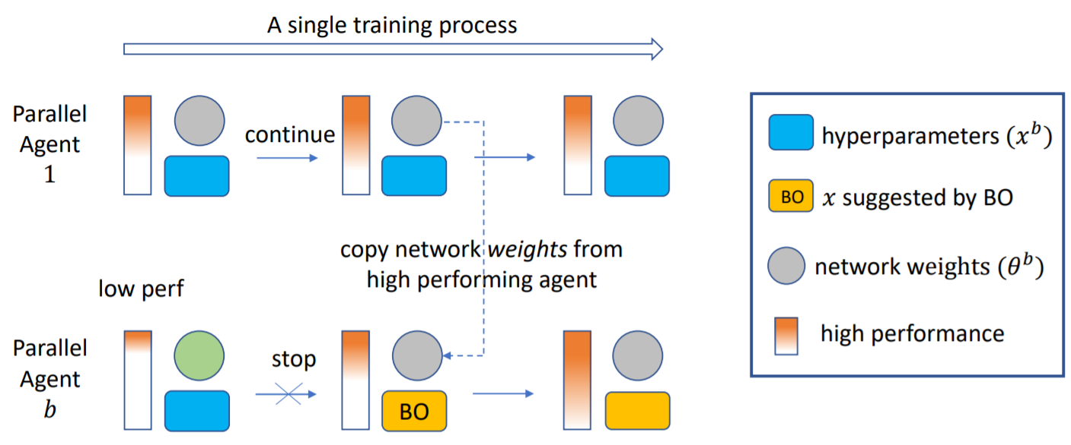

Population-Based Bandits (PB2) Optimization

Slide 6
Hyperparameter Search Space
Optimizer | Early Dropout | Non-Covalent K
Activation Function | Mid Dropout | Covalent K
Batch Size | Late Dropout | Non-Covalent Neighbor Threshold
Learning Rate | # of Fusion Layers | Covalent Neighbor Threshold
Model-Specific Fusion Layers | # of Dense Nodes | Non-Covalent Gather Width
Epochs | Early Residual Connection | Covalent Gather Width
Pre-trained Weights | Late Residual Connection | Covalent K
Batch Normalization | # of Early Conv. Filters | Non-Covalent Neighbor Threshold
 | # of Late Conv. Filters
Hyperparameters evaluated represented categorical /continuous training variables (traditional hyperparameters) and model architecture decisions.

Slide 7
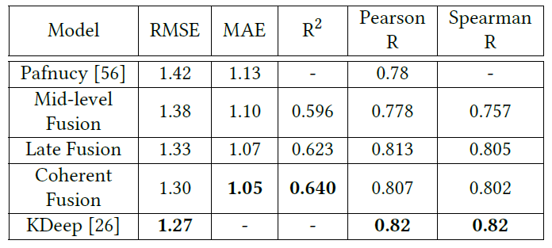
Evaluation Results: Crystal Structures
Benchmark PDBBind “Core” Set
  Representative of larger PDBBind
  290 Compounds
  In practice, crystal structure data is not available

Slide 8
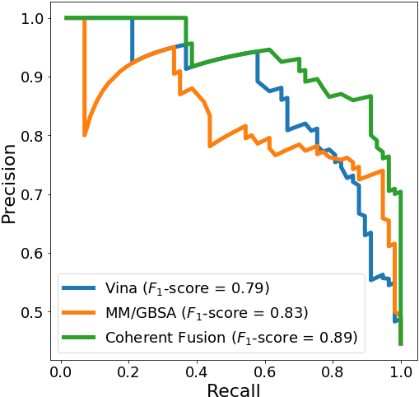
Evaluation Results: Docked Poses
PDBBind “Core” Set Docked Poses
  128 Compounds
  57 “strong” binders pKi/pKd > 8
  71 “weak” binders pKi/pKd < 6
Compare with Physics-based methods (Pearson correlation)
  Autodock Vina (0.579)
  MM/GBSA (0.591)
  Fusion (0.745)
Coherent Fusion shows predictive value in noisy docking space

Slide 9
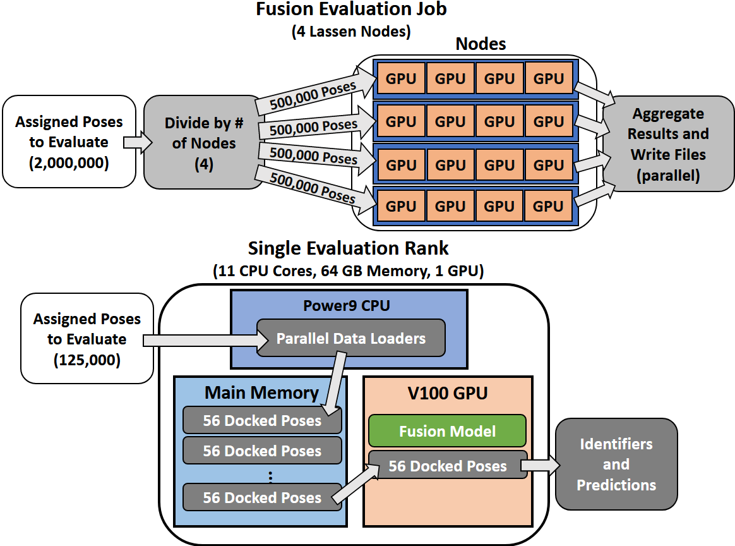
Structure of Single Fusion Scoring Job
Design for failure
  Screened over 5 billion docked poses against 4 targets
  4 nodes per job
Maximize throughput
  12 parallel data loaders per rank
  Parallel results writing

Slide 10
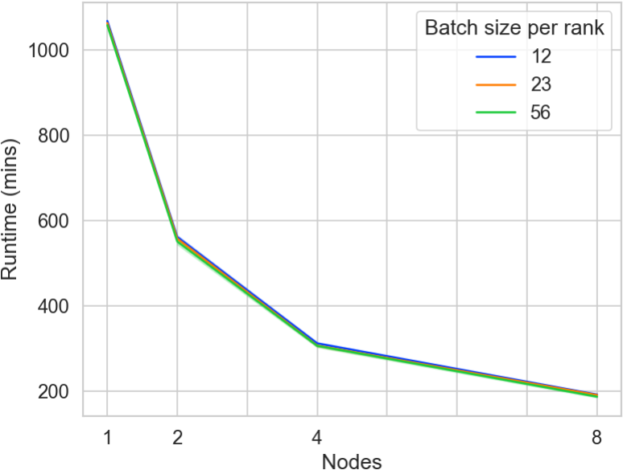
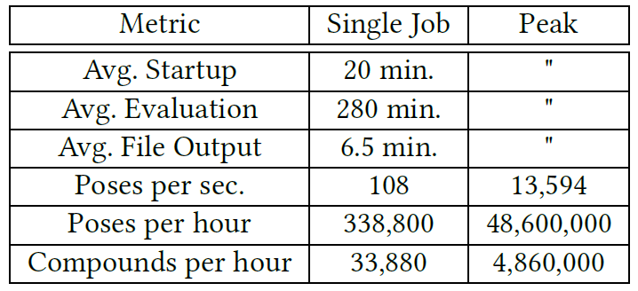
Throughput and Strong Scaling
Scaled up to 500 Lassen nodes
  Throughput increased more than 100x
  Evaluation time is 2.7x faster than Vina and 403x faster than single-point MM/GBSA

Slide 11
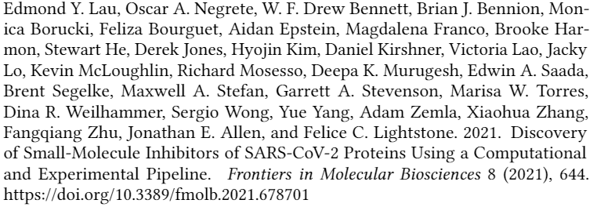
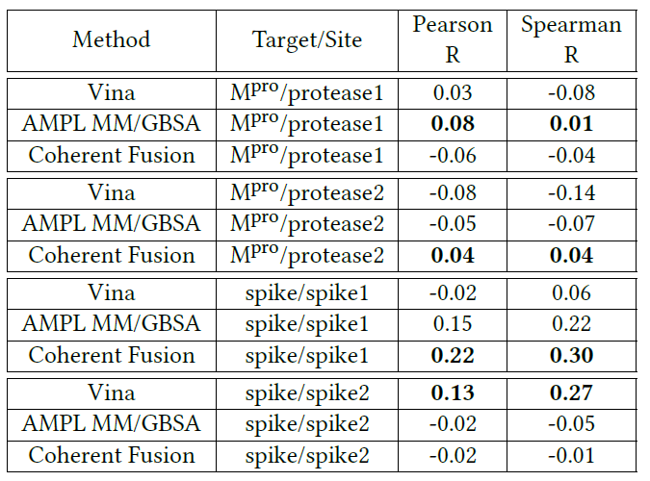
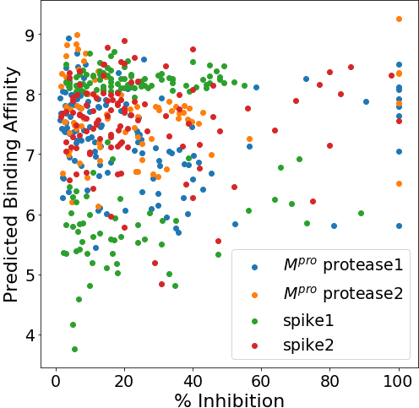
Experimental Results Evaluation
FRET-based (Mpro) and Biolayer Inferometry Assays (spike)
  Assays yield 0-100% inhibitions for each compound
  Correlations are poor, which is typical for drug discovery methods

Slide 12
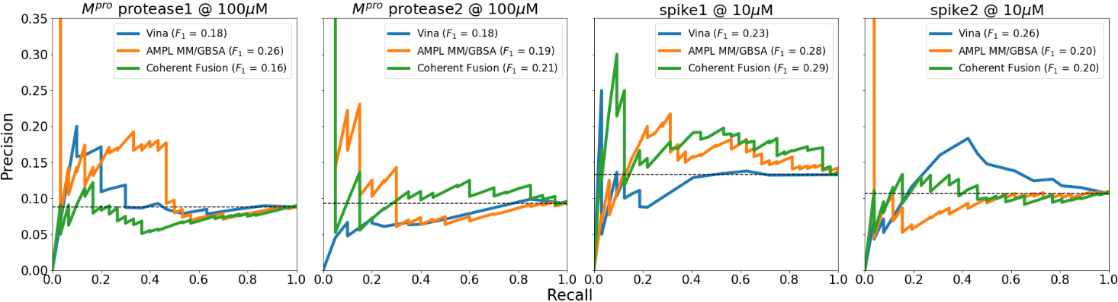
Precision/Recall Curves and F1-scores
<33% inhibition = positive, >33% inhibition = negative
  Black dashed line is Cohen’s Kappa statistic (random predictor)
  216-331 of samples per target
Best predictor varies per target
  Coherent Fusion predicts best on Mpro/protease1 and spike/spike1

Slide 13
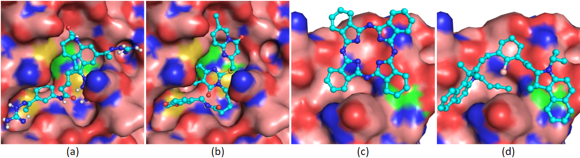
Visualizing Top Inhibitors
M_{pro} – protease1 @ 100µM
Spike – spike1 @ 10µM
100% inhibition
100% inhibition
100% inhibition
98% inhibition
eMolecules ID
76051337
eMolecules ID
24424612
eMolecules ID
18594404
eMolecules ID
313102183

Slide 14
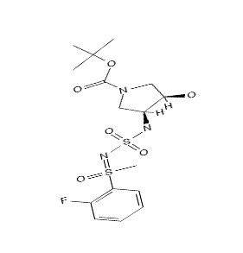
Novel M_{pro} Enamine Lead
Compound selected by Coherent Fusion in top <1% of Enamine
Verified inhibitory potential at multiple concentrations

Slide 15
Future Work
Target-specific tuning (M_{pro})
Semi-supervised training
CPU-only evaluation
Continue to use for compound selection

Slide 16







Funding / Acknowledgements
Professor Xinquan Wang
  Tsinghua University
National Virtual Biotechnology Laboratory
  DOE Office of Science
Coronavirus CARES Act
Laboratory Directed Research and Development projects
  Lawrence Livermore National Laboratory
American Heart Association
ATOM Consortium
  National Nuclear Security Administration
DTRA
Livermore Computing (LC)
Sandia National Laboratories

Slide 17
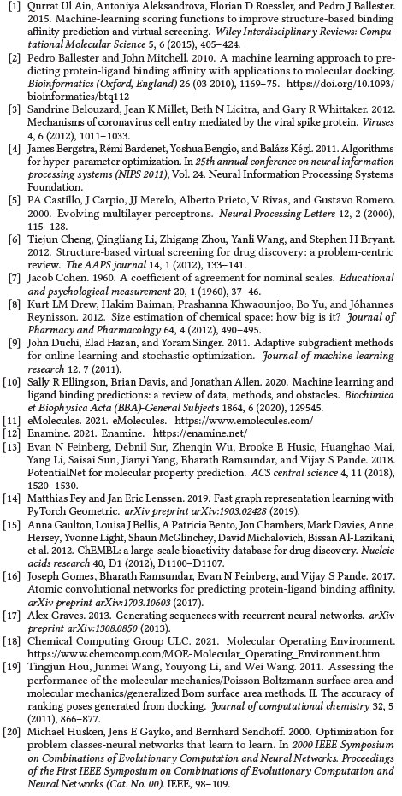
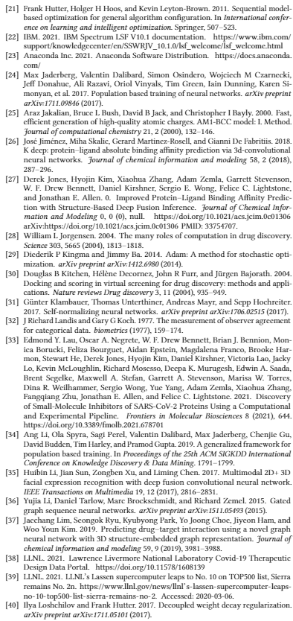
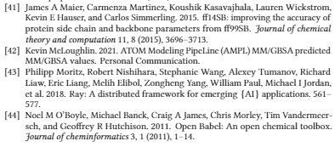
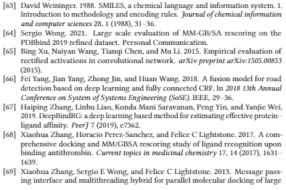
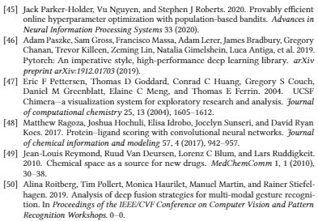
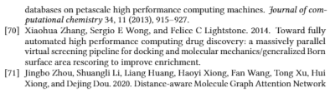

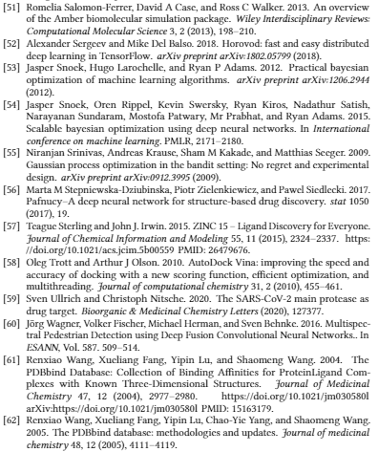
References

Slide 18
Disclaimer
This document was prepared as an account of work sponsored by an agency of the United States government. Neither the United States government nor Lawrence Livermore National Security, LLC, nor any of their employees makes any warranty, expressed or implied, or assumes any legal liability or responsibility for the accuracy, completeness, or usefulness of any information, apparatus, product, or process disclosed, or represents that its use would not infringe privately owned rights. Reference herein to any specific commercial product, process, or service by trade name, trademark, manufacturer, or otherwise does not necessarily constitute or imply its endorsement, recommendation, or favoring by the United States government or Lawrence Livermore National Security, LLC. The views and opinions of authors expressed herein do not necessarily state or reflect those of the United States government or Lawrence Livermore National Security, LLC, and shall not be used for advertising or product endorsement purposes.

Slide 19
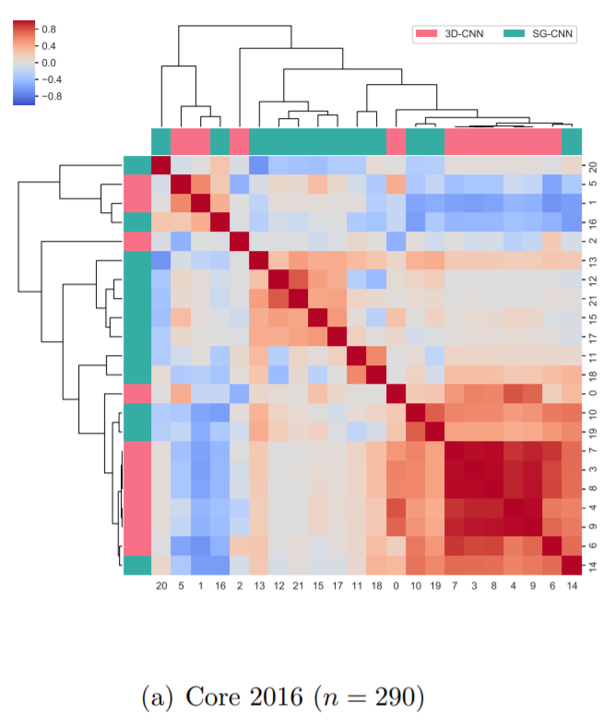
SG-CNN vs. 3D-CNN Features

Slide 20
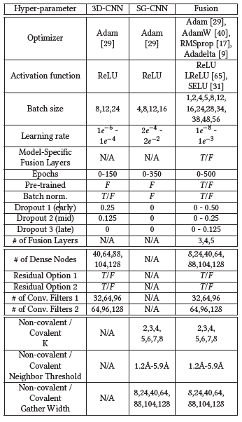
Hyperparameters

Slide 21
Core Features
One-hot encoded atomic number
Heavy-valence, Hetero-valence
Parital charges
Hydrophobic
Aromatic
Acceptor, Donor, Ring
Metal
Halogen
Van Der Waals Radius
Mass

