Slide 1


Lunule: An Agile and Judicious Metadata Load Balancer for CephFS
Yiduo Wang, Cheng Li, Xinyang Shao, Youxu Chen, Feng Yan, Yinlong Xu
University of Science and Technology of China
Anhui Province Key Laboratory of High Performance Computing
University of Nevada, Reno
Notes:
Hi everyone, I'm Yiduo Wang from University of Science and Technology of China. Today I'm going to present our recent work: "Lunule: An Agile and Judicious Metadata Load Balancer for CephFS“

Slide 2









Distributed File Systems (DFSs)
Cloud
AI
HPC
Distributed File Systems
Notes:
In the BigData era, many applications are very data-intensive. To cope with the unprecedented increase in the data volume, a common practice for these applications is to store massive data into distributed file systems. There have been proposed many distributed file system solutions, for instance BeeGFS, Lustre, CephFS, HDFS, GlusterFS. They have been widely used in many areas, such as Cloud Computing, Machine Learning, High Performance Computing, and so on.
[transition]
Let's review the architecture of DFS first.

Slide 3
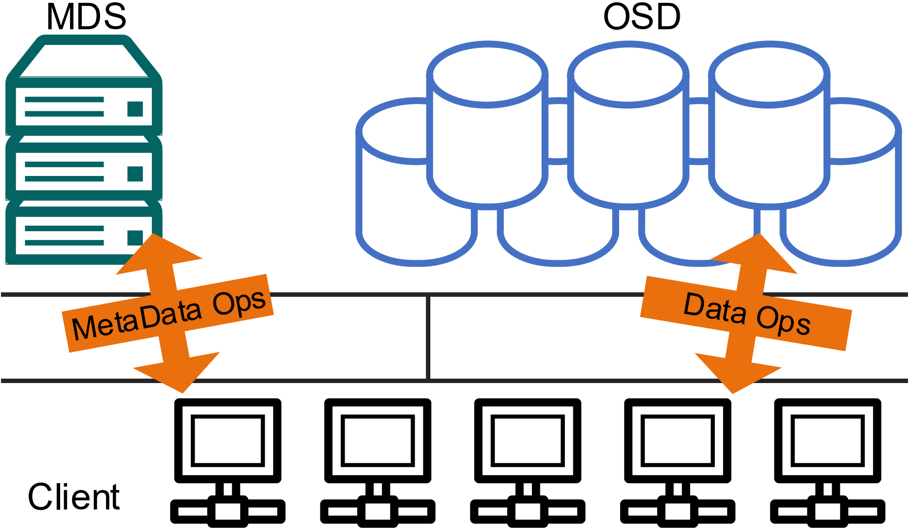


Modern DFS Architecture
Independent metadata/ data scaling
Fast in-memory metadata
processing
Expensive metadata management cost
Notes:
In general, most popular DFSs adopt a metadata/data decoupled design, which stores metadata in memory for fast lookup and allows independent metadata/ data scaling. However, this decoupled design requires additional effort for metadata management.

Slide 4
Modern DFS Architecture
High-capacity, low-latency
NVMe SSDs make data access extremely fast
Metadata becomes a bottleneck [1,2].
[1] Metadata traces and workload models for evaluating big storage systems. UCC 2012
[2] The composite-file file system: Decoupling the one-to-one mapping of files and metadata for better performance. FAST 2016
Notes:
What’s worse, with the evolution of hardware such as high-capacity, low-latency NVMe block devices, the latency of data access could be fairly low, and the overhead of metadata visits stands out. As a result, the metadata service, a.k.a. MDS, often becomes the bottleneck of modern DFS,
[transition]
Therefore, we need to improve the metadata service performance.

Slide 5
Scaling Metadata Service in DFSs
Maintain multiple MDSs, each hosting a set of metadata partitions
Notes:
To scaling the performance of metadata in DFSs, Morden DFSs will maintain multiple MDSs, each hosting a set of metadata partitions, so that ideally metadata operations can be handled in parallel by different MDSs.

Slide 6


Scaling Metadata Service in DFSs
Maintain multiple MDSs, each hosting a set of metadata partitions
Mainstream partitioning methods: Hash or Subtree partition
CephFS
SC’04
HBA
TPDS’07
Lustre-DNE1
2014
LocoFS
SC’17
HopsFS
FAST’19
CFS
SIGMOD’19
BeeGFS
SC’07
IndexFS
SC’14
Lustre-DNE2
2014
SoMeta
Cluster’17
Hash-Based
Subtree-Based
Notes:
So far, lots of distributed file systems have adopted the multi-MDS setup
[click]
and there are two mainstream solutions to partition and distribute metadata: Hash-based partition or subtree-based partition.

Slide 7

Scaling Metadata Service in DFSs
Maintain multiple MDSs, each hosting a set of metadata partitions
Mainstream partitioning methods: Hash or Subtree partition
CephFS
SC’04
HBA
TPDS’07
Lustre-DNE1
2014
LocoFS
SC’17
HopsFS
FAST’19
CFS
SIGMOD’19
The most popular subtree-based DFS
Evolving fast in the past decade
BeeGFS
SC’07
IndexFS
SC’14
Lustre-DNE2
2014
SoMeta
Cluster’17
Hash-Based
Subtree-Based
Notes:
And CephFS, the most popular one among the subtree-based distributed file systems, has evolved rapidly and well-developed over the past decade. Therefore, our work focuses on CephFS. However, it is worth noting that many of our design principles are also applicable to other partitioning methods.
[transition]
Next, I will give a brief introduce to the metadata management method in CephFS.

Slide 8
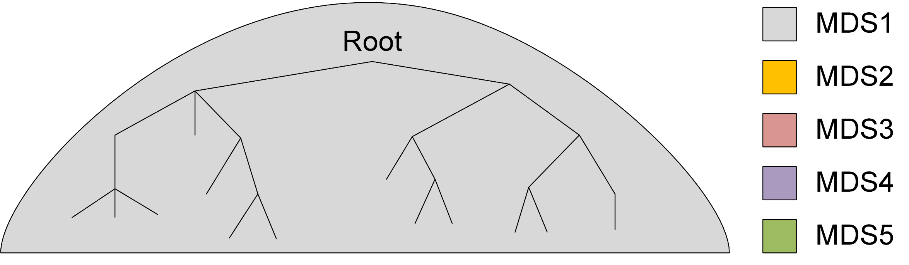
Subtree-Based Metadata Partition
Initially, one MDS stores all metadata.
Requests
Notes:
In CephFS, metadata is organized as subtrees, and initially, all metadata is stored in one MDS. In this example, it is MDS1.
Obviously, all requests will be directed to MDS1, and this state is unable to utilize the full resources of the cluster.

Slide 9

Subtree-Based Metadata Partition
Split metadata into multiple subtrees.
Requests
Notes:
Therefore, to balance the workload,
[click]
CephFS will first split metadata into multiple subtrees.

Slide 10
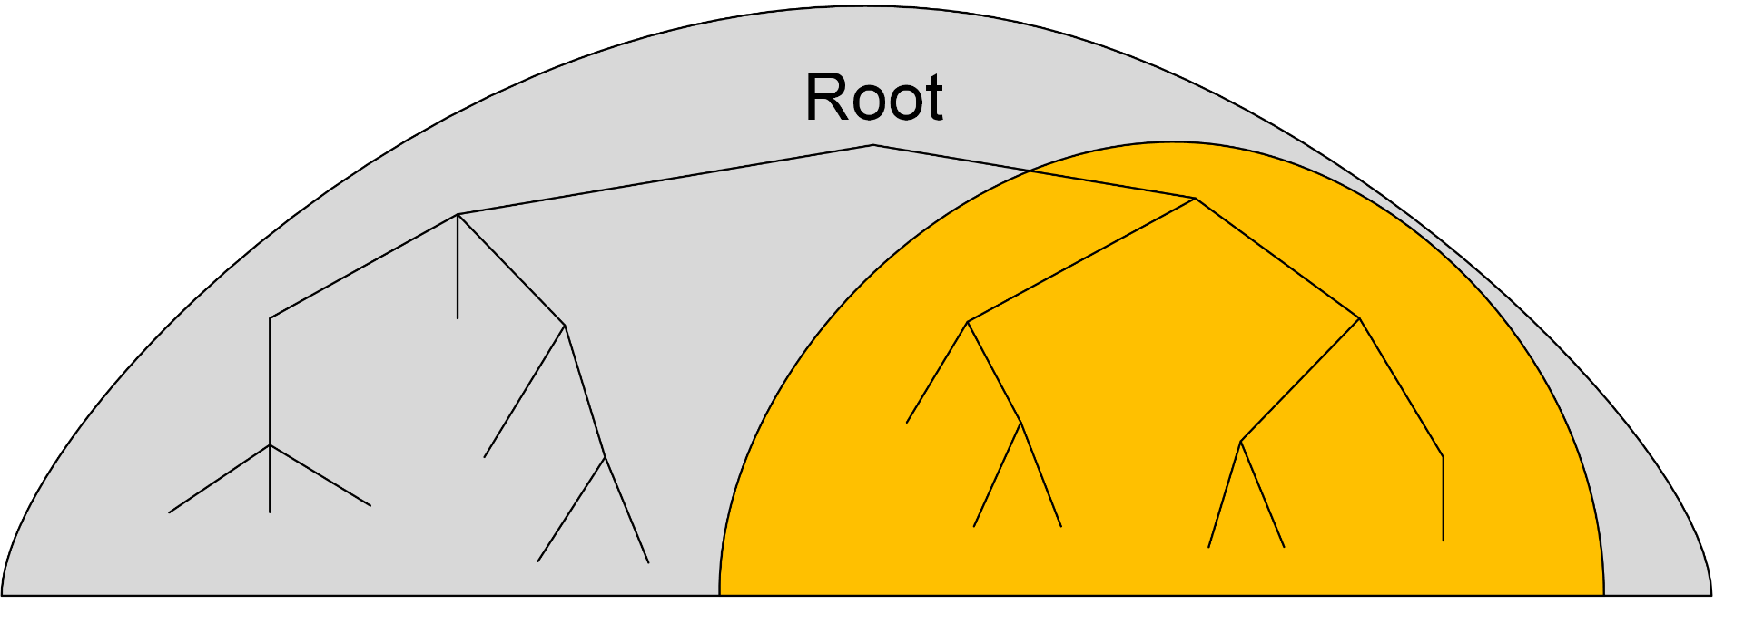
Subtree-Based Metadata Partition
Migrate subtrees to other MDSs.
Requests
Notes:
And then migrate the small subtrees to other MDSs.

Slide 11
Subtree-Based Metadata Partition
Migrate subtrees to other MDSs.
Requests
Notes:
This is a recursive method where the subtrees could be further split.

Slide 12
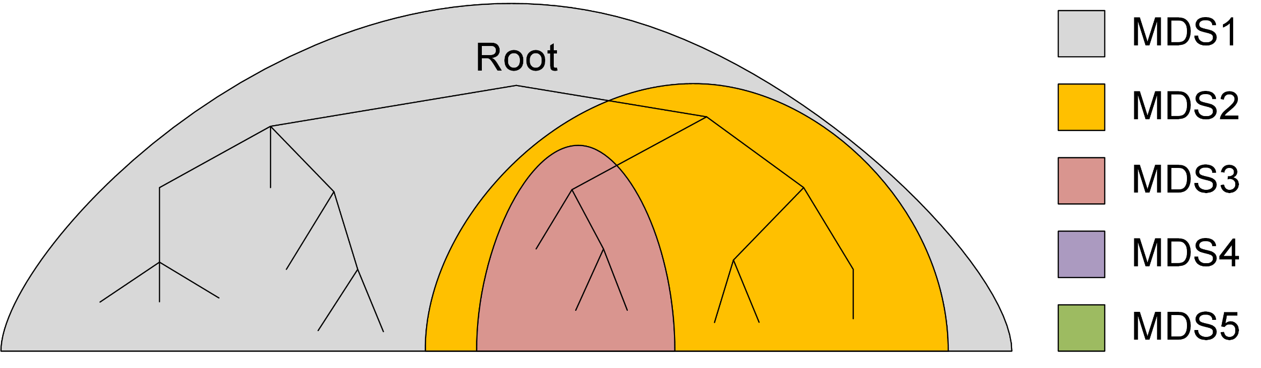
Subtree-Based Metadata Partition
Migrate subtrees to other MDSs.
Requests
Notes:
and migrated again.

Slide 13
Subtree-Based Metadata Partition
Metadata subtree is stored on multiple MDSs
Parallel processing
Preserved locality
Notes:
Finally, as the below figure shows, the metadata subtrees are distributed over the MDS cluster and managed by different MDSs.
The benefits of using subtree-based metadata partitioning are not only scaling metadata performance by parallel processing, but also ensuring localities of metadata.
[transition]
However, we may ask:

Slide 14
Question: Can the built-in metadata management
method of CephFS balance load well?
Notes:
Can the built-in metadata management method of CephFS balance load well?
[transition]
To answer the question,

Slide 15
Outline
Metadata management in DFSs
Metadata load balance study
Design of Lunule
Experimental results
Conclusion
Notes:
Next, we will study metadata load balance with some real-world workloads.

Slide 16
Metadata Load Balance Study
5 representative workloads
Workload | Scenario | Meta_op Ratio
CNN image pre-process (CNN) | Machine Learning | 78.1%
NLP training (NLP) | Machine Learning | 92.8%
Web trace replay (Web) | Traditional | 57.2%
Filebench Zipfian read (Zipf) | Traditional | 50.0%
Mdtest create (MD) | Traditional | 100.0%
Notes:
We select five representative metadata-heavy workloads for our study, two of them are Machine Learning workloads while the other three are Traditional. Their metadata operation ratios range from 50% to 100%.

Slide 17
Metadata Load Balance Study
5 representative workloads
Workload | Scenario | Meta_op Ratio
CNN image pre-process (CNN) | Machine Learning | 78.1%
NLP training (NLP) | Machine Learning | 92.8%
Web trace replay (Web) | Traditional | 57.2%
Filebench Zipfian read (Zipf) | Traditional | 50.0%
Mdtest create (MD) | Traditional | 100.0%
Machine Configurations
Metadata Server (MDS) | 5 nodes, 1 MDS per node
Data Server (DS) | 5 nodes, 1 DS per node
Client | 5 nodes, 20 clients per node
Network | 56Gb/s IPoIB
Persistent Storage | NVMe SSD (Intel P4610)
Notes:
The machine configurations are shown in the table. We used 15 bare metal machines to deploy a CephFS, which consists of 5 metadata servers, 5 data Servers, and 100 clients. Each machine is connected via a high-bandwidth IPoIB network, and the storage devices of data are low-latency NVMe SSD.

Slide 18
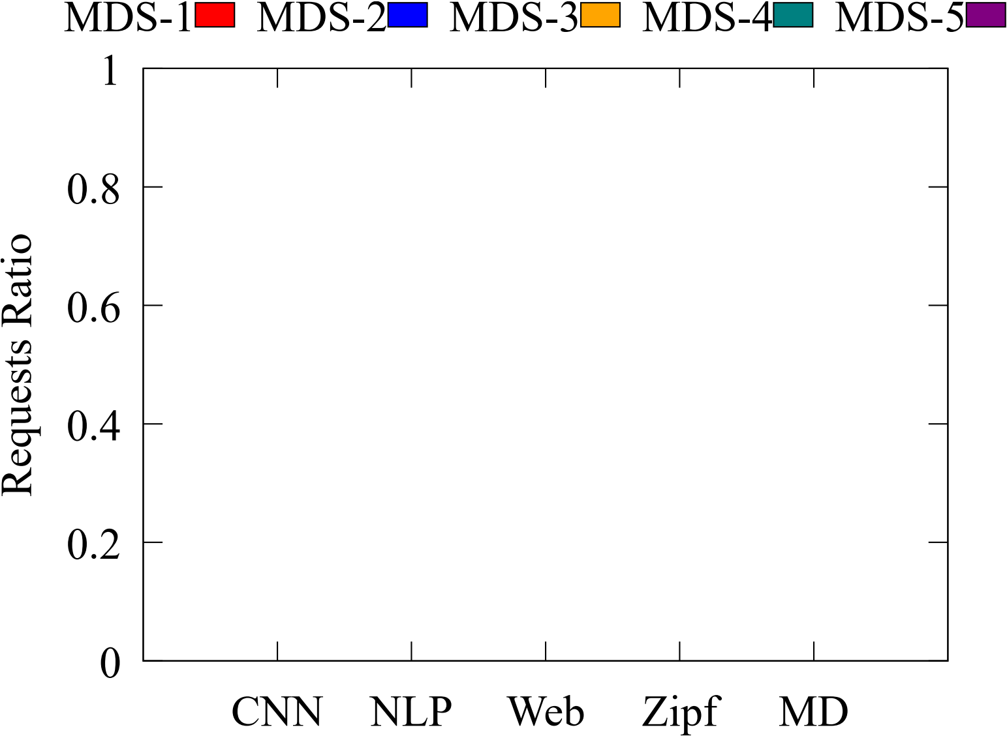
Metadata Load Balance Study
We measure the fraction of metadata requests received by each MDS w.r.t 5 workloads.
Notes:
We first measure the fraction of metadata requests received by each MDS with respect to the 5 workloads. Here, we summarize the results in this figure, where the X-axis refers to different workloads, while the Y-axis is the fraction, each color represents a single MDS. Let’s have a look at the results.

Slide 19
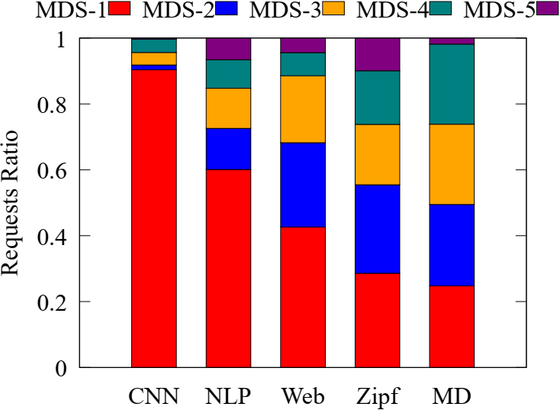

Metadata Load Balance Study
We measure the fraction of metadata requests received by each MDS w.r.t 5 workloads.
Imbalanced phenomenon exists in all workloads!
Notes:
We could find that in all five workloads, the number of metadata operations handled by different MDSs are quite different and the gap between the min and max is huge. All these imply that the metadata load imbalanced phenomenon exists in all workloads!

Slide 20
Metadata Load Balance Study
We measure the fraction of metadata requests received by each MDS w.r.t 5 workloads.
Imbalanced phenomenon exists in all workloads!
For some workloads, metadata load concentrates on a single MDS!
Notes:
More interestingly, for the CNN pre-processing and NLP workloads on the left, metadata load even concentrates on a single MDS with other MDSs idle.
[Transition]
To understanding the imbalance in the portion of metadata requests handled by each MDS.

Slide 21
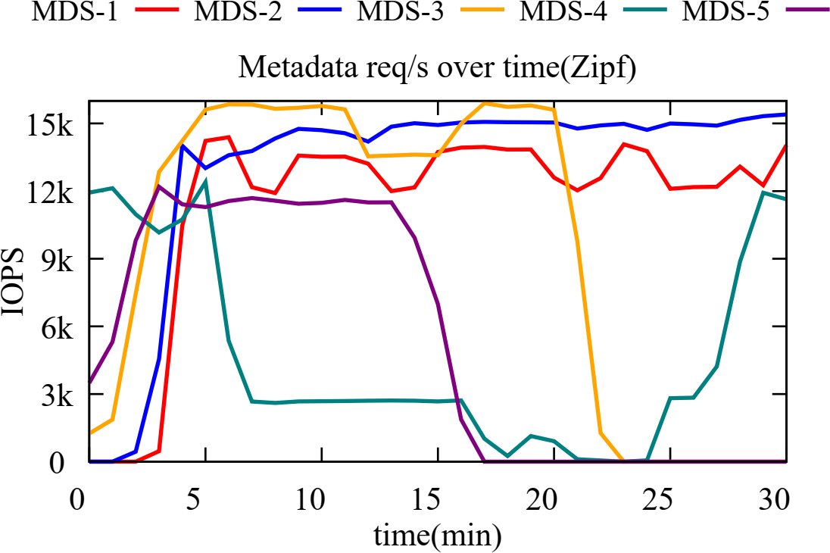
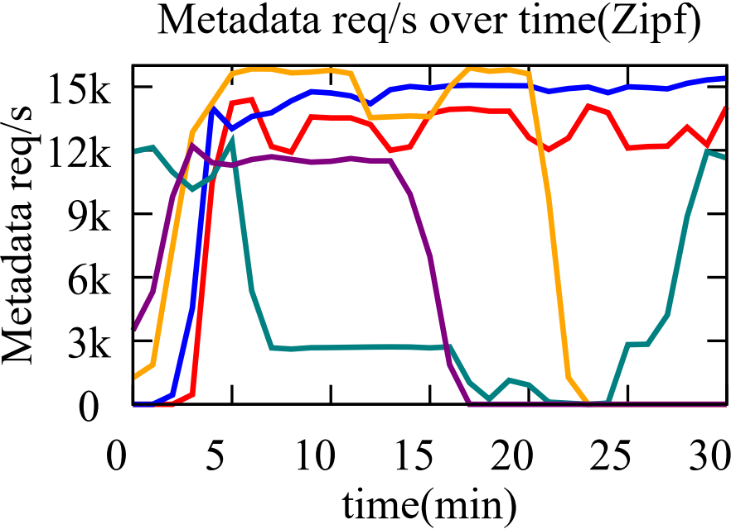
Inaccurate View of MDS Cluster Load
Case study: Filebench-Zipfian
ill-balanced between [5,20]
Notes:
we summarize the instantaneous metadata throughput of each MDS as time evolves.
Here, we take the Filebench-Zipfian workload as an example. The X-axis is time and the Y-axis is metadata requests per second. We could see that between 5 and 20 minutes, the loads among five MDSs are ill-balanced.

Slide 22
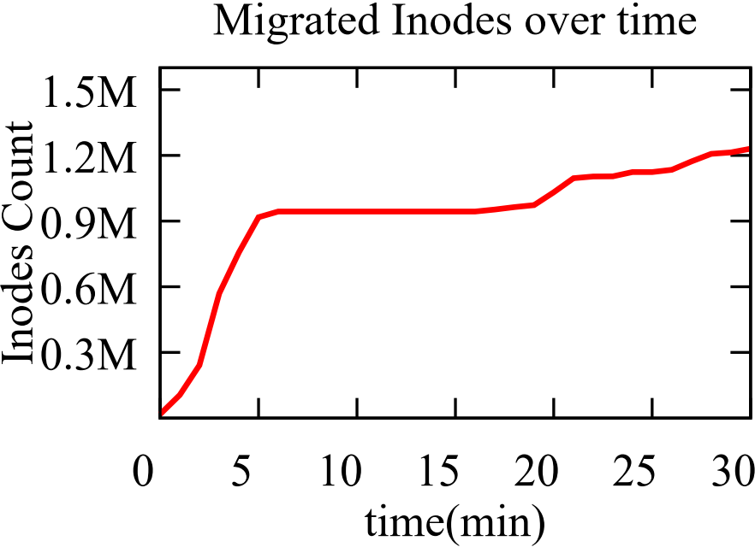
Inaccurate View of MDS Cluster Load
Case study: Filebench-Zipfian
ill-balanced between [5,20]
almost no migrations took place between [5,20]
Notes:
But the figure of migrated inodes on the right tells us that no migration activities are observed to react to such imbalance situations.

Slide 23
Inaccurate View of MDS Cluster Load
Case study: Filebench-Zipfian
ill-balanced between [5,20]
almost no migrations took place between [5,20]
Observation & Inefficiency 1:
Existing load model fails to draw an accurate view of the MDS cluster load to discover imbalance timely and trigger re-balance when needed, leading to high re-balance cost and bad overall throughput.
Notes:
This strange observation reveals the first inefficiency: the built-in load balancing mechanism fails to draw an accurate view of the cluster state to discover imbalanced situations timely and trigger the re-balance when needed.

Slide 24
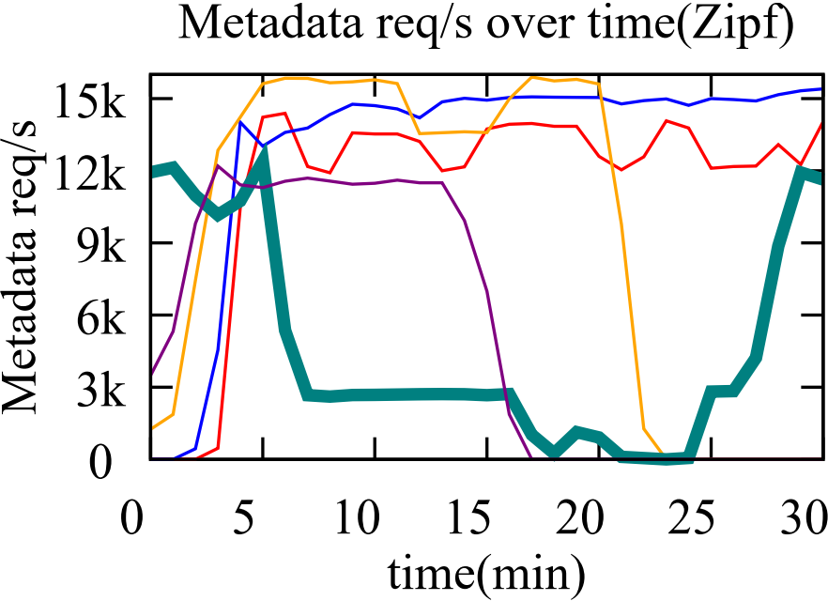
Aggressive Migration Decision Making
Case study: Filebench-Zipfian
5min: request rate drops sharply
Notes:
Next, we also zoom in on the decisions on the amount of migrated metadata generated in the Filebench-Zipfian workload experiment.
Around the fifth minute, we found a sharply drop in the request rate of the heaviest MDS-4.

Slide 25
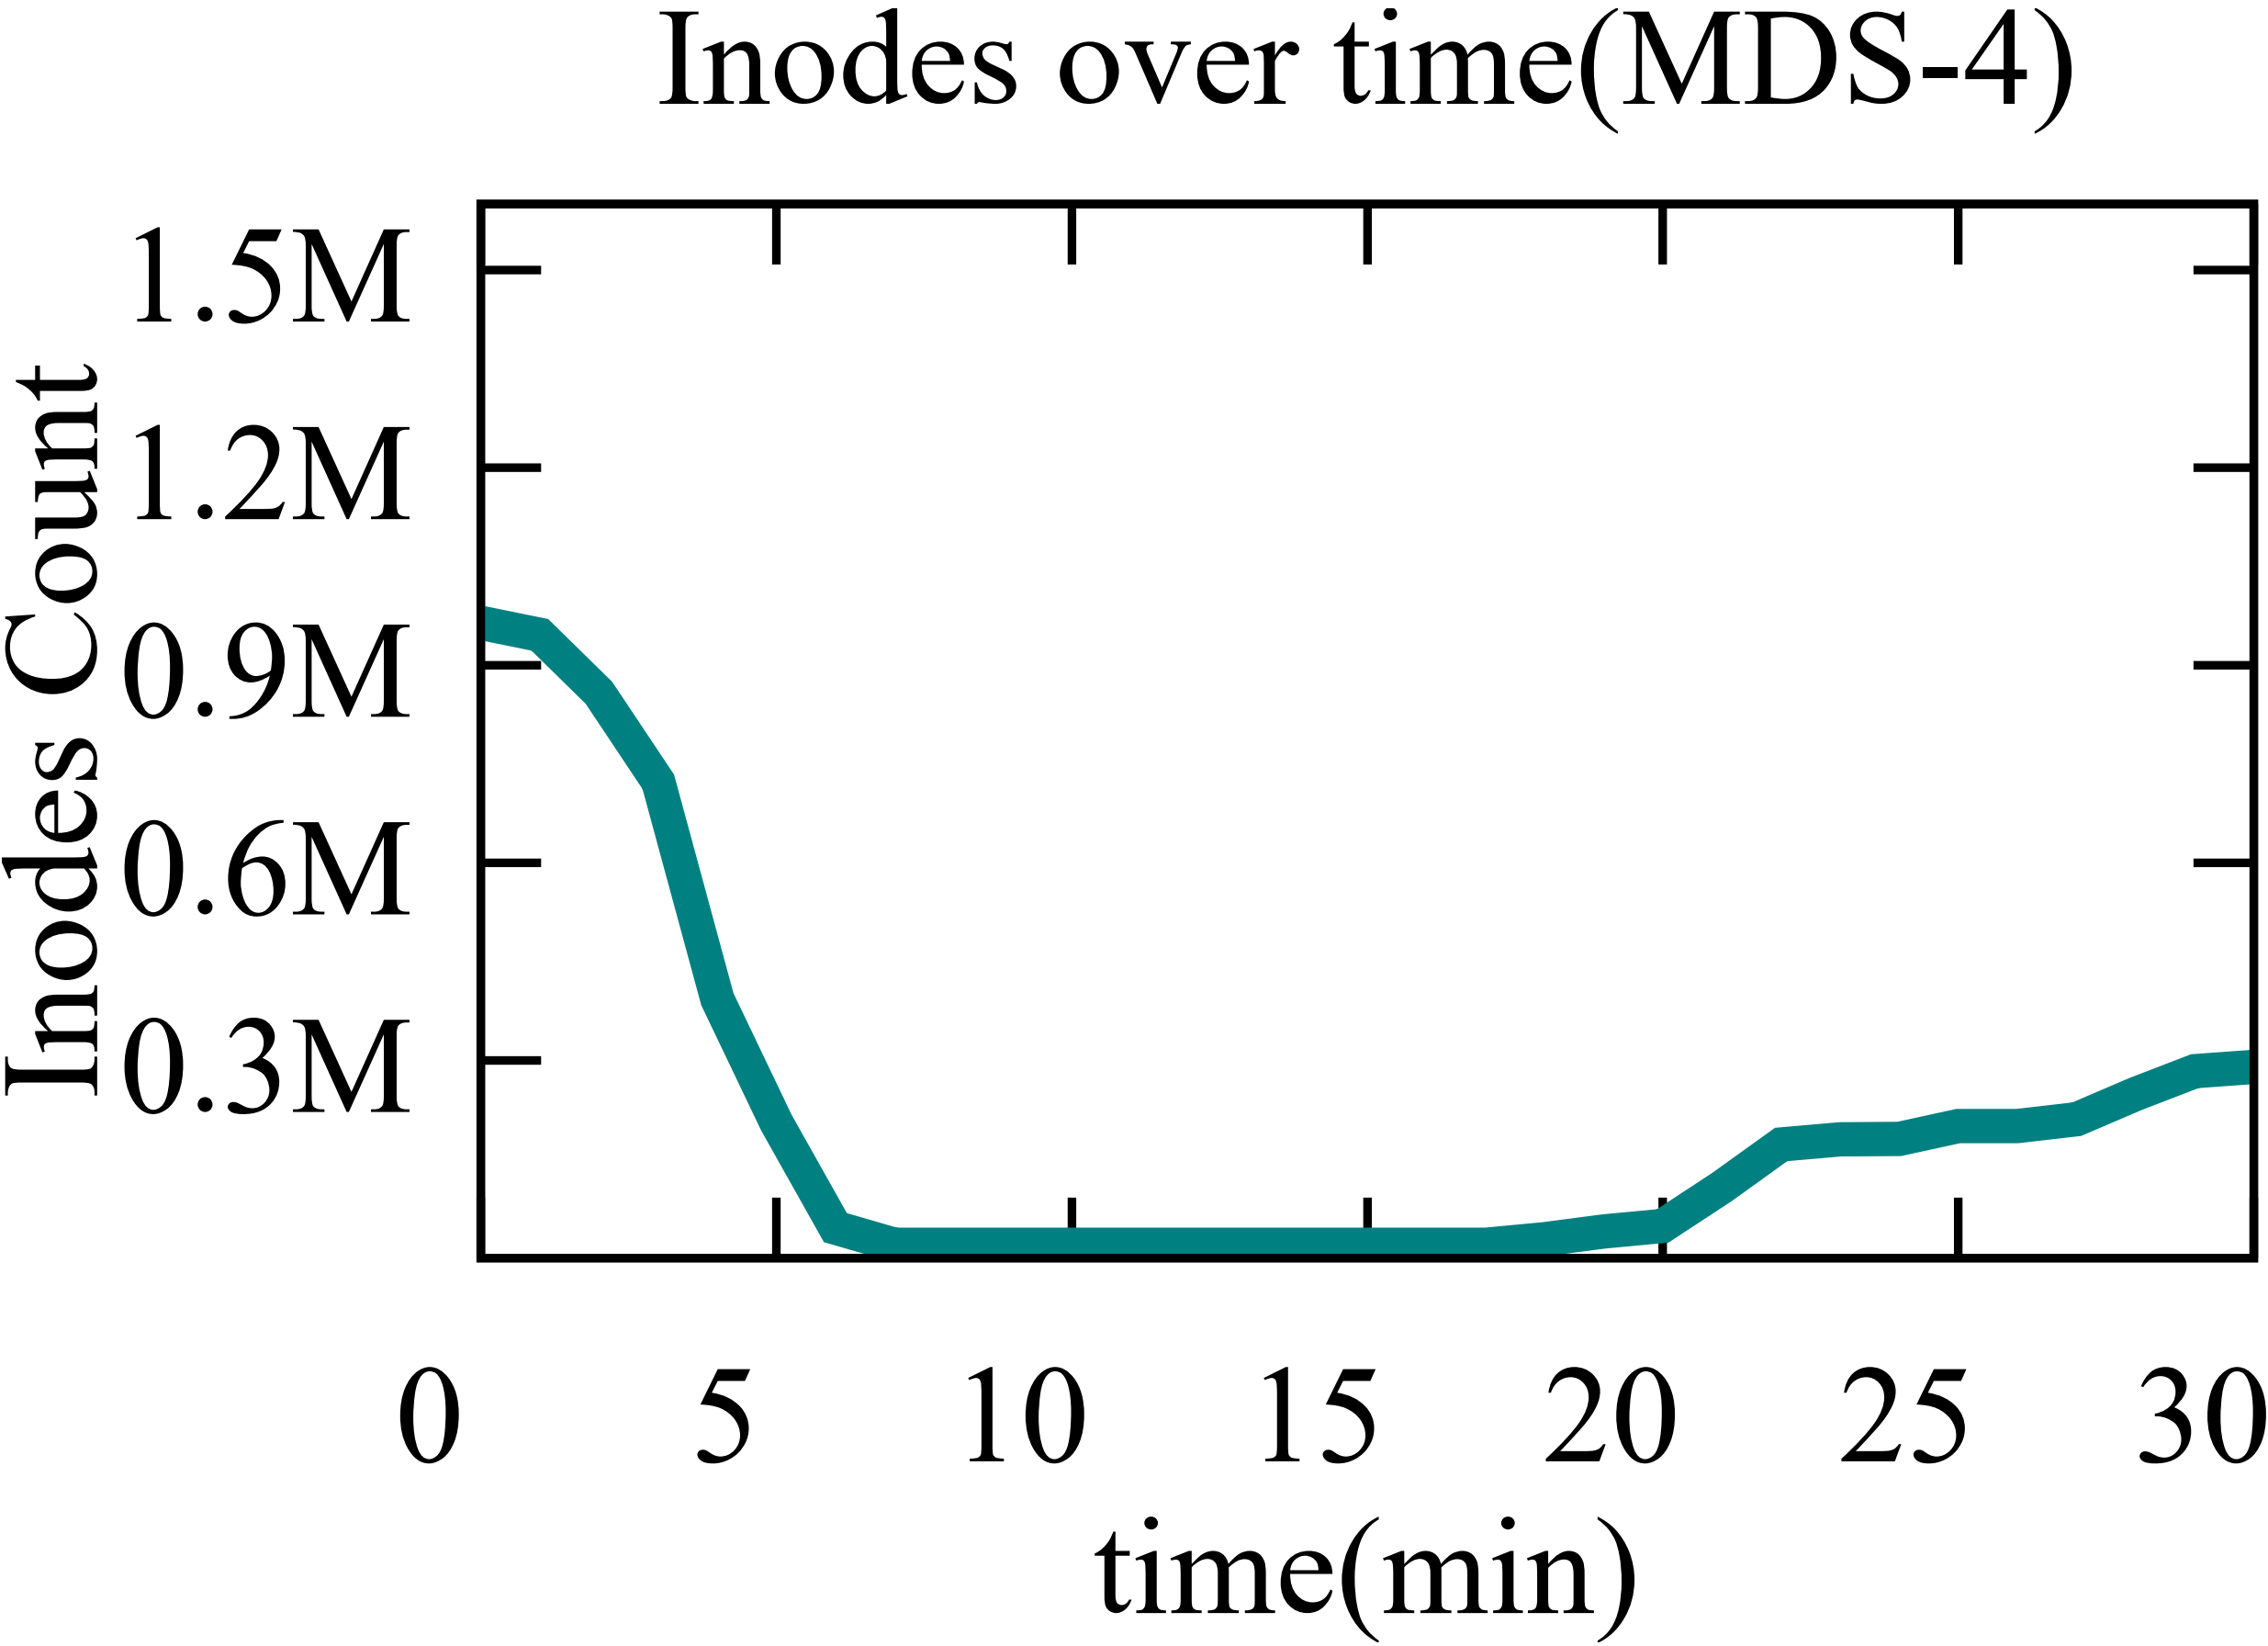
Aggressive Migration Decision Making
Case study: Filebench-Zipfian
5min: request rate drops sharply
5min: nearly 98% of inodes moved to other MDSs
Notes:
This can be explained by the total number of inodes hosted by MDS-4 in the Figure on the right. During the first interval, nearly 98% of inodes managed by MDS-4 is moved to other MDSs.

Slide 26
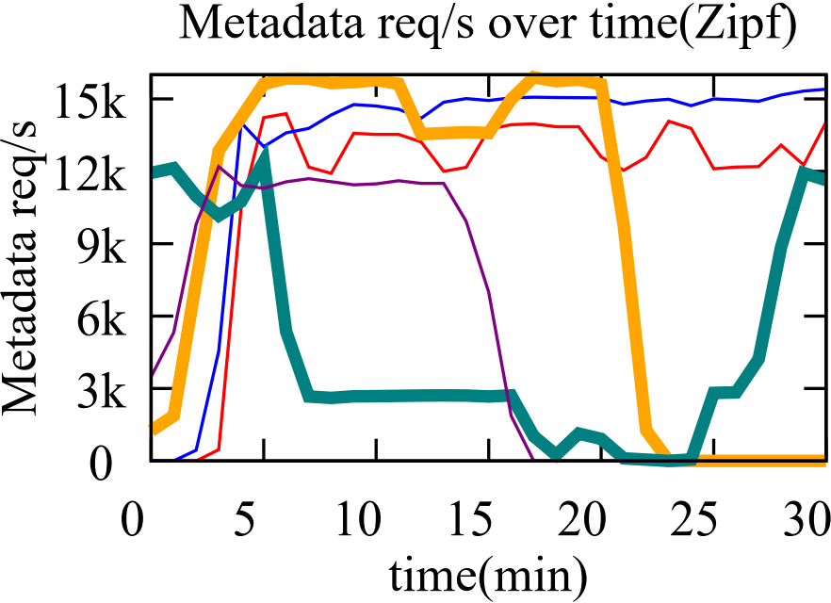
Aggressive Migration Decision Making
Case study: Filebench-Zipfian
5min: request rate drops sharply
25min: load on MDS-3, 4 swapped
5min: nearly 98% of inodes moved to other MDSs
Notes:
Moreover, during 20 to 30 minutes, we find the loads on MDS-3 and MDS-4 are just swapped,

Slide 27
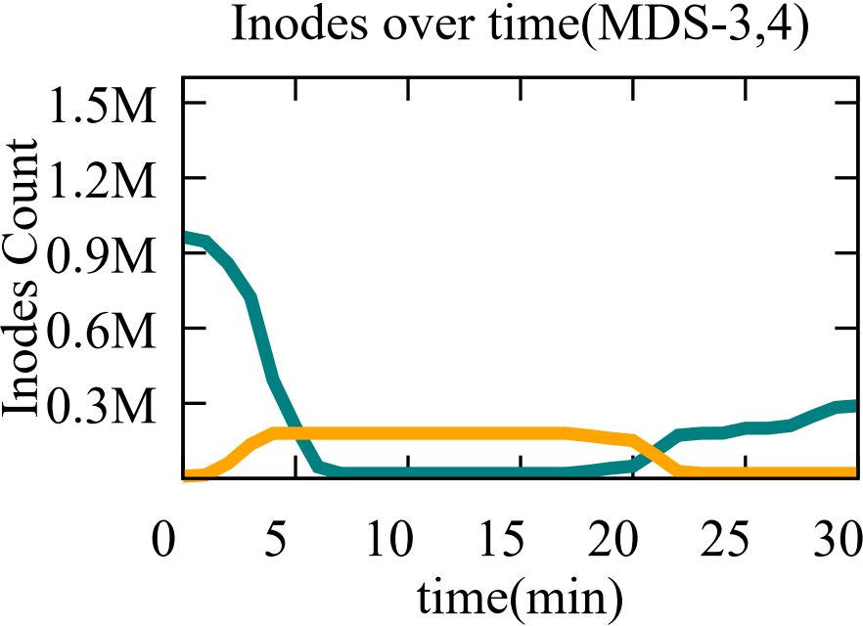
Aggressive Migration Decision Making
Case study: Filebench-Zipfian
5min: request rate drops sharply
25min: load on MDS-3, 4 swapped
5min: nearly 98% of inodes moved to other MDS
25min: 88% inodes of MDS-3 migrated to MDS-4
Notes:
This is also explained by the fact that 88% inodes of MDS-3 was migrated to MDS-4. We call this a ping-pong effect, which bring no benefits for balancing metadata load. Instead, it leads to waste of resource and poor performance.

Slide 28
Aggressive Migration Decision Making
Case study: Filebench-Zipfian
5min: request rate drops sharply
25min: load on MDS-3, 4 swapped
5min: nearly 98% of inodes moved to other MDS
25min: 88% inodes of MDS-3 migrated to MDS-4
Observation & Inefficiency 2:
The aggressive migration decision would offset the benefits of load balancing and artificially introduce new imbalanced situations.
Notes:
More precisely, we conclude that these over-migration and ping-pong effects reveals the second inefficiency: the aggressive migration decision would offset the benefits of load balancing
and artificially introduce new imbalanced situations.

Slide 29
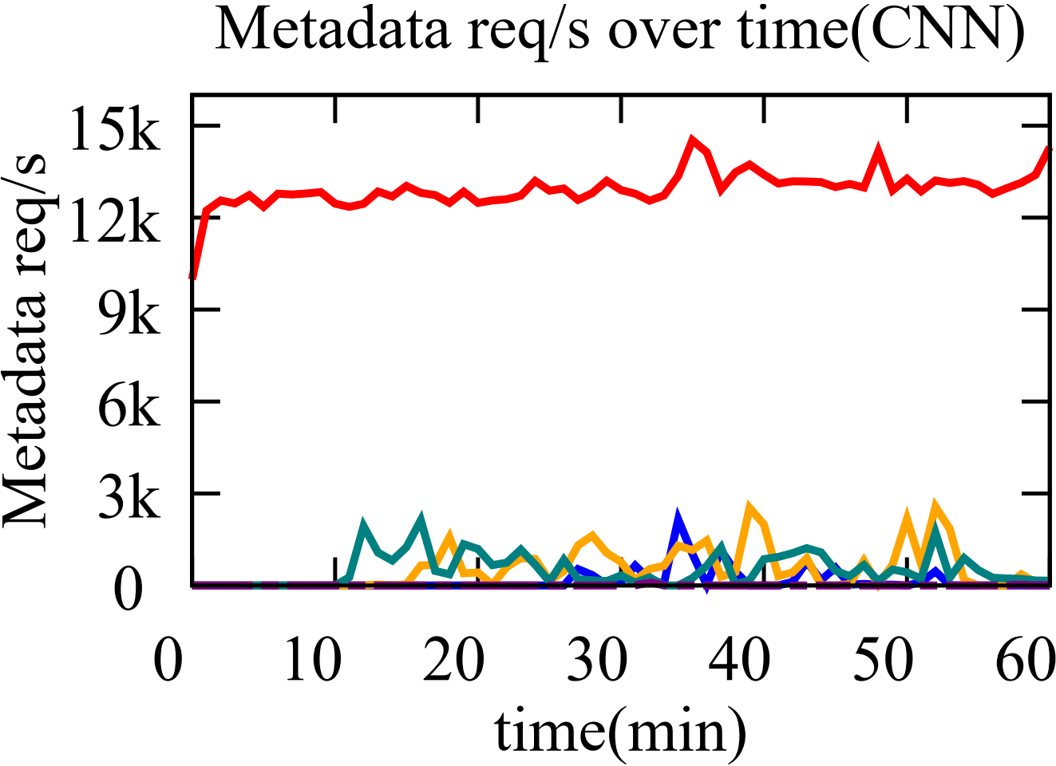
Ignorance of Spatial Locality
Case study: CNN pre-processing
load never moves from MDS-1 to other idle MDSs
Notes:
Finally, in addition to the Filebench experiments, we look into the migration activities taking place when running the CNN pre-processing workload.
Obviously, almost all metadata requests are concentrating on MDS1, and load never moves from MDS-1 to other idle MDSs.
Next we might wonder whether migration happened.

Slide 30
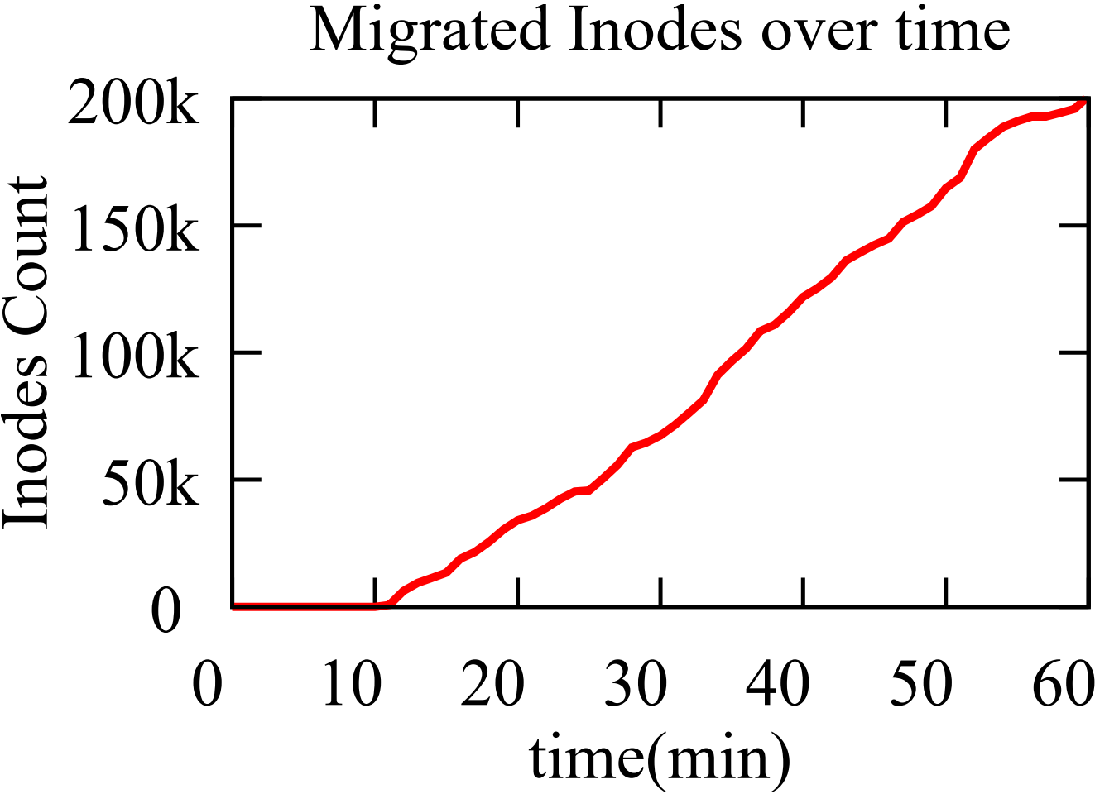
Ignorance of Spatial Locality
Case study: CNN pre-processing
load never moves from MDS-1 to other idle MDSs
metadata are continuously migrated
Notes:
In fact, metadata are continuously migrated among MDSs as time evolves.
To understand this counter-intuitive phenomenon, we analyze all migrated inodes and find that the vast majority of them are never visited after their migration.
This is a direct consequence of the temporal locality-based balancing strategy. The CNN workload does not re-visit scanned files, and thus invalidates the builtin load balancing mechanism’s assumption.

Slide 31
Ignorance of Spatial Locality
Case study: CNN pre-processing
load never moves from MDS-1 to other idle MDSs
metadata are continuously migrated
Observation & Inefficiency 3:
The temporal locality-based candidate selection policy does not consider the unique access patterns of various workloads.
Notes:
We summarize this as the third inefficiency: the one-size-fits-all temporal locality-based candidate selection policy does not consider the unique access patterns of various workloads.

Slide 32
Goals of Our Work
Improving the metadata load balance for CephFS via
  Accurately identifying imbalance as possible to quickly converge to balanced state and avoid unnecessary re-balances.
  Judiciously deciding the amount of metadata that need to be migrated and pairing the importer and exporter MDS to avoid over-migration.
  Appropriately selecting subtrees as migration candidates to avoid invalid migration.
Notes:
To address the aforementioned inefficiencies and improve the metadata load balance, we identify three critical missions:
First, we need to accurately identify imbalance as possible to quickly converge to balanced state and avoid unnecessary re-balances.
Second, we need to judiciously decide the amount of metadata that need to be migrated and pair the importer and exporter MDS to avoid over-migration.
Finally, it would be great to appropriately select subtrees as migration candidates to avoid invalid migration.

Slide 33
Outline
Metadata management in DFSs
Metadata load balance study
Design of Lunule
Experimental results
Conclusion
Notes:
Based on the problems identified, we propose a novel load balancing service for CephFS, Lunule. Next I will introduce our design of Lunule.

Slide 34
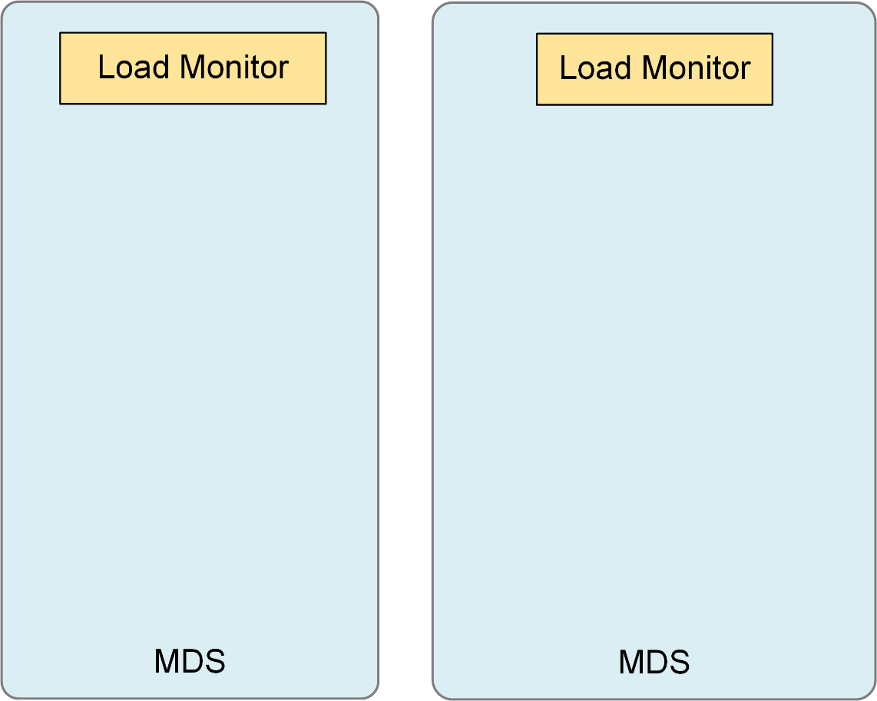
Lunule Architecture
CephFS-Vanilla
  Collect cumulative heat
Lunule
  Collect instantaneous IOPS
①
Notes:
First, for each MDS, Lunule deploys a load monitor to keep tracks of the load intensity levels of different MDS. Here, instead of using the cumulative heat value collected by the CephFS built-in load balancer, in each epoch, Lunule will collects Instantaneous IOPS.

Slide 35
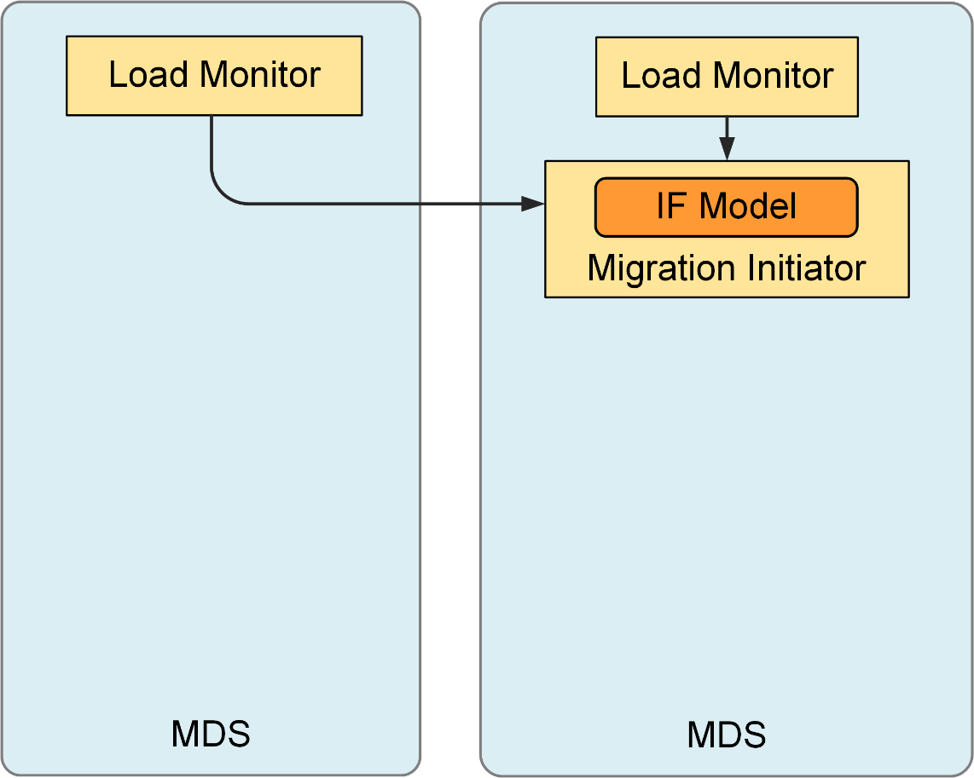
Lunule Architecture
CephFS-Vanilla
  Linear imbalance model
  Limited accuracy
Lunule
  Coefficient of Variation (CoV) based imbalance model
  Improved accuracy
  Benign imbalance tolerance
①
②
Notes:
These metrics will be periodically sent to the migration initiator via network. Here, we use a centralized coordinator to make the migration decisions, which will not be bottleneck since the metric exchange is light-loaded. Migration Initiator plays a very important role in achieving good load balance. It abandons the linear imbalance model used by CephFS, and instead use Coefficient of Variation model, which will be explained in details next.

Slide 36
Agile, Accurate Imbalance Detection
Leverage Imbalance Factor to calculate imbalance degree accurately.
Introduce an urgency parameter to tolerate benign imbalances.
CephFS-Vanilla
Load metric: Cumulative heat
Imbalance model: Linear difference
Inaccurate imbalance model
Aggressive migration decision
Notes:
The first problem is, the linear metadata load modeling method used in CephFS limits accuracy and cause aggressive migration decision.

Slide 37
Agile, Accurate Imbalance Detection
Leverage Imbalance Factor to calculate imbalance degree accurately.
Introduce an urgency parameter to tolerate benign imbalances.
CephFS-Vanilla
Lunule
Load metric: Cumulative heat
Imbalance model: Linear difference
Load metric: Instantaneous load
Imbalance model: Coefficient of Variation [3,4], a statistical measure which is commonly used to compare the data dispersion.
Inaccurate imbalance model
Improve accuracy
Aggressive migration decision
Judicious migration decision
[3] Dynamic load balancing without packet reordering. SIGCOMM 2007
[4] Coefficient of variation. Wikipedia
Notes:
So we abandon it and develop a the Coefficient of Variation based model, which could improve accuracy of calculate imbalance degree and make migration decision judiciously. Coefficient of Variation is a better math to quantify the load imbalance degree among different MDSs, has been widely used in many fields.

Slide 38
Agile, Accurate Imbalance Detection
Leverage Imbalance Factor to calculate imbalance degree accurately.
Introduce an urgency parameter to tolerate benign imbalances.
High
Load
MDS-0
MDS-1
MDS-0
MDS-1
Low
Harmful imbalance
Benign imbalance
Notes:
The second problem is that not all imbalanced situations need to trigger the re-balance procedure.
As shown in the figure, these two situations have the same imbalance degree, but only the first case is harmful to the cluster, since the heaviest MDS-0 almost runs out of its capacity. Balancing load from MDS-0 to MDS-1 would help avoid MDS-0 from being over-loaded and improve the overall performance. However, the example on the right would be fine, if we do not migrate load from MDS-0 to MDS-1, since MDS-0’s load is also quite low. We call this benign imbalance.

Slide 39
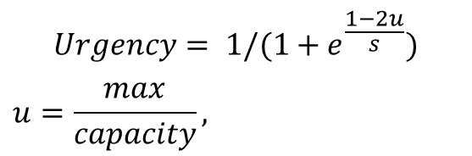

Agile, Accurate Imbalance Detection
Leverage Imbalance Factor to calculate imbalance degree accurately.
Introduce an urgency parameter to tolerate benign imbalances.
$$Urgency= 1/(1+e^{\frac{1−2u}{s}})$$
$$u=\frac{max}{capacity},$$
High
$$s: smoothness$$
Load
MDS-0
MDS-1
MDS-0
MDS-1
Low
Harmful imbalance
Benign imbalance
Notes:
To tolerate benign imbalances, we additionally introduce an urgency parameter to the imbalance factor model, to describe if the current imbalance is harmful.
We model urgency as a logistic function, and urgency’s growth is limited by the load on the most massive loaded MDS.

Slide 40
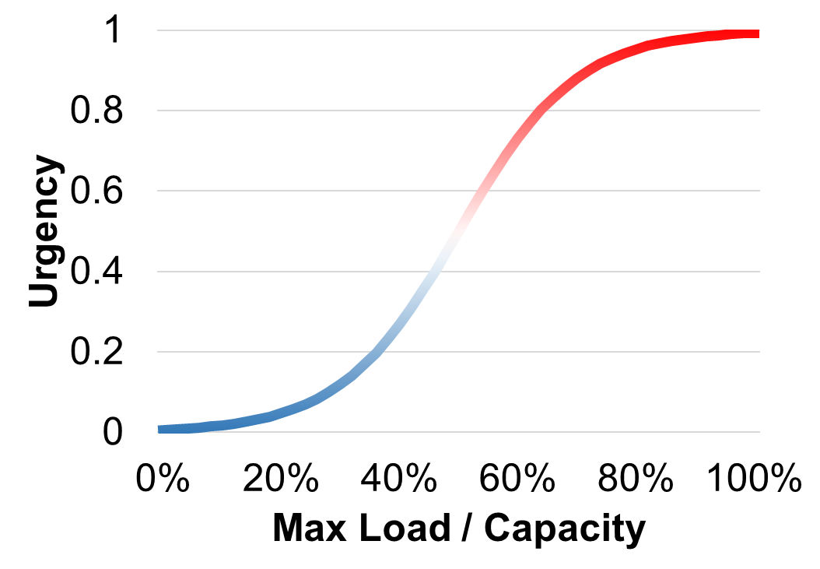
Agile, Accurate Imbalance Detection
Leverage Imbalance Factor to calculate imbalance degree accurately.
Introduce an urgency parameter to tolerate benign imbalances.
$$Urgency= 1/(1+e^{\frac{1−2u}{s}})$$
$$u=\frac{max}{capacity},$$
High
$$s: smoothness$$
Load
Harmful
MDS-0
MDS-1
MDS-0
MDS-1
Benign
Low
Harmful imbalance
Benign imbalance
Notes:
When the value of urgency is low, the model knows that the imbalance in the cluster is benign and tolerable. The re-balance is also triggered when the urgency value is located in the top-right area.

Slide 41
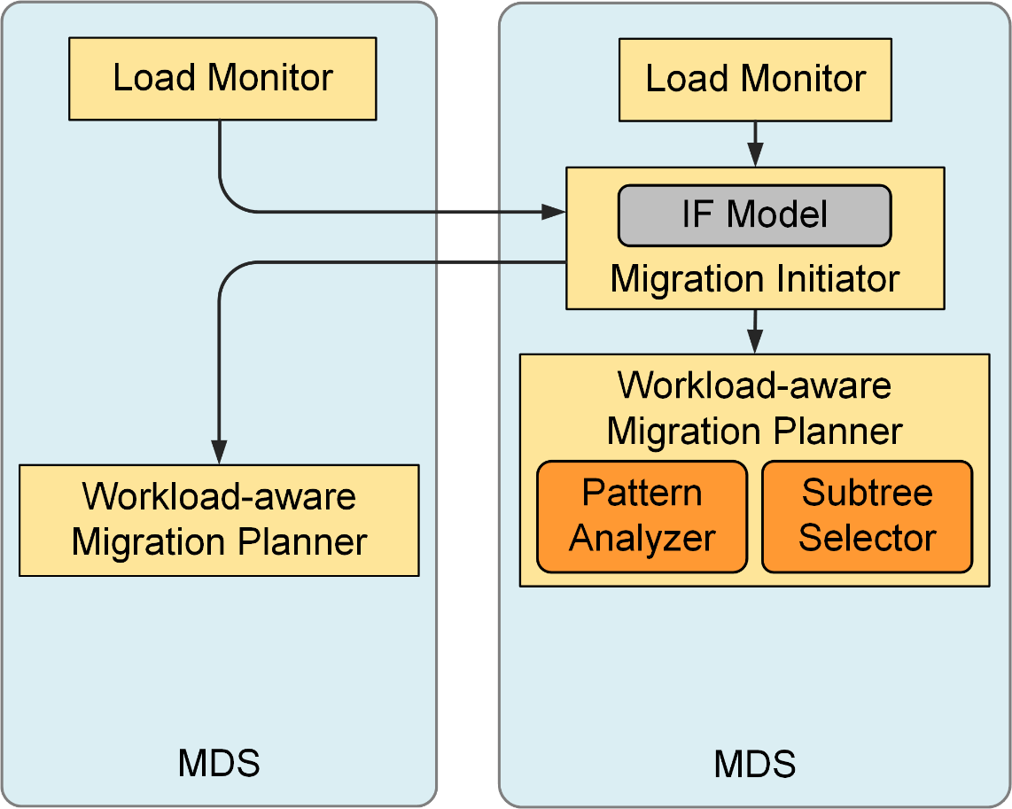
Lunule Architecture
CephFS-Vanilla
  Single heat-based policy
  Fails to handle various workloads
Lunule
  Workload-aware subtree selection
  Unification of the joint effect of temporal and spatial locality
  Consideration of the future load change on the balancing results
①
②
③
Notes:
Once we have the collected metrics and the re-balance decided by migration initiator, next, the initiator will call workload-aware migration planner sitting on each MDS to select a proper set of subtrees as the migration candidate. Here, the challenge we face is to handle various workloads that present different access patterns, some of them are more sensitive to temporal locality and the remaining are more sensitive to spatial locality.

Slide 42
Workload-aware subtree selection
Unifying the access pattern analysis via a joint consideration of the effects of temporal and spatial locality
Notes:
Here, we take an innovative solution to take a joint consideration of the effects of temporal and spatial locality on the future accesses. This unification simplifies our access pattern understanding.

Slide 43
Workload-aware subtree selection
Unifying the access pattern analysis via a joint consideration of the effects of temporal and spatial locality
mIndex= α*l_{t}+β*l_{s}
Notes:
To do so, we assign a migration index, or short, mIndex for subtrees, which corresponds to the predicted future load on the target subtree over time. The migration index is larger, the probability for the corresponding subtree to be migrated is higher.

Slide 44
Workload-aware subtree selection
Unifying the access pattern analysis via a joint consideration of the effects of temporal and spatial locality
mIndex= α*l_{t}+β*l_{s}
  α: Temporal locality impact factor.
  β: Spatial locality impact factor.
Notes:
The computation of migration indices needs to take a joint consideration of the impacts of both temporal locality and spatial locality exhibited in workloads, To do so, we introduce 𝛼 and 𝛽 as the impact factors of temporal and spatial locality, respectively, indicating the inclination of the recent workloads on subtrees to either of the two access patterns

Slide 45
Workload-aware subtree selection
Unifying the access pattern analysis via a joint consideration of the effects of temporal and spatial locality
mIndex= α*l_{t}+β*l_{s}
  l_{t}: Temporal locality visits count.
  l_{s}: Spatial locality visits count.
Notes:
In addition to the estimation of the temporal and spatial locality inclination, we have to predict the number of future visits falling into the two categories, which are summarized by 𝑙𝑡 and 𝑙𝑠.
How to calculate this, please refer to our paper.

Slide 46




Workload-aware subtree selection
Unifying the access pattern analysis via a joint consideration of the effects of temporal and spatial locality
mIndex= α*l_{t}+β*l_{s}
Record past access history
Identify current access pattern
Predict future load: mIndex
Select subtree with mIndex
Notes:
In summary, once the migration decisions are made, the following step will be choosing and moving an appropriate set of subtrees.
First, Record past access history,
Second, Identify current access pattern,
Third, Predict future load: mIndex,
And finally, select subtree with mIndex.
[transition] When the selection is complete, the last thing is

Slide 47
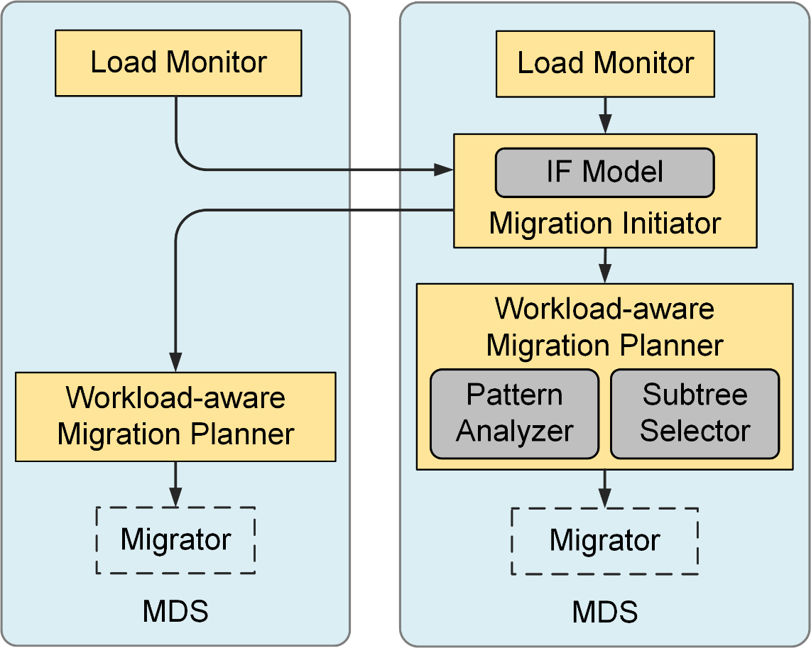
Lunule Architecture
CephFS-Vanilla
  Relocate subtrees from MDSs with heavy loads to the light ones
Lunule
  Unchanged
  Being integrated into CephFS for easy adoption
①
②
③
④
Notes:
migrate subtrees between MDSs.
We keep the built-in migrator of CephFS unchanged and integrate the above efforts into CephFS, for easy adoption.
[Transition]
After the introduction of Lunule architecture,

Slide 48
Outline
Metadata management in DFSs
Metadata load balance study
Design of Lunule
Experimental results
Conclusion
Notes:
Next, we will evaluate Lunule and show the experimental results.

Slide 49
Questions to Answer
Can Lunule eliminate imbalance?
Can Lunule improve the performance of the cluster?
Does Lunule adapt to changes in workloads or cluster scale-out?
Does Lunule have advantages over the hash-based load balance mechanism？
Notes:
Throughout all experiments, we focus on the following questions
First, can Lunule eliminate imbalance?
Second, can Lunule improve the performance of the cluster?
Then, Does Lunule adapt to changes in workloads or cluster scale-out?
Finally, Does Lunule have advantages over hash-based method

Slide 50
Experimental Setup
System configurations
  Vanilla: CephFS with built-in load balancer
  GreedySpill: CephFS with GreedySpill balancer via Mantle
  Lunule-Light: Lunule without workload-ware migration
  Lunule: Lunule with all optimizations on
Machine Configurations
Metadata Server (MDS) | 5 nodes, 1 MDS per node
Data Server (DS) | 5 nodes, 1 DS per node
Client | 5 nodes, 20 clients per node
Network | 56Gb/s IPoIB
Persistent Storage | NVMe SSD (Intel P4610)
Notes:
We used two state-of-the-art techniques: CephFS-Vanilla and Greedyspill for the baseline.
Additionally, to explore the benefits of various system components, we use a variant of Lunule: lunule-light, which switch workload-aware migration optimization off.
Machine configurations are shown in the table, which is the same as the previous experiments

Slide 51
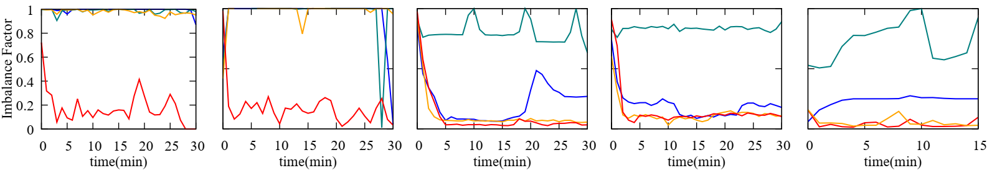
Improved Load Balance and Throughput
lower Imbalance Factor
CNN
NLP
Zipfian
Web
MD
Notes:
First of all, let's look at the balance.
These experiments compare the value of imbalance factor of the different approaches, each image represents a workload and each color represents an approach, X-axis is the time and Y-axis referring the value of imbalance factor, lower is better.
It can be seen that Lunule, the red lines, achieves a lower imbalance factor value regardless of the workload, which means a better balance.

Slide 52
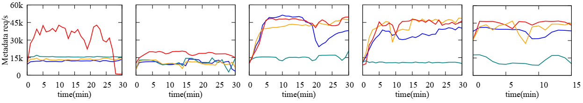
Improved Load Balance and Throughput
lower Imbalance Factor
higher throughput
CNN
NLP
Zipfian
Web
MD
Notes:
Correspondingly, the below five figures represent the throughput, with the Y-axis representing the number of metadata requests per second, higher is better.

Slide 53
Improved Load Balance and Throughput
lower Imbalance Factor
higher throughput
CNN
NLP
Zipfian
Web
MD
Lunule keeps IF at a fairly low level, while improving aggregated throughput
Notes:
These experiments illustrate that Lunule improves the overall throughput of the cluster while reducing imbalance.
[transition]
However, the real clusters often run multiple workloads at the same time.

Slide 54
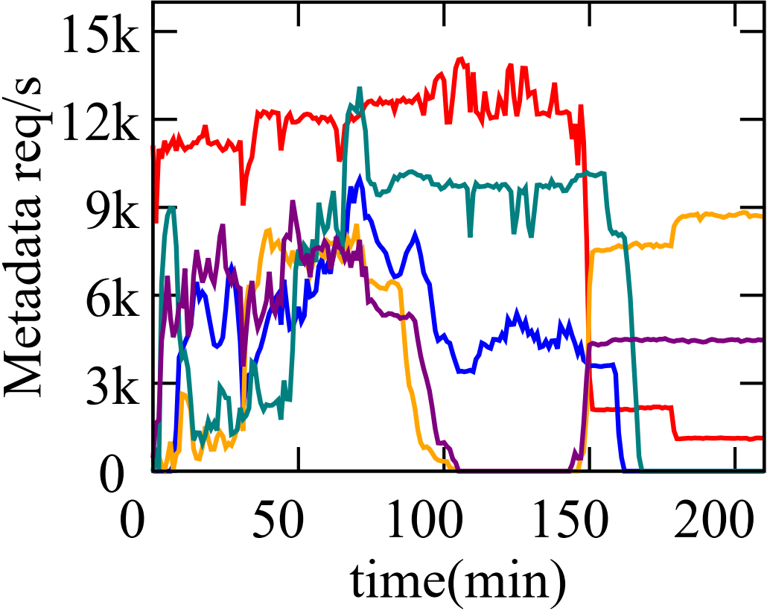
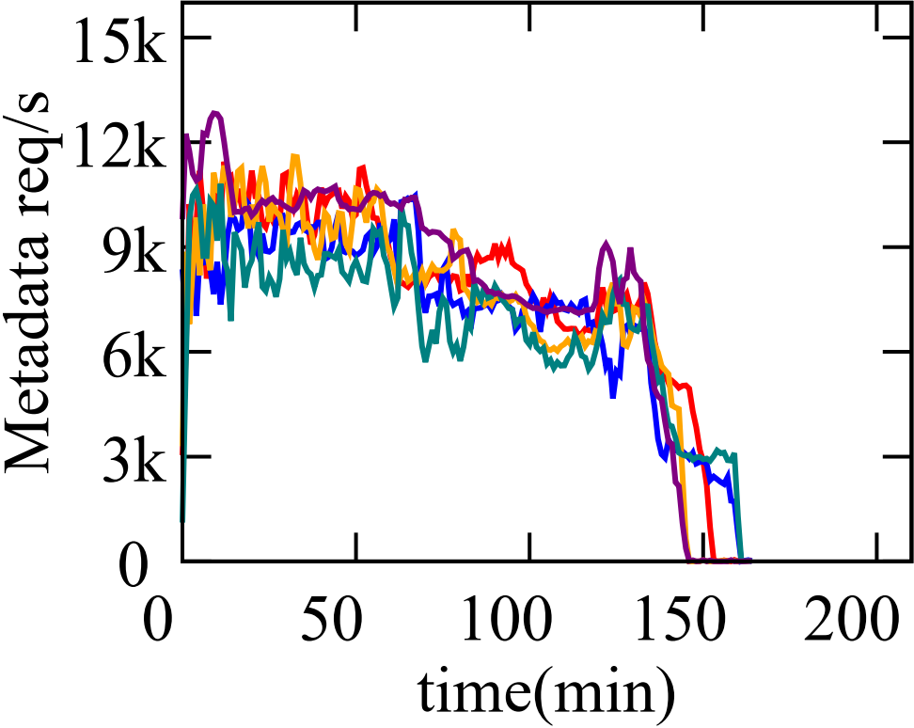
Improved Load Balance and Throughput
Moving from single workload to mixed
4 workloads: CNN, NLP, Web, Zipf
25 clients per workload
Ceph-Vanilla
Lunule
Imbalance
Ping-pong effect
Notes:
Therefore, we mix four different workloads to verify whether Lunule could handle this scenario.
The left is CephFS and the right is Lunule. The X-axis is the time while Y-axis is the metadata requests per second, and each color represents a MDS.
In CephFS, we could observe that the aforementioned imbalance phenomenon with the ping-pong effect appears as expected.

Slide 55
Improved Load Balance and Throughput
Moving from single workload to mixed
4 workloads: CNN, NLP, Web, Zipf
25 clients per workload
Ceph-Vanilla
Lunule
Imbalance
Ping-pong effect
Better balance
Shorter completion time
Notes:
While Lunule, the graph on the right, balance the load very well.
Moreover, the job completion time is significantly reduced thanks to the full use of cluster.

Slide 56
Improved Load Balance and Throughput
Moving from single workload to mixed
4 workloads: CNN, NLP, Web, Zipf
25 clients per workload
Ceph-Vanilla
Lunule
Answer to Q1, 2: Lunule significantly improve the performance of the cluster by eliminate imbalance.
Notes:
Now, we could answer questions 1 and 2: Lunule significantly improve the performance of the cluster by eliminate imbalance.

Slide 57
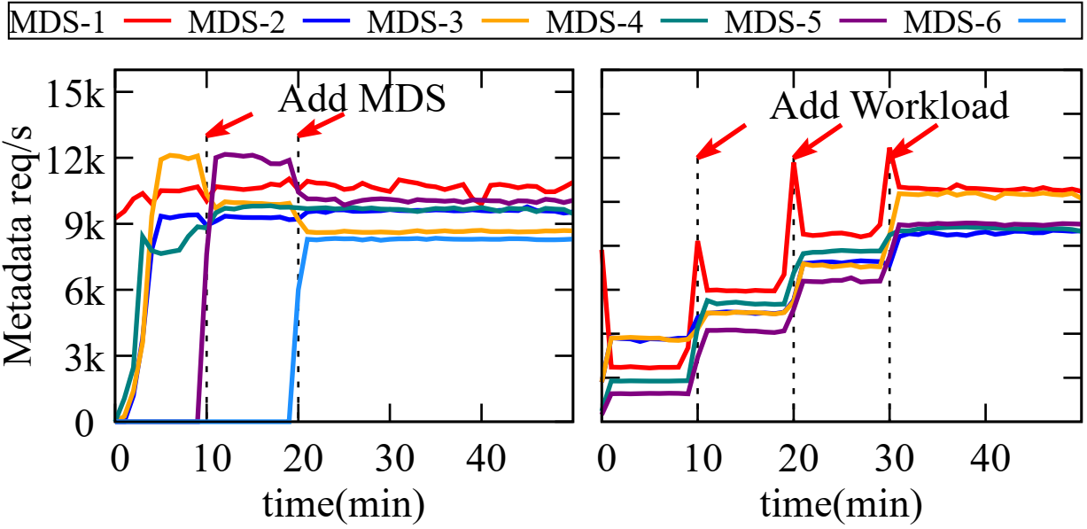
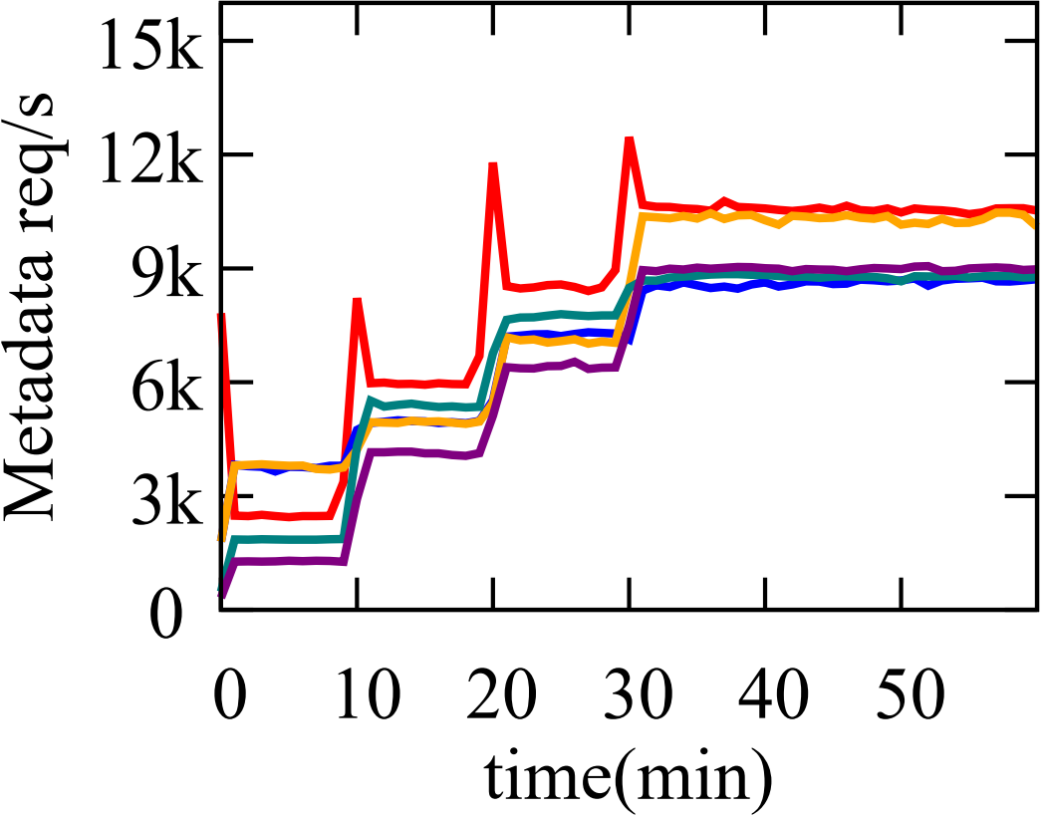
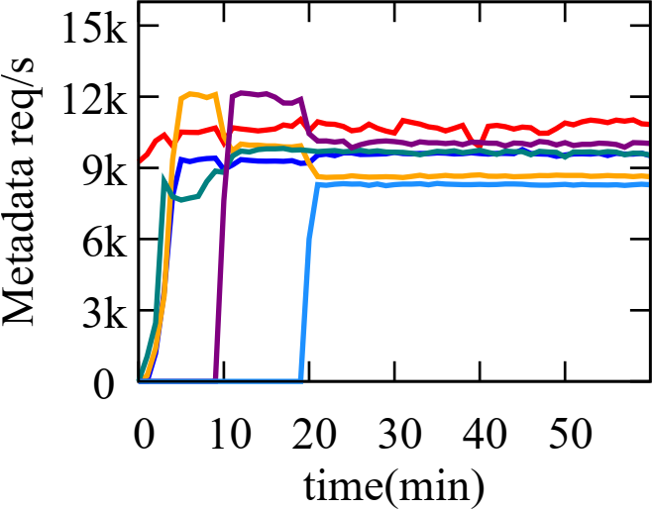
Adaptation of Dynamic Workload/MDSs
add workload
Dynamically add MDS/ Client at runtime
Workload: Zipfian
Lunule: Dynamic Workloads
Lunule: Dynamic MDSs
Load increase together
Notes:
As the load balancing is crucial for adapting to changes in terms of cluster expanding and denser workloads, here, we further stress Lunule with these two types of changes.
In the graph on the left, we add clients at minutes 10, 20, and 30, respectively. These changes will lead throughput spike for MDS-1, but Lunule caught changes in time and balanced the load.

Slide 58
Adaptation of Dynamic Workload/MDSs
add workload
add MDS
Dynamically add MDS/ Client at runtime
Workload: Zipfian
Lunule: Dynamic Workloads
Lunule: Dynamic MDSs
Load increase together
Load balance timely
Notes:
The experiment on the right is opposite, where the number of Clients is fixed and new MDS is added at minutes 10, 20. Lunule senses this change and leverage new spare resources for serving metadata requests in parallel, which improving the cluster's throughput and resource utilization.

Slide 59
Adaptation of Dynamic Workload/MDSs
add workload
add MDS
Dynamically add MDS/ Client at runtime
Workload: Zipfian
Lunule: Dynamic Workloads
Lunule: Dynamic MDSs
Answer to Q3: Lunule well adapts to changes of cluster expanding and denser workloads.
Notes:
So we could answer to the third question: Lunule well adapts to changes of cluster expanding and denser workloads.

Slide 60
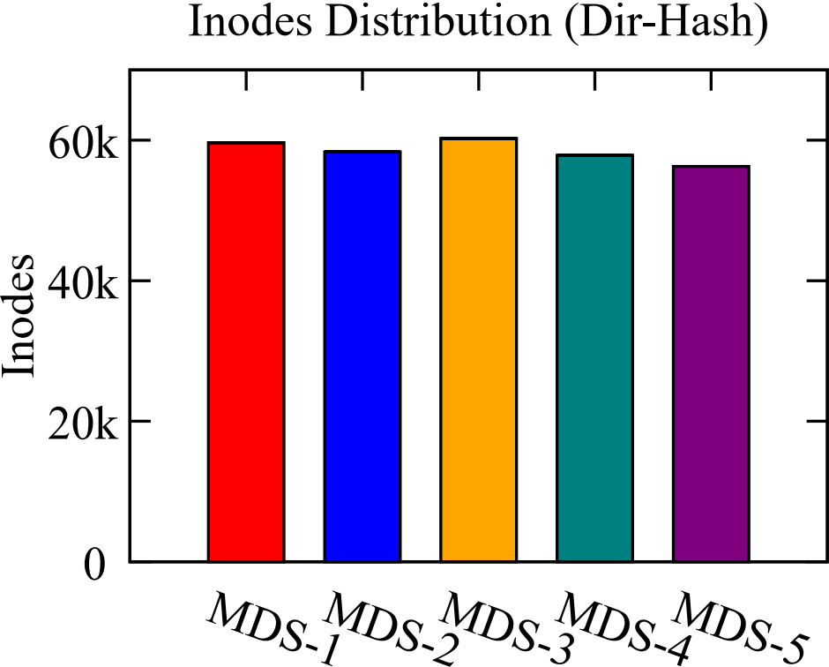
Lunule vs. Hash-based Solution
Hash subtree to 5 MDSs
Workload: web
Inodes balance
Notes:
Finally, we discuss the advantages and disadvantages of the hash-based approach versus Lunule. We implement a hash-based approach on CephFS, namely, Dir-Hash. The figure on the left shows the distribution of Inodes on 5 MDSs, with each color representing one MDS. It can be seen that Inodes could be distributed evenly over the 5 MDSs.

Slide 61
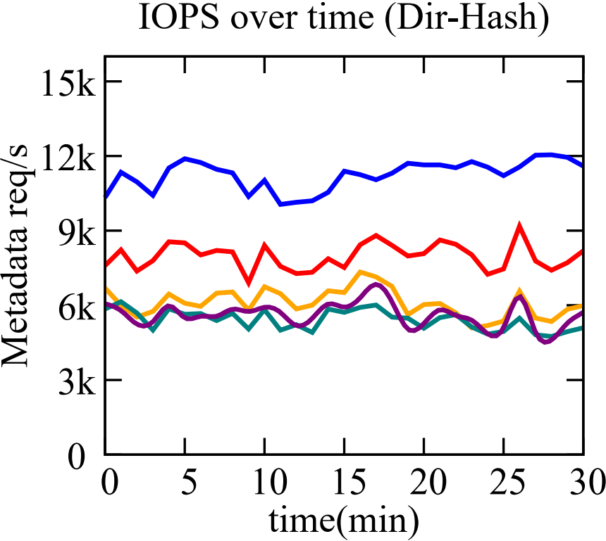
Lunule vs. Hash-based Solution
Hash subtree to 5 MDSs
Workload: web
Inodes balance
Load imbalance
Notes:
However, the runtime experiment shows that distributing the Inodes evenly did not balance the load well.

Slide 62
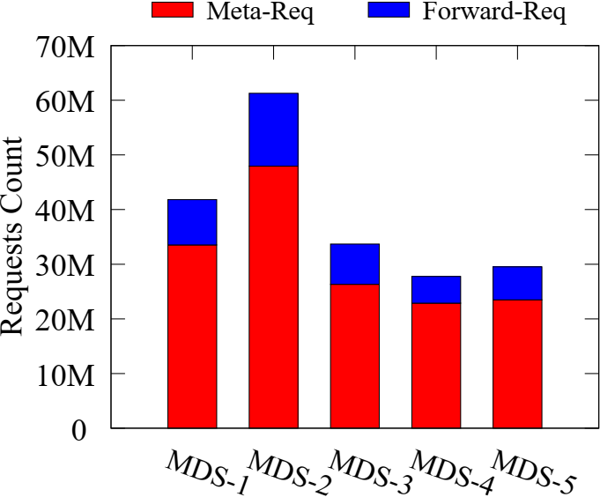
Lunule vs. Hash-based Solution
Inodes balance
Load imbalance
Many forwarding requests
Notes:
A more serious problem is shown in the figure on the right. We count the ratio of forwarded requests of hash-based method, nearly 20%, which is 98% higher than Lunule. Additional forwarding requests will definitely waste resources and lower the throughput.

Slide 63
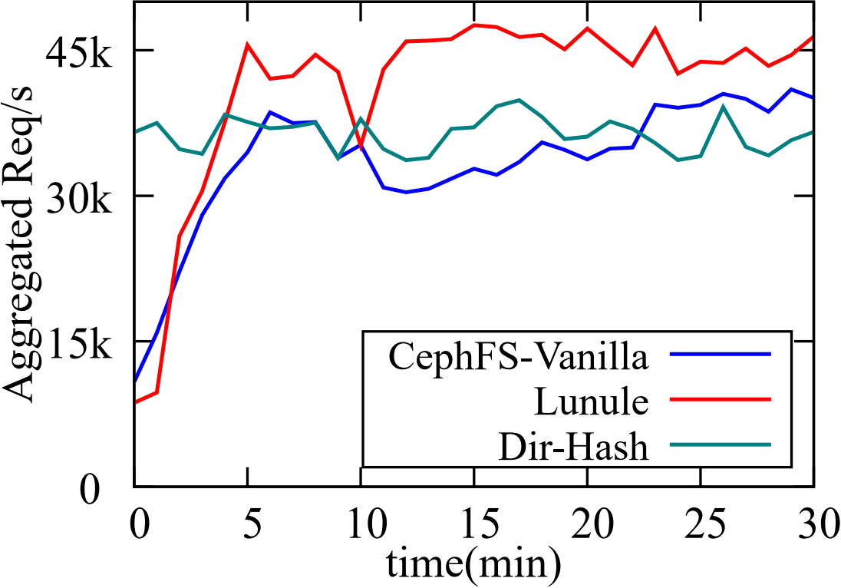
Lunule vs. Hash-based Solution
Hash subtree to 5 MDSs
Workload: web
Answer to Q4: Compared to hash-based method, Lunule archives better balance while maintaining metadata locality.
Notes:
This experiment verify our analysis: We compare the aggregated throughput of Lunule, CephFS, and Dir-hash. Although the hash-based approach achieved higher throughput in the beginning, it was quickly overtaken by Lunule, thanks to the load balancing mechanism of Lunule.
And the answer to the last question is: Compared to hash-based method, Lunule achieves better balance while maintaining metadata locality.

Slide 64
Outline
Metadata management in DFSs
Metadata load balance study
Design of Lunule
Experimental results
Conclusion
Notes:
Finally, to conclude,

Slide 65
Conclusion
Distributing Metadata among a MDS cluster is needed for
large-scale DFS deployments.
Metadata distribution and load balance is challenging.
Lunule is a new load balancer for CephFS:
  Employing an imbalance factor model.
  Adopting a workload-aware migration planner.
  Delivering better load balance.
  Increasing the metadata throughput by up to 315.8%.
Notes:
Distributing metadata among a MDS cluster is needed for large-scale DFS deployments, while metadata distribution and load balance is challenging.
To improve the load balance of metadata in DFSs, we propose Lunule, a novel CephFS metadata load balancer, which employs an imbalance factor model for accurately determining when to trigger re-balance and tolerate benign imbalanced situations. Lunule further adopts a workload-aware migration planner to appropriately select subtree migration candidates.
Compared to baselines, Lunule achieves better load balance, increases the metadata throughput by up to 315.8%.

Slide 66
Thanks & QA
Lunule: An Agile and Judicious
Metadata Load Balancer for CephFS
Yiduo Wang, USTC
Notes:
Thank you for your listening.

