Slide 1

Exploiting User Activeness for Data Retention in HPC Systems
Presenter: *Wei Zhang (Texas Tech University)
Co-authors:
Suren Byna (Lawrence Berkeley National Laboratory)
Hyogi Sim (Virginia Tech)
Sangkeun Lee (Oak Ridge National Laboratory)
Sudharshan Vazhkudai (Micron Technology)
Yong Chen (Texas Tech University)
Notes:
Hello, everyone, welcome to join my paper presentation. My name is Wei Zhang and I’m from Texas Tech University. The topic today is exploiting user activeness for data retention in HPC systems.

Slide 2


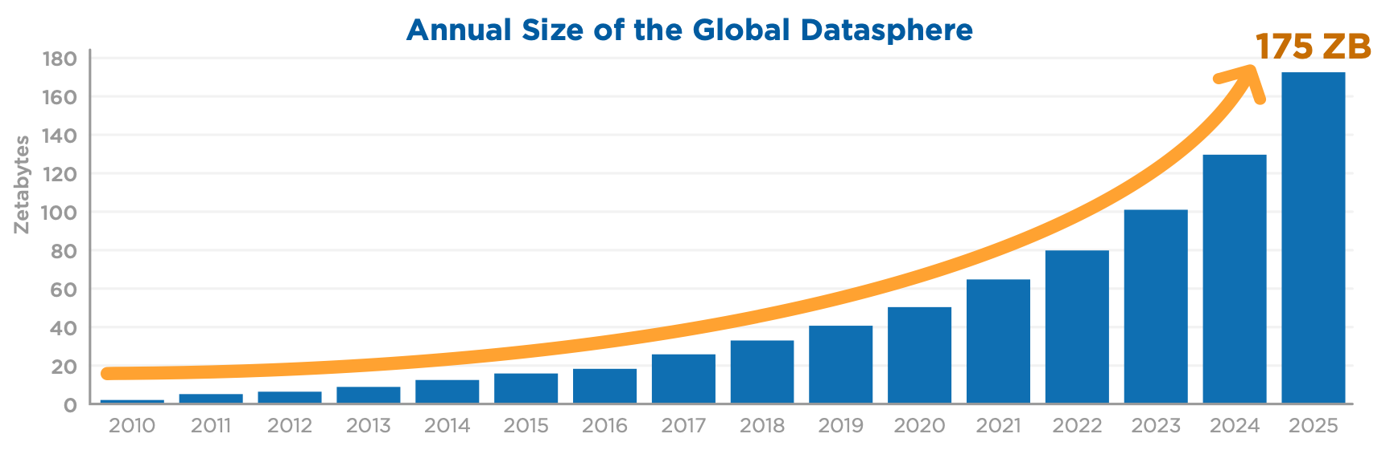

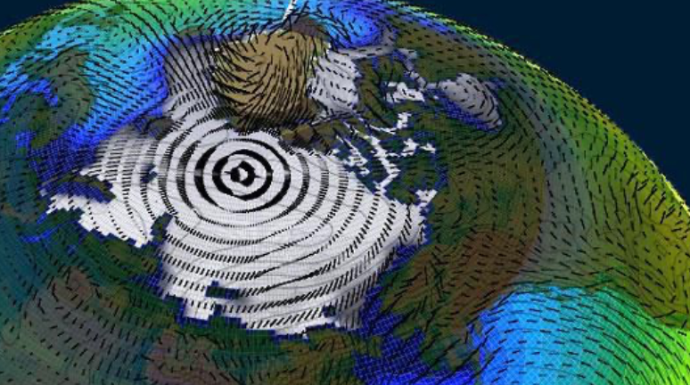
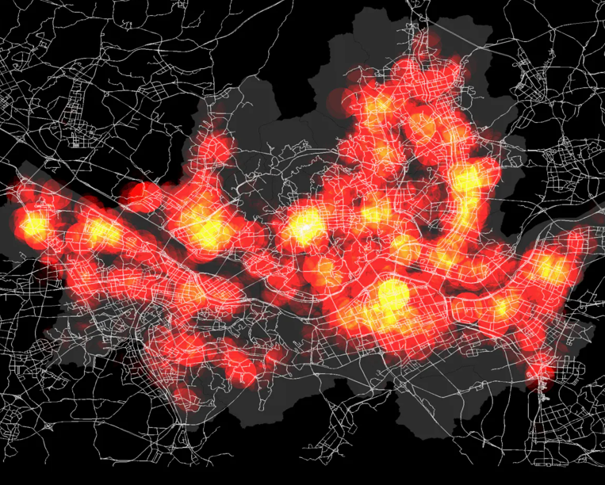
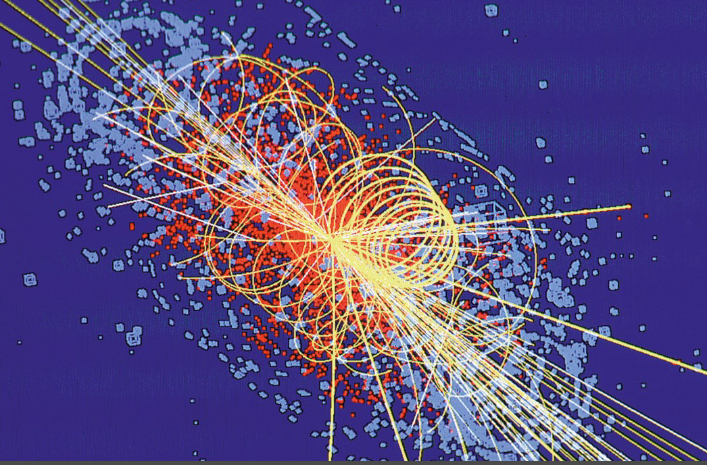

Introduction
Ever-growing data and the storage in HPC system
  Data Age 2025 – IDC White paper #US44413318
  Exponential data growth
  82ZB - 175ZB (2021 - 2025)
Notes:
Nowadays, People utilizes HPC system
to analyze the pandemic,
to study global warming,
to predict climate change,
to simulate collision among high energy particles,
to facilitate astronomical research,
to schedule industrial production tasks,
and to conduct economic forecast.
According to the IDC white paper: Data Age 2025, the total amount of data around the globe will surge to 175ZB within the next 4 years.
All of these data-intensive applications are imposing significant challenge to the supercomputers as well as the entire HPC community.

Slide 3
Introduction
Scratch Space in HPC
  Usage
    Design: Not a permanent storage
    Practices: User will not clean the data voluntarily.
  Space Utilization
    Upgrading is expensive
    Fixed capacity for a long time
    Applications continuously generates a vast amount of data
Notes:
Looking at a typical HPC system, the storage systems are usually following a layered design, where we have a faster storage like burst buffer with limited capacity, a regular parallel FS like scratch with medium capacity, and an archival storage with much lower performance.
Among them, The scratch space is where data is more frequently exchanged between faster storage and slower storage.
it serves as a temporary space for data files to be accessed by the applications.
Although it is not designed to serve as a permanent storage, but in practice, users often subconsciously treat it as a permanent storage without voluntarily clean their data.
However, the space utilization of a storage layer like scratch deserves a mention.
First of all, it can be very expensive to upgrade such storage layer for increasing the capacity,
so usually it will be having a fixed capacity for a long time.
But various applications are continuously generating a vast amount of data, which challenges its fixed capacity from time to time.
Therefore

Slide 4
Data Retention
Purge
Create/
Reserve
Life Cycle Check
Capacity Check
Retaining useful files
Purging unimportant files
To improve the storage space utilization
Notes:
HPC usually relies on data retention to manage the space utilization.
Data retention is defined as a process of retaining useful files and
purging unimportant files to
improve the utilization of storage space.

Slide 5
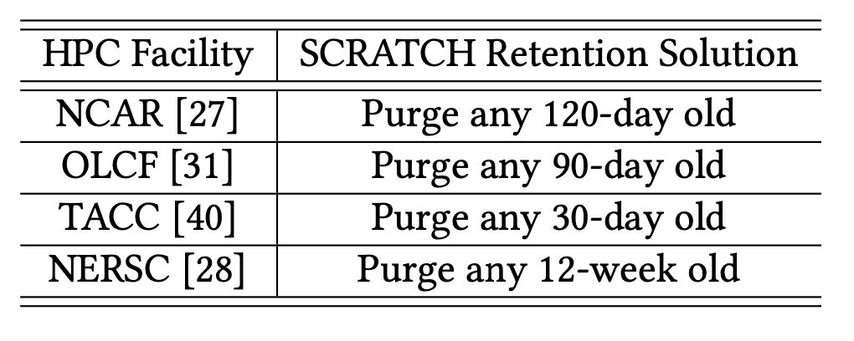
Existing Data Retention Solutions
Fixed Lifetime (FLT)
  Merits:
    Most widely used
    Based on temporal locality theory
    Easy to implement
  Drawback:
    Fixed file lifetime definition
    Only temporal properties of files are considered
Notes:
We have investigated literatures about data retention approaches and we found three major categories of them.
The first one is the FLT approach, which is the most commonly used one. The table on the right shows some concrete examples of the FLT approach, and they are used by some prominent HPC facilities.
It is based on temporal locality theory which deeply believes that the most recently accessed files will be accessed again in the near future (or within the file lifetime, to be specific).
It is also an easy-to-implement solution.
However, the drawback is that, it has a fixed lifetime approach, and only the temporal properties of files are considered.
Therefore,

Slide 6
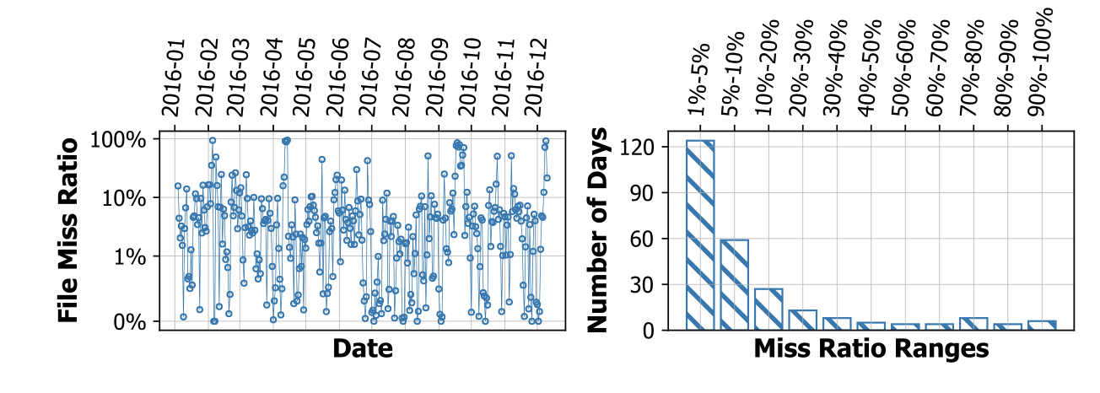
Fixed Lifetime (FLT)
Fixed file lifetime vs. Dynamic user file access
  A long experiment that lasts for months.
    Some files may not be found when it is close to the end.
  Users take care of time-consuming governance/logistic activities
    Files may be purged before users get back.
File miss occurs every month of the year
There are 120 days when 1%-5% file miss occurs
There are 60 days when 5%-10% file miss occurs
Notes:
there is huge gap between the fixed file lifetime definition and the dynamic user file access pattern.
For example, looking at this figure. For a storage system where a 30-day FLT retention policy is applied.
At the beginning of the first month, the user created a file,
and on the 26th day, he accessed the file, so the file is exempted from purge at the end of first month.
Then, the entire experiments lasts for longer than 30-days during which this file is not accessed,
or the user was taking care of other time-consuming governance or logistic activities
and was not able to access this file during the second month,
at the end of the second month, the file is purged.
When it comes to the third month, the user gets back and try to access the file,
but the file is not there and the user has to reload the file or regenerate the file due to such file miss, which is troublesome. Not to mention that, sometimes, there is no way to get the file back.
In fact, such file miss happens very often. We analyzed the logs from the previously decommissioned Titan supercomputer at Oak Ridge Leadership Computing Facility, and we found over the entire year of 2016, file miss occurs every month due to the ignorance of user dynamics in FLT data retention approach, and for the same reason, there are 120 days when 1%-5% files are missing and 60 days when 5%-10% files are missing.

Slide 7
Other Data Retention Solutions
Value-based Approach
  Define file value by
    File size
    File type
    File age
    File access frequency
    …
  No consensus on the definition of file value
  Limited interoperability
  Complex to find the most appropriate definition on file value
Scratch-as-a-cache
  Applications are “processes”
  Files on scratch are “data items in cache”
  Loading before application runs
  Off-loading after application stops running
  Extending the length of job execution
Notes:
We have also investigated the other two categories of data retention solutions.
One is called the value-based approach. It advocates that data retention should be performed according to the value of the file, which can be measured by various file-related metrics, like file size/ file type/ file age/ file access frequency, etc.
Since there is no consensus on the definition of file value, this approach suffers from its limited interoperability and it is not practical since it is complex for administrators to find the most appropriate definition of file value.
The other approach is called ‘sractch as a cache’
In this approach, all applications are considered as the ‘processes’ in an operating system, and the files on scratch are considered to be data items in cache. The data is loaded to scratch before an application is scheduled to execute while being offloaded after the application finishes its execution. However, it is not practical because it significantly increases the complexity of job scheduling and the length of job execution.
Being aware of the limitations we observed from the current practical FLT data retention method,

Slide 8
Activeness-based Data Retention
Vision:
  File availability to active users
  Overall utilization of HPC systems towards fruitful outcome
Other objectives:
  Automated
  Low integration cost
  Efficiency
Notes:
Being aware of the limitations we observed from the current practical FLT data retention method,
we envision that a better data retention solution should consider the file availability to the active users as well as the overall utilization of HPC systems towards fruitful outcomes.
Essentially, we think that the activeness of users should be well considered in the data retention solution.
In addition, such a data retention solution should be able to integrate with the current data management practices in an automated fashion and does not require extensive tuning or training efforts from system administrators.
Meanwhile, the solution should be efficient so that the purge decision can be made in a timely manner without taking a signficant amount of memory.
Therefore, we introduce a novel activeness-based data retention solution, named ActiveDR in short, to address the limitations of FLT and to meet data retention needs in HPC systems.
Basically, ActiveDR contains a user-activeness evaluation module,
in which each user’s activities are used to calculate a user activeness rank.
And we consider two types of activities, the operation activities and outcome activities. For each of them, we only need to know the starting time and the impact.
Then, there is the user classification module, where, the users are categorized into 4 groups by their activeness rank, like operation active only users, outcome active only users, the both active users,, and both inactive users.
Finally, in the data retention module, the files get scanned while the file lifetime are dynamically adjusted according to the users’ activeness rank, the purge decisions are made on the fly. Also our data retention module considers the purge exceptions like the admin-enforced file reservation requests.
Now, let’s take a closer look at these modules

Slide 9
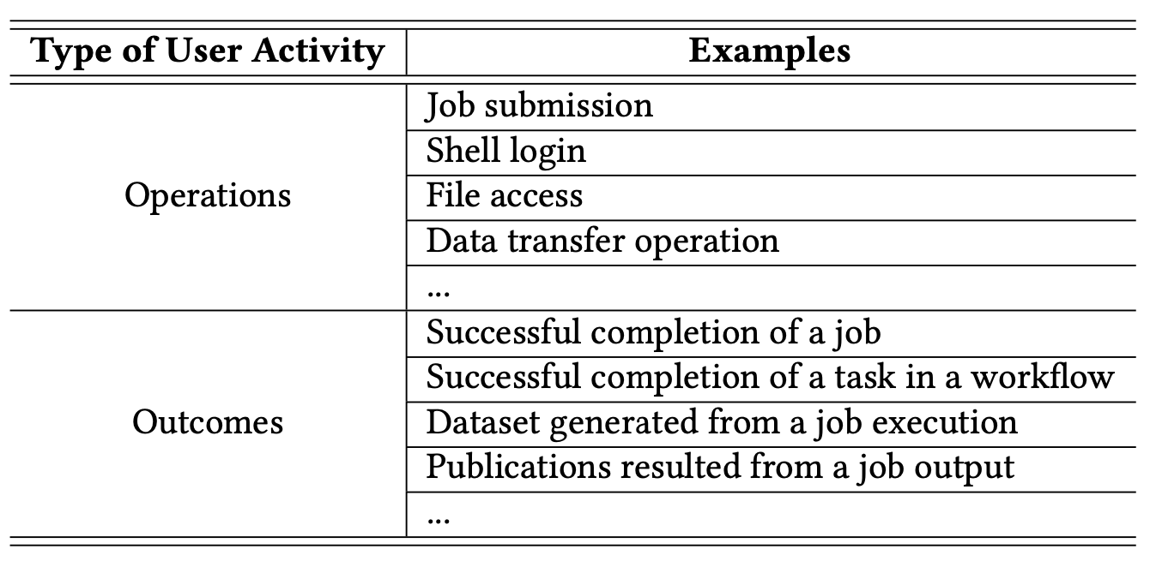
Activeness-based Perspective
Operations vs. Outcomes
  Operation: user activities performed on the system
  Outcome: accomplishment led by the use of the HPC system
Advantages:
  Fairness of user activity evaluation
  Preventing “periodic-file-touch” trick
Notes:
For activeness evaluation,
To capture the mutual impact between users’ ac-tivities and file accesses, we consider the data retention problem from a novel activeness-based perspective where users’ activities are categorized into two dimensions: operations and outcomes.
Our denition of an operation applies to a wide range of user activities performed on the system, as shown in the table. These operations reflect the activeness of users and thus change the priorities in the data retention process. Likewise, an outcome refers to an accomplishment users have achieved by using the HPC system, or, in other words, what the users produce or generate after performing the operations on the system (examples are also shown in the table).
The consideration of operation and outcome activities is the hallmark of the activeness-based perspective. It ensures the fairness of user activeness evaluation and prevents the “periodic-file-touch” tricks.
Since many HPC facilities do keep track of (or, at least are consider-ing tracking) user operations and outcomes [16,20,24,29,33,44],it is a fair assumption and feasible approach to include the consideration of operations and outcomes for the data retention solution

Slide 10
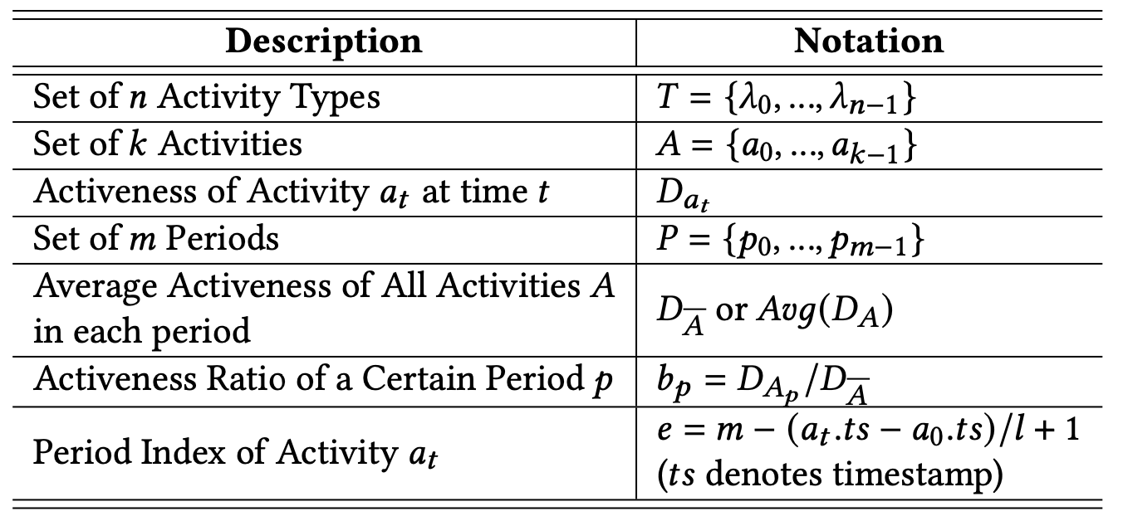

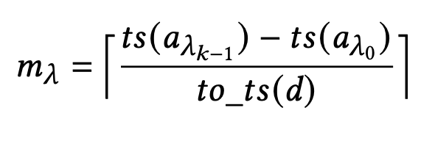
User Activeness Evaluation
Activeness D:
  A metric that represents the impact of the activity.
  Needs to be defined by the system administrator.
For
  Total number of periods:
Notes:
Now let’s take a look at how the activeness rank is calculated.
As shown in the table here, we denote the set of activity types using …
And for a particular type of activity, we consider there are k activities from … to …
We denote the activeness of activity a_t at time t to be D_{a_t}
Then we denote the average activeness of .. As…
And the activness ratio is the activeness of an activity over the average activeness
And we can calculate the period index using the given equation.
Given an activity \lambda, we consider D to be a metric that represents the impact of the activity and it is set by the system administrator.
Then the first step of user activeness evaluation is to calculate how many periods the collection of a particular type of user activites spans over.

Slide 11

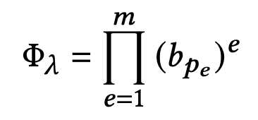
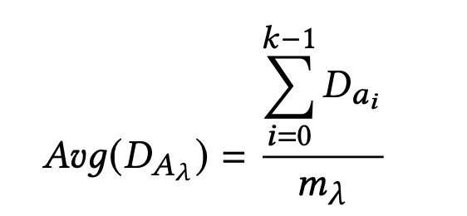
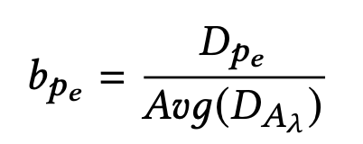
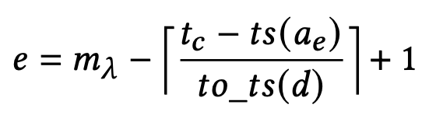
User Activeness Evaluation (Cont.)
❶ Average activeness for each activity type
❷ Activeness ratio of each period for each activity type
❸ Overall activeness rank of each activity type
Average Activeness:
  of all k activities of type 𝜆 across all m_{𝜆} periods.
For a period p_{e} ,
  Let
  Activeness ratio in this period:
Index of period e:
For activity type 𝜆, overall activeness rank:
Inactive:
  0 ≤ Φ_{𝜆} < 1
Active:
  Φ_{𝜆} ≥ 1
Notes:
Next, we first, calculate the average activeness for each activity type
Then, we calculate the activeness ratio of each period for each activity type, which is the activeness sum of all activites over the average activeness across all periods.
Finally, we calculate the overall activeness rank of each activity type like this, which is the product of period-index-powered activeness ratio of each period
With this calculation, the activeness rank of inactive activity types will be a fraction less than 1 while the activenss of active activity type should be larger than 1 . Also, for a given user, all the activities happened earlier will have less weight on the overall activness rank while those activities will weight more.

Slide 12
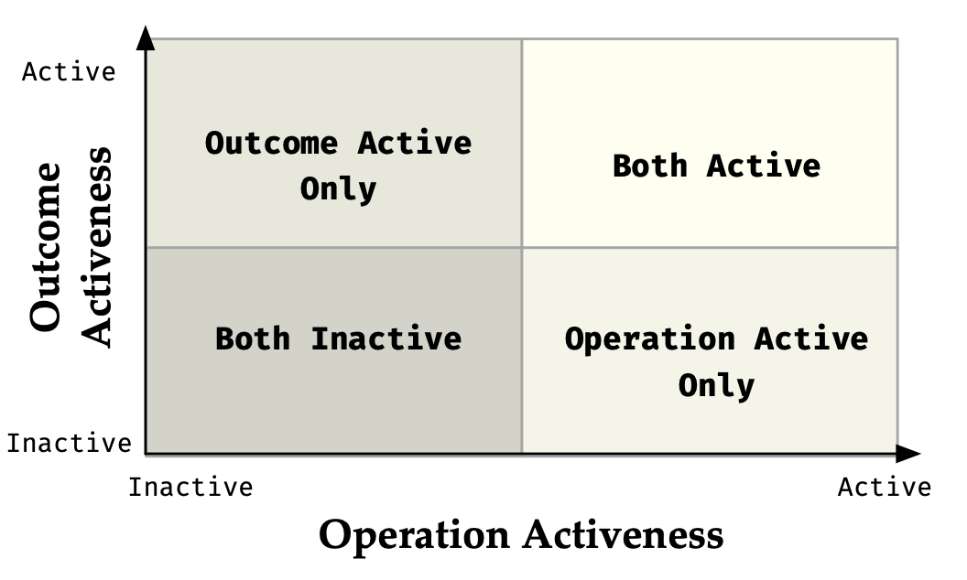
User Classification Matrix
Activeness Ranking
  Not by a single value
  (Φ_{𝑜𝑝} , Φ_{𝑜c})
  Each user corresponds to a point in a 2-D space
Notes:
After performing the activeness evaluation, we rank each user with a binary tuple containing the operation activeness and the outcome activeness scores.
we categories the users into four activeness groups according to their activeness score. Like both active, outcome active only, operation active only and both inactive.
Each user corresponds to a point in this orthorgnal 2-D space.

Slide 13
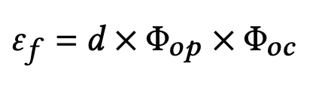

Data Retention
Initial file lifetime: d
Initial activeness for each user: 1.0
Initialization (by admin)
Y
Check Purge Target
N
File Scanning
Y
Check Purge Exception
N
Adjusted file lifetime:
N
Y
RESERVE
PURGE
Notes:
Finally, the data retention module.
We first set up the initial file lifetime d, and initially the activeness of each user is 1.0, just in case that no activity information is available for a new system
and then we scan all the files starting from the user directories of low activeness users.
We check the purge target, if the purge target is reached, we skip the purge,
Otherwise, we check purge exception, if a purge exception has been proposed, we skip the purge again,
Otherwise, we calculated the adjusted file lifetime , and a purge decision is made based on whether the lifetime of the file is expired or not.
To see the efficacy of ActiveDR.

Slide 14
Evaluation
Dataset & Procedure
  For evaluating activeness
    Job scheduler log (2013-2016)
    Publication list (2013-2016)
  For simulating file system
    Metadata snapshots (2015-2016)
  For simulating data access from jobs
    Application logs (2015-2016)
  User information
    User list (13813 users as of 2016)
Experimental Platform
  Cori @ NERSC
    2x 16-core Intel Xeon E5-2698 v3
    128GB DDR4 @ 2133 MHz
    Lustre file system (peak @ 700GB/s)
  ActiveDR prototype implementation
    https://github.com/zhangwei217245/ActiveDR
Notes:
We perform our evaluation on Cori supercomputer at NERSC with the software prototype which is now an available artifact.
For the dataset, we use the set of logs from the previously decommissioned Titan supercomputer and its spider II storage system at Oak Ridge Leadership Computing Facility (OLCF)
We use … logs for …

Slide 15
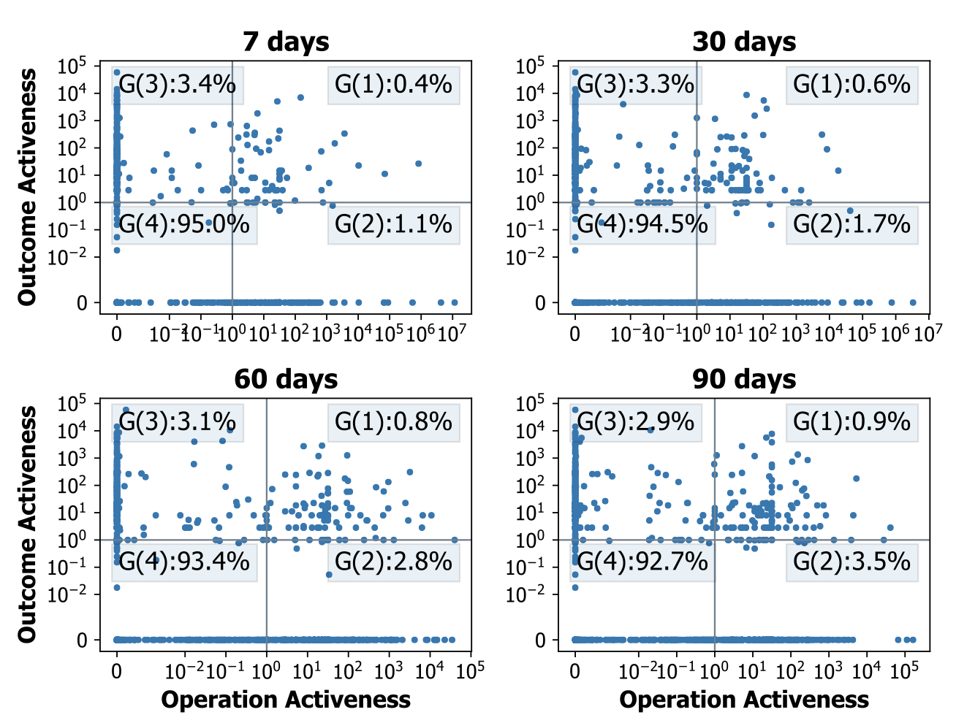
User Activeness
G1: Both Active:
  only 0.4%-0.9% users
G2: Operation Active Only:
  1.1% - 3.5% ( 7 day ~ 90 day)
G3: Outcome Active Only:
  3.4% - 2.9% ( 7 day ~ 90 day)
G4: Both Inactive
  92.7% - 95%
Observed:
  Most users rarely perform operations.
  Operations are not as active as outcome activities. (this is something FLT does not capture)
Notes:
We performed an activeness analysis on the OLCF logs with four different period settings like 7, 30, 60 and 90 days.
And we found for all four period settings, over 90% users are both inactive, while only less than 1% users are both active.
Outcome active only users are slightly more than operation active only users, which shows that
most users are inactive,
active users tend to be more outcome active.
Overall, we can see that most of the users rarely perform operations. And even the operations are not as active as outcome activities. (this is something FLT does not capture)

Slide 16
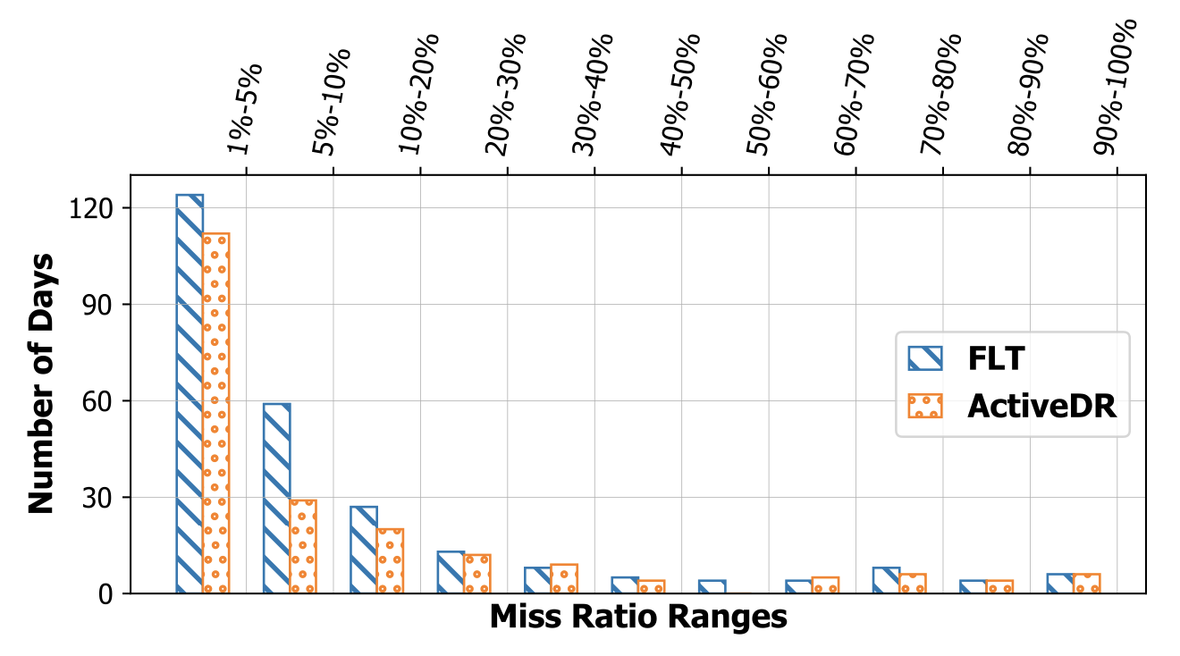
File Miss Reduction
With ActiveDR:
  File miss yearly duration: Total number of days with 5%+ file misses
  With ActiveDR, the file miss yearly duration has been reduced from half a year to a single quarter (from 138 days to 95 days)
Notes:
We performed data retention with FLT and ActiveDR separately and
we found that with ActiveDR, the number of days with over 5% file misses is reduced from half a year to only a quarter.

Slide 17
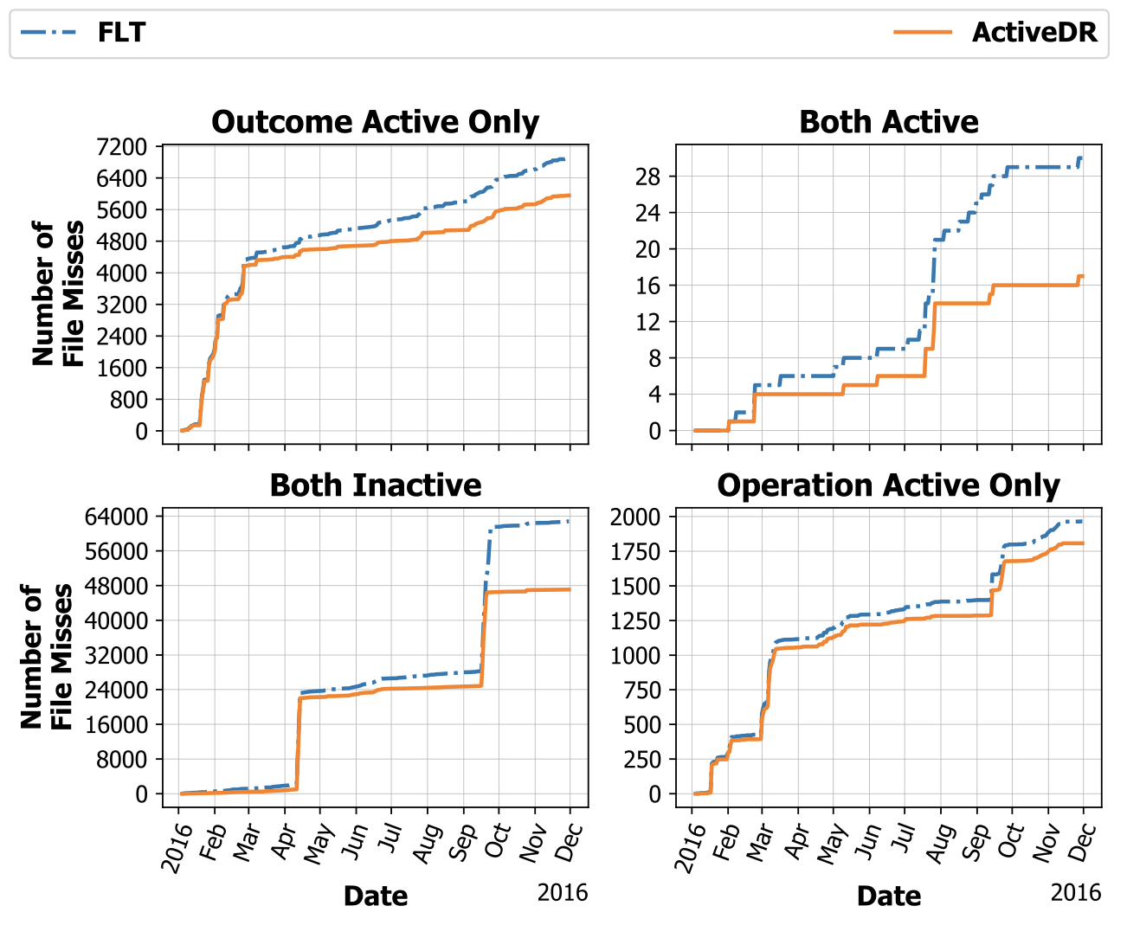
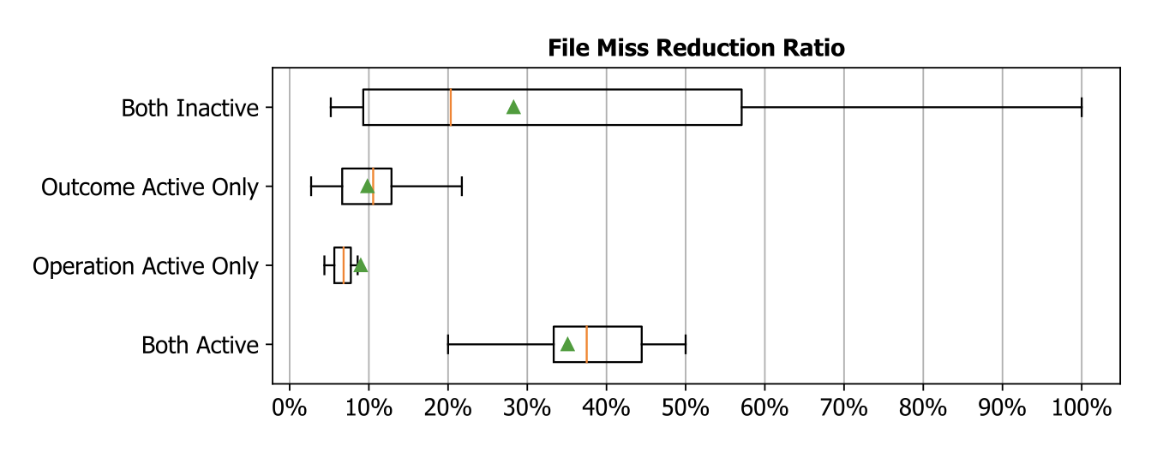
File Miss Reduction
Max file miss reduction
  For both active users
Notes:
As for file miss reduction, ActiveDR helps reduce the file misses in the long run, as compared to FLT solution. Especially, ActiveDR helps to reduce file miss significantly for both-active users.

Slide 18
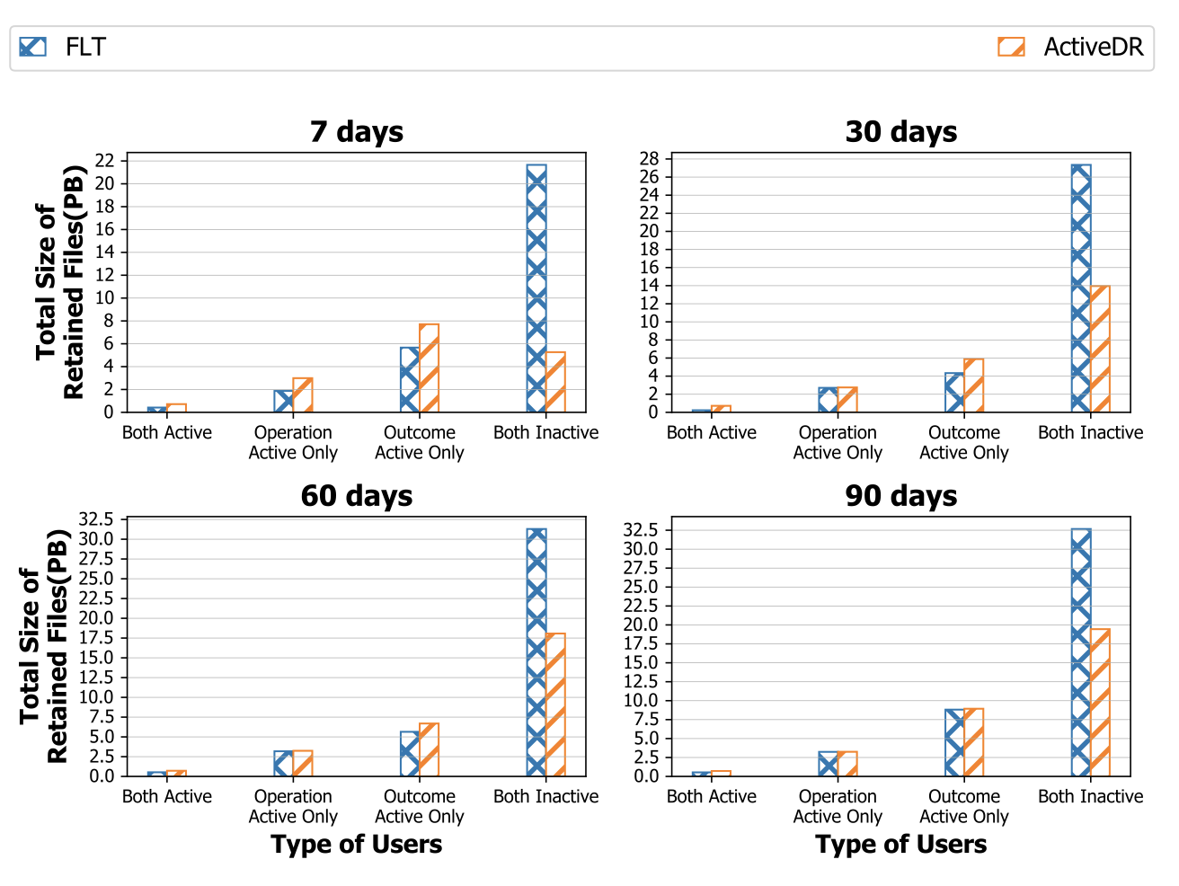
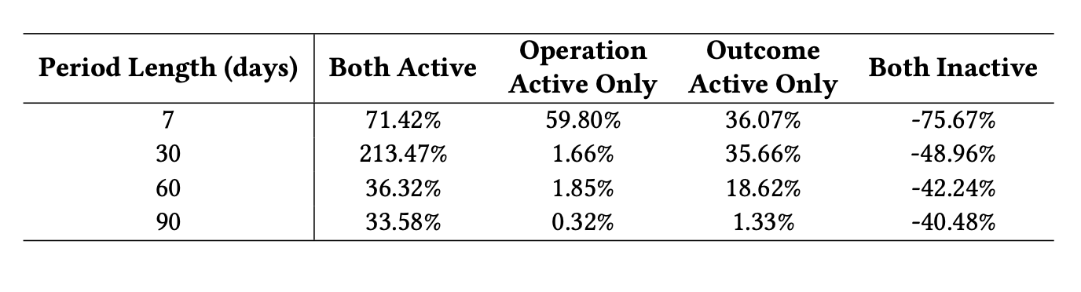
Retention with Various Lifetime Settings
With ActiveDR :
  Less files are retained for inactive users
  More files and more space are reserved for active users
Percentage of file size that ActiveDR retains more than FLT
Notes:
When comparing the total size of retained files, we can clearly see that ActiveDR retains much less files for the inactive users, and more files for active users

Slide 19
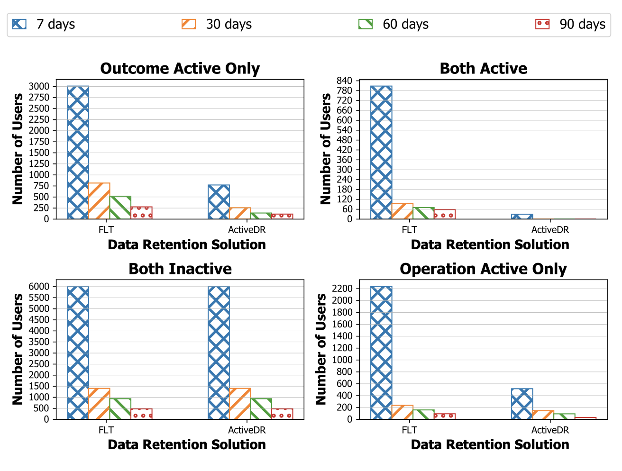
Number of Users Affected by File Purge
Using ActiveDR:
  Less number of active users are affected by file purge
  Roughly the same impact on both inactive users
Notes:
Also, we observed that with ActiveDR , less number of active users are affected by file purge operations while the number of inactive users affected by file purge are roughly the same.
Performance wise,

Slide 20
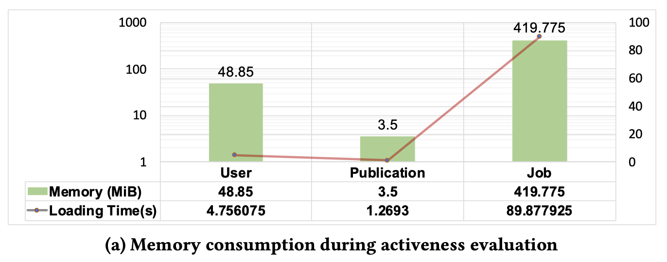
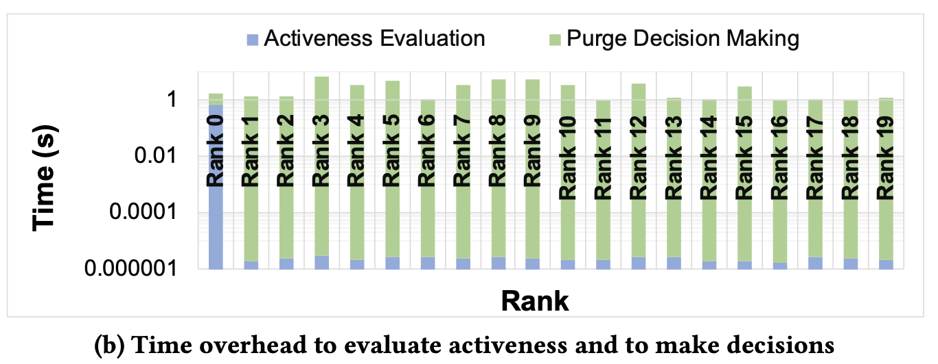
Performance
Memory and Loading Time:
  Roughly 500 MB
  Finished loading within 2 minutes
Efficient activeness evaluation
  Only the master process need to perform the evaluation
  Finished within a second
Rapid purge decision making
  1-5 seconds for 1,040,886 files in total
Notes:
ActiveDR is very efficient in terms of memory blueprint and data loading time. Loading all the job scheduler logs only took 500MB space while the entire data loading time is only 2min.
The activeness evaluation process is efficient as well: the activeness evaluation on the main process only took less than 1s.
And for all the processes, it took only up to 5 seconds to finish purge decision making for over 1 million files.

Slide 21
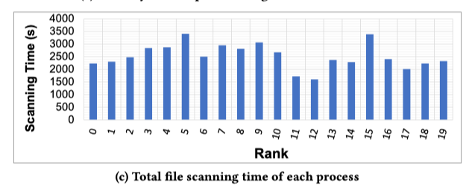
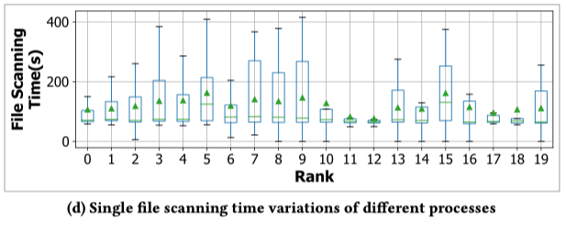
Performance (cont.)
File Scanning Time
  Roughly 1 hour to finish all file scanning with 20 parallel processes
  Scanning each metadata snapshot file can only take 50 – 400 seconds
Notes:
As for file scanning time, it took roughly 1 hour to finish all the scanning with 20 parallel processes,
and scanning a single snapshot file took 50-400 seconds.

Slide 22
Conclusion
User-friendliness
  Value user experience and aim to reduce file misses for active users
Administrator-friendliness
  Maximum freedom for sysadmin to choose activity types and sources
Resource-friendliness
  Low memory footprint
  Blazing fast evaluation and decision making
HPC-ecosystem-friendliness
  Promote fruitful and productive use of HPC system
Designed for HPC storage
New insights on HPC storage management
Impact on new practices in the HPC community
A valuable reference to other storage system where data retention is needed.
Data retention is a general, growingly critical problem, we call for community’s collective effort to take the challenge!
Notes:
In conclusion: in this work, we proposed ActiveDR – a novel activeness-based data retention solution.
Comparing to the limitations of the existing data retention methodologies on HPC systems, our solution is unique, effective and reproducible with 4 remarkable characteristics:
First, our solution is user-friendly: in ActiveDR, we consider users and their activities at the core of its design. The activeness-based per- spective holistically captures both operations that users perform on the system and the outcomes that users yield by using the system. We value the user experience of the scratch space and we aim to reduce the file misses for active users;
Second, our solution is also administrator-friendly: the definition of operations and outcomes in the activeness-based perspective covers a wide range of user activities. Therefore, the administrators can simply utilize traces available or activities captured by monitoring tools they have been using to serve the user activeness evaluation. They can customize the ActiveDR as needed too;
Additionally, we should notice that our solution is resource-friendly: ActiveDR provides an efficient activeness evaluation algorithm that only requires some important properties of user activities. As such, the activeness evaluation process of ActiveDR runs very fast and the memory footprint is negligible;
Finally, we would like to emphasize its HPC-ecosystem-friendliness: ActiveDR is the first data retention solu- tion that promotes the active and fruitful use of the HPC system, which helps promote productive use of HPC facilities.
Our solution is designed for HPC storage system, it offers new insights about HPC storage management problem and can have an impact on new practices in the HPC community. It is also A valuable reference to other storage system where data retention is needed.
Data retention is a general, growingly critical problem, we call for community’s collective effort to take the challenge!

Slide 23


Follow Up / Q&A
Acknowledgement:
We are thankful to the anonymous reviewers for their valuable feedback. This research is supported in part by the National Science Foundation under grant CCF-1718336, OAC-1835892 and CNS1817094. This manuscript has been authored by an author at Lawrence Berkeley National Laboratory under Contract No. DE-AC02-05CH11231 with the U.S. Department of Energy, and has been authored by UTBattelle, LLC, under contract DE-AC05-00OR22725 with the U.S. Department of Energy (DOE). The U.S. Government retains, and the publisher, by accepting the article for publication, acknowledges that the U.S. Government retains a non-exclusive, paid-up, irrevocable, world-wide license to publish or reproduce the published form of this manuscript, or allow others to do so, for U.S. Government purposes. DOE will provide public access to these results of federally sponsored research in accordance with the DOE Public Access Plan (http://energy.gov/downloads/doe-public-access-plan).
Notes:
Finally, we would like to thank all the audiences for being here, and we appreciate all the comments and suggestions from the anonymous reviewers of this paper.
Also many thanks to the funding agencies who provided fundings for our research project.
All right, if you are interested in this research, please follow up, and – any questions?

Slide 24
Thank you !

