Slide 1

Parallel Construction of Module Networks
Ankit Srivastava*, Sriram Chockalingam,
Maneesha Aluru, and Srinivas Aluru
November 16th, 2021

Slide 2

Module Networks
Bayesian networks (BNs) learn direct interactions between variables
CPD 2
P(MSFT)
CPD 1
NVDA
NVDA
CPD = Conditional Probability Distribution
MSFT
CPD 3
CPD 4
GOOGL
AMZN
CPD 5
CPD 6
SPOT
NFLX

Slide 3
Module Networks
Bayesian networks (BNs) learn direct interactions between variables
  Difficult to use BNs to understand indirect relationships – emergent behaviors
CPD 2
P(MSFT)
CPD 1
NVDA
NVDA
CPD = Conditional Probability Distribution
MSFT
CPD 3
CPD 4
GOOGL
AMZN
CPD 5
CPD 6
SPOT
NFLX

Slide 4
Module Networks
Bayesian networks (BNs) learn direct interactions between variables
  Difficult to use BNs to understand indirect relationships – emergent behaviors
Important to identify emergent behaviors in multiple fields
  e.g., stock market analysis, cancer research, genome annotation, etc.
CPD 2
P(MSFT)
CPD 1
NVDA
NVDA
CPD = Conditional Probability Distribution
MSFT
CPD 3
CPD 4
GOOGL
AMZN
CPD 5
CPD 6
SPOT
NFLX

Slide 5
Module Networks
Bayesian networks (BNs) learn direct interactions between variables
  Difficult to use BNs to understand indirect relationships – emergent behaviors
Important to identify emergent behaviors in multiple fields
  e.g., stock market analysis, cancer research, genome annotation, etc.
Segal et al. (2005) proposed a specialization of BNs that formalize indirect interactions – module networks (MoNets)

Slide 6
Module Networks
Bayesian networks (BNs) learn direct interactions between variables
  Difficult to use BNs to understand indirect relationships – emergent behaviors
Important to identify emergent behaviors in multiple fields
  e.g., stock market analysis, cancer research, genome annotation, etc.
CPD 2
P(NVDA)
CPD 1
NVDA
NVDA
MSFT
CPD 3
CPD 4
GOOGL
AMZN
CPD 5
CPD 6
SPOT
NFLX

Slide 7
Module Networks
Bayesian networks (BNs) learn direct interactions between variables
  Difficult to use BNs to understand indirect relationships – emergent behaviors
Important to identify emergent behaviors in multiple fields
  e.g., stock market analysis, cancer research, genome annotation, etc.
CPD 2
P(NVDA)
CPD 1
Module 1
CPD 1
NVDA
NVDA
NVDA
Module 2
MSFT
CPD 2
MSFT
CPD 3
CPD 4
GOOGL
GOOGL
AMZN
AMZN
CPD 5
CPD 6
Module 3
CPD 3
SPOT
NFLX
SPOT
NFLX

Slide 8
Module Networks
Bayesian networks (BNs) learn direct interactions between variables
  Difficult to use BNs to understand indirect relationships – emergent behaviors
Important to identify emergent behaviors in multiple fields
  e.g., stock market analysis, cancer research, genome annotation, etc.
Segal et al. (2005) proposed MoNets to formalize indirect interactions
  A module consists of a set of variables which share CPD and set of parents
  The set of descendants of the variables in a module may be different

Slide 9
Module Networks
Bayesian networks (BNs) learn direct interactions between variables
  Difficult to use BNs to understand indirect relationships – emergent behaviors
Important to identify emergent behaviors in multiple fields
  e.g., stock market analysis, cancer research, genome annotation, etc.
Segal et al. (2005) proposed MoNets to formalize indirect interactions
  A module consists of a set of variables which share CPD and set of parents
  The set of descendants of the variables in a module may be different
BN structure for the variables can be inferred from the learned MoNet

Slide 10
Module Network Construction
Constructing MoNets requires learning the assignment of variables to modules, in addition to learning the DAG structure
  At least as hard as learning BN structure – NP-hard

Slide 11
Module Network Construction
Constructing MoNets requires learning the assignment of variables to modules, in addition to learning the DAG structure
  At least as hard as learning BN structure – NP-hard
Multiple heuristic methods have been proposed for the purpose
  Segal et al. (2005) proposed an iterative algorithm – Genomica
  Bonnet et al. (2015) proposed a task-based algorithm – Lemon-Tree

Slide 12
Module Network Construction
Constructing MoNets requires learning the assignment of variables to modules, in addition to learning the DAG structure
  At least as hard as learning BN structure – NP-hard
Multiple heuristic methods have been proposed for the purpose
  Segal et al. (2005) proposed an iterative algorithm – Genomica
  Bonnet et al. (2015) proposed a task-based algorithm – Lemon-Tree
Previous studies have found Lemon-Tree to be more effective at constructing robust MoNets
  Lemon-Tree has been employed for constructing MoNets in multiple recent works aiming to improve life expectancy and quality of life

Slide 13
Module Network Construction – Lemon-Tree
Lemon-Tree constructs MoNets by executing three tasks
  GaneSH Co-Clustering
    Variable-observation co-clusterings – Gibbs sampler algorithm
    Multiple variable clusters are sampled – random initializations

Slide 14
Module Network Construction – Lemon-Tree
Lemon-Tree constructs MoNets by executing three tasks
  GaneSH Co-Clustering
    Variable-observation co-clusterings – Gibbs sampler algorithm
    Multiple variable clusters are sampled – random initializations
NVDA
NFLX
NVDA
NFLX
NVDA
NFLX
GOOGL
SPOT
GOOGL
SPOT
GOOGL
SPOT
AMZN
MSFT
AMZN
MSFT
AMZN
MSFT
GaneSH 1
GaneSH 2
GaneSH 3

Slide 15
Module Network Construction – Lemon-Tree
Lemon-Tree constructs MoNets by executing three tasks
  GaneSH Co-Clustering
    Variable-observation co-clusterings – Gibbs sampler algorithm
    Multiple variable clusters are sampled – random initializations
NVDA
NFLX
NVDA
NFLX
NVDA
NFLX
GOOGL
SPOT
GOOGL
SPOT
GOOGL
SPOT
AMZN
MSFT
AMZN
MSFT
AMZN
MSFT
GaneSH 1
GaneSH 2
GaneSH 3

Slide 16
Module Network Construction – Lemon-Tree
Lemon-Tree constructs MoNets by executing three tasks
  Consensus Clustering
    Single consensus variable clustering solution – spectral clustering
NVDA
NFLX
NVDA
NFLX
NVDA
NFLX
GOOGL
SPOT
GOOGL
SPOT
GOOGL
SPOT
AMZN
MSFT
AMZN
MSFT
AMZN
MSFT

Slide 17
Module Network Construction – Lemon-Tree
Lemon-Tree constructs MoNets by executing three tasks
  Consensus Clustering
    Single consensus variable clustering solution – spectral clustering
NVDA
NFLX
NVDA
NFLX
NVDA
NFLX
GOOGL
SPOT
GOOGL
SPOT
GOOGL
SPOT
AMZN
MSFT
AMZN
MSFT
AMZN
MSFT
Consensus Clustering
GOOGL
NFLX
NVDA
MSFT
AMZN
SPOT

Slide 18
Module Network Construction – Lemon-Tree
Lemon-Tree constructs MoNets by executing three tasks
  Consensus Clustering
    Single consensus variable clustering solution – spectral clustering
    Consensus variable clusters are used as modules
GOOGL
NFLX
NVDA
MSFT
AMZN
SPOT

Slide 19
Module Network Construction – Lemon-Tree
Lemon-Tree constructs MoNets by executing three tasks
  Consensus Clustering
    Single consensus variable clustering solution – spectral clustering
    Consensus variable clusters are used as modules
Module
Module
Module
GOOGL
NFLX
NVDA
MSFT
AMZN
SPOT

Slide 20
Module Network Construction – Lemon-Tree
Lemon-Tree constructs MoNets by executing three tasks
  Learning Module CPDs and Parents
    CPD regression tree structures for each module – GaneSH runs for clustering observations followed by hierarchical agglomerative clustering
GOOGL
NFLX
NVDA
MSFT
AMZN
SPOT

Slide 21
Module Network Construction – Lemon-Tree
Lemon-Tree constructs MoNets by executing three tasks
  Learning Module CPDs and Parents
    CPD regression tree structures for each module – GaneSH runs for clustering observations followed by hierarchical agglomerative clustering
Observation Clusters
GOOGL
NFLX
NVDA
MSFT
AMZN
SPOT

Slide 22
Module Network Construction – Lemon-Tree
Lemon-Tree constructs MoNets by executing three tasks
  Learning Module CPDs and Parents
    CPD regression tree structures for each module – GaneSH runs for clustering observations followed by hierarchical agglomerative clustering
Regression Tree Structures
Observation Clusters
GOOGL
NFLX
NVDA
MSFT
AMZN
SPOT

Slide 23
Module Network Construction – Lemon-Tree
Lemon-Tree constructs MoNets by executing three tasks
  Learning Module CPDs and Parents
    CPD regression tree structures for each module – GaneSH runs for clustering observations followed by hierarchical agglomerative clustering
    Candidate parent variables and corresponding observation values are scored,
    assigned to the non-leaf nodes of regression tree structures
Regression Tree Structures
Observation Clusters
GOOGL
NFLX
NVDA
MSFT
AMZN
SPOT

Slide 24






Module Network Construction – Lemon-Tree
Lemon-Tree constructs MoNets by executing three tasks
  Learning Module CPDs and Parents
    CPD regression tree structures for each module – GaneSH runs for clustering observations followed by hierarchical agglomerative clustering
    Candidate parent variables and corresponding observation values are scored,
    assigned to the non-leaf nodes of regression tree structures
GOOGL
Parent and Split Value Assignments
NVDA
$$<5\%$$
$$≥5\%$$
$$<6\%$$
$$≥6\%$$
AMZN
$$<4\%$$
$$≥4\%$$
GOOGL
NFLX
NVDA
MSFT
AMZN
SPOT

Slide 25
Module Network Construction – Lemon-Tree
Lemon-Tree constructs MoNets by executing three tasks
  Learning Module CPDs and Parents
    CPD regression tree structures for each module – GaneSH runs for clustering observations followed by hierarchical agglomerative clustering
    Candidate parent variables and corresponding observation values are scored,
    assigned to the non-leaf nodes of regression tree structures
    Variables assigned to module regression trees are parents for the module
GOOGL
NVDA
$$<5\%$$
$$≥5\%$$
$$<6\%$$
$$≥6\%$$
AMZN
$$<4\%$$
$$≥4\%$$
GOOGL
NFLX
NVDA
MSFT
AMZN
SPOT

Slide 26
Module Network Construction – Lemon-Tree
Lemon-Tree constructs MoNets by executing three tasks
  Learning Module CPDs and Parents
    CPD regression tree structures for each module – GaneSH runs for clustering observations followed by hierarchical agglomerative clustering
    Candidate parent variables and corresponding observation values are scored,
    assigned to the non-leaf nodes of regression tree structures
    Variables assigned to module regression trees are parents for the module
GOOGL
NVDA
$$<5\%$$
$$≥5\%$$
$$<6\%$$
$$≥6\%$$
AMZN
$$<4\%$$
$$≥4\%$$
GOOGL
NFLX
NVDA
MSFT
AMZN
SPOT

Slide 27
Module Network Construction – Lemon-Tree
Lemon-Tree constructs MoNets by executing three tasks
  Learning Module CPDs and Parents
    CPD regression tree structures for each module – GaneSH runs for clustering observations followed by hierarchical agglomerative clustering
    Candidate parent variables and corresponding observation values are scored,
    assigned to the non-leaf nodes of regression tree structures
    Variables assigned to module regression trees are parents for the module
> 90% of Total Sequential Run-time
GOOGL
NVDA
$$<5\%$$
$$≥5\%$$
$$<6\%$$
$$≥6\%$$
AMZN
$$<4\%$$
$$≥4\%$$
GOOGL
NFLX
NVDA
MSFT
AMZN
SPOT

Slide 28
Parallelizing Lemon-Tree
Proposed the first parallel solution for the Lemon-Tree method
  Developed parallel algorithms for the first and the last task –
  GaneSH clustering and learning module CPDs and parents

Slide 29
Parallelizing Lemon-Tree
Proposed the first parallel solution for the Lemon-Tree method
  Developed parallel algorithms for the first and the last task –
  GaneSH clustering and learning module CPDs and parents
  Consensus clustering takes < 0.04% of the total sequential run-time –
  can be executed sequentially

Slide 30
Parallelizing Lemon-Tree
Proposed the first parallel solution for the Lemon-Tree method
  Developed parallel algorithms for the first and the last task –
  GaneSH clustering and learning module CPDs and parents
  Consensus clustering takes < 0.04% of the total sequential run-time –
  can be executed sequentially
Key Idea: Parallel algorithm for the most computationally expensive phase – scoring candidate parent splits

Slide 31
Parallelizing Lemon-Tree
Proposed the first parallel solution for the Lemon-Tree method
  Developed parallel algorithms for the first and the last task –
  GaneSH clustering and learning module CPDs and parents
  Consensus clustering takes < 0.04% of the total sequential run-time –
  can be executed sequentially
Key Idea: Parallel algorithm for the most computationally expensive phase – scoring candidate parent splits
  Multiple modules, multiple regression tree structures per module, multiple non-leaf nodes per regression tree structure, multiple candidate splits

Slide 32
Parallelizing Lemon-Tree
Proposed the first parallel solution for the Lemon-Tree method
  Developed parallel algorithms for the first and the last task –
  GaneSH clustering and learning module CPDs and parents
  Consensus clustering takes < 0.04% of the total sequential run-time –
  can be executed sequentially
Key Idea: Parallel algorithm for the most computationally expensive phase – scoring candidate parent splits
  Multiple modules, multiple regression tree structures per module, multiple non-leaf nodes per regression tree structure, multiple candidate splits
  Create a tuple <module, tree, node, variable, split value> corresponding to all the candidate parent splits for fine-grained distribution of work

Slide 33
Parallelizing Lemon-Tree
p=0
Communication
p=1
Data set, Parameters
Data set, Parameters

Slide 34
Parallelizing Lemon-Tree
p=0
Communication
p=1
Data set, Parameters
Data set, Parameters
GaneSH
GaneSH
Reassign-Var-Cluster
Merge-Var-Cluster
Reassign-Var-Cluster
Merge-Var-Cluster
Reassign-Obs-Cluster
Merge-Obs-Cluster
Reassign-Obs-Cluster
Merge-Obs-Cluster
Set of variable clusters
Set of variable clusters

Slide 35
Parallelizing Lemon-Tree
p=0
Communication
p=1
Data set, Parameters
Data set, Parameters
GaneSH
GaneSH
Reassign-Var-Cluster
Merge-Var-Cluster
Reassign-Var-Cluster
Merge-Var-Cluster
Reassign-Obs-Cluster
Merge-Obs-Cluster
Reassign-Obs-Cluster
Merge-Obs-Cluster
Set of variable clusters
Set of variable clusters
Consensus-Clustering
Consensus-Clustering
Modules
Modules

Slide 36
Parallelizing Lemon-Tree
p=0
Communication
p=1
Data set, Parameters
Data set, Parameters
GaneSH
GaneSH
Reassign-Var-Cluster
Merge-Var-Cluster
Reassign-Var-Cluster
Merge-Var-Cluster
Reassign-Obs-Cluster
Merge-Obs-Cluster
Reassign-Obs-Cluster
Merge-Obs-Cluster
Set of variable clusters
Set of variable clusters
Consensus-Clustering
Consensus-Clustering
Modules
Modules
Learn-Module-CPDs
Learn-Module-CPDs
Learn-Tree-Struct
Learn-Tree-Struct
Learn-Tree-Splits
Learn-Tree-Splits
Learn-Parents
Learn-Parents
Module network
Module network

Slide 37
Experiments & Results
Experimental setup
  171 nodes of the Phoenix cluster, 24 MPI processes per node – 4096 cores
  RHEL 7.6, gcc v10.1.0, MVAPICH2 v2.3.3

Slide 38
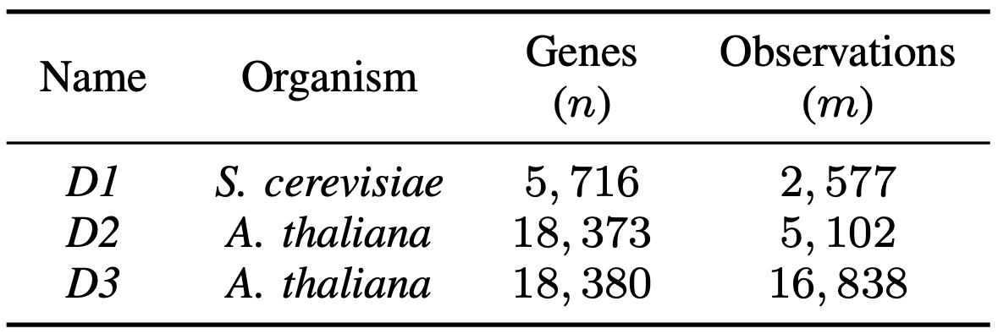
Experiments & Results
Experimental setup
  171 nodes of the Phoenix cluster, 24 MPI processes per node – 4096 cores
  RHEL 7.6, gcc v10.1.0, MVAPICH2 v2.3.3
Used real gene-expression data set for two different organisms to learn gene networks

Slide 39
Experiments & Results
Experimental setup
  171 nodes of the Phoenix cluster, 24 MPI processes per node – 4096 cores
  RHEL 7.6, gcc v10.1.0, MVAPICH2 v2.3.3
Used real gene-expression data set for two different organisms to learn gene networks
Estimated sequential run-time of prior implementation
48.6 days
> 4 years

Slide 40
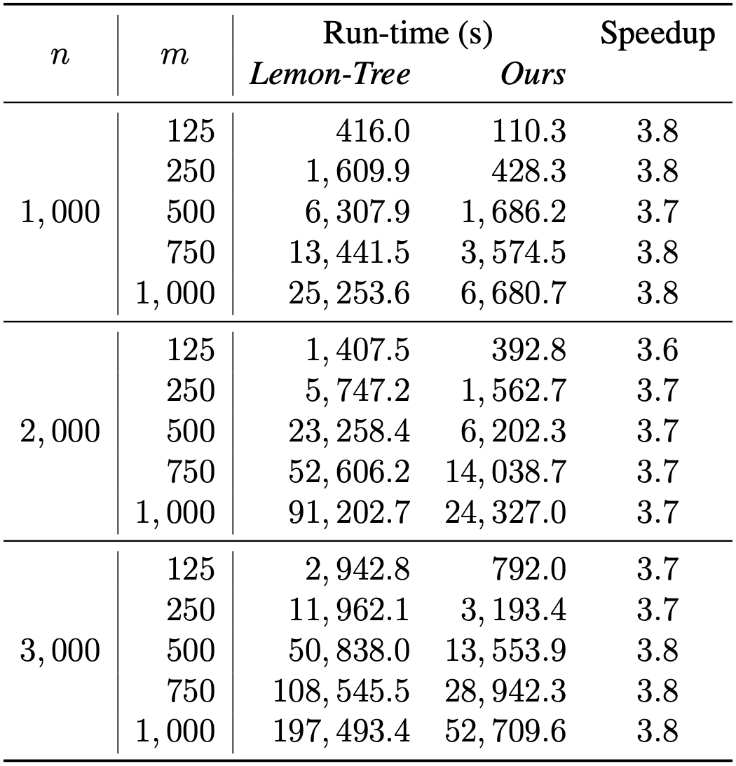
Experiments & Results
Comparison of our optimized implementation in C++ with the previous state-of-the-art sequential implementation in Java

Slide 41
Experiments & Results
Comparison of our optimized implementation in C++ with the previous state-of-the-art sequential implementation in Java
  3.7–3.8X speedup for generating the same network in all the cases

Slide 42
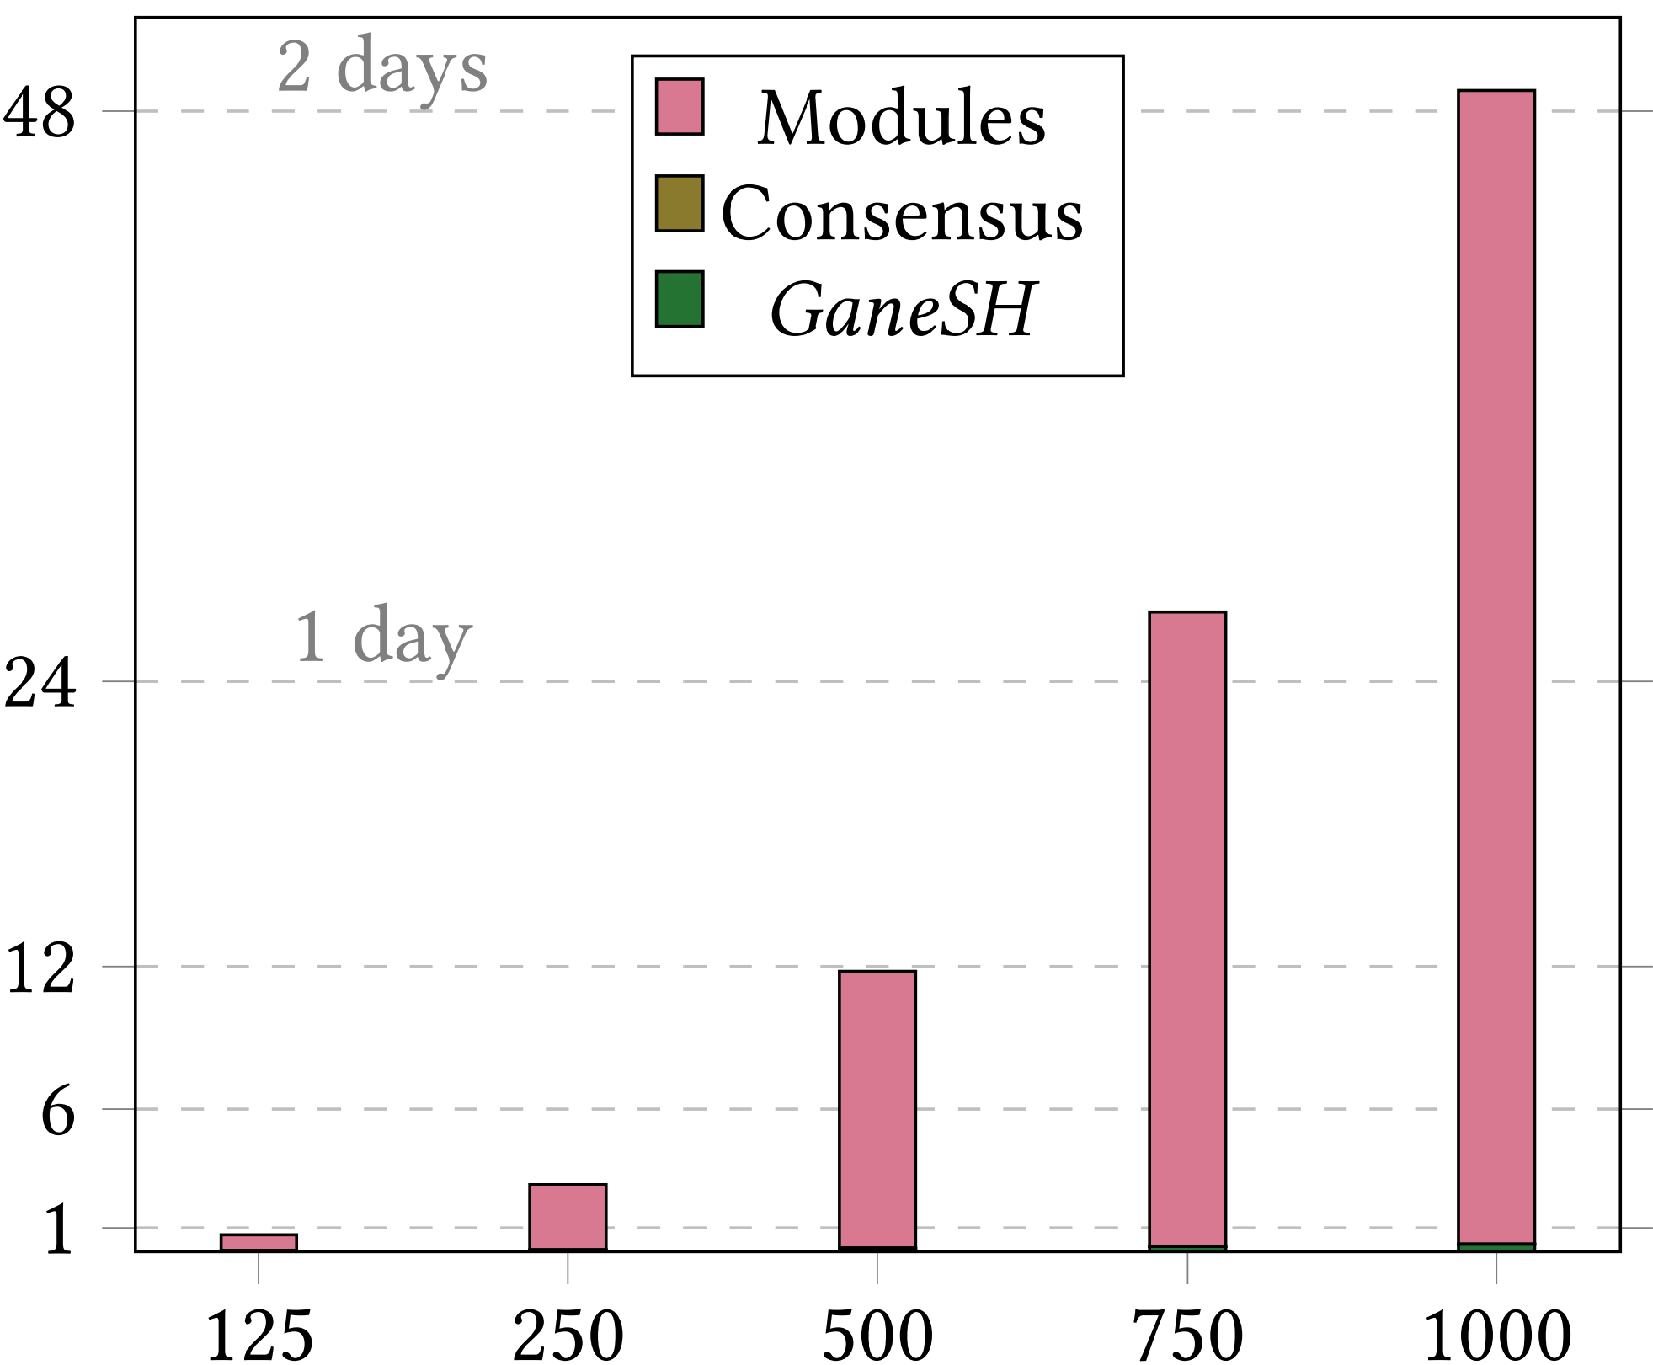



Experiments & Results
Scalability of our implementation – S. cerevisiae (all $n$, some $m$)
$$Sequential run\text{–}time (hours)$$
$$Number of observations (m)$$
Notes:
Talk about the fraction of each task
Scalability is good until 64 cores and then tapers off – more distribution of splits means work imbalance between processors
The posterior probabilities for the splits are computed by discrete sampling for a maximum number of steps. Therefore, the time required for this phase cannot be estimated a priori and varies significantly across splits. Measured imbalance is low on smaller number of cores.

Slide 43
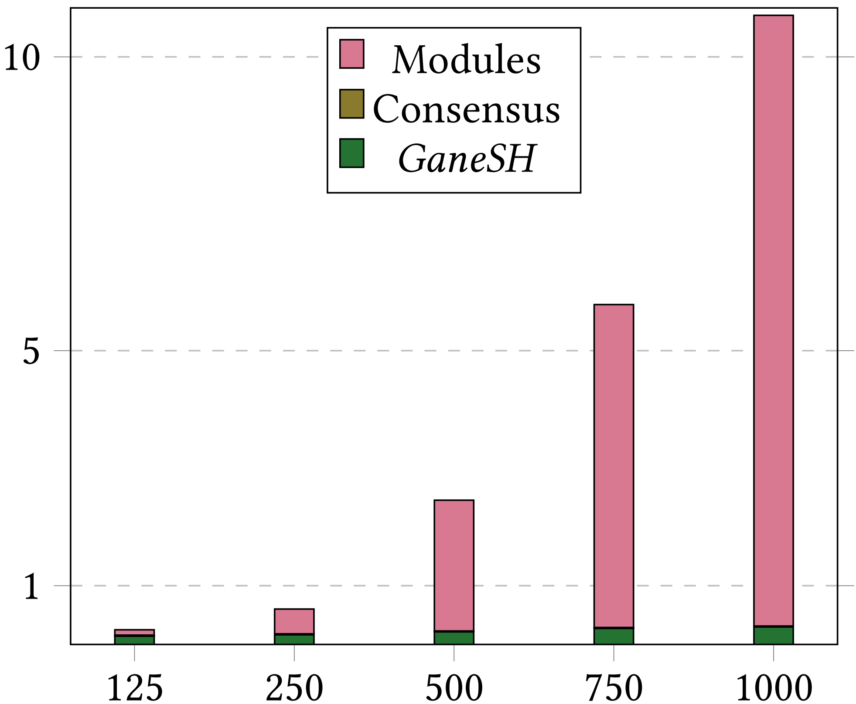


Experiments & Results
Scalability of our implementation – S. cerevisiae (all $n$, some $m$)
$$Sequential run\text{–}time (hours)$$
$$Run\text{–}time using p=1024 (minutes)$$
$$Number of observations (m)$$
$$Number of observations (m)$$
Notes:
Talk about the fraction of each task
Scalability is good until 64 cores and then tapers off – more distribution of splits means work imbalance between processors
The posterior probabilities for the splits are computed by discrete sampling for a maximum number of steps. Therefore, the time required for this phase cannot be estimated a priori and varies significantly across splits. Measured imbalance is low on smaller number of cores.

Slide 44
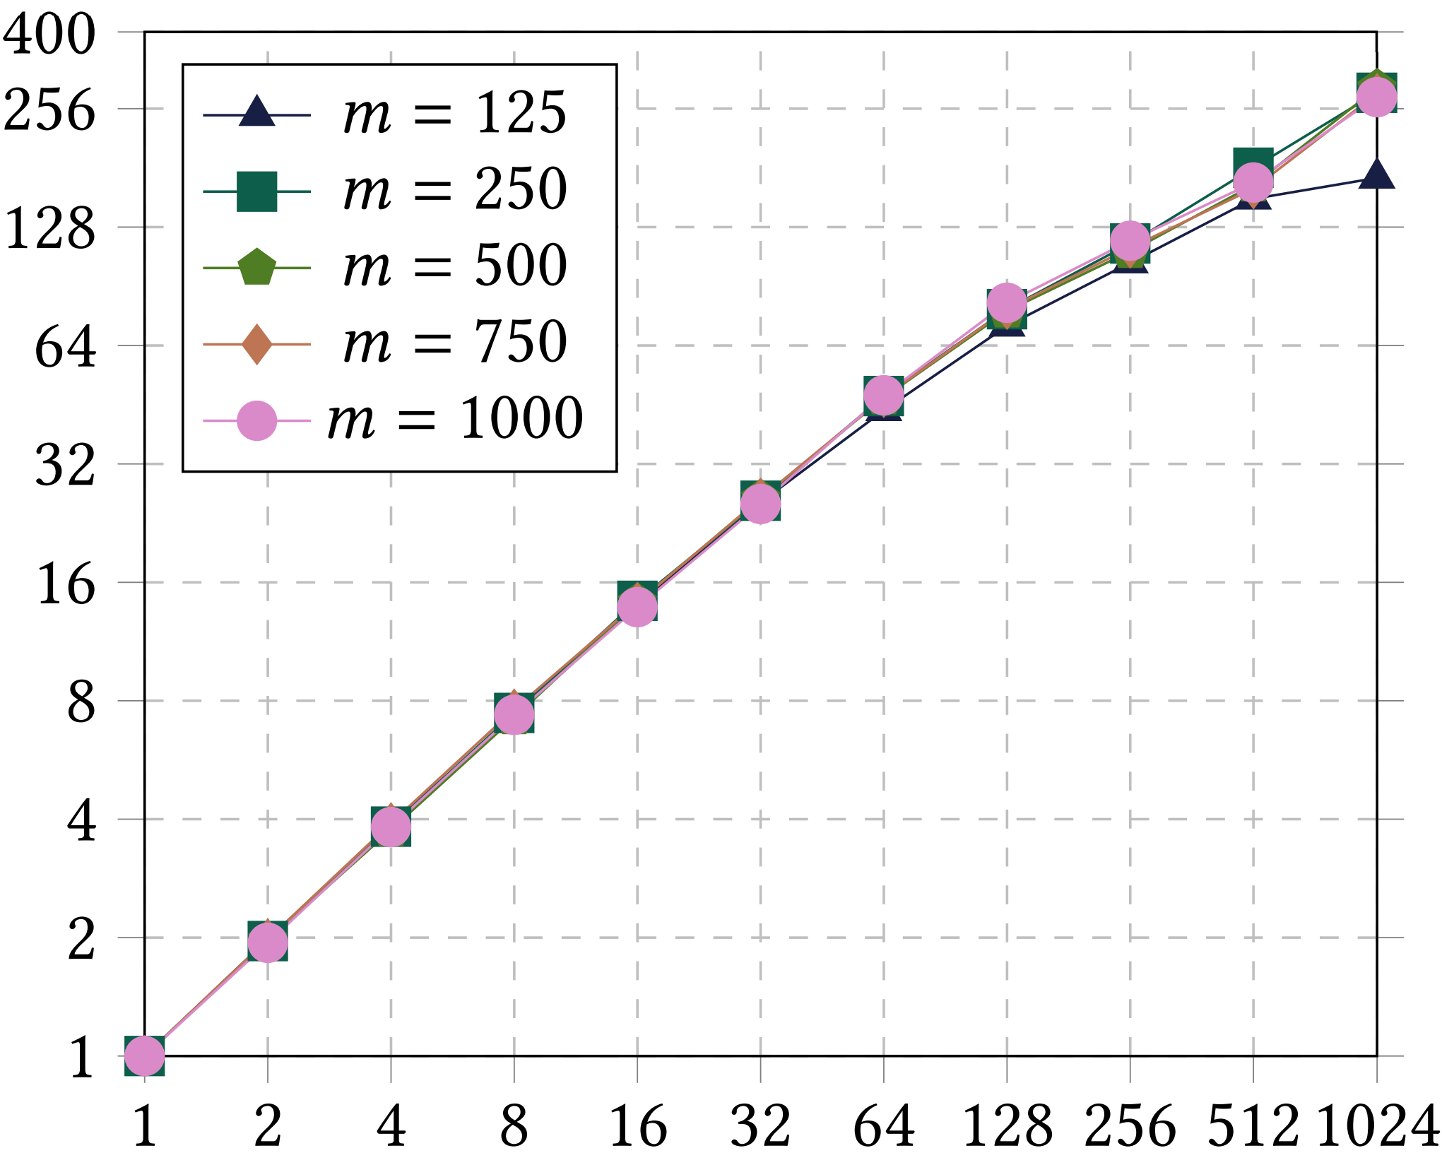






Experiments & Results
Scalability of our implementation – S. cerevisiae (all $n$, some $m$)
$$Sequential run\text{–}time (hours)$$
$$Speedup$$
$$Run\text{–}time using p=1024 (minutes)$$
$$Number of observations (m)$$
$$Number of cores (p)$$
$$Number of observations (m)$$
Notes:
Talk about the fraction of each task
Scalability is good until 64 cores and then tapers off – more distribution of splits means work imbalance between processors
The posterior probabilities for the splits are computed by discrete sampling for a maximum number of steps. Therefore, the time required for this phase cannot be estimated a priori and varies significantly across splits. Measured imbalance is low on smaller number of cores.

Slide 45
Experiments & Results
Scalability of our implementation – S. cerevisiae (complete)
  Estimated sequential run-time is 13.5 days – used a minimum of 4 cores

Slide 46
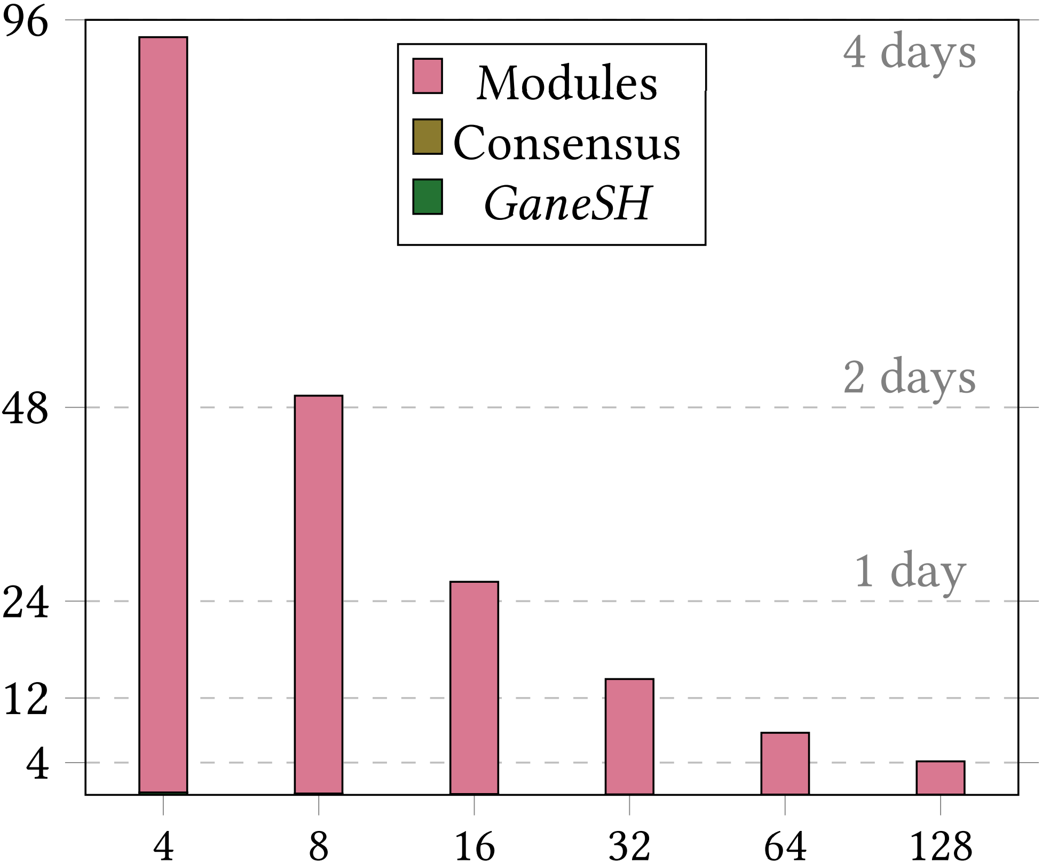
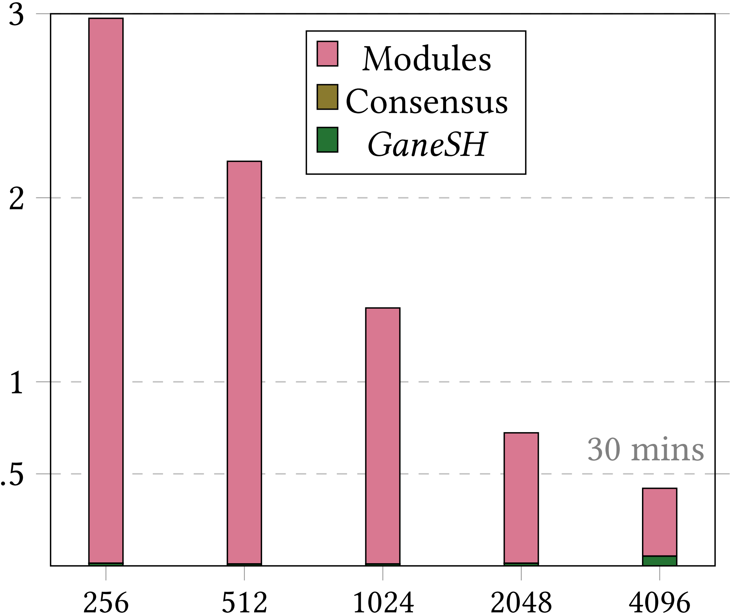



Experiments & Results
Scalability of our implementation – S. cerevisiae (complete)
  Estimated sequential run-time is 13.5 days – used a minimum of 4 cores
$$Total run\text{–}time (hours)$$
$$Number of cores (p)$$
$$Number of cores (p)$$

Slide 47
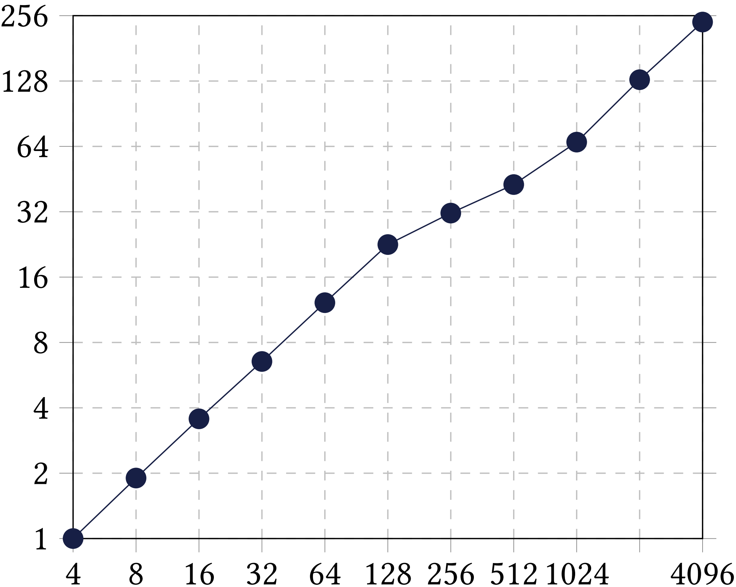



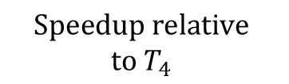

Experiments & Results
Scalability of our implementation – S. cerevisiae (complete)
  Estimated sequential run-time is 13.5 days – used a minimum of 4 cores
$$Speedup relative \\ to T_{4}$$
$$Total run\text{–}time (hours)$$
$$Number of cores (p)$$
$$Number of cores (p)$$
$$Number of cores (p)$$

Slide 48
Experiments & Results
Scalability of our parallel implementation – A. thaliana
  Estimated sequential run-time is 433.6 days – used a minimum of 256 cores

Slide 49
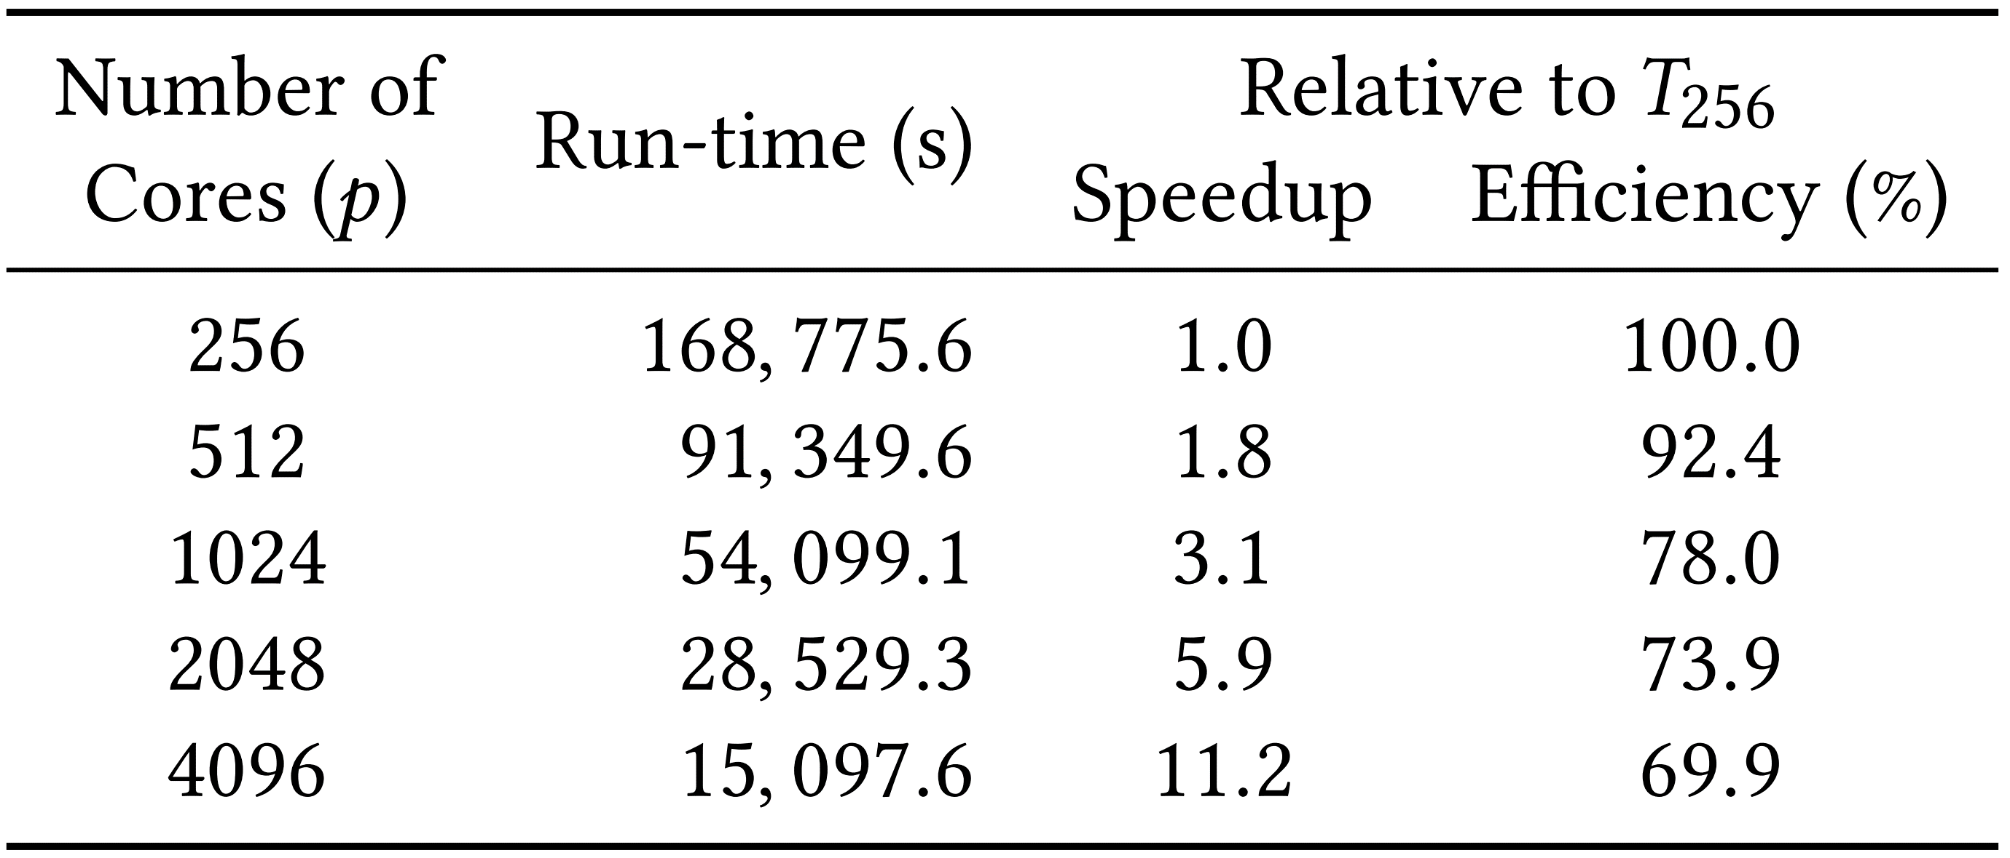
Experiments & Results
Scalability of our parallel implementation – A. thaliana
  Estimated sequential run-time is 433.6 days – used a minimum of 256 cores

Slide 50
Experiments & Results
Scalability of our parallel implementation – A. thaliana
  Estimated sequential run-time is 433.6 days – used a minimum of 256 cores
Relative scaling seems to improve with increasing data set size
  Scaling efficiency relative to 256 cores for S. cerevisiae is 47.4%

Slide 51
Conclusions
Proposed first parallel method for learning MoNets using Lemon-Tree
  Our optimized implementation learns exactly the same networks as Lemon-Tree

Slide 52
Conclusions
Proposed first parallel method for learning MoNets using Lemon-Tree
  Our optimized implementation learns exactly the same networks as Lemon-Tree
Significant run-time savings for learning MoNets from large data sets
Estimated sequential run-time of prior implementation
48.6 days
> 4 years

Slide 53
Conclusions
Proposed first parallel method for learning MoNets using Lemon-Tree
  Our optimized implementation learns exactly the same networks as Lemon-Tree
Significant run-time savings for learning MoNets from large data sets
Estimated sequential run-time of prior implementation
48.6 days
> 4 years
Parallel run-time of our implementation using 4096 cores
23.5 minutes
4.2 hours

Slide 54
Conclusions
Proposed first parallel method for learning MoNets using Lemon-Tree
  Our optimized implementation learns exactly the same networks as Lemon-Tree
Significant run-time savings for learning MoNets from large data sets
Our parallel implementation scales to 4096 cores
  Maximum relative speedup of 10.7X and 67% scaling efficiency on 4096 cores as compared to the run-time on 256 cores
  Efficiency of our implementation increases with an increase in data set size
Estimated sequential run-time of prior implementation
48.6 days
> 4 years
Parallel run-time of our implementation using 4096 cores
23.5 minutes
4.2 hours

Slide 55
Future Works
Further improve the scalability of our proposed parallel method – distribution of candidate parent splits
Notes:
Weighted distribution: about 15 minutes for yeast and 2.8 hours for Arabidopsis,

Slide 56
Future Works
Further improve the scalability of our proposed parallel method – distribution of candidate parent splits
  Weighted distribution of candidate split tuples using the asymptotic run-time estimate as the weight
Notes:
Weighted distribution: about 15 minutes for yeast and 2.8 hours for Arabidopsis,

Slide 57
Future Works
Further improve the scalability of our proposed parallel method – distribution of candidate parent splits
  Weighted distribution of candidate split tuples using the asymptotic run-time estimate as the weight
  Dynamic load balancing
Notes:
Weighted distribution: about 15 minutes for yeast and 2.8 hours for Arabidopsis,

Slide 58
Future Works
Further improve the scalability of our proposed parallel method – distribution of candidate parent splits
  Weighted distribution of candidate split tuples using the asymptotic run-time estimate as the weight
  Dynamic load balancing
Extend the parallel components to accelerate GENOMICA
Notes:
Weighted distribution: about 15 minutes for yeast and 2.8 hours for Arabidopsis,

Slide 59
Thank you!

Slide 60



Thank you!
OAC-1828187
OAC-1854828
CCF-1718479

Slide 61



Thank you!
OAC-1828187
OAC-1854828
CCF-1718479
https://github.com/asrivast28/ParsiMoNe

