Slide 1



cuTS: Scaling Subgraph Isomorphism on Distributed Multi-GPU Systems Using Trie Based Data Structure
Lizhi Xiang, Arif Khan, Edoardo Serra, Mahantesh Halappanavar, Aravind Sukumaran-Rajam
Notes:
Hello everyone, my name is Lizhi Xiang. I am from advanced parallel processing lab at WSU, today I am going to present cuts, cuts is a subgraph isomorphism solver using multi-gpu. This work is a collaboration between WSU, PNNL and BSU.

Slide 2
Graph Isomorphism
Requirements
Distributed
Experiment
Algo
Intersection
Introduction
Data representation
The same number of vertices.
The same number of edges.
Same connectivity structure.
Notes:
Before we go into subgraph isomorphism, let’s first talk about graph isomorphism. Graph isomorphism essentially tells whether two graphs are similar. Intuitively, they should have the same number of vertices, same number of edges, and connectivity structure.

Slide 3
Graph Isomorphism
Distributed
Experiment
Algo
Intersection
Introduction
Data representation
1
2
1
2
1
1
2
1
2
1
2
1
3
4
3
4
3
c)
4
2
d)
3
3
e)
4
3
f)
4
a)
b)
Two graphs G1(𝑉1,𝐸1) and G2(𝑉2,𝐸2) are isomorphic, if there exists a bijective function 𝑓:𝑉1→𝑉2 such that for any two vertices 𝑢∈𝑉1 and 𝑣∈𝑉1 are adjacent in
G1 if and only if u’ = 𝑓(𝑢) and v’ = 𝑓(𝑣) are adjacent in G2..
Two graphs G1(𝑉1,𝐸1) and G2(𝑉2,𝐸2) are isomorphic, if there exists a bijective function 𝑓:𝑉1→𝑉2 such that for any two vertices 𝑢∈𝑉1 and 𝑣∈𝑉1 are adjacent in
G1 if and only if u’ = 𝑓(𝑢) and v’ = 𝑓(𝑣) are adjacent in G2..
Notes:
Let's consider graph A and compare it with B. These are essentially the same graph, and one is the stretched-out version of the other. If we flip the bottom two vertices of graph A we will get graph C, hence they are isomorphic. Graph D has less number of vertices and edges than A; hence it is not isomorphic. Graph E has more edges; hence it's also not isomorphic. Graph F has the same number of vertices and edges, but the connectivity structure is different. That is, Node 3 in Graph F has degree 3, whereas none of the nodes in Graph A has degree three.

Slide 4
Subgraph Isomorphism
Distributed
Experiment
Algo
Intersection
Introduction
Data representation
1
a
d
2
Objective: Given a query graph Q and a data graph D, find all the subgraphs mappings in D which are isomorphic to Q.
b
3
c
e
Q
D
1->a, 2->b, 3->d
1->a, 2->b, 3->c
Notes:
In subgraph isomorphism we are given a query graph and a data graph and we have to find whether any sub graph of the data graph is isomorphic to the query graph. For example, the query graph Q is isomorphic to the subgraph
(a,b,c) in the data graph. It is also isomorphic to the subgraph (a,b,d).

Slide 5
Distributed
Experiment
Algo
Intersection
Introduction
Data representation
Objective: Given a query graph Q (v₁,v₂…,v_{n})
and a data graph D (u₁,u₂,…,u_{m}), find all the |Q| vertices tuples G (u₁,u₂,…,u_{m}) in D which are isomorphic to Q. M = |D|, N = |Q|.
Algorithm:
M^{N} (u₁,u₂,…,u_{N}) tuples in D
for each tuple:
for any edge v_{i}->v_{j} in Q:
if u_{i}->u_{j} not in D:
break
add tuple to matching table
Complexity:
M^{N} (NP-complete)
Notes:
Assume that the query graph has N vertices, and the data graph has M vertices. Each of the N query graph vertices can potentially match all the M data graph vertices. Hence, the total number of combinations that we have to check is M^N. Each such choice should be validated by looking at the neighbors, and hence the total cost is M^N E -- NP-complete.

Slide 6
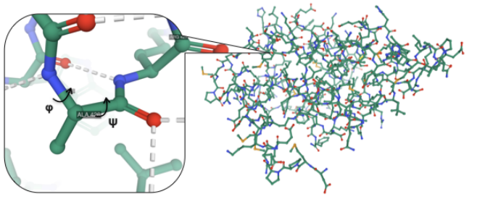
Subgraph Isomorphism
Applications
Distributed
Experiment
Algo
Intersection
Introduction
Data representation
Bioinformatics
protein−protein interaction
metabolic interaction
Computer Vision
pattern recognition
Social Network Analysis
property matching
Chem-informatics
molecular structure comparison
Source: https://arxiv.org/pdf/2012.11762v1.pdf
Notes:
Subgraph isomorphism has a lot of applications. For example, in bioinformatics, it can be used on protein−protein interaction and metabolic interaction. In computer vision, we can use it as a tool to do pattern recognition.
For social network analysis, we can use it to compare the properties of two networks. In chem-informatics, it is widely used in molecular structure comparison.

Slide 7
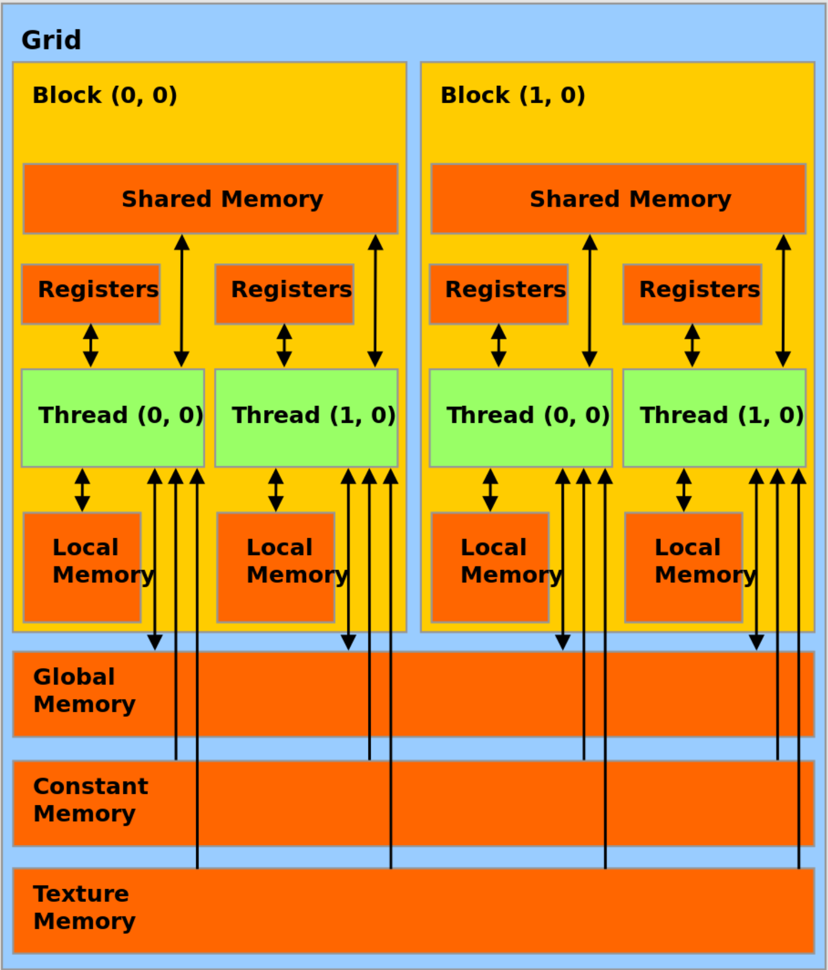
GPU Architecture
Thread hierarchy:
Memory hierarchy:
grid
block
warp
thread
Source: https://docs.nvidia.com/ cuda/cuda-c-programming-guide/index.html
Notes:
Let's take a quick look at the GPU architecture. In GPUs, a group of 32 threads is called a warp. All threads in the same warp will execute the same instruction. If different threads follow different control paths, some threads are masked from performing any useful work. This situation is called as warp divergence and is one of the fundamental factors that limit the performance of sparse algorithms on GPUs. Multiple warps are combined to form a thread block, and the set of thread blocks is called the grid.
On the memory hierarchy side, the biggest and slowest memory is called the global memory. All threads have access to this memory. There is a shared L2 cache. Since it is small, we will ignore it in our discussion. The next layer is shared memory which is a fast and programmable cache. All the threads in the same thread block have access to the same shared memory. Finally, we have the registers which are private to each thread and is the fastest. Achieving good performance relies on effective utilization of the memory subsystem. For example, when contiguous threads in a warp request contiguous global memory locations, these requests can be aggregated into a single transaction, and this is called as coalesced access. If the threads are requesting non-contiguous data, we have to issue multiple transactions, which will slow down the code.

Slide 8
Challenges
Distributed
Experiment
Algo
Intersection
Introduction
Data representation
Exponential storage requirement for representing partial paths.
Memory coalescing and warp divergence.
GPU architecture aware intersection.
Load imbalance.
Distributed communication and synchronization.
Notes:
Several challenges associated with subgraph isomorphism can significantly degrade the achievable performance on GPUs. One such challenge is storage requirement. As we will see later, a naïve representation of partial path requires exponential storage and thus is not compatible with bigger graphs. The second challenge is in memory coalescing and warp divergence, which arises from the random memory access pattern associated with subgraph isomorphism. Fast set intersection is yet another challenge. We also need to ensure that all levels of thread hierarchy, including distributed level, have good load balance. Efficient communication and synchronization overhead in distributed implementation is yet another critical challenge that accepts scalability.

Slide 9
Contributions:
Distributed
Experiment
Algo
Intersection
Introduction
Data representation
A trie based data structure which allows to reduce the memory storage requirement.
An efficient GPU micro-kernel design for fast intersections.
GPU architecture aware algorithm which promotes load-balancing and good data reuse.
A distributed, low overhead, GPU implementation: allows to handle bigger data/query graphs.
Extensive evaluation.
Notes:
Our cuTS solution is carefully designed to overcome these challenges. We introduce a trie-based data structure that significantly reduces the storage requirement without affecting the performance. We also create adaptive and memory hierarchy-aware GPU microkernels for efficient set intersections, which promotes good load balance and data reuse. We also devise a scalable distributed implementation which not only allows us to solve a given problem faster, but also allows us to handle bigger and complex graphs. We demonstrate the effectiveness of our approach using extensive evaluation.

Slide 10
Query Graph
v1
v2
v3
Algo
Distributed
Experiment
Introduction
Data representation
Intersection
Find all (u₁,u₂,u₃,u₄) tuples which are isomorphic to (v₁,v₂,v₃,v₄)
v4
Assuming we have a tuple T = (v₁->u₁, v₂->u₂, v₃->u₃, v₄->?)
Candidate(v4) should hold same connectivity constraints
u1
u2
u3
candidate(v4) = neighbors(u1)Ո neighbors(u2) Ո neighbors(u3)
u4
u6
……
u5
u7
Data Graph
Notes:
The next couple of slides shows how we solve each of the previous challenges. In a naïve algorithm, we enumerate all the tuples and verify each of them. However, it is not necessary to verify all the tuples. Consider the example on the left side, where we have mapped v1,v2,v3 to u1, u2, u3. In the next step, we are going to find the candidates for v4. Since v4 is a common neighbor of v1, v2, v3. The candidates of v4 should be the common neighbors of u1, u2, u3. In other words, we can ignore any other vertices which are not neighbors of u1, u2, u3.

Slide 11
Subgraph Isomorphism
Distributed
Algo
Intersection
Experiment
Introduction
Data representation
A path expansion algorithm:
Input: G_{q} = (V_{q}, E_{q}) V_{q} = {v₁, v₂, …, v_{N}}
G_{d} = (V_{d}, E_{d}) V_{d} = {u₁, u₂, …, u_{M}}
Output: M(result table)
1 for u in v_{d}:
2 write u to M[0]
3 for i, v in enumerate V_{q}[1:]:
4 for p in M[i-1]:
5 candidates = constraints(p, E_{d}, E_{q}, V_{q}[:i])
6 for c in candidates:
7 M[i].append({p,c})
Good for GPUs
-leverage massive GPU threads
//Write all candidates to table M[0] for v₁
Challenges for GPUs
-High performance intersection strategy selection
//For other vertices in query graph
//For partial path from last iteration
//Find candidates to expand partial path
//Write expanded partial paths to table
Bad for GPUs
-Intermediate table grows exponentially
GPU has limited memory
Notes:
Similar to some existing work, our algorithm only considers tuples that are valid under the connectivity constraints. In the first step, we write all the candidates for the first vertex of the query graph to the table M[0]. In the further steps, we will find the candidates for each remaining vertices. For each depth d, we expand the partial paths at depth d-1 by adding candidates that satisfy the connectivity and validity constraints. The partial paths expansion can be fully parallelized and benefit from the massive parallelism in GPUs. Note that each partial path must be written to global memory, which accounts for the massive storage requirement in subgraph isomorphism.

Slide 12
Exponentially growth of the
partial matching table.
Distributed
Algo
Intersection
Experiment
Introduction
Data representation
Partial path table
Storage requirement
Query Graph
Data Graph
u1 | u2 | u3 | u4
u1 | u2 | u3 | u7
u1 | u2 | u6 | u7
u1 | u2 | u6 | u5
u1 | u2 | u6
Partial path depth | Candidates | Storage size requirement (words)
1 | 16 | 16
2 | 48 | 48×2 = 96
3 | 96 | 96×3 = 288
4 | 192 | 192×4 = 368
u1
u3
u4
v1
u2
v2
u5
u6
u7
u8
v3
u9
u11
u10
u12
u10
ˉ
ˉ
ˉ
ˉ
u15
u13
u16
v4
u14
ˉ
ˉ
ˉ
ˉ
Notes:
Let’s look at the examples here, if we write the partial paths in plain format. A lot of partial paths will share some common prefix which is a waste of memory space. The table on the right most side
shows the storage requirement for each depth.

Slide 13
Exponentially growth of the
partial matching table.
Intersection
Algo
Distributed
Experiment
Introduction
Data representation
Partial path table
Query Graph
Data Graph
Notations:
𝑃_{i} denotes the number of paths at depth i.
𝑑𝑠 denotes the maximum expansion ratio.
𝑙 denotes the maximum depth.
𝑆pace_𝑡𝑟𝑎𝑑𝑙 = |𝑃₁| × 𝑑𝑠^{𝑙−1} × 𝑙
u1
u3
u4
u1 | u2 | u3 | u4
u1 | u2 | u3 | u7
u1 | u2 | u6 | u7
u1 | u2 | u6 | u5
u1 | u2 | u6
v1
u2
v2
u5
u6
u7
u8
v3
u9
u14
u15
u16
u10
u13
ˉ
ˉ
ˉ
ˉ
u12
u11
v4
u10
ˉ
ˉ
ˉ
ˉ
Notes:
Let Pi to denote the number of paths at depth I, ds denote the expand ratio, l denote the maximum depth. The space requirement for traditional is |𝑃₁| × 𝑑𝑠^{𝑙−1} × 𝑙.

Slide 14
Experiment
h
(1,2,3,4,5,6, ) can map any permutations of (a,b,c,d,e,f, )
  It will terminate at depth 7.
7 doesn’t have any valid candidates in D.
  It will terminate at depth 1.
a
b
1
2
i
f
c
6
7
3
g
e
d
5
4
j
Q
D
Notes:
MISSING COMMENTS!!!!

Slide 15
Exponentially growth of the
partial matching table.
Distributed
Experiment
Algo
Intersection
Introduction
Data representation
u0 | u1
u1
u0
0 | 2 | 3
Two-stages writing required
u2
u3 | u4 | u2
u3
u4
0 | 3 | 5 | 6
Require computation to retrieve full partial path
u2
u4
u3
u2 | u4 | u6 | u7 | u1 | u3
u1
u6
u7
0 | 2 | 3 | 5 | 6 | 7 | 8
u5
u4
u5 | u7 | u8 | u9 | u4 | u1 | u8 | u4
u7
u8
u8
u4
u9
u1
- | - | - | - | - | - | - | -
A) Tree Representation
B) CSF Representation
Notes:
The key insight behind our compression scheme is that the many partial paths share common parents. Tree-based structures like CSF, which is an extension of the CSR format, can take advantage of this property.
The first array contains the candidates at a given level, and the second array, which is similar to the rowPtrs array in CSR format, holds the corresponding index information. Let's look at the edges u3->u2, u3->u4, u3->u6, in the candidate's array at the second level; u3 is in position 0. The first two elements in the rowPtrs array are (0,3), which indicates that u3 has (3-0), which is equal to 3 neighbors and these neighbors are placed in the range of 0->3 in the third level's candidates array. Unfortunately, such a representation has two major disadvantages. The first one is that we have to perform a search operation to find the parent of a given prefix path. While this problem can be avoided by traversing the tree from root to leaves, such an approach will suffer from severe load imbalance. Hence we must traverse from leaves to root for achieving performance.
The second disadvantage is on parallel construction of the CSF representation. Multiple threads working on multiple paths have to synchronize to find the exact write location, which is extremely expensive. Existing approaches use two passes, where the first pass figures out the write locations and the second performs the actual computations. Such an approach also degrades performance significantly.

Slide 16
A trie based data structure.
Distributed
Experiment
Algo
Intersection
Introduction
Data representation
- | -​
u1
u0​ | u1​
u0
0​ | 0 | 1
Struct{
parent location;
candidate id;
}
u2
u3
u4
u3​ | u4​ | u2​
0​ | 0​ | 0​ | 1​ | 1 | 2​
u2
u4
u3
u1
u6
u7
u2​ | u4​ | u6​ | u7​ | u1​ | u3​
u5
u4
0​ | 0​ | 1​ | 2​ | 2​ | 3​ | 4​ | 5
u7
u8
u8
u4
u9
u1
u5​ | u7​ | u8​ | u9​ | u4​ | u1​ | u8​ | u4​
A) Tree Representation
B) cuTs Representation
Notes:
Our trie-based data structure avoids these challenges and still achieves significant compression with respect to the naive representation. Our representation uses two arrays at each level. The first array contains the candidates expanded at this level, and the second array contains the parent location of each candidate. Let's look at the edges u3->u2, u3->u4, u3->u6, in the candidate's array at the second level. Note that u3 is in position 0. At the third level, we put u2, u4, u6 at the candidate'sarray, all of which share the same parent u3. Since U3 is in location 0 in the second level, we write 0 in the location array corresponding to vertices u2, u4, u6 to mark the parent location. Note that even though u2,u4,u6 are written contiguously in level 3 of this example, unlike the CSF representation, our representation allows us to place them anywhere in level 3, and they don't have to be contiguous. This means that different threads expanding a given prefix path do not have to write to adjacent locations, which significantly reduces the synchronization overhead.

Slide 17
A trie based data structure.
Distributed
Experiment
Algo
Intersection
Introduction
Data representation
𝑆pace_𝑐𝑢𝑇𝑆𝑙 ≈ |𝑃₁| × 𝑑𝑠^{𝑙−2}
Compression factor:
= 𝑆pace_𝑡𝑟𝑎𝑑𝑙 /𝑆pace_𝑐𝑢𝑇𝑆𝑙
= 𝑑𝑠 × 𝑙
Notes:
Recall we use |𝑃i| to represent the partial paths count at level i, and ds to represent the average expand ratio. The storage requirement of our scheme can be approximated as |𝑃1| × 𝑑𝑠𝑙−2. Compared to the naive partial paths representation, we achieved 𝑑𝑠 × 𝑙 compression ratio.

Slide 18
An efficient GPU micro-kernel design
for fast intersections
Distributed
Experiment
Algo
Intersection
Introduction
Data representation
v1 u1, v2 u2, v3 u3
v4 is a common neighbor of v2 and v3
Candidates(v4) = neighbor(u2) ∩ neighbor(u3)
Efficient intersection of neighbors is arguably the most important computational part of subgraph isomorphism
v1
u1
v2
u2
u3
v3
u4
u5
u7
u6
v4
Notes:
When we expand a partial path to the next level, we need to find the valid candidates which satisfy the connectivity constraints from previously matched vertices. For example, consider the graph on the left side. We mapped v2 to u2, v3 to u3. The candidates for v4 are the common neighbor of u2 and u3, which means the candidates must be present in the intersection between the set of u2’s neighbor and u3’s neighbor. Efficient intersection is arguably the most critical computational part of subgraph isomorphism. Hence, developing a GPU architecture aware, high-performance implementation of intersection is crucial for subgraph isomorphism.

Slide 19
An efficient GPU micro-kernel design
for fast intersections
Distributed
Experiment
Algo
Intersection
Introduction
Data representation
Notations: vertices to be intersected (𝑎1, 𝑎2, 𝑎3...𝑎𝜒 ), Graph D in CSR|CSC format
D.cs(x) denotes the children of x
D.ps(x) denotes the parent of x
𝛿 denotes the average degree
c−intersection():
interset1[] = {}
for v ∈ D.𝑐𝑠(𝑎1) :
interset1.append(v)
for C ∈ (D.𝑐𝑠(𝑎2), D.𝑐𝑠(𝑎3), ...D.𝑐𝑠(𝑎𝜒 ))
interset2[] = {}
for v ∈ C:
if v ∈ interset1:
interset2.append(v)
interset1 = interset2
return interset1
v1
u1
v2
u2
u3
Time complexity:
_{𝛿}²𝜒
Data movement:
_{𝛿}𝜒
//shared memory
v3
u4
u5
u7
u6
//shared memory
v4
Candidates(v4) = D.cs(u2) ∩ D.cs(u3)
Notes:
Imagine that we have to intersect all neighbors of a1 to 𝑎𝜒 to find common neighbors. Our first GPU-friendly scheme is called c-intersection. In this method, we declared two buffers, interset1 and interset2, both of which are placed in the shared memory. In the first step, all the threads inside a warp read a1's children and write them to intersect1. In the further steps, process the neighbors of a2 to 𝑎𝜒. All the threads in a warp read each child set in a contiguous manner and check if they are present in intersect 1. If yes, they are written to intersect 2. Note that this operation achieves good memory coalescing and does not suffer from shared memory bank conflicts. After processing all the neighbors of 2 to 𝑎𝜒, we swap intersect1 with interset2 buffers. If we use 𝛿 to represent the average number of children of each vertex, the time complexity for this method is 𝛿^2𝜒, and the data movement from global memory perspective is 𝛿𝜒. Shared memory is a limited resource; if the buffer size for interset1/2 is large, we may not achieve high occupancy. However, the buffer size of interset1/2 is bounded by the size of the children's set of a1. In our implementation, we choose the vertex with the least number of children as our initial children set, enabling us to reduce the shared memory buffer size requirement.

Slide 20
An efficient GPU micro-kernel design
for fast intersections
Distributed
Experiment
Algo
Intersection
Introduction
Data representation
Notations: vertices to be intersected (𝑎1, 𝑎2, 𝑎3...𝑎𝜒 ), Graph D in CSR|CSC format
D.cs(x) denotes the children of x
D.ps(x) denotes the parent of x
𝛿 denotes the average degree
p−intersection():
interset1[] = result[] = {}
for v ∈ D.𝑐𝑠(𝑎1) :
interset1.append(v)
for v ∈ interset1:
if (𝑎2, 𝑎3...𝑎𝜒 ) ⊂ D.𝑝𝑠(𝑎𝑣 )
result.append(v)
return result
v1
u1
v2
u2
u3
Time complexity:
_{𝛿}²𝜒
Data movement:
_{𝛿}²
v3
u4
u5
u7
u6
v4
for any v ∈ D.𝑐𝑠(𝑎1)
if {u3} ⊂ D.𝑝𝑠(𝑎𝑣 )
Notes:
The second intersection scheme is called p-intersection. This method used a global memory buffer called ps. We also require two shared memory buffers -- interset1 and result. Initially, we put all the a1’s children into interset1. Then, for each element x in inserset1, we want to checkif {a2, …a𝜒} is a subset of x’s parents set. If it is, we will add x to the result buffer. The time complexity of this scheme is the same as the c-intersect method. However, the data movement is 𝛿^2. The best approach depends on the connectivity of the graph, which is known apriori. We dynamically select the intersection method based on the connectivity property such that the data movement is minimized.

Slide 21
A distributed GPU implementation
Distributed
Experiment
Algo
Intersection
GPU-1
GPU-2
Introduction
Data representation
The workload for each depth varies between each GPU
Depth 1
Depth 1
We can sync each depth to ensure all GPUs have equal partial paths to expand.
-Sync between each depth between GPUs is expensive
-Equal partial paths doesn’t guarantee equal workload
-Hard to merge two different tries-based data to one
Depth 2
Depth 2
Depth 3
Depth 3
Depth N
Depth N
Notes:
A distributed GPU implementation can help to bring down the execution time of a given problem. In addition, the added memory capacity can help to execute bigger problems. Load imbalance is the biggest challenge here. Initially, at depth 1, we can evenly partition the candidates across all nodes. However, even at depth 1, we have load imbalance as the degree distribution of vertices per compute node can drastically vary. At depths greater than 1, the number of pruned candidates can vary a lot, resulting in a significant load imbalance. One naive solution is to synchronize the GPUs after each step, which improves the load balance; however, such an approach has three disadvantages. The first disadvantage is the synchronization overhead which can be significantly expensive. The second disadvantage is that a balanced workload per depth is still not guaranteed even if we distribute the partial paths equally to each GPU machine. The third disadvantage is that, since we use a trie-based data structure, it is hard to merge two different tires into one.

Slide 22
Depth d=0
chunk-id ++
Chunk-id =0
process chunk
Chunk-id <C
F
T
F
process chunk
check free
Depth d++
T
set depth
F
send data
if depth= D
T
T
broadcast free
F
if receive data
T
if all free
exit
F
Notes:
In our distributed implementation, we eliminate the sync overhead at each depth. The flow chart on the left side shows the details of our workflow. The main idea of our distributed implementation is to let each compute node complete its entire work without any synchronization. First, we split each outer iteration into several chunks. Each chunk is processed sequentially. At the end of each chunk, every busy node checks if any free node is available to share the workload. A node is considered free if it has finished all its work (across all iterations). Once the node finishes all its work, it saves the final results and discards its local trie. Then it broadcasts a message to all other nodes to tell that it has finished its execution. A node that has not finished processing will then send a portion of its work to the free node along with the trie, and this whole process is repeated till the entire work is done.

Slide 23
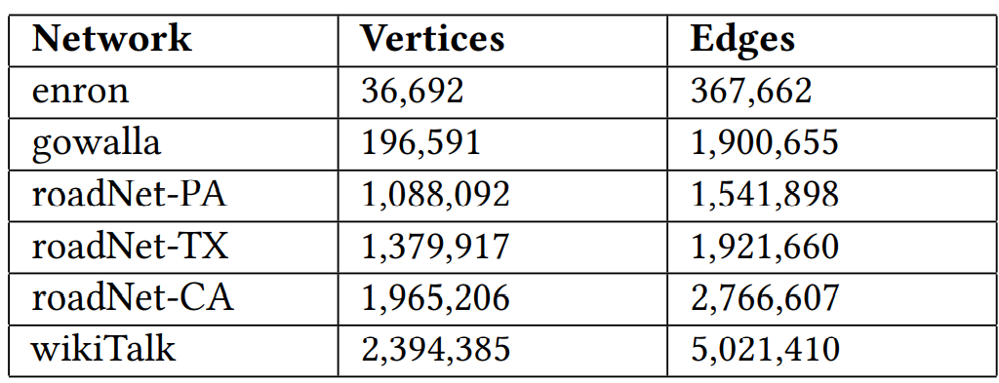
Experiment
Distributed
Experiment
Algo
Intersection
Background
Data representation
Data graph selections
Query graph selections
33 query graphs with vertices number from 5 to 7
Notes:
For our experiment, we selected 6 directed graphs. The table on the left side shows the detailed information of each data graph. We generated complex query graphs by generating all possible 5 to 7 node graphs, sorted them by the total number of edges in decreasing order, and selected the top 11 as the query graphs.

Slide 24
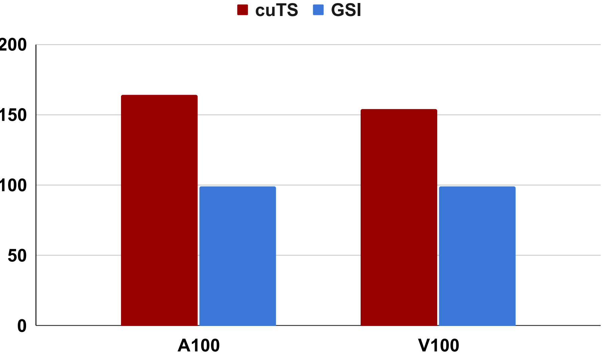
Experiment
Distributed
Experiment
Algo
Intersection
Background
Data representation
Total cases = 198
Number of cases can be handled by two frameworks
Notes:
We compare our approach against GSI, as the GSI paper has shown that it is faster than other state-of-the-art approaches such as XXX, YYY, and ZZZ. We used two evaluation metrics. The first metric is how many cases can be handled by different frameworks. For cuts, in the A100 machine, we can handle 158 cases. With the V100 machine, we can handle 152 cases. GSI can only handle 99 cases for both machines. // FIX XXX YYY ZZZ

Slide 25
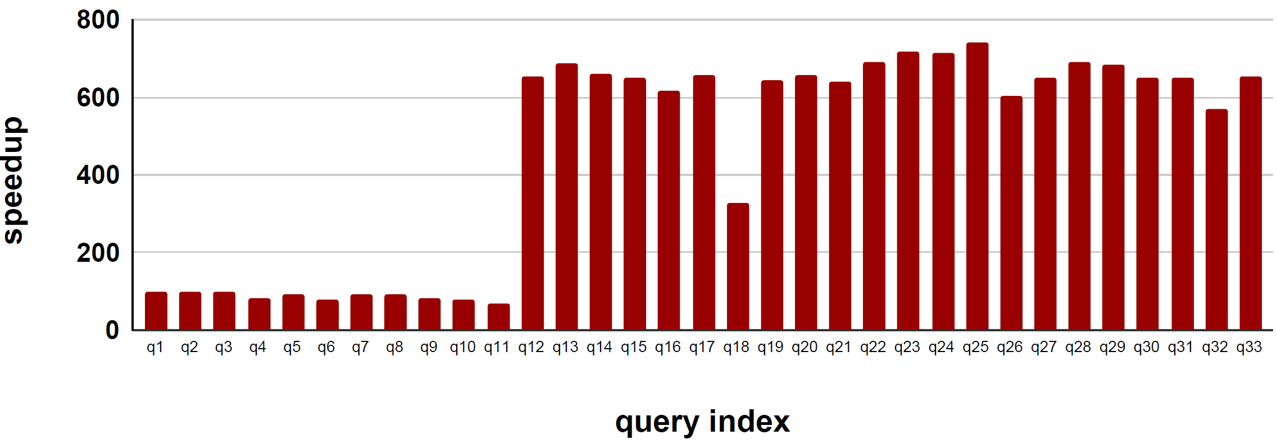
Experiment
Speedup against GSI using roadNet-PA as data graph
Geomean speedup 397
Notes:
For the 99 cases which are compatible with both the frameworks, we achieved a geomean speedup of 397. Our analysis shows that the speedup comes from two factors. The first is the query graph order selection mechanism which enables faster filtering. The second factor is our dynamic intersection mechanism. We have presented detailed analysis in the paper

Slide 26
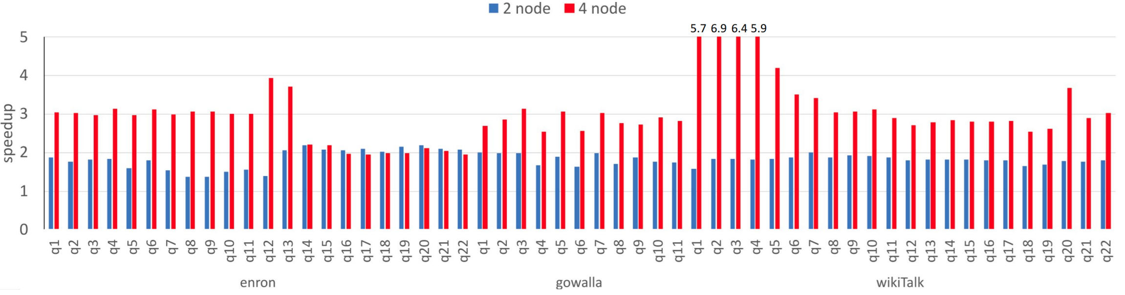
Experiment
Notes:
Since this is the first distributed GPU framework for subgraph isomorphism, we evaluate our distributed framework using 2 and 4 V100 GPU machines and compare their running time with a single V100 machine to study the scalability. Since the running time for the query graphs on the three roadNet graphs is so small, we only compare the running time on the other 3 data graphs. We achieve close to 2x speedup for the big datasets using two nodes and close to 3.1x using four nodes across the query graphs. There are cases where we achieve superlinear speedup, which can be attributed to better cache hits.

Slide 27
ACKNOWLEDGMENTS
This work is supported in part by
  the National Science Foundation through awards (1816793 and 1919211) at the WSU
  U.S. Department of Energy (DOE) through the Exascale Computing Project (17-SC-20-SC) at PNNL.
We also thank the IT department at Washington State University.

Slide 28
Thank you

