Slide 1

LibShalom: Optimizing Small and Irregular-Shaped Matrix Multiplications on ARMv8 Multi-Cores
Weiling Yang ,
Jianbin Fang, Dezun Dong, Xing Su, Zheng Wang †
National University of Defense Technology
† University of Leeds

Slide 2
Outline
1
Background and Motivation
2
Our Approach
3
Experimental Results
4
Conclusion

Slide 3
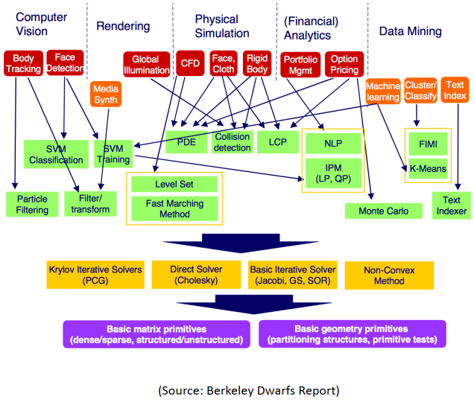
Linear algebra kernels are widely used
Linear algebra kernels have been widely used
Scientific simulation
Big data analytics
Machine leaning
Matrix-matrix multiplication (GEMM)
One of the most fundamental kernel
Core computation of many applications
The most of the computation time of
applications

Slide 4
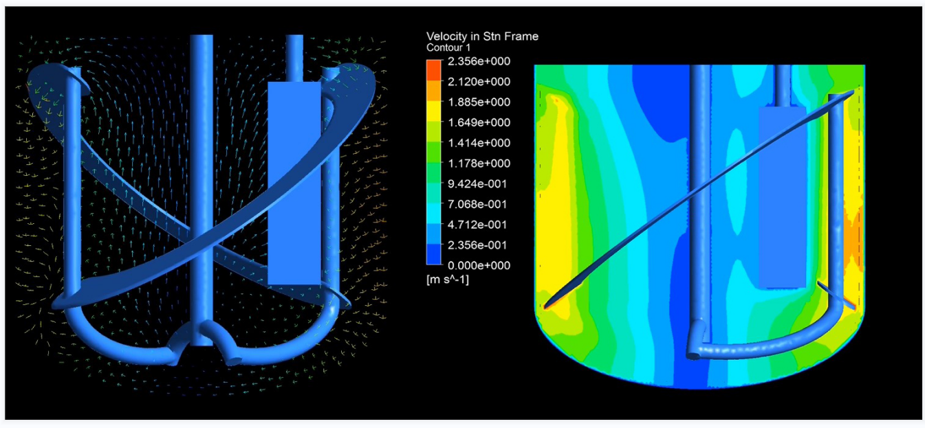
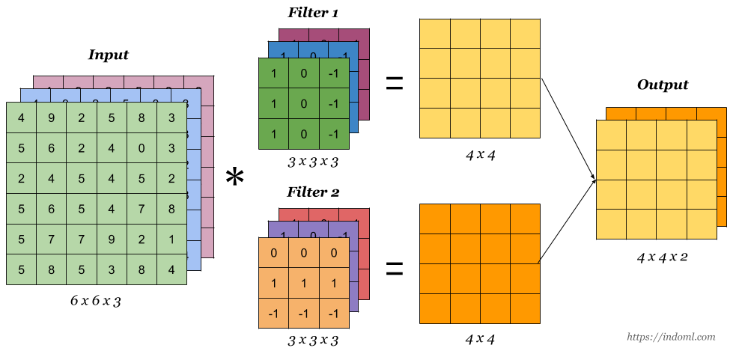
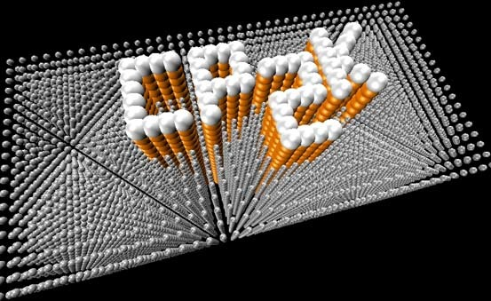
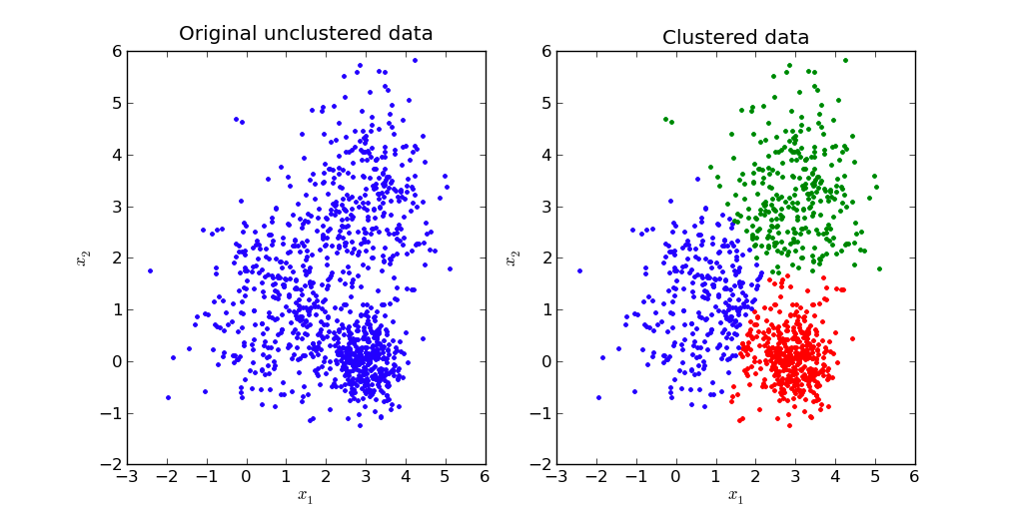
The shape of GEMM varies from application to application
small-scale shape
irregular shape
computational fluid dynamics
DNN
CP2K
K-means

Slide 5
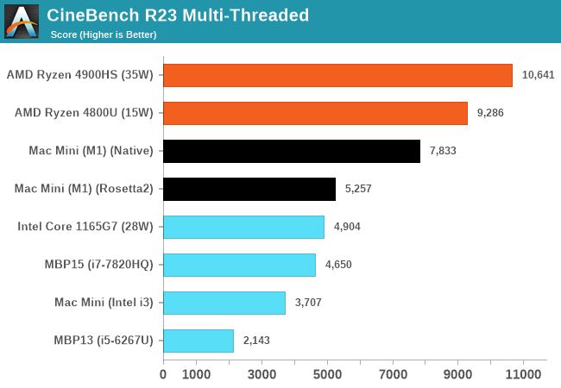
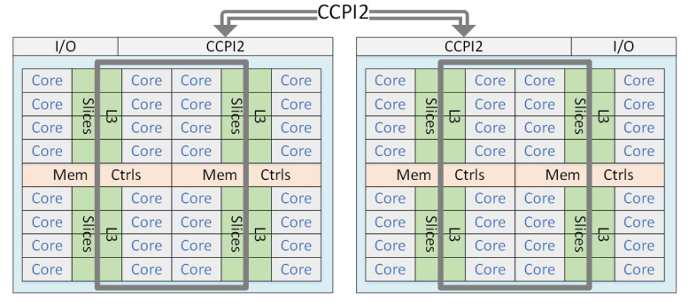
ARMv8 multi-cores processor
Good at parallelized computations.
It is widely concerned in HPC community.
technology is developing rapidly, i.e ARMv9, SME, SVE2.
(source: wccftech)

Slide 6
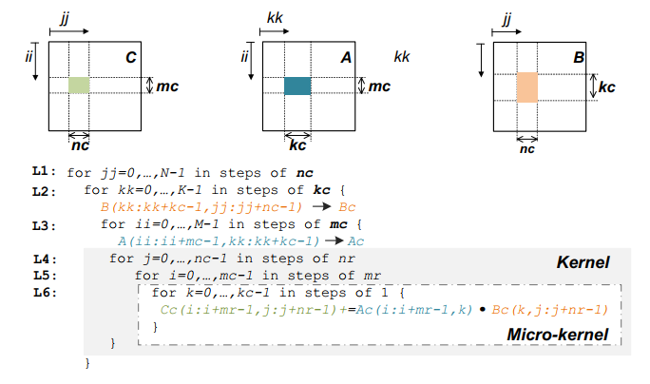
Goto algorithm
Using six-layer loops
Two packing routines
Outer-product formula

Slide 7
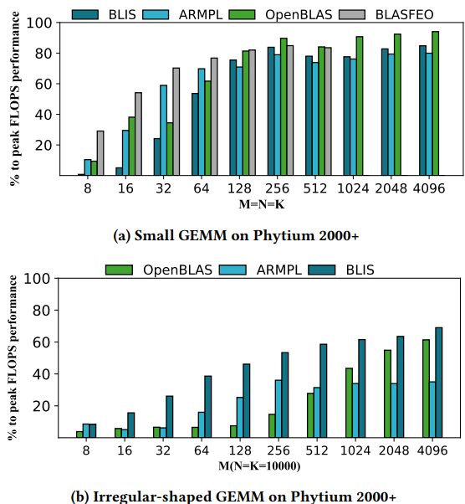
bottlenecks
The overhead of packing cannot be ignored
Inefficient handling of edge cases
Ineffective parallelization method for irregular-shaped matrices

Slide 8
Relate Work
Large-scale GEMM
OpenBLAS
  inner three-tier loop
  micro-kernel (16x4)
BLIS
  Innermost loop
  micro-kernel (12x8)
Small-scale GEMM
LIBXSMM
JIT
no packing
BLASFEO
panel-major
packing or no packing

Slide 9
Our proposed ideas
Several factors are considered:
Avoid partial packing
Overlap packing and computing
Efficient handling of edge cases
Parallelization method

Slide 10
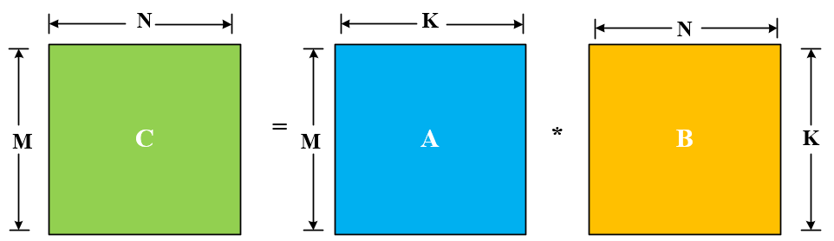
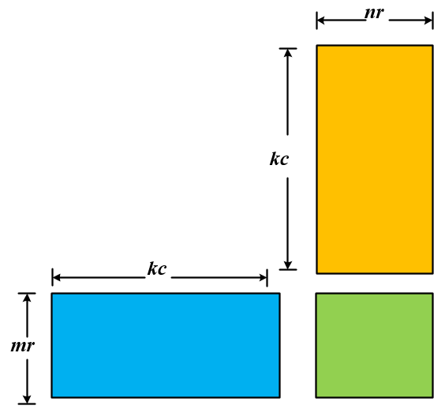
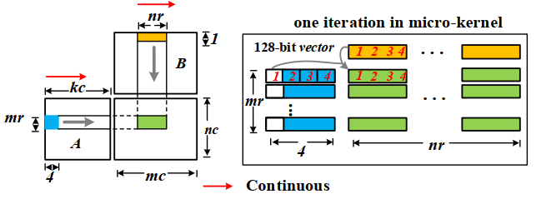
Our proposed ideas
Accessing matrix A along the K dimension has better spatial locality than accessing matrix B
Kc > nr
NN GEMM
Kernel
micro-kernel

Slide 11
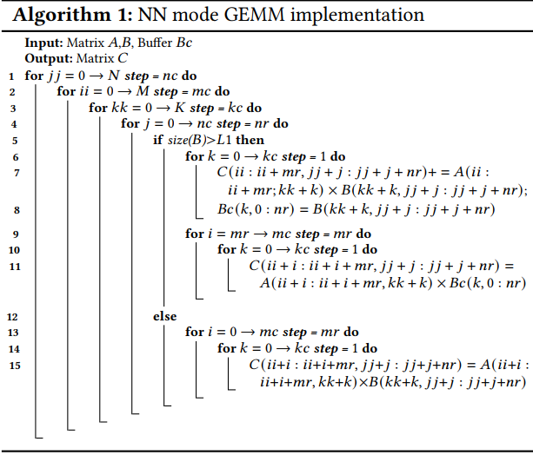
Overview
NN mode GEMM:
removes the always-executed packing steps
perform packing at the microkernel level
Outer-product formula
Packing
the data cannot be accessed continuously in the micro-kernel (i.e. cache-unfriendly)
the CMR of the micro-kernel is too low to hide the memory latency without packing

Slide 12
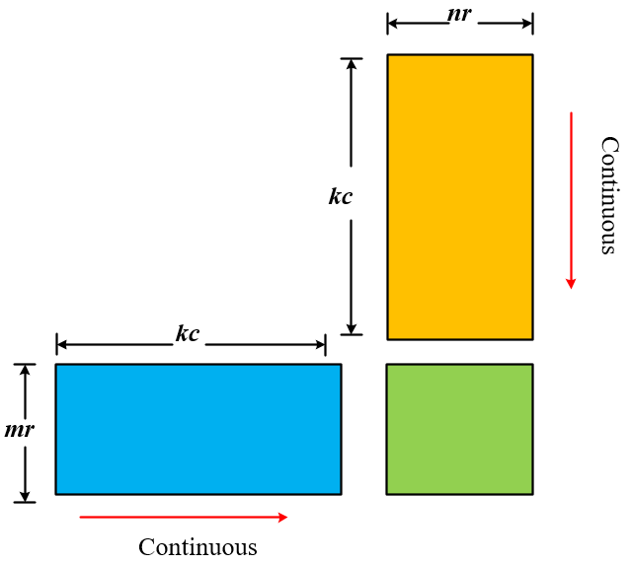
Our proposed ideas
NT mode
mr elements of A is continuous, but nr elements of B in not continuous.
vector-vector FMA -> scalar-vector FMA.

Slide 13
MICRO-KERNEL DESIGN
three types of micro-kernels:
main micro-kernel for computing A · B
perform packing while updating parts of matrix C
process the edge cases

Slide 14
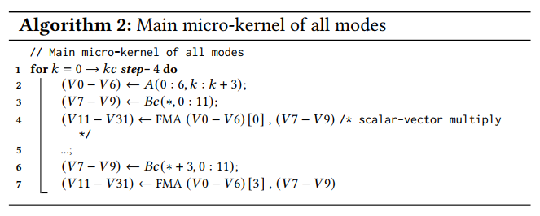


main micro-kernel
constraint:
object:
$$\left\{\begin{aligned}mr+\frac{nr}{j}+\frac{mr×nr}{j}≤(32−1) \\ nr\%j=0\end{aligned}\right.$$
$$CMR=\frac{2×mr×nr}{mr+nr}$$
(1)
(2)
mr=7, nr =12

Slide 15
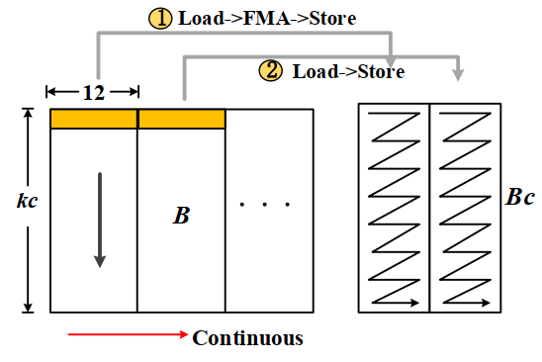
Micro-kernel for Packing
NN mode:
Overlap packing and computing
Reduce cache and TLB misses
perform step 1 or 2

Slide 16
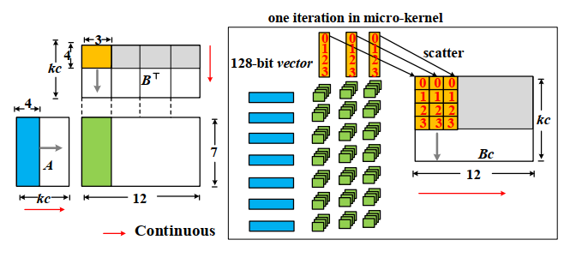
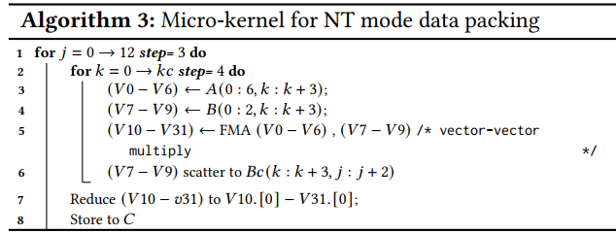
Micro-kernel for Packing
NT mode:
Overlap packing and computing
To use scalar-vector FMA in the main micro-kernel.
interleave the load and store instructions required in the packing step with FMAs

Slide 17
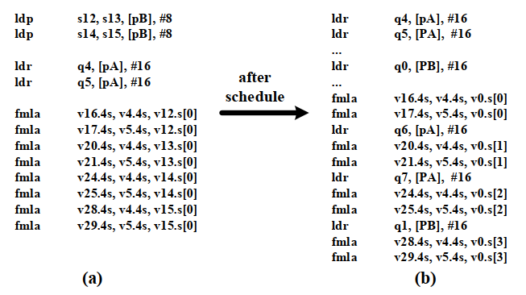
process the edge cases
Load
Use

Slide 18



Parallelization method
CMR=$\frac{M×N}{M×Tn+N×\frac{T}{Tn}}$
(1)
CMR$≤\frac{M×N}{2×\sqrt{T×M×N}}$
(2)
Tn=$\left\lceil \sqrt{\frac{T×N}{M}}\right\rceil$
(3)

Slide 19
Experimental evaluation
 | Phytium 2000+ | KP920 | ThunderX2
Peak perf. (FP32 GFLOPS) | 1126.4 | 2662.4 | 1280
Number of Cores | 64 | 64 | 32
Ferquency | 2.2 GHZ | 2.6 GHZ | 2.5 GHZ
L1 cache | 32KB | 64 KB | 32 KB
L2 cache | 2 MB | 512 KB | 256 KB
L3 cache | None | 64MB | 32 MB

Slide 20
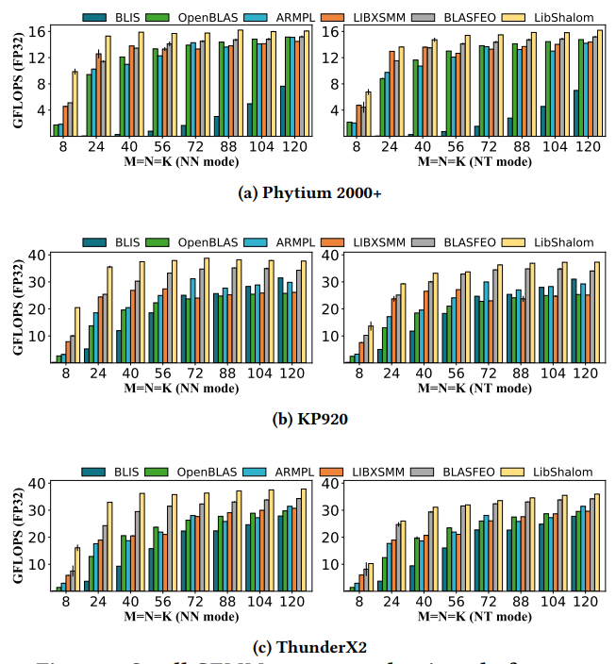
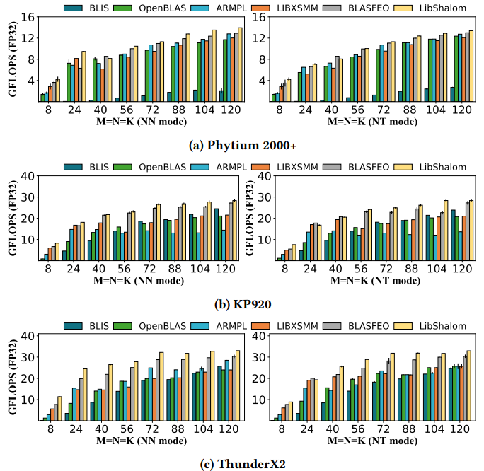
Experimental evaluation: small-scale GEMM

Slide 21
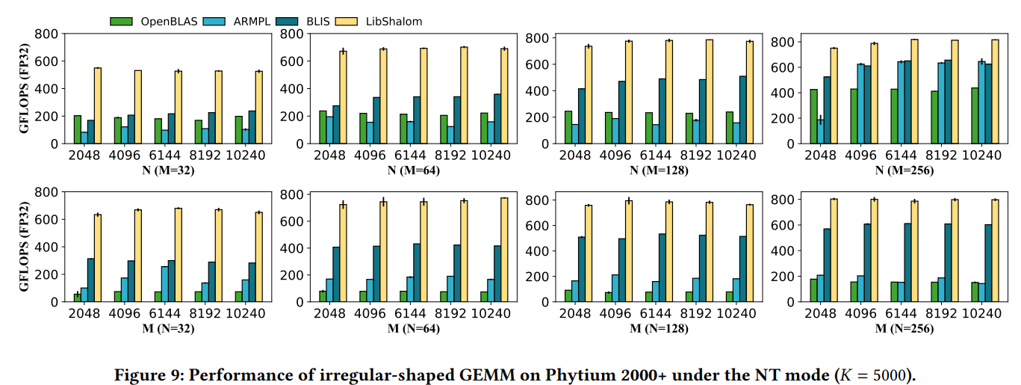
Experimental evaluation: Irregular-shaped GEMM

Slide 22
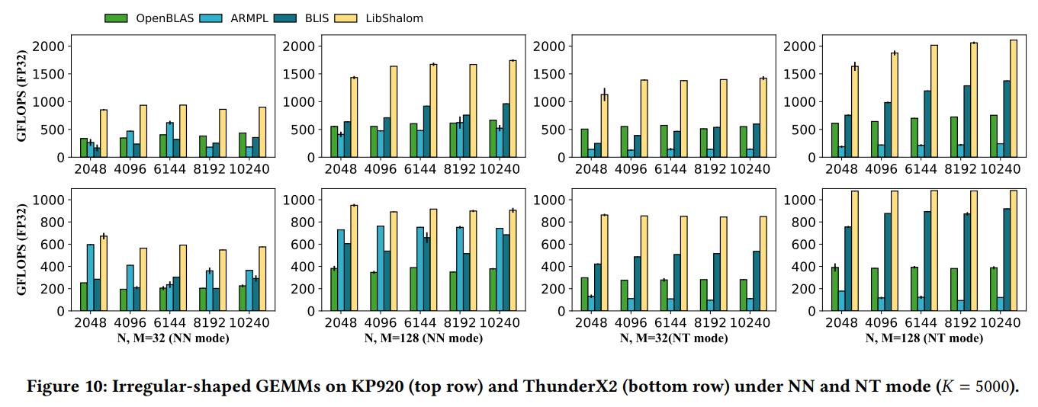
Experimental evaluation: Irregular-shaped GEMM

Slide 23
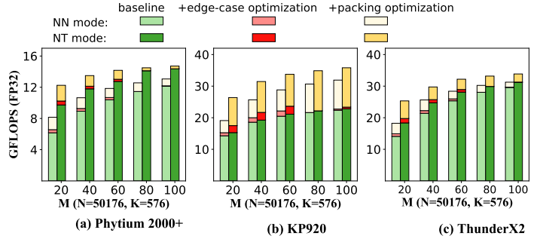
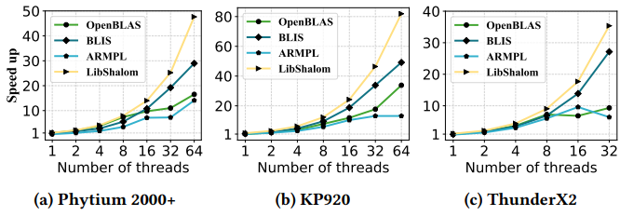
Experimental evaluation:

Slide 24
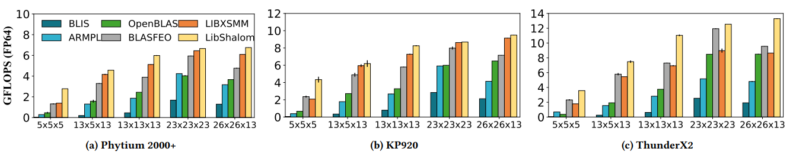
Experimental evaluation: CP2K kernels

Slide 25
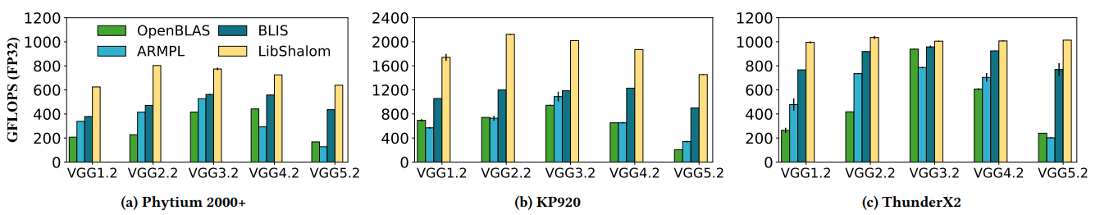
Experimental evaluation: VGG kernels
M={64,128,256,512,512} × N={50176,12544,3136,784,196} × K={576,1152,2304,4608,4608}

Slide 26
Conclusion:
ARM processor has great potential to be exploited
Overlapping packing and computing are important for small and irregular-shaped GEMMs
Download at: https://github.com/AnonymousYWL/MYLIB or https://github.com/AnonymousYWL/LibShalom
Future Work:
Optimizing convolution operation in CNN on ARM processores
irregular sparse matrix multiplication

Slide 27
To End
Thank you

