Slide 1
Online Evolutionary Batch Size Orchestration
For Scheduling Deep Learning Workloads in GPU Clusters
Zhengda Bian¹, Shenggui Li¹, Wei Wang², Yang You¹
¹National University of Singapore, ²ByteDance
Notes:
Welcome to my talk. I‘m Bian Zhengda, from National University of Singapore.
And I'm going to talk about using an online evolutionary approach to schedule deep learning jobs in GPU clusters

Slide 2
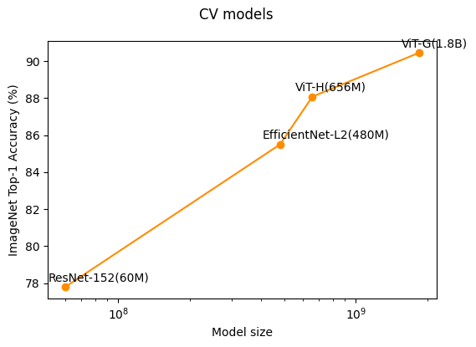
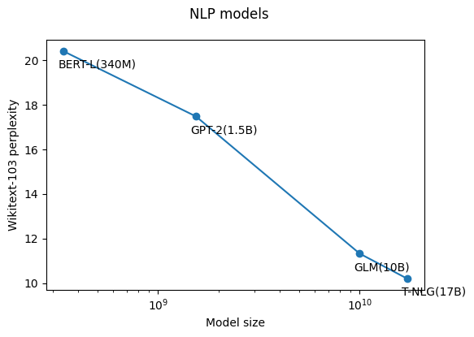
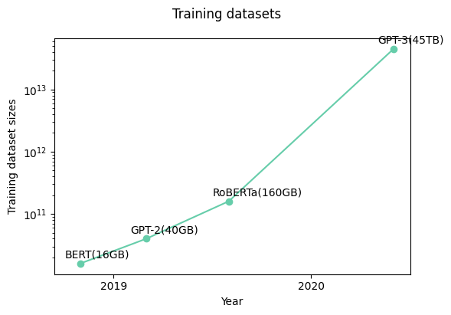
GPU Cluster Management for Deep Learning
The success of larger-scale models and datasets
A growing demand for GPU resources
  To speed up the computation of neural networks with distributed training on multiple GPUs.
  E.g. 5x increase in Microsoft Philly cluster in one year
This paper is about how to efficiently manage deep learning jobs in a GPU cluster to maximize the utilization
Notes:
Recent breakthroughs in deep learning show the success of larger-scale models and datasets.
For example, the latest vision transformer pushes the state-of-the-art record of ImageNet top-one accuracy to 90 percent, while its model size is 30 times larger than ResNet, which is proposed in 2016.
Similarly, the size of NLP models grows from 3 hundred and 40 million parameters to billions of parameters in very few years.
At the same time, there is also a significant increase in the size of datasets used to train theses models.
To deal with the increasing size of deep learning models and datasets, there has been a growing demand for GPU resources to speed up the computation of neural networks with distributed training on multiple GPU devices.
For example, the Microsoft Philly cluster increased its scale by 5 times in just one year.
But, we know GPU resources are very expensive.
So, an urgent problem we are going to address in this paper is how to efficiently manage deep learning jobs in a GPU cluster to maximize the utilization.

Slide 3


GPU Cluster Management for Deep Learning
Workflow
Workloads
Nodes
Inputs:
Jobs $J$, and GPUs $C$
J₄
J₃
1
5
9
13
Scheduler:
Decide resource allocation
$$J→\{c∈C\}$$
J₂
2
6
10
14
J₁
GPUs
3
7
11
15
Cluster Status
Objective:
Minimize
Average Job completion time (JCT)
Scheduler
4
8
12
16
Schedule Decisions
Notes:
Lets start with how a GPU cluster works with deep learning jobs.
Suppose we have a GPU cluster where each machine may have multiple GPU devices.
As deep learning jobs do not have high CPU or memory usage, we just need to focus on the GPU resources.
Users continuously submit their jobs to the cluster in an online fashion, and each job requests for at least one GPU to start.
A scheduler will be responsible for collecting cluster status and deciding an appropriate resource allocation accordingly.
Like in this example, GPU_1 to GPU_4 are allocated to Job_1, GPU_5 and GPU_6 are allocated to Job_2, and so forth.
The objective of the scheduler is to minimize average job completion time, which stands for the time between job submission and completion.

Slide 4
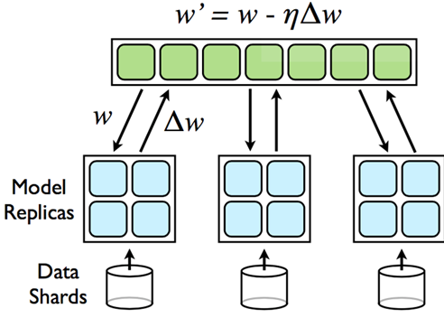
GPU Cluster Management for Deep Learning
Challenge of scheduling DL jobs
  Deep Learning jobs with Distributed Data Parallel training
    Identical model replica on each device
    Parameters from all the devices are averaged and updated after each step
    Performance is strongly related to resource allocation
      Batch size & learning rate
    Hard to scale
    Hard to utilize idle resources
Notes:
To speed up deep learning jobs, a dominant practice is distributed data parallel training on multiple GPUs.
This approach runs an identical model replica on each GPU and averages the parameters from all the devices after each step.
However, the training performance is strongly related to resource allocation.
Especially, we need to find appropriate batch size and learning rate accordingly.
As a result, deep learning jobs are hard to scale and hard to utilize idle resources.

Slide 5
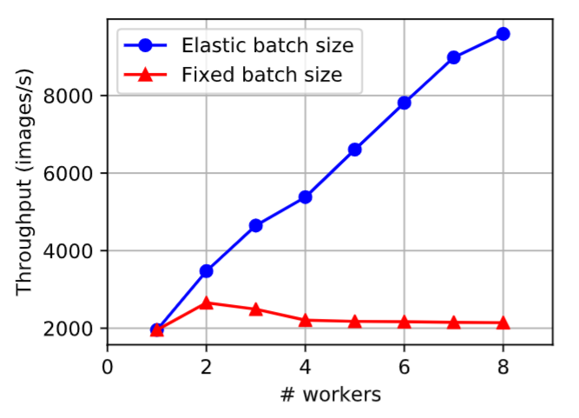
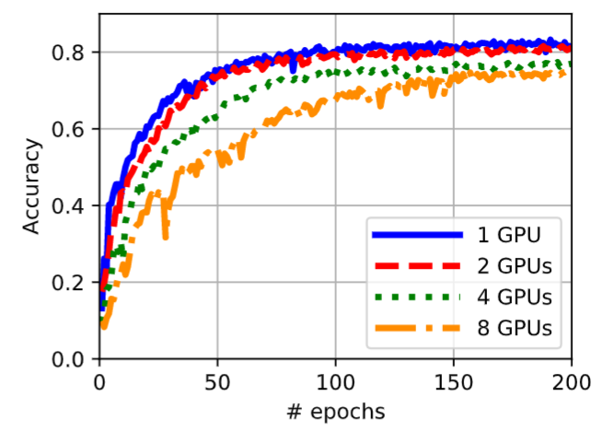
GPU Cluster Management for Deep Learning
Challenge of scheduling DL jobs
  Deep Learning jobs with Distributed Data Parallel training
Fixed global batch size:
  # GPUs ↑
  Local batch size ↓
  GPU utilization ↓
Fixed local batch size:
  # GPUs ↑
  Global batch size ↑
  # parameter updates per epoch ↓
  # epochs ↑
Notes:
Lets look at some examples, there are 2 common ways to scale a job on different numbers of GPUs.
First, we can set a fixed global batch size.
However, when the number of GPUs is increasing, the local batch size on each GPU is decreasing, lowering the GPU utilization.
Second, we can set a fixed local batch size on each GPU.
Then the global batch size is growing, and the number of parameter updates per training epoch is decreasing.
So, the job needs more epochs to achieve equivalent accuracy.

Slide 6
Prior Deep Learning Schedulers
Using greedy strategies to determine the priority of each job to get resource
These greedy strategies are inefficient to deal with online workloads
  Jobs in the cluster are dynamic and time-varying
  A limited number of solutions are taken into account
Scheduler
SLAQ [SoCC 17]
Optimus [EuroSys 18]
Tiresias [NSDI 19]
Objective
System-wide job quality
Average job completion time
Average job completion time
Strategy
Prioritizing jobs with predicted loss reduction
Shortest predicted remaining time first
Least attained service first
Notes:
There have been some researches of resource schedulers for deep learning jobs.
These schedulers tend to schedule jobs by using greedy strategies to determine the priority of each job to get resource
For example, SLAQ tries to maximize system-wide job quality by prioritizing jobs with predicted loss reduction.
Optimus uses shortest predicted remaining time first to minimize average job completion time, while Tiresias uses least attained service first for the same purpose.
However, these greedy strategies are inefficient to deal with online workloads because jobs in the cluster are dynamic and time-varying.
Also, the greedy strategies only take a limited number of solutions into account.

Slide 7
Prior Deep Learning Schedulers
Lack of elasticity
  Many schedulers are not able to adjust # GPUs or do not allow preemption
  No scheduler is able to arbitrarily adjust the batch size for each job
    Most appropriate batch size × Best training efficiency ×
 | Gandiva [OSDI 18] | Tiresias [NSDI 19] | Chic [IWQoS 19] | Optimus [EuroSys 18] | …
Elastic Batch Size | N | N | N | N | …
Elastic #GPUs | N | N | Y | Y | …
Preemption | Y | Y | N | Y | …
Notes:
Besides, these schedulers lack elasticity in their designs.
Many of them are not able to adjust the number of GPUs or do not allow preemption
And no one so far is able to arbitrarily adjust the batch size for deep learning jobs, so that it’s hard for the jobs to have the most appropriate batch size to achieve the best training efficiency

Slide 8
Motivation
Elastic batch size scheduling
  Scheduler adjusts batch size according to # GPUs of a job
  A dynamic batch size limit is set to guarantee training quality
24
24
24
24
24
24
24
16
16
16
16
16
16
Batch size limit: 96
: GPUs
_{b}
: worker with local batch size b
Notes:
Our work is motivated by the idea that when we allow jobs to have elastic number of GPUs, we also need to support elastic batch size.
More specifically, we allow the cluster scheduler to adjust the batch size according to the number of GPUs of a job.
Also, to guarantee the training quality, we set a dynamic batch size limit for each job to avoid generalization problem of too large batch size.
For example, suppose we have a job with batch size of 24 and the limit is 96.
On 2 or 4 GPUs, each GPU holds a batch size of 24, while on 6 GPUs, each one holds a batch size of 16.

Slide 9
Motivation
ONES: a scheduler for deep learning jobs that solves two problems of elastic batch size scheduling
  How to determine the batch size for each job?
  How to minimize the cost of running jobs with assigned batch sizes?
Notes:
Based on the idea, we propose ONES, a scheduler for deep learning jobs that solves two problems of elastic batch size scheduling.
The first is, how to determine the batch size for each job.
And the second is, how to minimize the cost of running jobs with assigned batch sizes.

Slide 10
Design
I
How to determine the batch size for each job?
Notes:
Let me show our solutions to these problems one by one.
First, how does the scheduler determine the batch size.

Slide 11
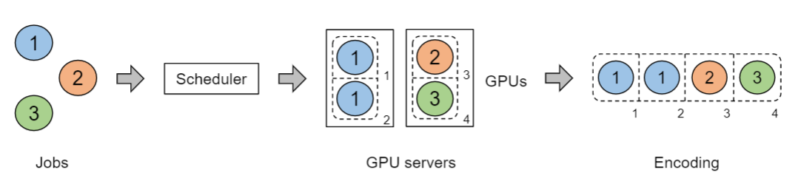
Design
Online evolutionary search
  Advantages:
    It maintains a group of solutions that give higher chance to reach higher performance
    It continuously optimizes the solution for online workloads
    Scheduling decisions can be directly encoded into genomes
Notes:
We use an evolutionary search to continuously search for the solution.
The algorithm is more suitable than greedy strategies because
First, it maintains a group of solutions that give a higher chance to reach high performance
Next, it is able to continuously optimize the solution for online workloads
Besides, scheduling decisions can be directly encoded into genomes, which is the basic form of solutions in evolutionary search

Slide 12
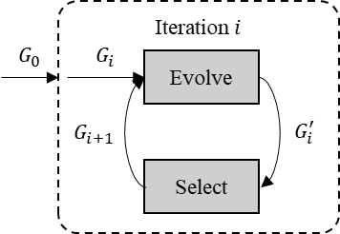
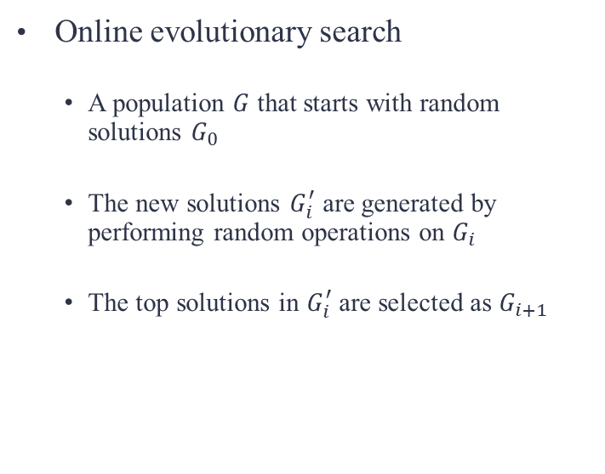
Design
Online evolutionary search
  A population $G$ that starts with random solutions $G_{0}$
  The new solutions $G_{i}^{′}$ are generated by performing random operations on $G_{i}$
  The top solutions in $G_{i}^{′}$ are selected as $G_{i+1}$
Evaluate
Notes:
The algorithm works with a population of candidate solutions in an iterative way.
The population G starts with random solutions G_0.
Then at every iteration i, the new solutions G_i_prime are generated by performing random operations on G_i,
G_i_prime will be evaluated, and the top solutions from it will be selected as G_i_plus_1

Slide 13
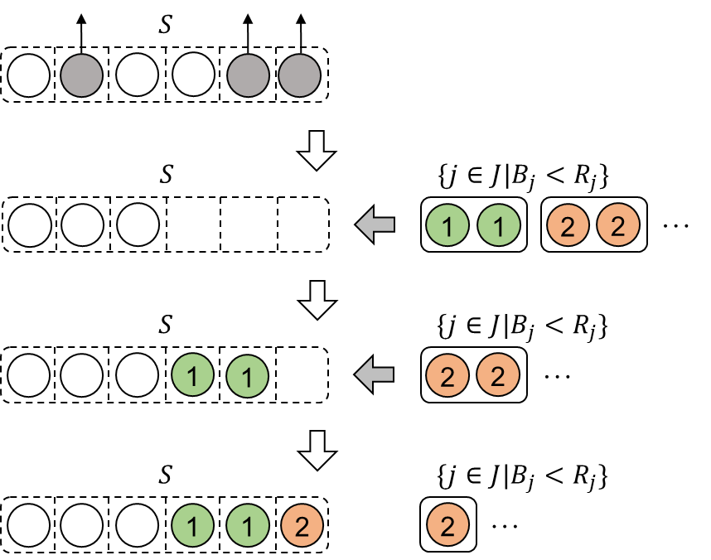
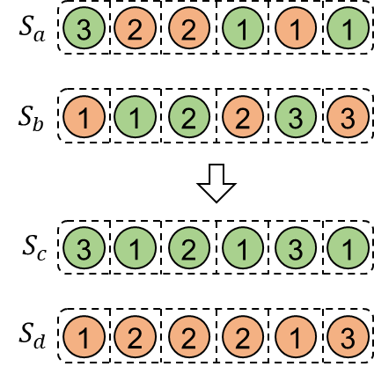


Design
How candidates evolve
  Refresh
  Crossover
: GPUs
_{j}
_{j}
: worker of job j
$B_{j}$: batch size of $j$
$R_{j}$: batch size limit of $j$
Notes:
According to the real-time status, the scheduler performs random operations to generate new solutions
The refresh operation removes inactive jobs out and adds new jobs in if necessary.
The crossover operation mixes up the existing solutions

Slide 14
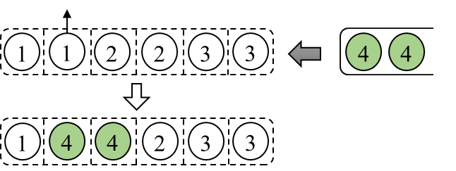
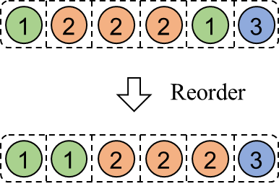
Design
How candidates evolve
  Mutation
  Reorder
: GPUs
_{j}
_{j}
: worker of job j
$B_{j}$: batch size of $j$
$R_{j}$: batch size limit of $j$
Notes:
The mutation operation randomly replaces running jobs with waiting jobs.
And the reorder operation packs the workers of each job for better placement.

Slide 15
Design
Candidate evaluation
  Shortest remaining time first (SRTF)
    Recent jobs in a cluster may have similar performance
      E.g. model testing, hyper-parameter tuning
    We can build an online prediction model based on recent job information to infer the remaining job time
Notes:
We use SRTF to evaluate the candidate solutions to achieve overall minimum job completion time,
And we profile the remaining time based on the idea that recent jobs in a cluster may have similar performance, for example model testing, or hyper-parameter tuning.
Then we can build an online prediction model based on recent job information to infer the remaining job time

Slide 16
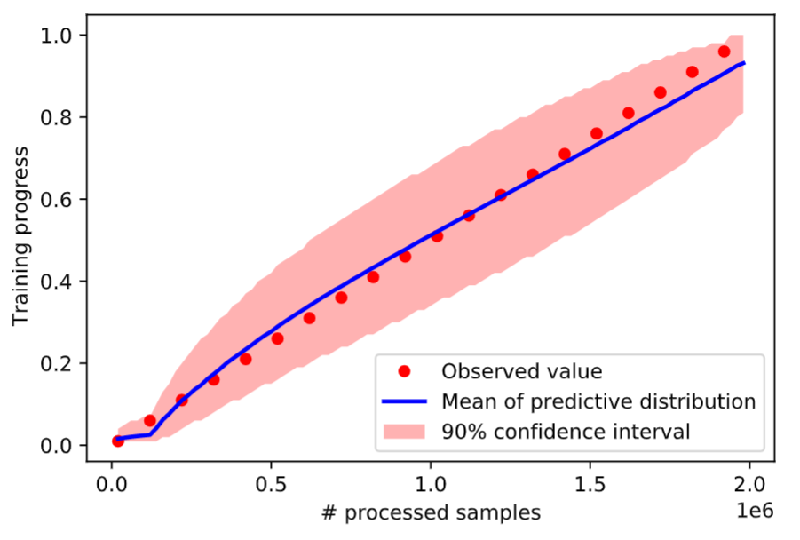
Design
Candidate evaluation
  Shortest remaining time first (SRTF)
    Collect real-time job information e.g. dataset size, current loss, processed workload size
    Predict the training progress with uncertainty, using a Beta distribution, instead of an exact number
    Sample the training progress of each job from its distribution
    Compute the overall remaining time of each candidate
    Select the top ones
Example of training progress prediction
Notes:
We collect real-time job information such as dataset size, current loss and processed workload size,
And predict the training progress with uncertainty, using a Beta distribution, instead of an exact number
Then we sample the training progress of each job from its distribution,
compute the overall remaining time of each candidate,
And select the top ones
We use random sampling instead of using exact number here because it can help evolutionary algorithm reach higher-quality solutions

Slide 17
Design
II
How to minimize the cost of running jobs with assigned batch sizes?
Notes:
Next, we solve the problem of how to minimize the cost of running jobs with assigned batch sizes

Slide 18
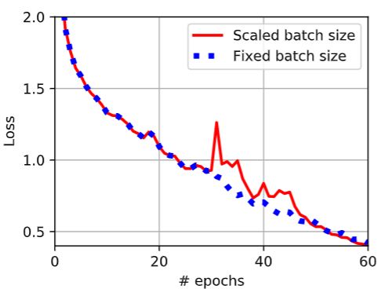
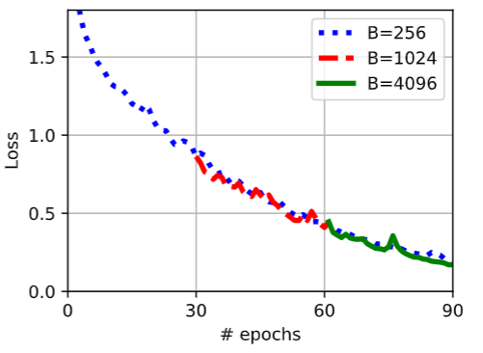

Design
Convergence cost
  Linear scaling rule: $B→kB$, $η→kη$
  Increase batch size gradually
Notes:
The first cost is convergence cost.
Simply adjusting the batch size may affect convergence, which means the job needs more epochs to converge.
To control the convergence, we need to follow the linear scaling rule, which linearly scales the learning rate with the batch size.
We also need to avoid too large batch size gap before and after scaling, because this may result in a sudden increase in the training loss.
Instead, we can increase the batch size gradually, as shown on the right.

Slide 19
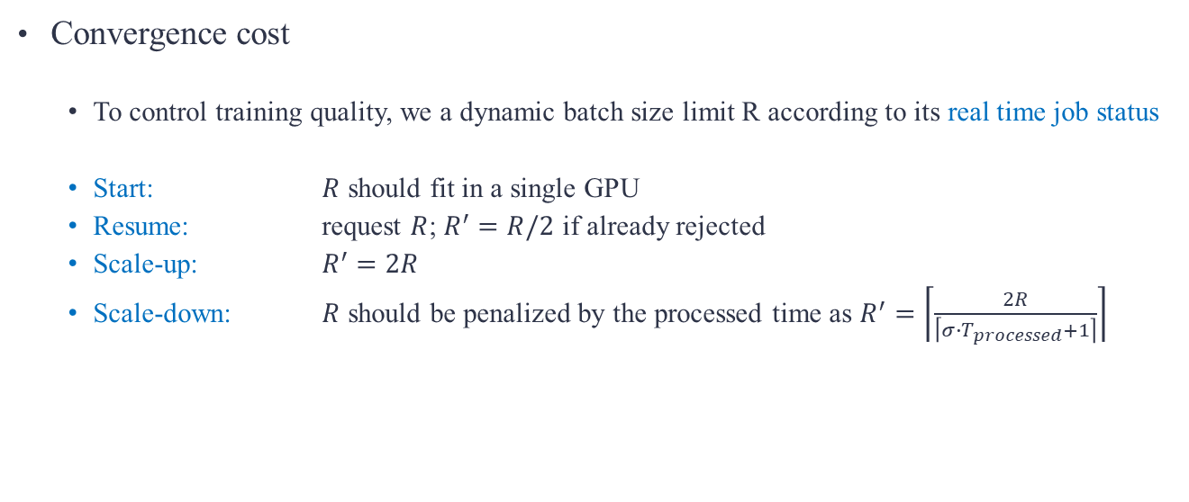
Design
Convergence cost
  To control training quality, we a dynamic batch size limit R according to its real time job status
  Start: $R$ should fit in a single GPU
  Resume: request $R$; $R^{′}=R/2$ if already rejected
  Scale-up: $R^{′}=2R$
  Scale-down: $R$ should be penalized by the processed time as $R^{′}=\left\lceil \frac{2R}{\left\lceil σ∙T_{processed}+1\right\rceil }\right\rceil$
Notes:
We also use a dynamic batch size limit R for each job to control the training quality according to its real time job status,
For example, to start, the batch size should fit in a single GPU;
To resume, the batch size limit will be halved if already rejected;
To scale-up, the batch size limit will be doubled;
Finally, when a job already runs for a long time, the batch size should be penalized.

Slide 20
Design
Scheduling cost
  Periodic offline rescheduling
    pause all the jobs → reschedule → restart the jobs
  Slow responses to job arrivals or completion
  Rescheduling overhead
Notes:
The next cost is scheduling cost
Existing schedulers handle online workloads with periodic offline rescheduling.
That is, between a certain time interval, the scheduler pauses all the jobs in the cluster, reschedules the jobs, then restarts them with new configurations.
Rescheduling leads to two problems.
First, the scheduler makes slow responses to job arrivals or completion.
Second, there will be a large overhead because pause-resuming deep learning jobs usually take more than tens of seconds, but at the same time, the GPUs are wasted.

Slide 21
Design
Scheduling cost
  Elastic batch size scaling
Worker Manager
GPU
Scheduler
Start job
User
Script
Input Tensors
Model, dataset, Optimizer & Loss function
Load job on GPU
Model
Scaling Agent
Connect
Other workers
Notes:
To reduce the cost, we design the elastic batch size scaling, which can be automatically completed in the background and avoids stopping the training.
There is a scaling agent deployed on each GPU.
Initially, the scheduler starts a job
and invokes the scaling agent,
which loads the modules from user script to the GPU device,
and connects other workers of the same job.

Slide 22
Design
Scheduling cost
  Elastic batch size scaling
Worker Manager
GPU
User
Script
Input Tensors
Train model
Model
Scaling Agent
Notes:
Then, the user script is allowed to start the training

Slide 23
Design
Scheduling cost
  Elastic batch size scaling
Worker Manager
  Use NCCL to migrate model status through network
  No need to stop training
  Very small overhead
GPU
Scheduler
User
Script
Input Tensors
Scale Batch size
Pause
Model
Scaling Agent
Migrate
Reconnect
Other workers
Notes:
When the job needs scaling, the agent gets new configurations from the scheduler
and pauses the training.
Then it reconnects other workers and uses NCCL to synchronize its model through network.
The migration can be completed at the end of any training step, with a very small overhead, because we do not need to stop the training

Slide 24
Design
Scheduling cost
  Elastic batch size scaling
Worker Manager
  Use NCCL to migrate model status through network
  No need to stop training
  Very small overhead
GPU
User
Script
Input Tensors
Train model
Resume
Model
Scaling Agent
Notes:
Finally, the scaling agent resumes the user script to continue the training

Slide 25
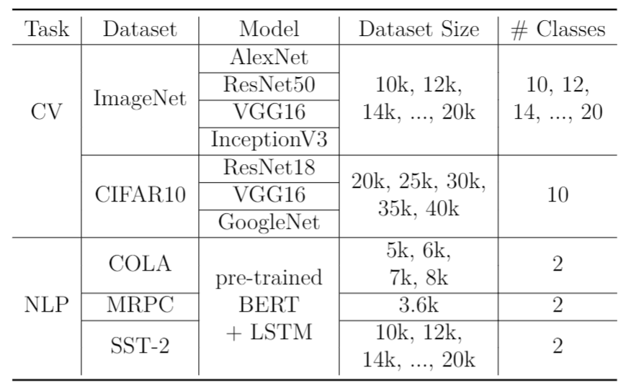

Evaluation
Testbed
  16 nodes $×$ 4 V100 GPUs (64 GPUs in total)
  400 jobs with Poisson arrivals
  50 different workloads (CV+NLP)
Notes:
Next, we evaluate our scheduler on a testbed with 64 GPUs on the TACC platform.
Our evaluation trace includes 400 jobs from 50 different workloads as shown in the table.

Slide 26
Evaluation
Baselines
        ※ DRL: the deep reinforcement learning scheduler
 | DRL | Optimus | Tiresias | ONES
Elastic job size | Y | Y | N | Y
Elastic batch size | N | N | N | Y
Preemption | N | Y | Y | Y
Scheduling goal | Minimize JCT | Minimize JCT | No | Yes
Notes:
We compare our scheduler with some state-of-the-art deep learning schedulers, including the deep reinforcement learning scheduler, the optimus scheduler, and the Tiresias scheduler
The differences of elasticity between the schedulers are shown in the table.

Slide 27
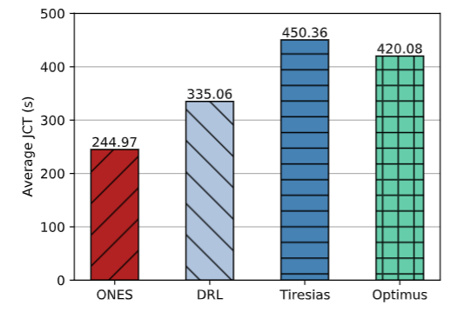
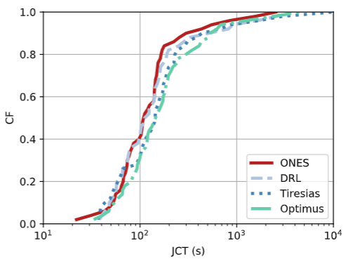
Evaluation
Average JCT
Notes:
We first evaluate the average job completion time.
So from the results, our scheduler achieves the smallest average JCT.
ONES can reduce the average JCT by 27%, 46% and 42%, compared to DRL, Tiresias and Optimus.
We also see that ONES is effective to reduce JCT especially for long jobs, as the fraction of jobs completed within 200s is 86%, while the baseline schedulers can only achieve about 60-80%.

Slide 28
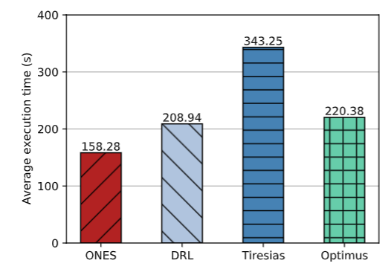
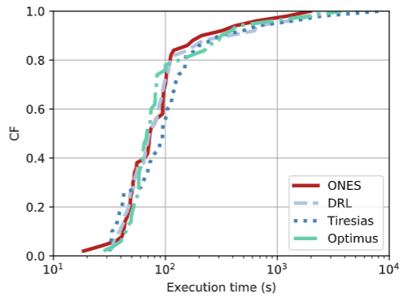
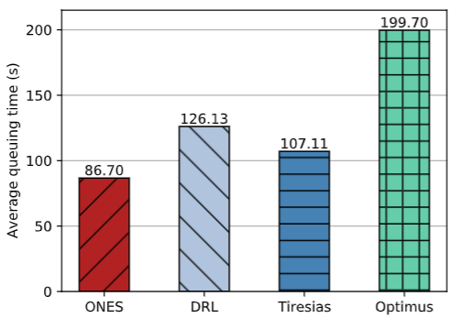
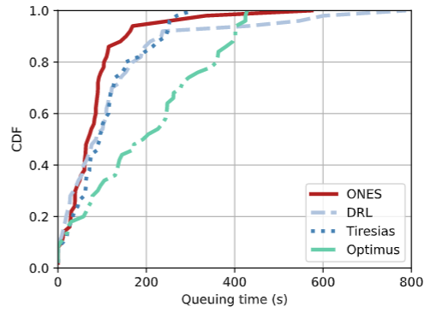
Evaluation
Average execution time
Average queuing time
Notes:
To further explain the improvement, we also evaluate the average execution time and queuing time.
And we can see ONES also outperforms the baselines.

Slide 29
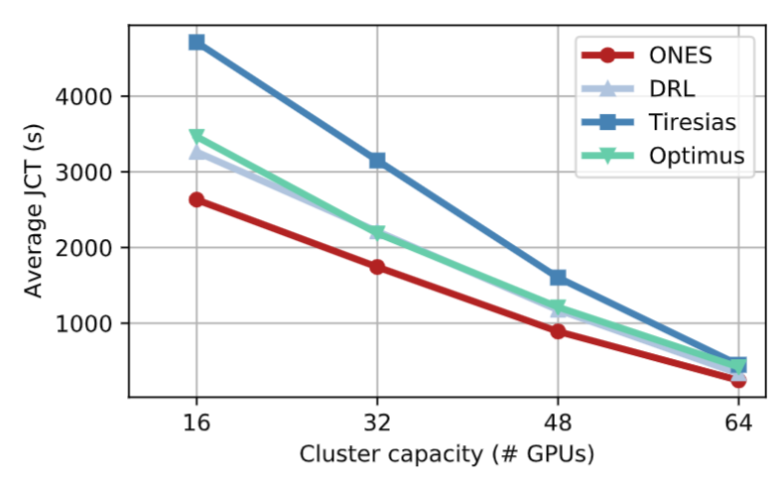
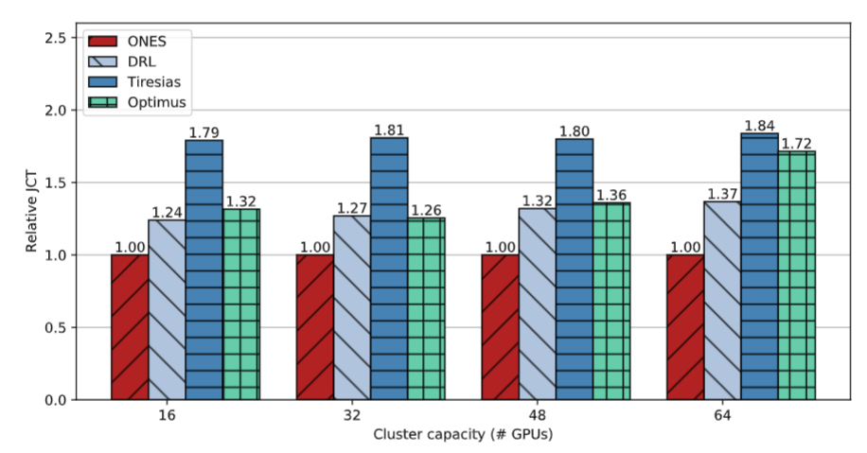
Evaluation
Scheduling scalability
  The cluster capacity scales from 16 GPUs to 64 GPUs
Notes:
We also evaluate the scheduling scalability by scaling the cluster size from 16 GPUs to 64 GPUs.
It seems that all the schedulers have similar behaviors.
But we find that with more GPUs (for example, with 64 GPUs), our scheduler may have a larger improvement.

Slide 30
Conclusion
ONES
  High elasticity: # GPUs & batch size
  Robust training quality
  High training efficiency
  Small scheduling overhead
Notes:
Finally, to conclude
ONES is a scheduler for deep learning jobs that achieves high elasticity, robust training quality, high training efficiency and small scheduling overhead.

